Slide 1
Forest fire protection

Slide 3
Fire prevention means varied actions undertaken to prevent fire, delay its development, and reduce the area covered by fire until the firefighting actions are started.

Slide 4
So what should we do to prevent forest fire?

Slide 5
Share information in media.
Media influence public awareness to the largest extend. That is why condemning bad behavior towards nature by media can bring extraordinary positive effects.

Slide 6
Read tables.
They are located at the edge of the forests and incude some important information about the forest which should be followed by everybody.

Slide 7
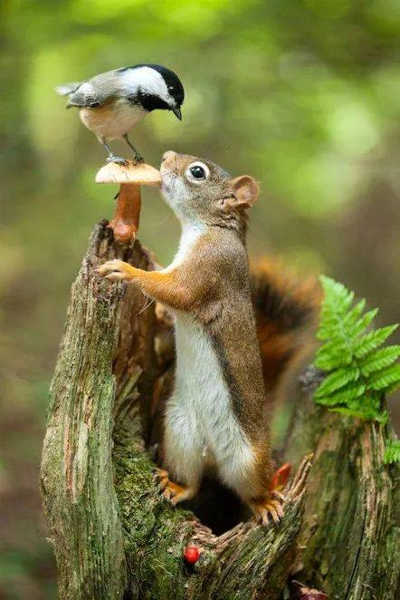
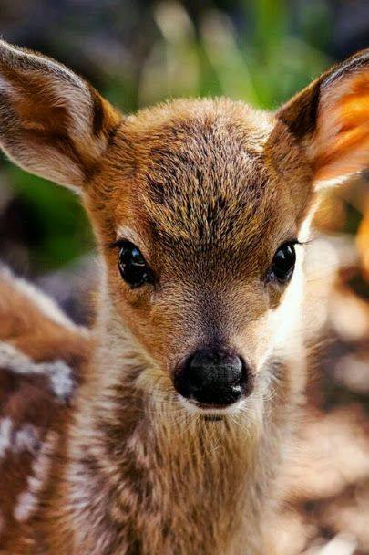
Remamber about the rules.
When we were children we lerned how to behave in forest.Small children know that we musn't shout, light a fire, feed animals and throw away rubbish so why we cannot obey these simple rules.

Slide 8
Something for the youngest.
Young kids are very open to new information but it has to be interesting for them. The games are a perfect option because kids can learn and play.

Slide 9
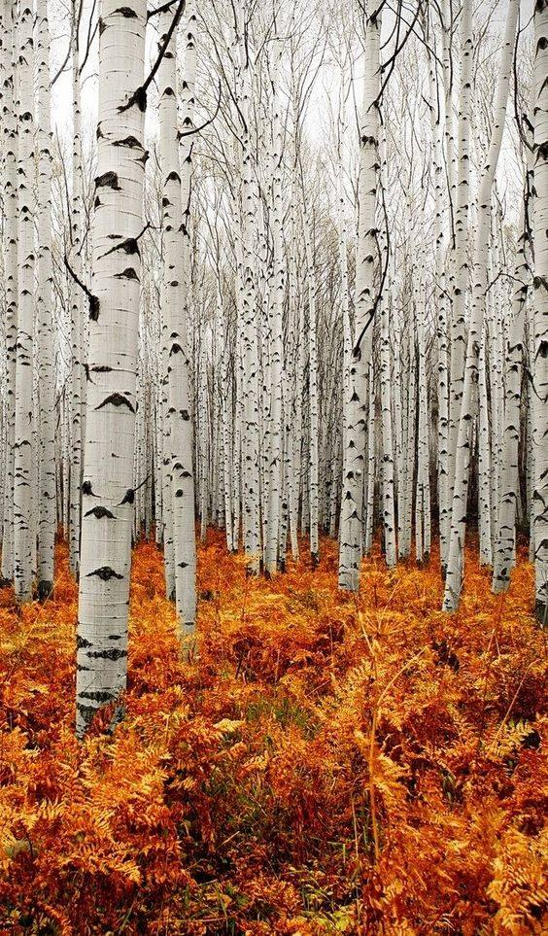
Lessons for teenagers.
These types of lessons can help young people to become aware of the forestfire problem as well as show the effects of the fires.

Slide 10
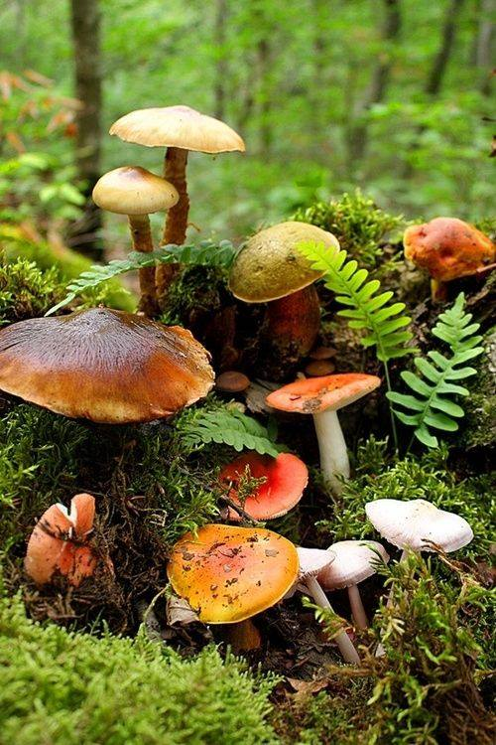
competitions
This is the next opion to encourage people to get intrested in forestfire protection.

Slide 11
Make event.
They can attract attention of the authorities and make them focus on the major problems.

Slide 12
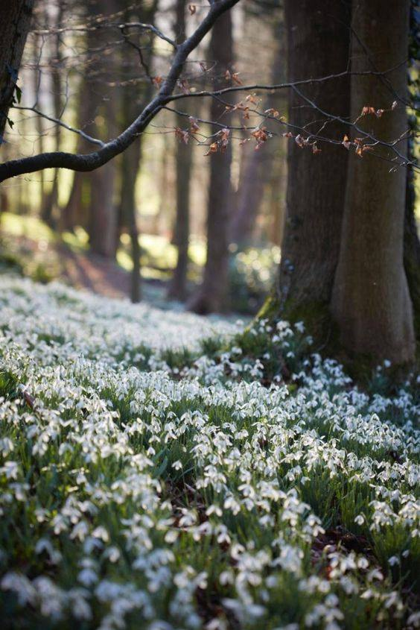
Stop grassfires.
This is the most common problem of wildfires in Poland. People lose control over the fire they have started intentionally and it spreads rapidly causing massive destruction.

Slide 13
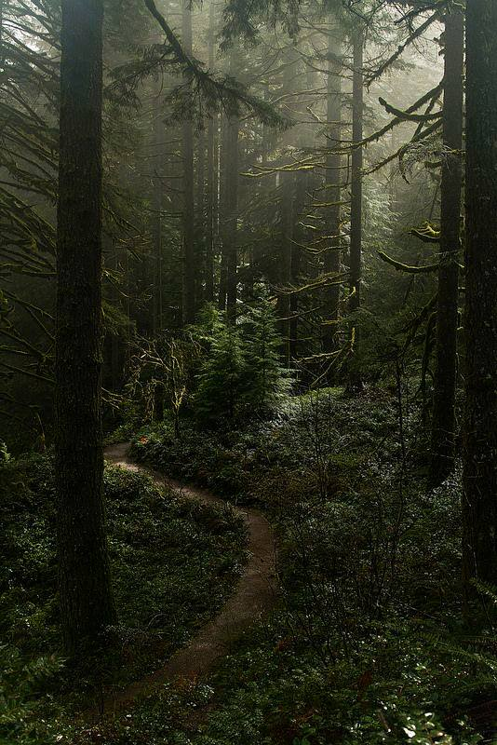
https://www.youtube.com/watch?v=0sIEaE_hE38 http://www.lasy.gov.pl/publikacje/copy_of_gospodarka-lesna/ochrona_lasu/ochrona-lasow-przed-pozarami

Slide 14
Karolina Szmajdzińska Katarzyna Mostowska Weronika Machura Liceum Ogólnokształcące im. Jana Pawła II w Siewierzu Klasa I

