Slide 1
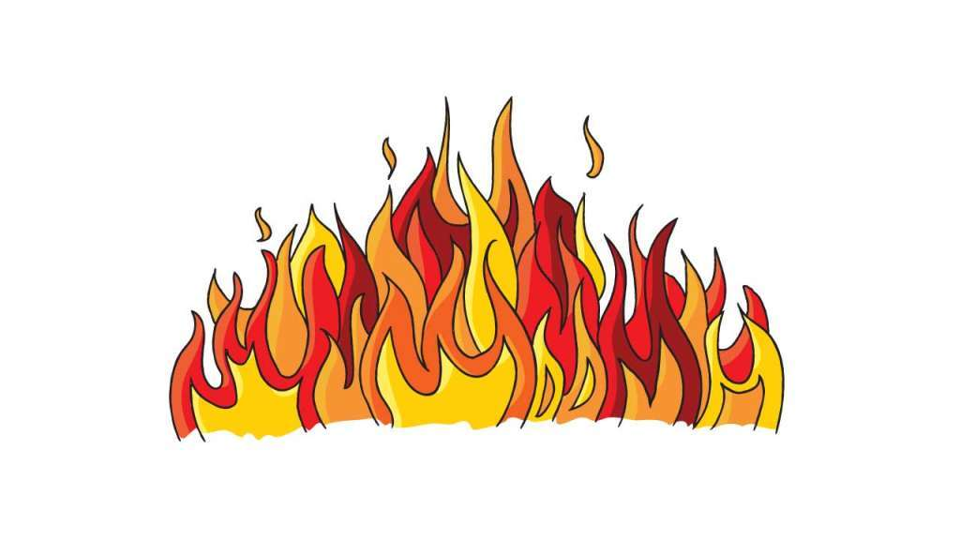
Lesson
Subject: Causes of forest fires in Poland.

Slide 2
1. Poland is a country with a high forest cover, unfortunately it's also one of those where the most fires happen. About 40% of world's forest resources are highly flammable, in Europe almost 65% and in Poland 85% of forest cover.
.

Slide 3
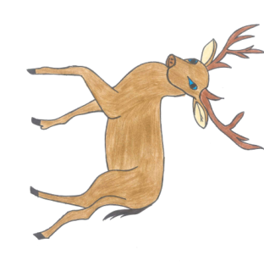
.
2. Poland is in the third place in Europe when it comes to number of fires.

Slide 4
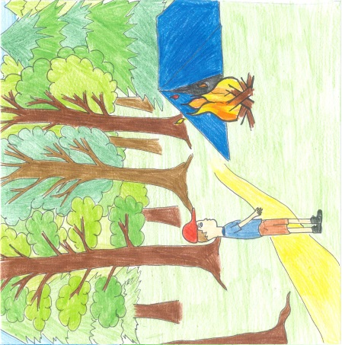
Causes of fire
reckless adults – tourism and recreation are the reason of a lot of fire outbreakes. The direct causes of them are smoking cigarettes, making bonfires, using grills and burning tree branches

Slide 5
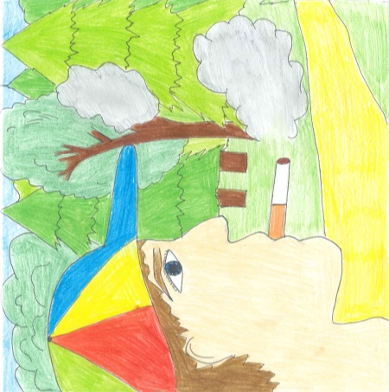
reckless minors – fires caused by the lack of imagination and not realising the risks of playing with fire. The direct causes are usually smoking cigarettes, playing with open fire, making bonfires, using fireworks.

Slide 6
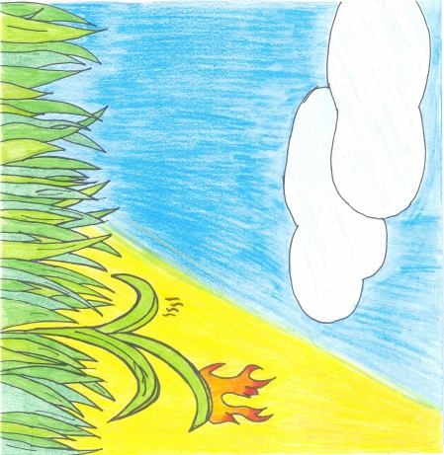
fires that don't originate in forest – fires that break out outside of forests and spread out due to the wind. The direct causes of those fires are: burnig grass, plants and the outer surface of soil on meadows, fields and grasslands.

Slide 7
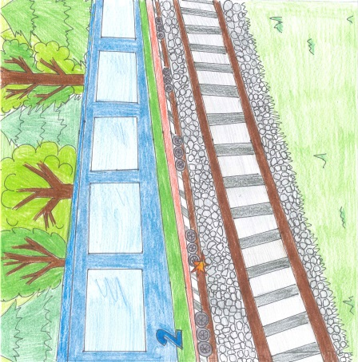
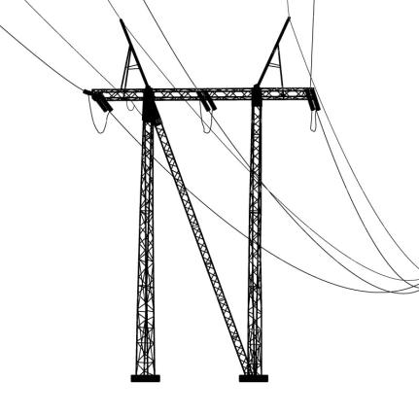
machines and devices – fires initiated by damaged power lines, means of transport like cars and trains. The direct causes are damaged wires under voltage, sparks created by stopping train or the ones that come from locomotive.

Slide 8
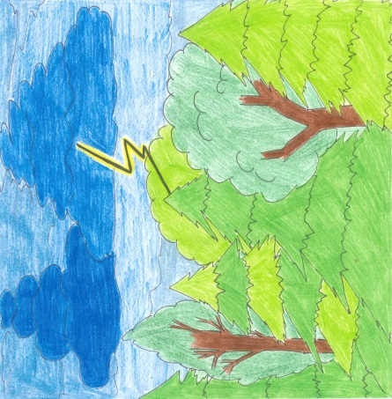
lightning storms – rare cause of fires in our country, since lightnings are usually accompanied by rainfall, also they target constructions and machines outside of forests.

Slide 9
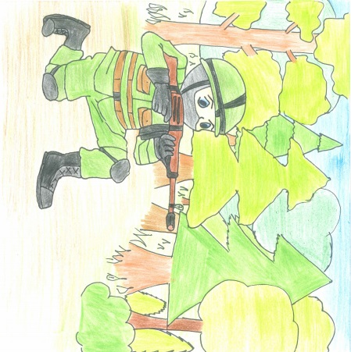
other – fires caused by catastrophes, military exercises, testing weapions, storing weapions and military equipment. The direct causes of fire are; shooting, bombing and other actions involving explosives.

Slide 10
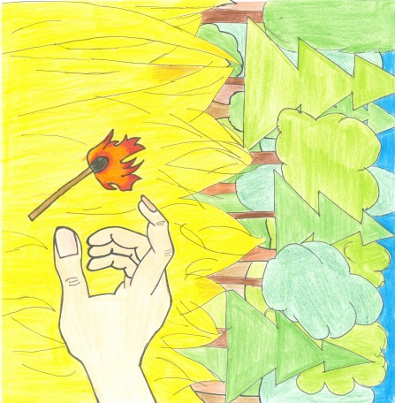
.
arsons – fires intentionally caused by people especially mentally ill ones (e.g. pyromancers)

Slide 11
unknown – causes of fires can't be established

Slide 12
If you notice a fire in the forest:
inform fire brigade (call 998 or 112)
estimate the situation, if you see smoldering forest cover, grass or single twigs in a small area (a few m²) try to extinguish it with branches, blanket, piece of clothing, water(if you have access to it) or try to use shovel to uncover layer of soil to prevent fire from spreading.

Slide 13
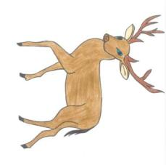
if fire is impossible to extinguish using available resources check if you are in the safe place, if not – run! In case of fire spreading evacuate in the direction perpendicular to the direction of the wind. If you find yourself in the smoke zone lean forward very low (there is less smoke close to the ground) and cover your mouth and nose with some kind of cloth or piece of clothing.
if possible go to the driveway to the forest and wait for fire brigade or forestry service and point them the place where fire originated.

Slide 14
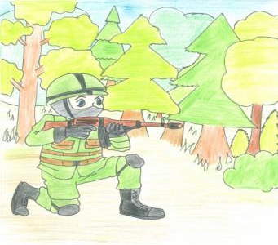
Always remember!
When you see fire, call 112 or 998.
When you are in a forest:

Slide 15
Bibliography
Drawings were made by us.
Music: „Forest Fire Song” – ParrMr (https://www.youtube.com/watch?v=YZvhkoKAd0U)
Laurowski Tadeusz , Vademecum ochrony przeciwpożarowej ,KABE, 2006, ISBN 83-89387-31-x
http://www.fao.org/forestry/27221-06293a5348df37bc8b14e24472df64810.pdf
http://effis.jrc.ec.europa.eu/
https://pl.wikipedia.org/wiki/Po%C5%BCary_w_Polsce

Slide 16
Gabriela Procyk
Anna Sopel
Hubert Polek
II Liceum Ogólnokształcące w Rzeszowie
1D

