Slide 1
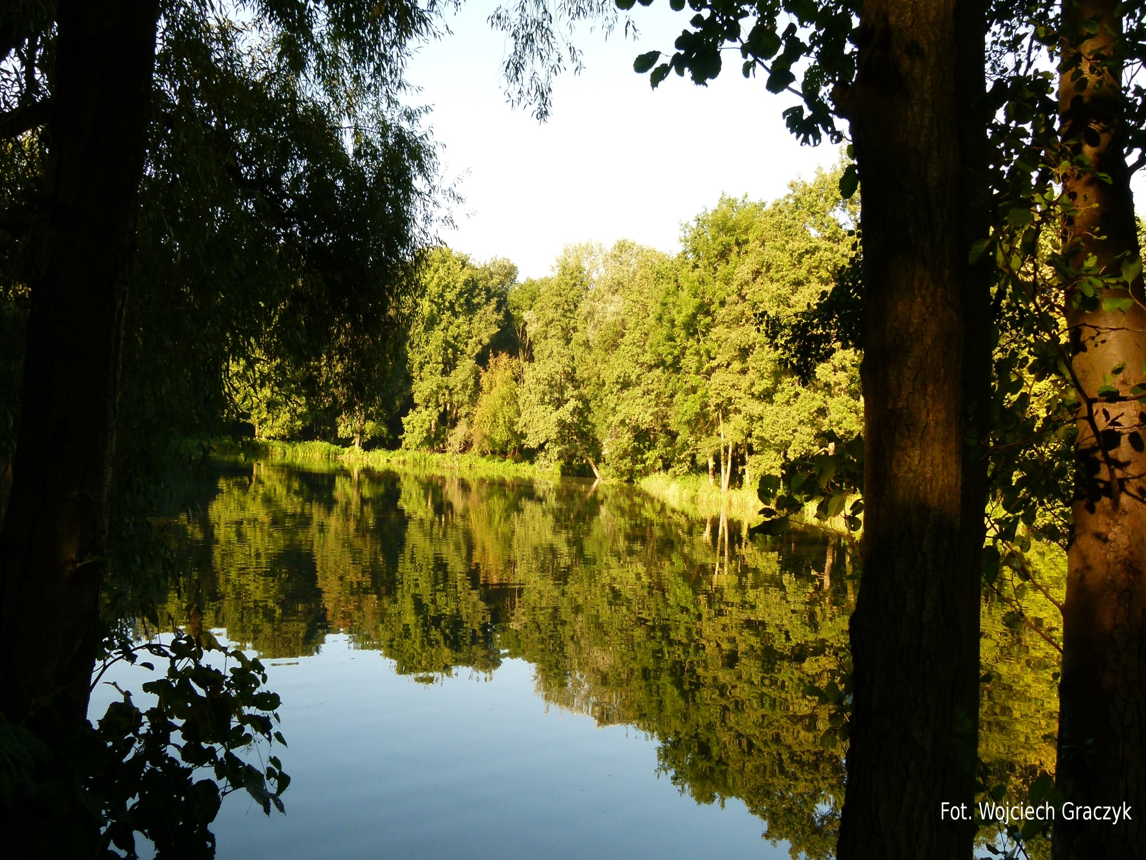
„Forest in Poland and Europe. Characteristics and management”
„Forestfireprotection in Poland and Europe.”
TOPIC: HUGE FOREST FIRE IN 1992 IN POLAND.
Creators:
Dawid Ciesielski
Wojciech Graczyk
Radosław Ziółkowski
Class: 3B
School: Gimnazjum nr 43 im. PTPN in Poznan in Poland.

Slide 2
Forests in Poland
Forests occupy about 9 140 000 hectares area of Poland, what means, they occupy as for back 29,2% area our beautiful country. In forest structure prevail coniferous forests, where dominanted species are wonderful - Pine pine (Pinus sylvestris).

Slide 3
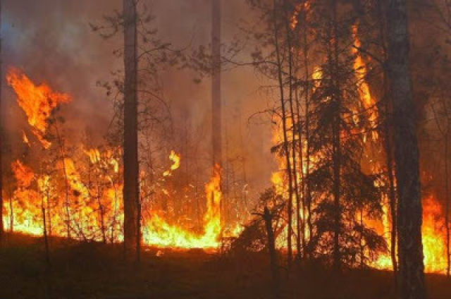
Important factoring
Very valuables cause is certainly rainless weather and high temperature air. An average is about 3 500 fire on area above 5000 hectares a year. And this is a very huge area.

Slide 4
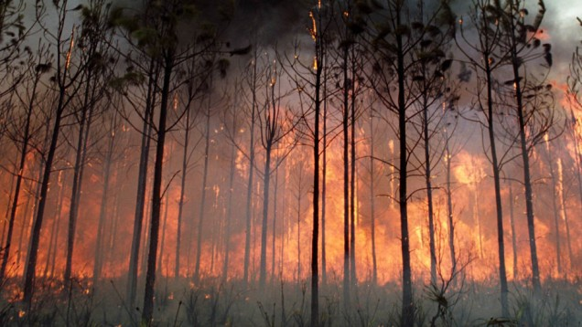
Results
Results
Burning out dry grass and ecological wasteland causes death begins living in forest. In soil environment follow irreversible change structure and loss biologic activity. Burning out dry grass often causes people death.

Slide 5
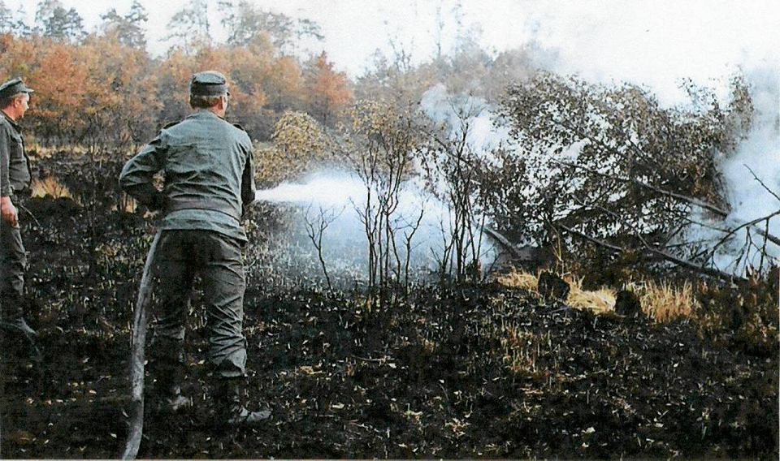
Short about fire in 1992
On 26th August 1992 about 2 p.m. with second observational bond was reports about appearing smoke near railroad tracks. First of all fires was in Nędza forest inspectorate - forestry, length about 1100 meters, and second was in ward 96 forestry Kiczowa on length about 800 meters, and third in forestry Lubieszów, length about 1 400 meters.

Slide 6
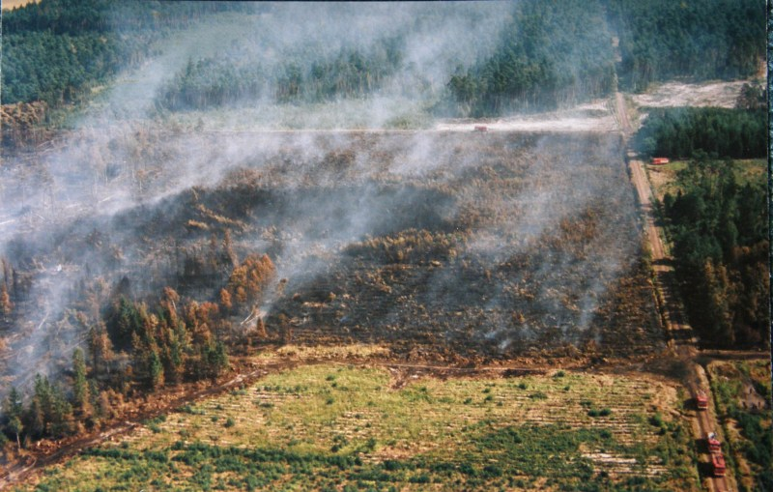
Area:
18.00 P.M., 26.08.92 600 hectares -/ 4 hours from uprising.
10.00 P.M., 26.08.92 about 2 200 hectares.
7.00 A.M., 27.08.92 about 3 800 hectares.

Slide 7
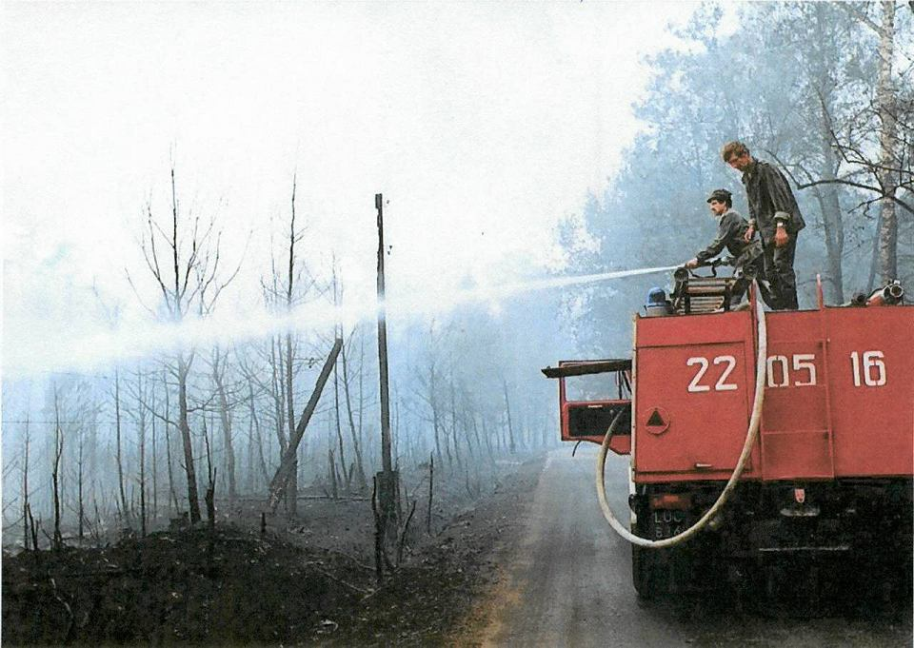
Control fire
Action's headquarters were dissolved in 20.09.1992. Until that day action lasted, together for 26 days.

Slide 8
Forest district administration
Fire embraced area 9062 hectares, with this:
in Nadleśnictwie Rudy Raciborskie 4480 hectares.
in Nadleśnictwie Rudziniec 2352 hectares.
in Nadleśnictwie Kędzierzyn 2230 hectares.

Slide 9
8641 hectares forest has been burned. Including:
627,53 hectares of yields.
1009,09 hectares of young forest.
1369,39 hectares of 2th grade of age tree stands.
5042,06 hectares of older tree stands.
326,88 ha other area.

Slide 10
Financial losses
Global direct financial losses were:
Costs of LP's action: 12 000 000 000 złotych.
Losses in tree stands: 354 600 000 000 złotych.
Losses in infrastructure: 13100 000 000 złotych.
Together: 379 700 000 000 złotych.

Slide 11
Curiosity:
In the culiminating moment of forest fire took.
part:
859 sections of fire brigade (4700 people).
3200 soldiers.
650 policemens.
1220 people from civil defense.
1150 workers from Forest Service.
In action were involved:
4 helicopters.
27 planes.
48 heavy and specialist tractors.
36 labor tractors.

Slide 12
THE END

Slide 13
Sources:
Substantive:
https://pl.wikipedia.org/wiki/Lasy_w_Polsce
https://pl.wikipedia.org/wiki/Po%C5%BCary_w_Polsce
https://pl.wikipedia.org/wiki/Po%C5%BCar_lasu_ko%C5%82o_Ku%C5%BAni_Raciborskiej_(sierpie%C5%84_1992)
http://strazacki.pl/to-ju%C5%BC-22-lata-od-wybuchu-najwi%C4%99kszego-po%C5%BCaru-lasu-w-polsce
http://strazacki.pl/artyku%C5%82y/kuznia-raciborska-21-lat-od-wybuchu-najwiekszego-pozaru-lasu-w-polsce-i-europie-po-ii-wojnie-swiatowej
http://www.tvn24.pl/poznan,43/najwieksze-pozary-w-historii-polski,568332.html
Graphics:
Third slide:
http://r-scale-68.dcs.redcdn.pl/scale/o2/tvn/web-content/m/p1/i/35309226eb45ec366ca86a4329a2b7c3/ac9b9a5d-20f6-4cdb-a28e-c33850e355bc.jpg?type=1&srcmode=4&srcx=0/1&srcy=0/1&srcw=640&srch=2000&dstw=640&dsth=2000&quality=80
4th slide:
fot. sxc.hu http://www.eostroleka.pl/luba/dane/pliki/obrazy/2012/pozar_lasu_sxchu.jpg
5th slide:
Photographer by: Nadleśnictwo Rudy Raciborskie
http://bi.gazeta.pl/im/2b/75/bc/z12350763V,Sierpien-1992-r---pozar-w-Kuzni-Raciborskiej.jpg
6th slide:
http://www.gliwiczanie.pl/Historia/1992/rudy05.jpg
7th slide:
http://bi.gazeta.pl/im/10/86/bc/z12355088V,Sierpien-1992-r---pozar-w-Kuzni-Raciborskiej.jpg
11st slide:
Photographer by: Nadleśnictwo Rudy Raciborskie
http://bi.gazeta.pl/im/15/86/bc/z12355093V,Sierpien-1992-r---pozar-w-Kuzni-Raciborskiej.jpg

Slide 14
YPEF VII PL In the culimination moment of forest life took part:
Dawid Ciesielski – 3rd class student in Gimnazjum nr 43 im. PTPN in Poznań (translator).
Wojciech Graczyk – 3rd class student in Gimnazjum nr 43 im. PTPN in Poznań (leader, co-creater prezentation project and photographer – first, second and twelfth slide).
Radosław Ziółkowski - 3rd class student in Gimnazjum nr 43 im. PTPN in Poznań (c0-creator prezentation project).

