Slide 1
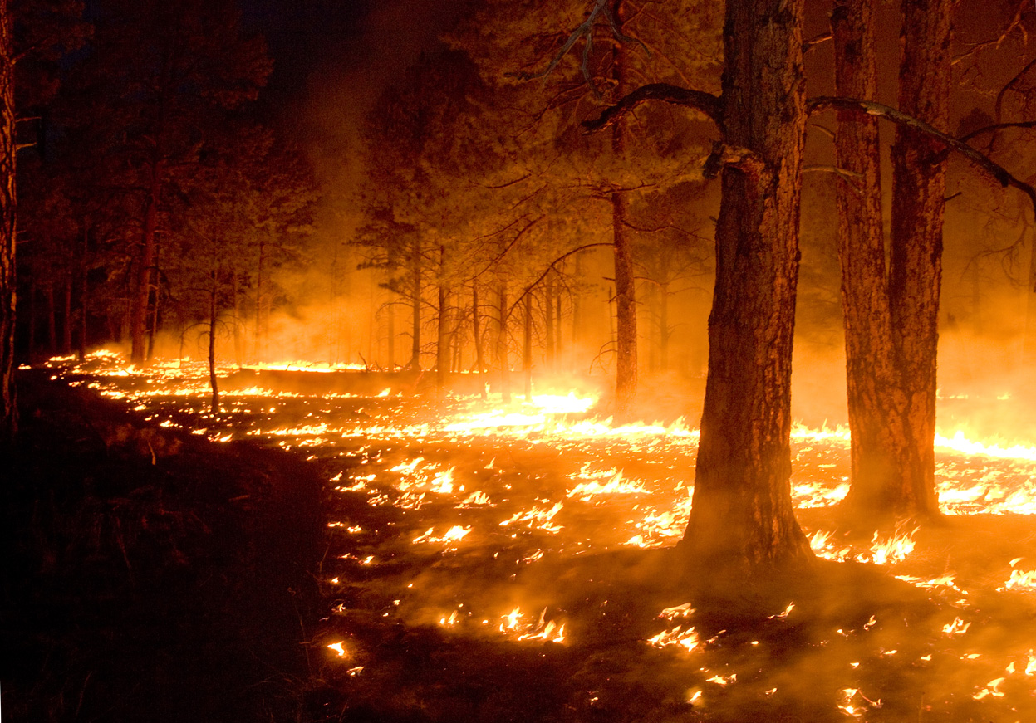
FOREST FIRE! PROTEcTION

Slide 2
Factors affecting fire risk in forests
Tourist and recreational values ​​of the forest
Road network and the intensity of traffic
Age and type of trees
Local conditions
Type of substrate / soil cover
Intensity of development of forest areas
Settlement of sediment

Slide 3
SEASON COULDN’T BE SO IMPORTANT… COULD BE?
The fire hazard in our climate zone appears since the beginning of spring when the snow cover disappears. At this time, particularly susceptible to inflammation are forests where there are significant amounts of flammable materials such as: dry forest floor vegetation, fallen leaves, brushwood, post-operative residues. Forest fire also affects the neighborhood of wasteland, meadows and pastures. With the growth of fleece and foliage of trees, as the water content of (green) biomass increases, the risk of fire decreases. At the turn of spring and summer, the threat is increasing again, especially in places where blueberry berry (black berry) occurs when people start gathering fruit. In summer, strong solar radiation increases the risk of fire, mainly in drywood (BS) and fresh birch habitats (BSs), and then in other boric habitats, as a result of freezing and sowing of fleece plants (mainly grasses). An important factor shaping the threat at this time is the length of the day. In the autumn, low temperatures and higher air humidity cause the threat to decrease again.

Slide 4
What else matters?
The degree of forest fire risk in different seasons is shaped by meteorological conditions. They primarily depend on the susceptibility to inflammation of combustible materials located in the forest or its vicinity.
Significance also have:
precipitation,
air temperature,
air humidity,
wind speed and direction,
frequency of change of direction and wind speed as a function of time,
intensity of solar radiation,
cloudy

Slide 5
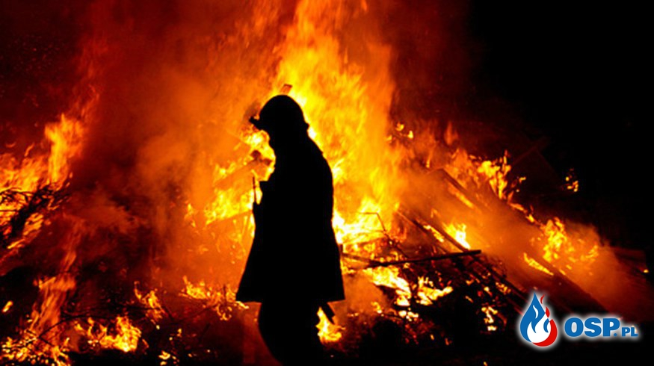
FIRE PREVENTION
ZAPOBIEGANIE POŻAROM
Fire prevention is a multifaceted effort to prevent fire, delay its development, and reduce the area covered by fire until the firefighting measures are taken.
Zapobieganie pożarom to wielorakie działania, których celem jest niedopuszczenie do powstania pożaru, opóźnianie jego rozwoju oraz ograniczanie powierzchni obejmowanej przez ogień, aż do czasu podjęcia działań gaśniczych.

Slide 6
Firebreaks in forests
„The firebreaks is understood to be a system of stands of different widths subjected to special economic and orderly processing or surface deforestation and purification to the mineral layer." ... We know that the definition may not be clear, so next we have posted a photo

Slide 7
„FIRE IN THE MEDIA”
Man is the main culprit of fires, hence the basis of information and warnings and propaganda directed to people should be detailed monitoring of the causes, time and location of fires. As the fire risk increases over the year and the number of fires increases, this activity needs to be intensified, using the press, radio and television, and involving people and institutions of high trust and authority. The media has the greatest influence on shaping public awareness. Stigma by the media bad behavior towards nature brings extraordinary effects. The whole activity in this respect is reduced to inducing appropriate behavior in the forest and its surroundings and accepting the restrictions (eg banning access to forests).

Slide 8
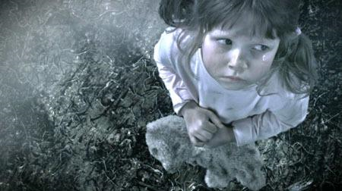
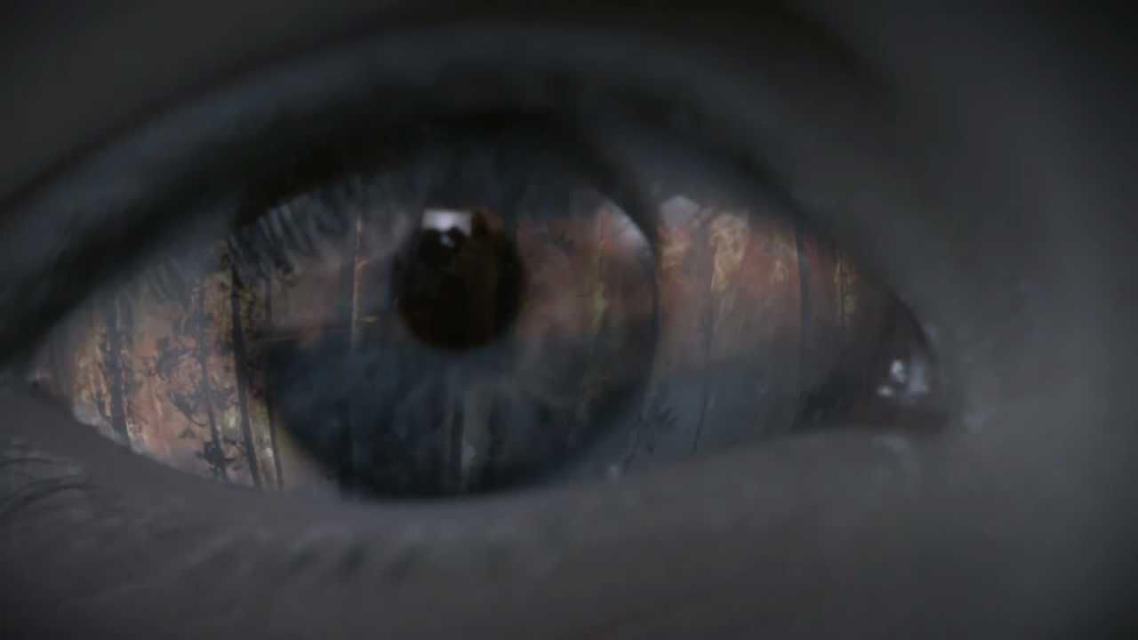
DIFFERENT PEOPLE, DIFFERENT METHODS
Different types of propaganda should be used for groups differentiated by age, education or place of residence and avoid repeating the same passwords, graphic designs or ideas
Tears will not extinguish the fire - " Świadomi zagrożenia" campaign

Slide 9
PREVENTION BURNING OF GRASS
Despite the current law and increasing public awareness of the need to protect the natural environment, fires resulting from the mindless and unreasonable practice of spring grass firing continue to be recorded. On agricultural land this is most often due to the high cost of growing crops using machinery, and recently, when agricultural subsidies have been introduced, the restoration of set aside fields and meadows for production has also been restored. In some regions of Poland, the burning of untreated lawns or slopes belongs to the specifically conceived tradition of spring cleaning.

Slide 11
COMPLAINTS OF PROHIBITIONS
In case of high fire risk the superintendent may introduce a temporary ban on entering the forest. This can be done if, for 5 consecutive days, the litter humidity measured at 9.00 will be less than 10%.
According to the Forest Act, a ban on entry to forest superintendents may be introduced when
Forest stands or fleets have been severely damaged. The ban is designed to ensure the safety of people.
There is a high fire risk - so that a man does not cause a fire in the forest;
Economic treatments related to breeding, forest protection or timber harvesting are performed.
For failure to comply with the ban on entry into the forest in Poland is mandatory.

Slide 12
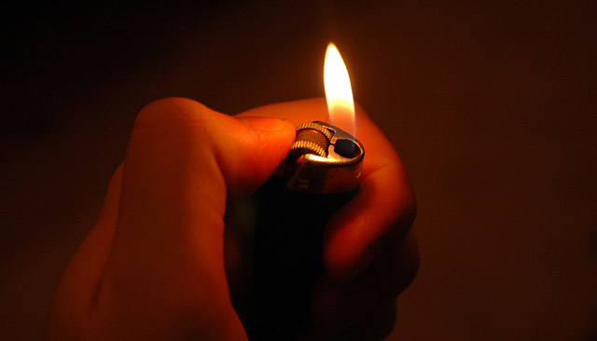
WE NEED TO RAISE AWARNES ABOUT FOREST FIRE PROTECTION!
9 of 10 forest fires are caused by (unintentional) human beings
9 to 10 fires of forests is started through inadvertence of man.
WE NEED TO RAISE AWARNES ABOUT FOREST FIRE PROTECTION!

Slide 13
SOURCES
http://www.zielonagora.lasy.gov.pl/ochrona-przeciwpozarowa/-/asset_publisher/1M8a/content/statystyki-pozarowe#.WPjVv4VOJPZ
http://www.kampaniespoleczne.pl/kampanie,1738,lza_nie_ugasi_pozaru
By Famartin - Own work, CC BY-SA 3.0, https://commons.wikimedia.org/w/index.php?curid=28044975
http://www.lasy.gov.pl
http://xuln.com/gurps/midgard-burns/
http://tuszownarodowy.osp.pl/artykuly/pozar-drewna-w-awnicy,6146/
http://nasygnale.pl/kat,1025341,title,Satanista-podpalil-kosciol-Wpadl-po-11-latach,wid,15835819,wiadomosc.html?ticaid=61901c

Slide 14
Wiktoria Dobrowolska 1bb Karina Dukaczewska 1bb Hanna Szewczyk 1c
XL Liceum Ogólnokształcące z Oddziałami Dwujęzycznymi im. Stefana Żeromskiego w Warszawie

