Slide 1
Forestfireprotection in
Poland and Europe
1

Slide 2
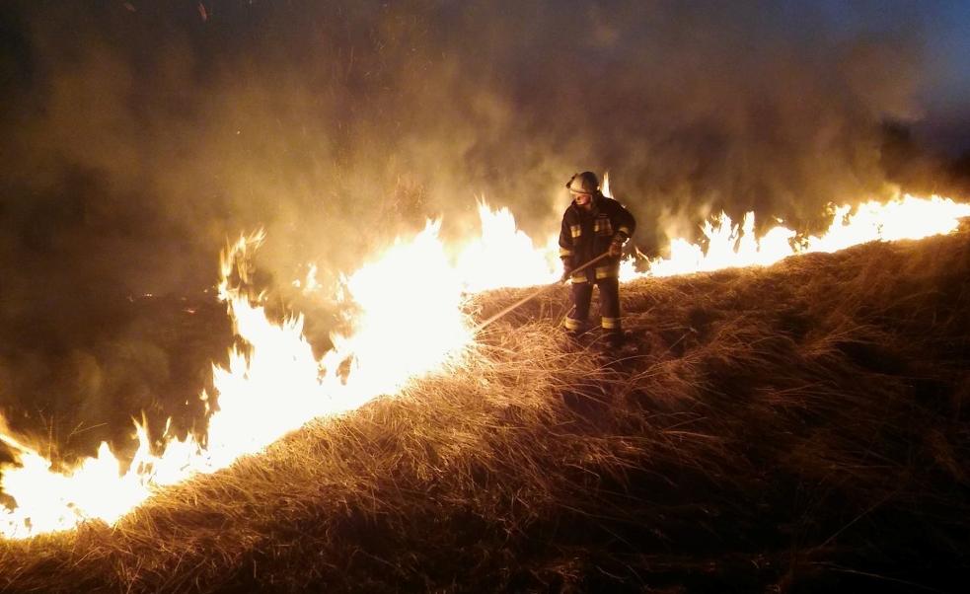
According to the category of wildlife, forest fire risk and regional directorates of State forests, are obliged to act in accordance with organizational and technical principles of preparing to extinguish forest fires.
1

Slide 3
The preparation of these mainly concern: the Organization of a network of observation and patrolling in order to detect fires, create alarm-control points, creation a communication network in forest complexes, creation a database of fire-fighting equipment, forest air bases organization, develop forestry practices in the event of fire, the appointment of agents in forest districts to arrange fire action.
1

Slide 4
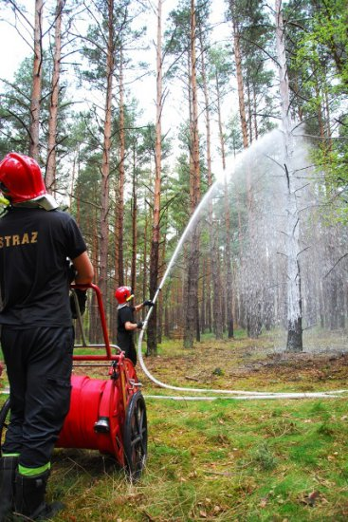
On the efficiency of the fire protection and emergency action affects above all the quick detection of forest fire. On the observation system consists of a network of permanent observation points and patrolling the air and ground. In State forests is 656 fire come, including 226 equipped with apparatus.
1

Slide 5
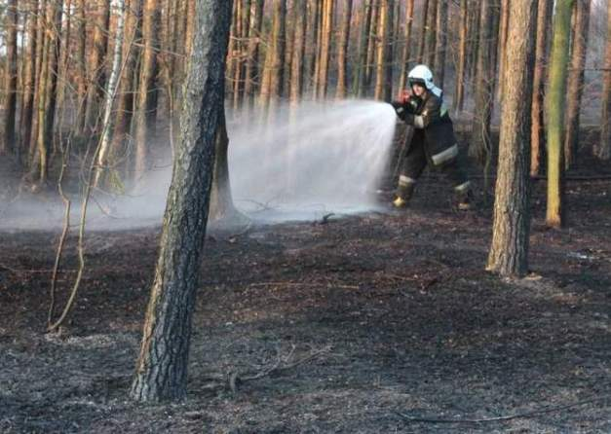
METHODS for FOREST FIREEXTINGUISHING
Fires underground: firefighting operations in the case oflarge fires underground consist mainlyof monitoring the fire situation its limitand keeping to the spread of the afterdeck. Boarding obkopać ditch. Thetrench should cut Board peat until themineral soil or extend slightly below thelevel of the groundwater.
1

Slide 6
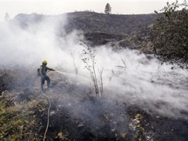
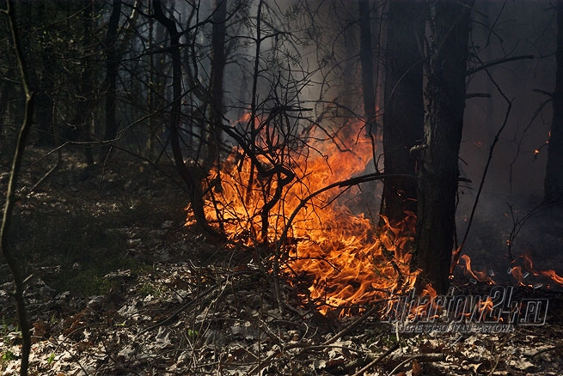
FIRE FIGHTING OF THE MUNDANE.
Forest fires mundane most ofteneliminates through location andsuppression. Gaszący should dig beforethe tall fire parallel belt width of 2 to 5 mand keep him as insurance. Equally goodfire effects will give you use dampenexternal. If possible, take advantage ofthe water to be used hydronetkamipożarniczymi hoses or lines quickly. It isrecommended to use distributedcurrents or fine water spray. foam.
1

Slide 7
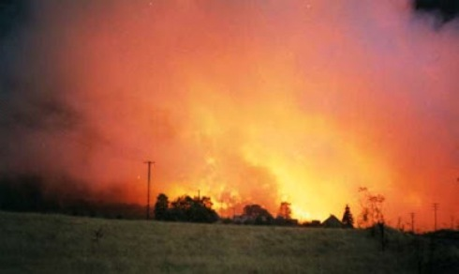
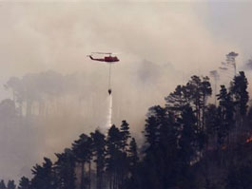
FIRE POINT.
Countersink forest fire eliminates or bydirect location and fire. Direct locationshall be made by cutting a tree beltwidth 50 to 100 m. or by detonation ofthe explosive point lying parallel to theface of fire. Fire restrictions you can usevertex called against a fire that is burning undergrowth and morestanding in the way of fire. However, themost effective method of fire is the so-called execution.
1

Slide 8
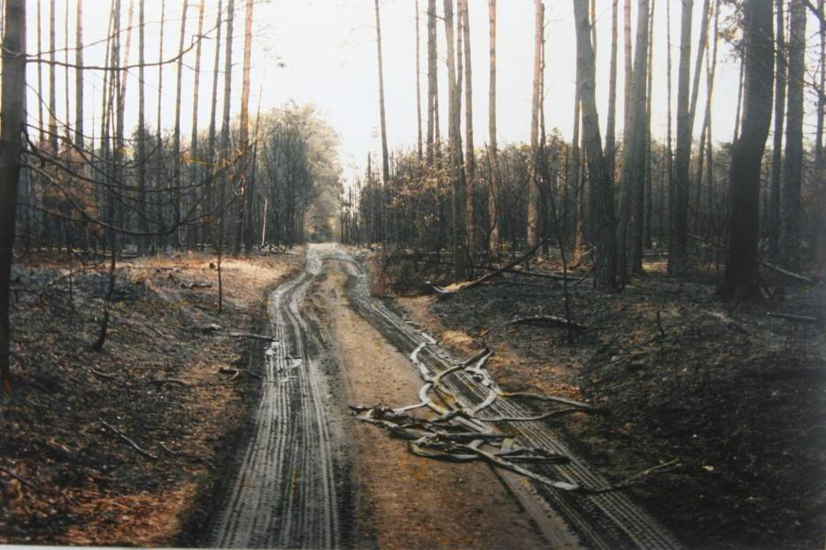
Prevention of tree-fires
No smoke in the woods
Not sharing the fire with the children, Matches not available for children
Do not burn grass especially and especially in the long absence of rain and those that are near the forest
Fire prevention
Refractory building if there is a high fire hazard in a given area
Penalties for breaking bans
Control by state forest service through patrols or various types of thermal imaging tools
1

Slide 9
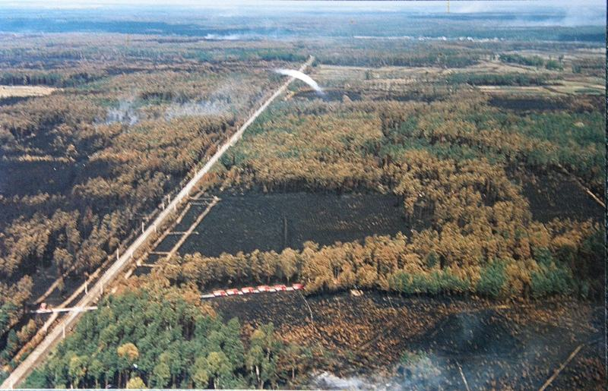
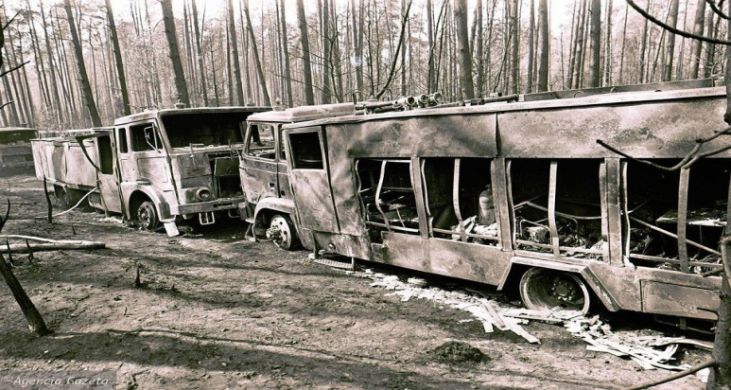
The effects of fires
Deforestation of oxygen producing trees.
Disappearance of animals and plants.
Uncontrollable fire can reach homes and ruin huge grounds
Isolation of large quantities of solid (particulates and soot), liquid and gaseous pollutants (carbon dioxide, carbon monoxide, nitrogen oxides, hydrocarbons)
Large amounts of solid (particulates and soot), liquid and gaseous pollutants are emitted (carbon dioxide, carbon monoxide, nitrogen oxides, hydrocarbons)
Destruction of the landscape
Threat to people and fire suppression services
1

Slide 10
Bibliography
Foto: OSP Równe, Nadleśnictwo Tuchowo, KW PSP Poznań, olawa998, lubartow24, Strażacki blog, tv.strazackie, sadisti, Gliwickie Metamorfozy, Gazeta Wyborcza, raciborz.naszemiasto
1

Slide 11
Karol Patla 1cl
Wiktor Zawitkowski 1cl
Kacper Pelczar 1c
Zespoł Szkół Ponadgimnazjalnych nr 5 w Krośnie.
1

