Slide 1
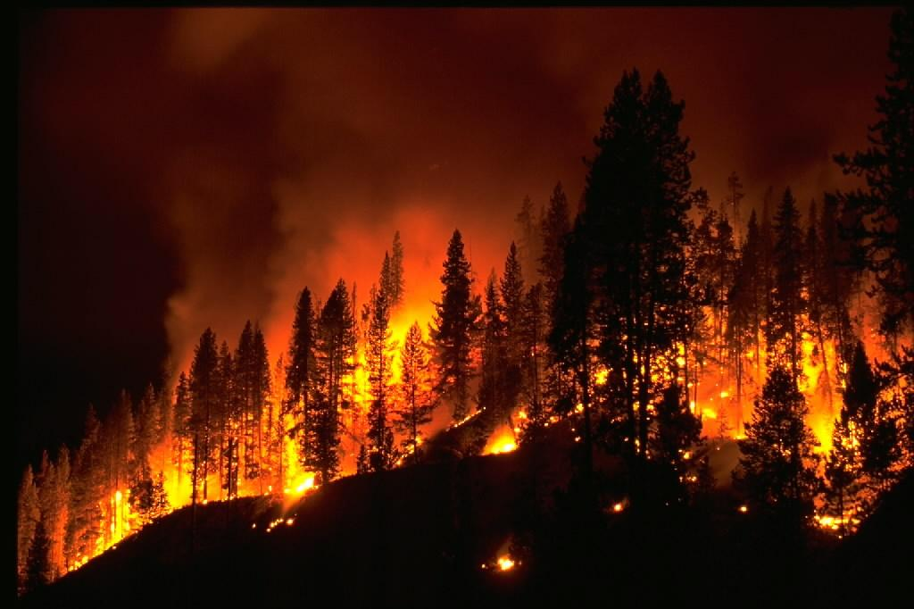
Forest Fire Protecion in Poland and Europe

Slide 2
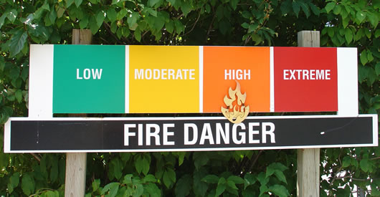
Poland, as a heavily forested country, is in the lead in forest fires. Around 40% of the forest resources in the world are prone to fires, nearly 65% in Europe, and about 85% in Poland.
According to FAO, hundreds of thousands of fires are created each year, destroying about 10 million hectares of forest. In the European Union alone 450 thousand. Hectares of forested areas are burned in fires.
Poland ranks fourth in terms of number of fires and tenth in terms of burned areas.

Slide 3
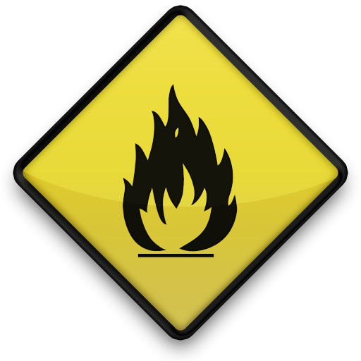
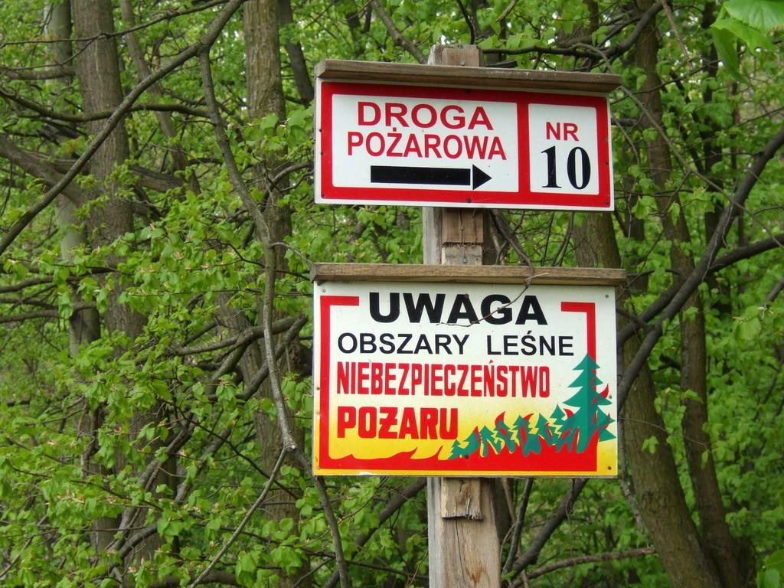
Poland is at the forefront of the forestation. The forests cover almost 30% of the territory of the country, in a combined volume of 9.3 million hectares. The vast majority are state forests, of which 7.1 million hectares is managed by the State Forests ''Lasy Państwowe”.
Private forests occupy 1.6 million hectares. Polish forests are one of the most fire vulnerable forests in Central Europe. This is the result of high share of beaver habitat occurring on 52.6% of forest area, pine dominance in species composition, age of trees and widespread.
Potential fire risk in Poland concerns about 85% of the area, which is 7.4 million hectares.

Slide 4
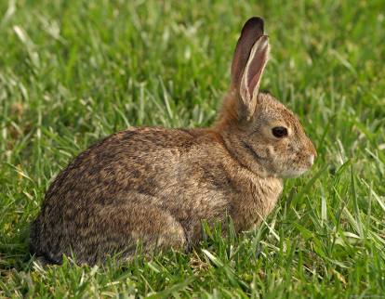
There are eight groups and thirteen reasons for the classification of the causes of forest fire in the State Forests.
Here is a brief description of the causes of a fire:
- carelessness of adults
- carelessness of minors
- machines and devices
- lightning strikes
- non-forest land fire spread
- arsons
- others
- unclear

Slide 5
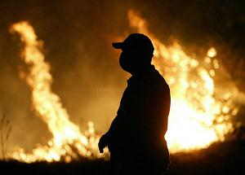
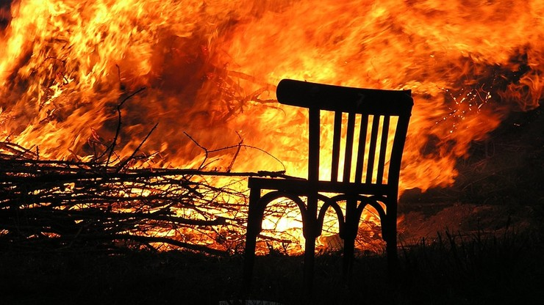
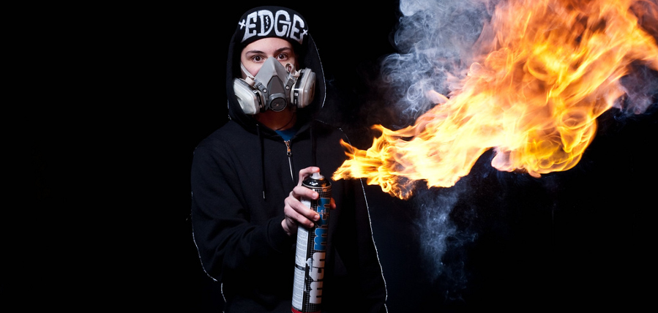
For many years, the main cause of forest fires in Poland is the activity of a people who deliberately cause over 95-99% of all fires. Intentional arson in Poland is the group with the highest share in the total number of fires in Poland. On the basis of a study carried out by the Forestry Research Institute (2006) it was found that a typical perpetrator of a fire was a child aged 15 and a non or primarly educated man between the age of 41 and 60.

Slide 6
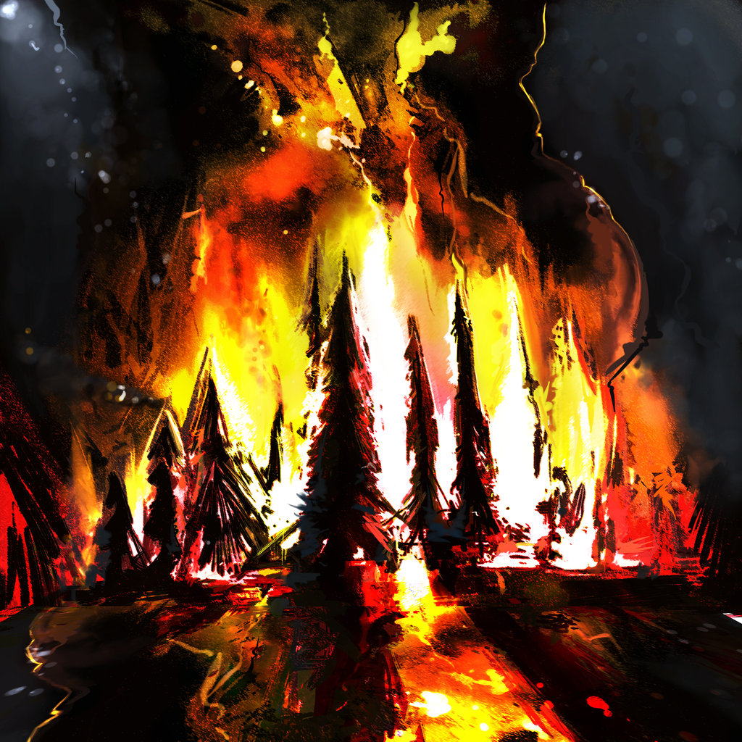
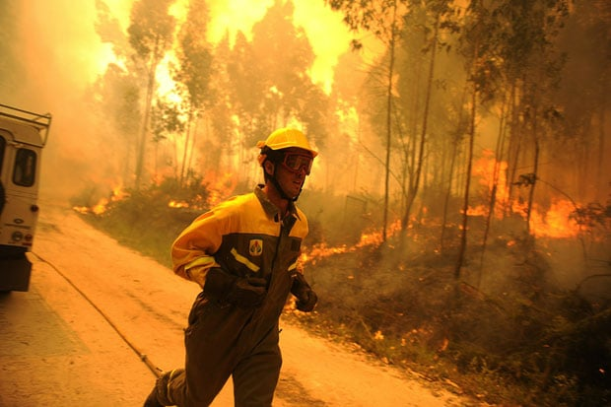
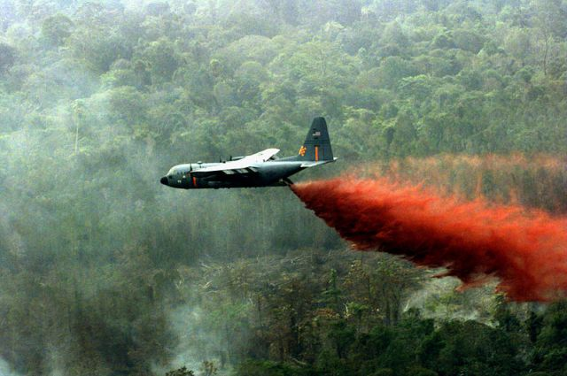
Fire extinguishing in Poland
According to Aldona Perlinska, head of the Forest Protection Department at the Directorate General of State Forests, forest fires in Poland are extinguished using ground and air forces. In 60% of cases the fire is controlled in the initial stage. Airplanes and helicopters take part in firefighting in inaccessible areas. For example in unoccupied, post-fire or sandy areas, where fire brigade vehicles can not reach. They drop fire extinguishing foam ahead of fire, to prevent it from spreading.

Slide 7
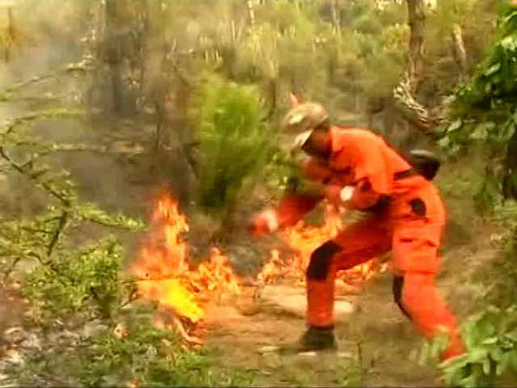
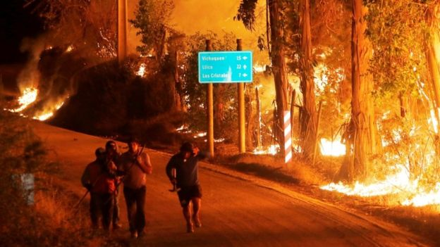
The fire of the reserve "Torfowisko Karaska in the Forest District of Myszyniec lasted from 1 to 2 September. It would not be possible to handle without the involvement of „dromader” type fireplanes. Within two days they were in the air for exactly 64 hours and 5 minutes. They dropped 84 water bombs, which is about 168 thousand liters of water! The cost of extinguishing peat bogs in Myszyniec Forest District by aircraft is exactly 424 thousand pln! The action involved six planes - two from the Regional Directorate of State Forests in Olsztyn and in Białystok, one from RDSF in Warsaw and Toruń.

Slide 8
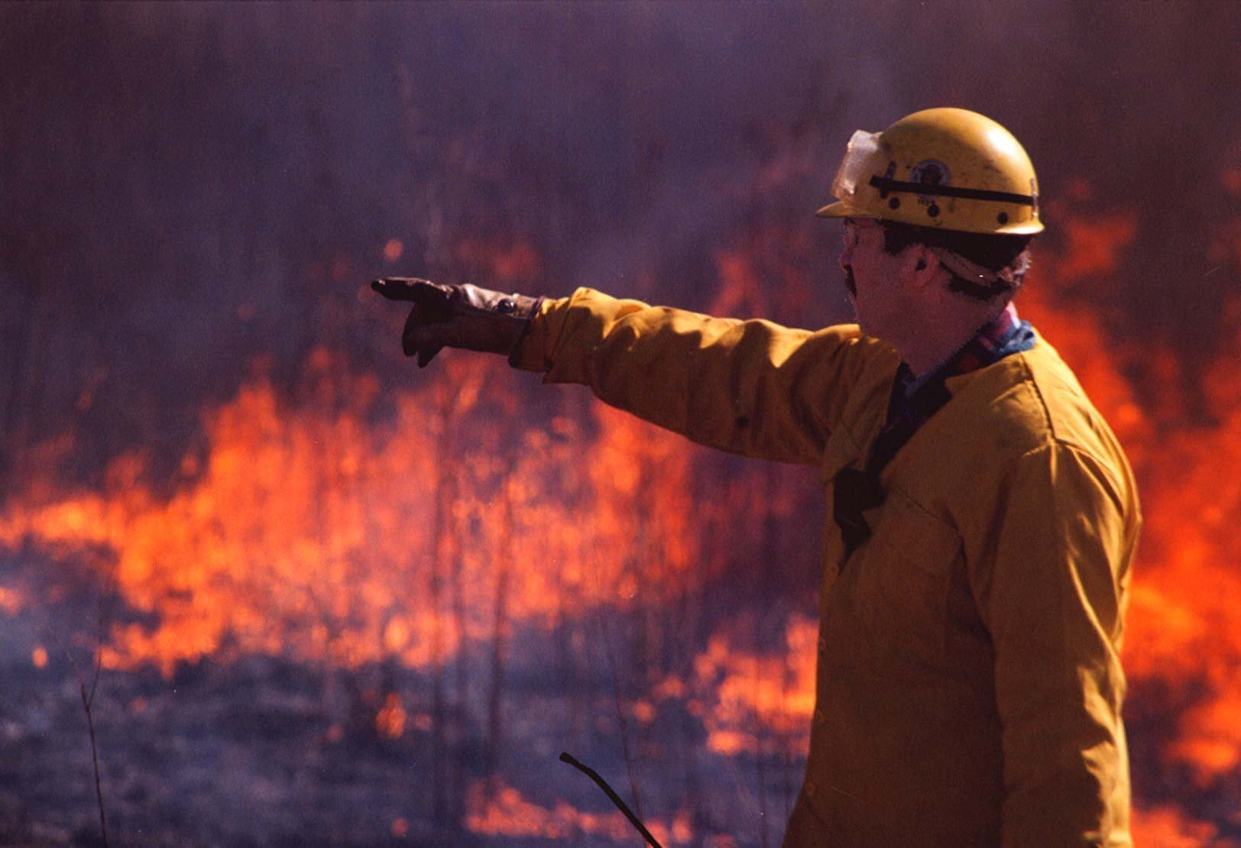
In some areas, firefighting vehicles can extinguish fires only up to 50m from the road, to guarantee the safety of people involved in firefighting.
Situations where the fire is extinguished only with the use of aircraft equipment, without ground forces are very rare. When, for example, an airplane in the air notice a forest fire, it can immediately suppress it. This way is efficent in 2-3% of all fires.

Slide 9
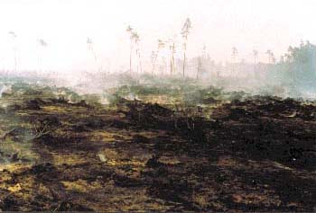
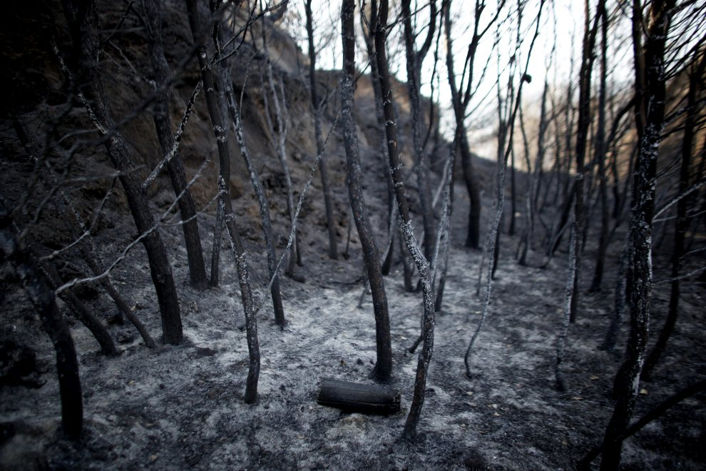
Burning processes during a forest fire cause the formation of toxic substances carried along with the smoke over long distances, causing devastation of the natural environment. A typical example could be forest fires in Indonesia. They covered 3.6 million hectares between 1982 and 1983, 5.11 million hectares in 1994, about 1.5 million hectares in 1997. Particularly acute was the recent fire that spread to the territories of Malaysia , Singapore, Thailand, Philippines and Papua New Guinea. The most affected was Malaysia, where its registered Air Pollution Index (API) was 859, which is more than 600 points above the safety limit. In Indonesia alone, smoke has directly or indirectly affected at least 20 million people.

Slide 10
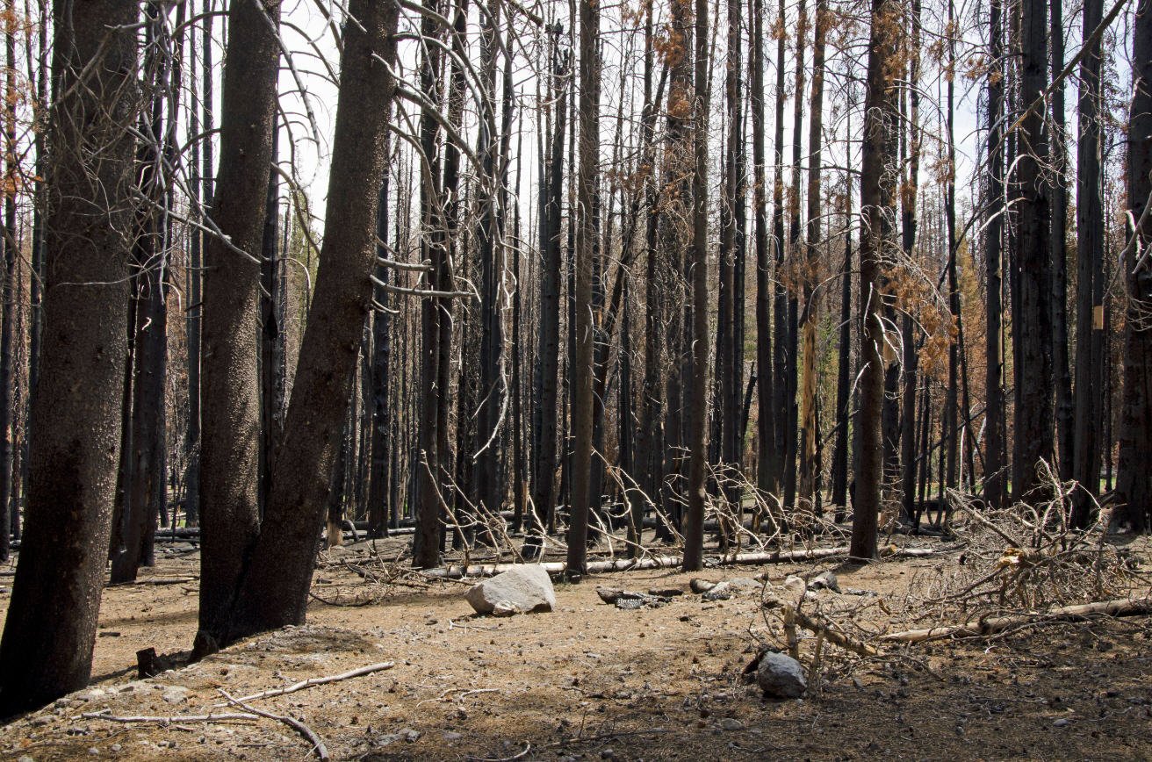
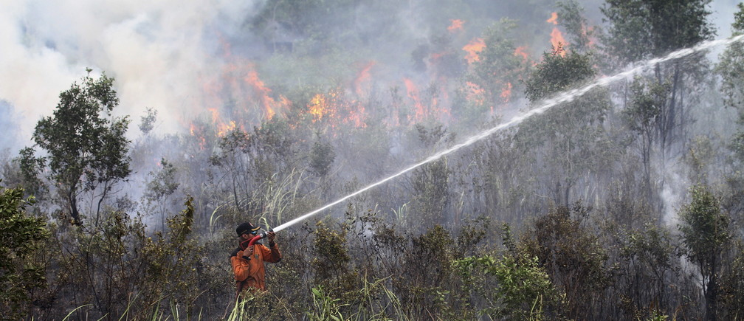
Classification of forest areas in terms of fire hazard is carried out in accordance with the Ordinance of the Minister of the Environment of 26 March 2006 on detailed rules for forest fire prevention. The Forest Research Institute's method of forest classification makes it possible to classify superintendents, national parks, municipalities, counties, subregions (powiaty) and voivodships. Assignments to the forest fire risk category are made on the basis of the following criteria:
Average annual forest fires over the past 10 years, per 1000 ha of forest area,
Percentage of tree stands growing in habitats: dry, fresh, mixed fresh, moist, mixed moist and floodplain forest,
Average number of inhabitants per hectare of forest area.

Slide 11
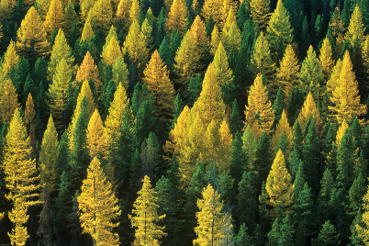
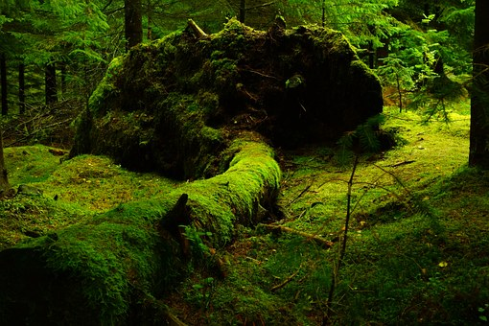
Preventing fires: - no fires in the woods,
- When the camping is over, extinguishing the bonfire and taking trash is neccessary,
- controlling electrical and gas installations,
- Proper storage of flammable materials,
- no burning grass,
- having a lightning rod,
- building using fireproof materials,
- do not smoke cigarettes in forests,

Slide 12
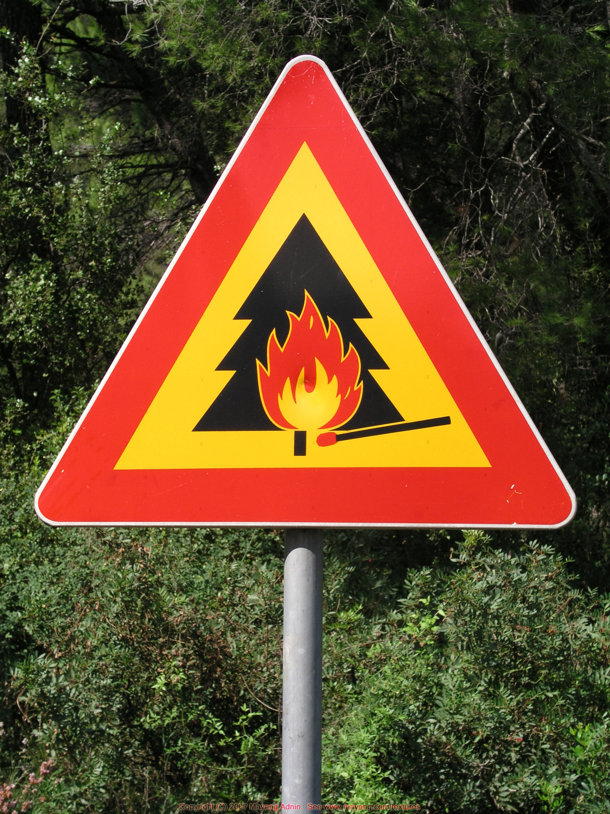
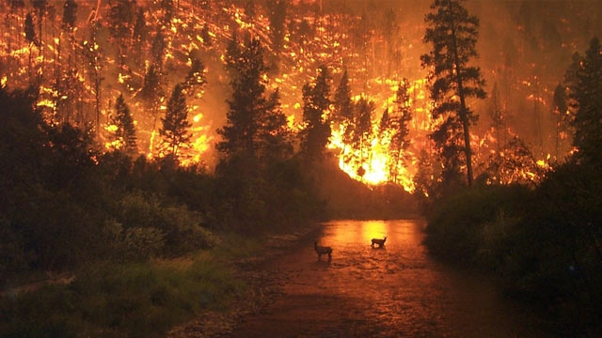
If you notice a fire in the forest:
Notify the fire brigade (phone 998 or 112),
Examine the situation; if the fire is not big yet, try to extinguish it by using, blankets, water or shovel.

Slide 13
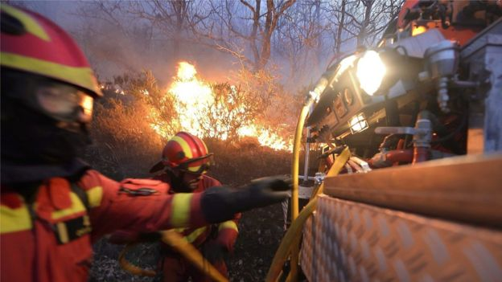
If the fire is impossible to extinguish for you, make sure you are in a safe place, if not - run! In case of fire spread, evacuate in a direction opposite to wind direction. If you find yourself in the smoke zone lean low and cover your mouth and nose with a tissue or garment.
If it's possible wait for the fire department and tell them the exact location of the fire.

Slide 14
source materials
http://www.ekologia.pl/wywiady/lasy-zagrozone-pozarem-wywiad-ekologia-pl,12802.html
http://www.lasy.gov.pl/informacje/aktualnosci/ile-kosztuje-pozar-w-lasach
https://olawa998.wordpress.com/2014/03/06/przyczyny-pozarow-lasow-w-polsce/

Slide 15
Adam Kania
Mateusz Biemann
Jakub Dendys
Zespół Szkół Mechaniczno-Elektrycznych w Żywcu klasa 1 CT

