Slide 1
,,Forestfireprotection in Poland and Europe.’’

Slide 2
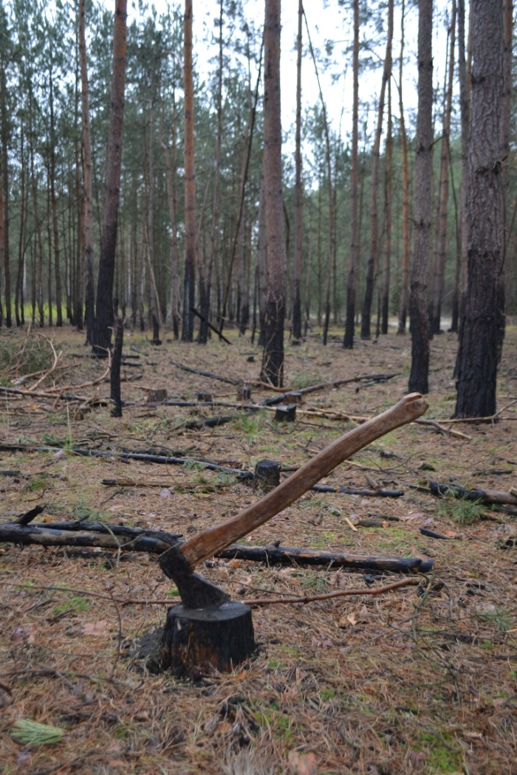
Important questions
Is there good side of forests logging ? Can we live without burning and destoying earth’s lungs ? How to prevention cutting trees? Is there any chance for us and our world? It is questions such as these that we want to answer.

Slide 3
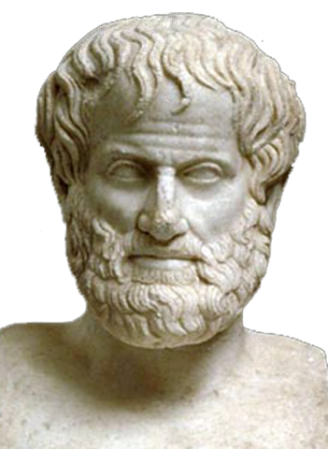
Philosophy in our lifes
Aristotle said that: ”Everything has a natural fuction”. Unfortunately , today we don’t use this rule in our lifes. Large companies are burning and cutting down the trees to make big profits. Without trees and plants , the forests cannot produce oxygen or absord carbon dioxide, so everyone is at risk.

Slide 4
The biggest fire in Poland
The 26th of August 1992 at 13:50 in the district of Rudy Raciborskie (Raciborz) there was the biggest forest fire in Poland and Europe after The Second World War . In total 9000 hectares of forest were burn in the fire. For several years the place of fire is visited by country and abroad trips to see how the forest is reborn.

Slide 5
Forests are earth’s lugs…
Substantial losses of native plants and animals occurred . We often forget that forests not only emit oxygen, but also filter water. The task of understanding global change, how important are forests for a men, anticipating impacts, and keeping human activity in some harmony with the physical environment looms as a test that our species (humans) could easily fail.

Slide 6
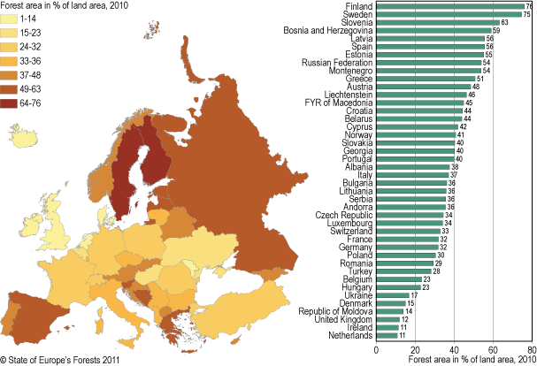

Slide 7
Wrong situation of forests..
The earth’s precious forests are in danger. They becomming smaller and smaller, and the situation is growing worse every day…

Slide 8
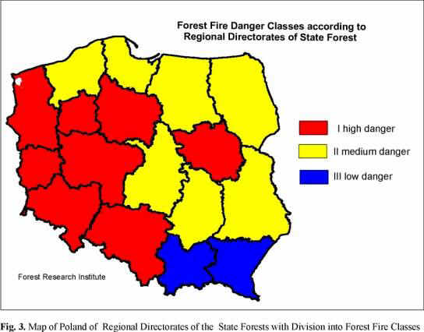
Fire Situation in Poland
The main causes forest fires in Poland are the irresponsible behavior of a man and the weather, but a lot of companies increase the awareness of Polish society.

Slide 9
Do you know what the biggest problem of our civilization is?
Counties develop their industries, mechanise, agriculture and at the same time pollute the air, the ground and the water . The production increases but the contamination of our environment increases even faster.

Slide 10
ARE YOU WORRIED ABOUT…
global warming?
damge to the ozone
layer?
acid rain?
air polliuton?

Slide 11
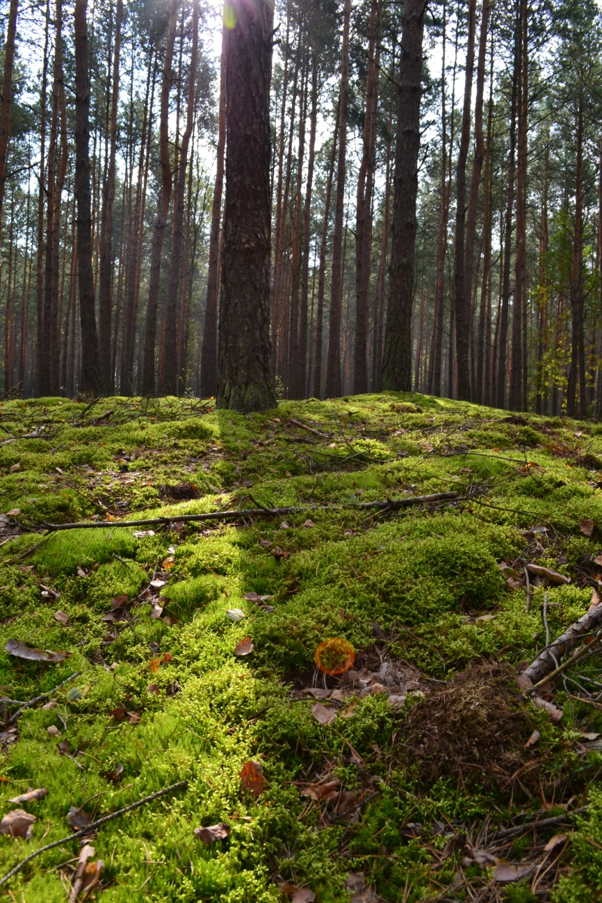
Earth is our planet…..
We humans are the ultimate predator ; we breed to quickly and we are both messy and poisonous. We don’t seem to know when to stop. We are changing our whole world climate in ways we don’t understand. It appears we are paying the ultimate price for our so-called civilization ; the desruction of the natural stuctures and processes of our planet.

Slide 12
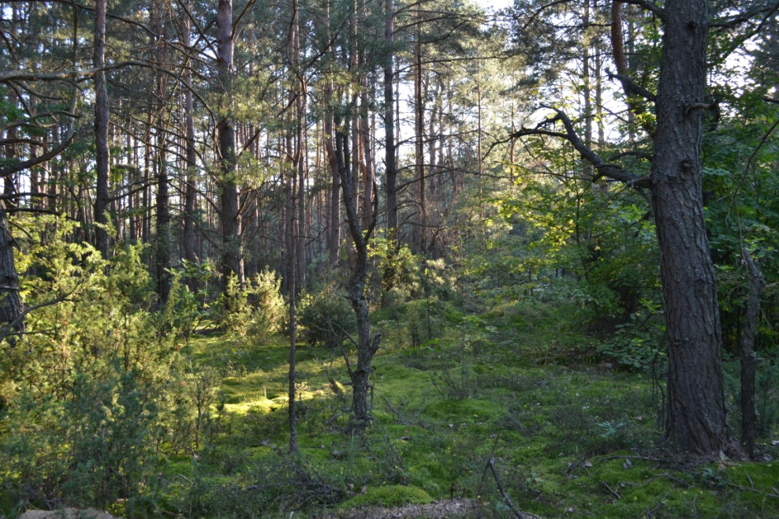
What can we do?
If the development is controlled, we can stop buring and cutting down trees. But we need to change our whole way to life, stop polluting the earth and contaminating water. Otherwise we could destroy the whole planet. Is our conclusion to be all doom and gloom? Is this the price we need to pay for our human civilisation, the complete annihilation of life on earth?

Slide 13
Sources:
https://www.gimpuj.info/index.php?action=gallery;sa=view;id=76508
http://filing.pl/29-zdjec-udowadniajacych-ze-nigdy-nie-chcialbys-zobaczyc-pozaru-lasu-na-wlasne-oczy/
http://pantheion.pl/Arystoteles-Dzielnosc-etyczna-jest-skutkiem-przyzwyczajenia-dzielnosc-dianoetyczna-doswiadczenia
http://www.wykop.pl/link/1738660/zalesienie-w-krajach-europy-ile-powierzchni-kraju-stanowia-lasy/
http://www.fire.uni-freiburg.de/iffn/country/pl/pl_5.htm
https://www.przystanek-eko.pl/2015/04/miedzynarodowy-dzien-ziemi/
Steve Elswortf, Jim Rose - ,,Go!2’’
Virginia Evans, Jenny Dooley - ,,Interprise 4’’
Philip Stokes - ,,Philosophy’’

Slide 14
Zofia Jasik Gabriela Jeżak
NIEPUBLICZNE GIMNAZJUM ,,SIÓDEMKA’’
KLASA II

