Slide 1
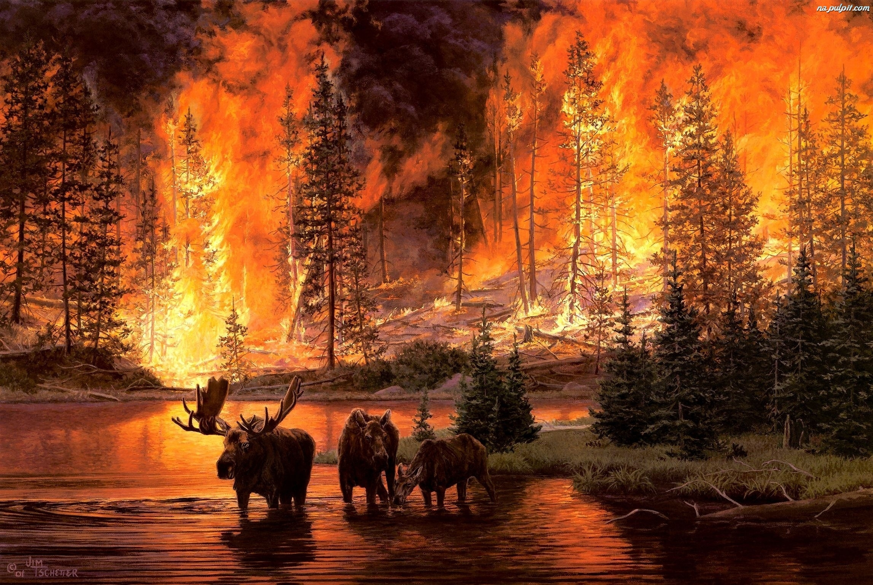
Forestfireprotection in Poland and Europe
„You can lit a fire with one perk, but you can't extinguish it with one drop of water…”

Slide 2
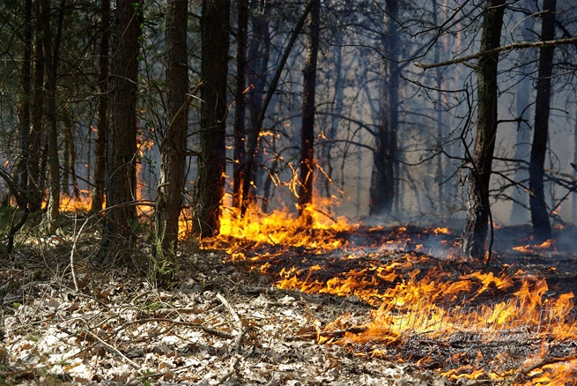
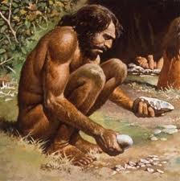
Imagine a fire, burning at night in the middle of wildness. The trees are on fire, their crownes were probably lit by a lightning turning a storm, but does it matter? Imagine a man, staring at this cruel show. His face express fear of this wild element of nature. But he’s a man from a former times. He doesn’t know how to use fire, nor how to prevent it from expanding, but soon, he’s going to learn it. The whole mankind is going to have the fire under… control? No, the fire can’t be taken under control and it’s an element of nature that should be used with wisdom. This man seems to understand that. But do we?

Slide 3
Around 40% of the forest resources in the world are prone to fires, nearly 65% in Europe and about 85% in Poland. Poland ranks fourth in terms of number of fires and tenth in terms of burned areas.
Carelessness of adults
Machinery and equipment
Arson
Carelessness of minors
Lightning
Common Causes of forest fires
Others

Slide 4
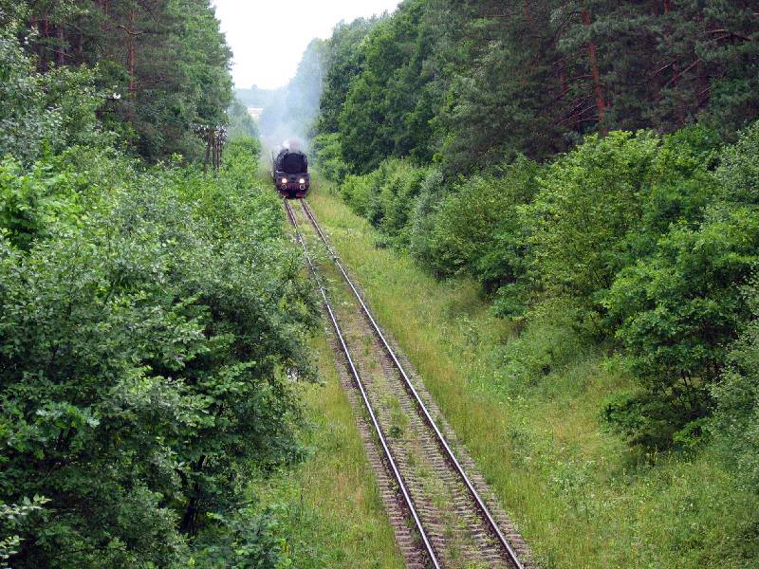
For many years, the main cause of forest fires in Poland is the activity of humans who deliberately cause over 95-99% of all fires. Even the least anticipated event can cause a fire.
Fire by the spark from wheels of a braking train ? „(... )the passing train " spilled "sparks, sparking a fire…"

Slide 5
One of the biggest fire, which took place in Poland was the wildfire in forest division „Kuźnia Raciborska”. It was also the biggest natural disaster in Central and Western Europe after the Second World War. It happened at 26th August, 1992. The cause of it was probably a spark from wheels of a braking train. After 4 days the fire absorbed 9062 hectares of forest and lives of three people, leaving behind only ash and emptiness. Now people are visiting this place to see the rebirth of the woods.

Slide 6
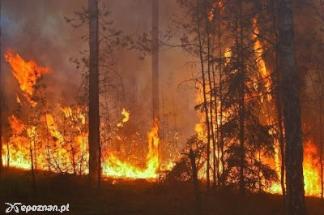
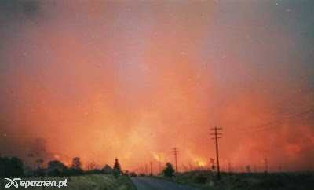
Effects of destructive power of fire could be also visible in the 1992, in Puszcza Notecka. On 10th August sparks from blocked brakers of train caused ignition of a forest between „ Mialy” and „Prawski Młyn”. Fire lasted for around 9 hours and was extinguished in 15 minutes by a sudden storm. It destroyed 6 hectares of woods, 19 buildings, 3 premises. It was the second biggest fire in Poland.

Slide 7
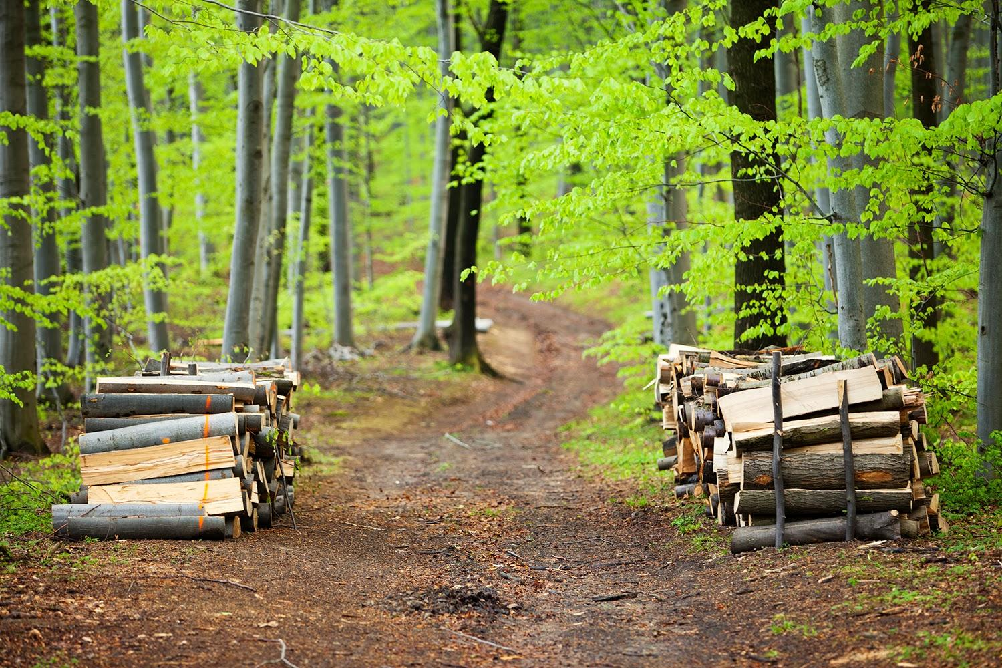
These fires were accidential. Just like all of them- lit by a sun and a broken glassleft in the woods, by thrown cigarette or bonfire which was thought to extinguish without any human help. A little spark can evolve in a giant fire. It’s worth remembering that etery insensible act can lead to a serious problem. Unfortunately, it’s human whose disrespectfull behaviour in the woods causes disasters such as fires.

Slide 8
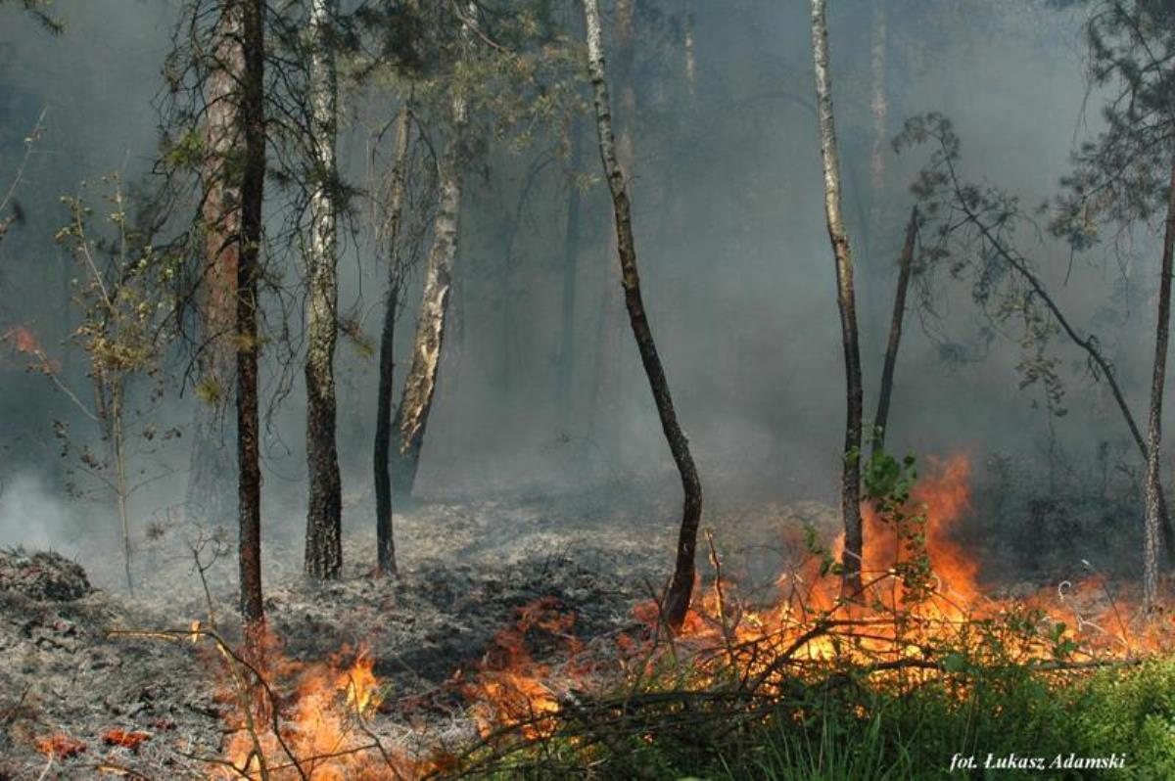
In order to prezent fire in the future, in Kuźnia Raciborska a system of special hedges was made. There is also „ Memorial of the younger captain Andrzej Karyna and Andrzej Malinowski” Originally it was an annual cycling race which took place in August. Right now this is a wrestling competition connected with other sport events and concerts. This event memorializes firefighters who died during extinguishing the fire.
On the other hand, in Puszcza Notecka there were 80mln saplings planted in the place where the fire happened. Moreover, there were made 8 meters wide firebreaks, which are areas without plants that could be easily lit. Not only this, in the wood there were but cysterns filled with water in order to help firefighters to extinguish fire if it happened. In Potrzebowice, a town in Puszcza Notecka, there is also an exhibition dedicated to fire and to eliminating its results.

Slide 9
Why protection of forests is so important?
Forest are not only places where many plants and animals live but they are also a part of the world which helps us- humans live:
*they take part in a process of purification of the air, letting us breathe
*they make living better by smothering noises
*they make our world more beautiful
That is why we must care about forests and should not ever let them disappear !

Slide 10
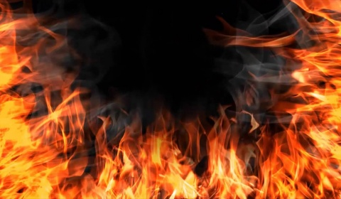
Ways to prevent a fire:
Fires are mostly caused by irresponsible actions of people. This is why the best way to stop them is to make people obey rules of the safety in forests (for example: prohibition of starting a bonfire)
It is also important for a firefighters to have a special equipment which would help them locate fire as quickly as possible, so it won’t spread on bigger area
We should also stop building train tracks next to the woods!

Slide 11
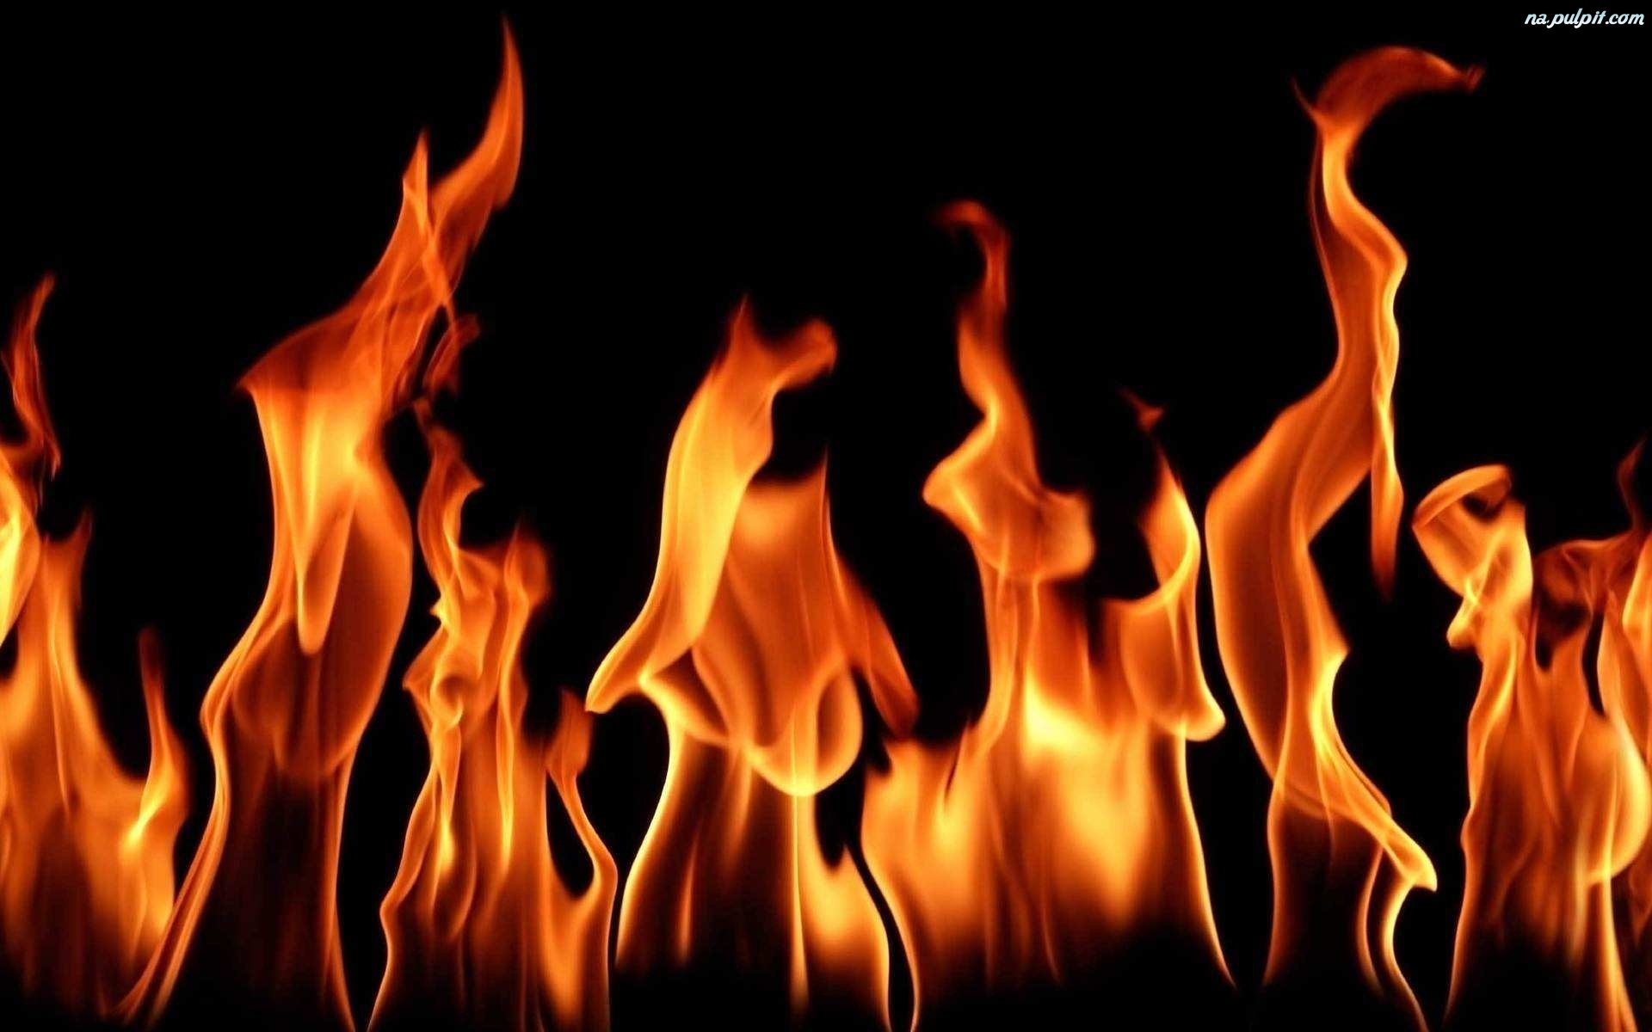
It is hard to talk about accurate fire statistics. Currently, everything is being done to minimize forest fires. In 2014, 5245 forest fires were registered (in 2013 - 4883) and 2690 hectares of forest stands were burned, 1401 ha more than in the previous year.
Unfortunately, in recent years, there has been an increase in the risk of fire and the resulting number of fires and affected areas. This is due to the occurrence of extreme meteorological conditions. Occurrence of warm, often snowless winters, extends the period originally considered non-flammable.

Slide 12
CURIOSITY
In our region, which is under the patronage of Włocławek Forest District, there were 39 forest fires in 2016. Their total area was 1.64 hectares. The most devastating was the forest fire in Dębice, which covered 0.67 hectares. In 2017 there is no fires in our forests.

Slide 13
Do you remember the man we were talking about at the beggining? He was unable of rising a fire, he could only stare at it- we, on the other hand, can do with it whatever we want. This ability is a great power, but also a great responsibility. Because of unappropiate usage of fire many environments can be destroyed and many animals can be hurt. Survival of these innocent creatures depends on our wisdom! And our future is up to us too. Do we want t live in a place full of plants animals and balanced nature? Let’s answer ourselves this question. And let’s try to do our best to make our future better than today.

Slide 14
BIBLIOGRAPHY
http://www.srodowisko.abc.com.pl/czytaj/-/artykul/chronmy-nasze-lasy-przed-ogniem
https://pl.m.wikipedia.org/wiki/Pożar_Puszczy_Noteckiej
http://www.dziennikzachodni.pl/artykul/zdjecia/635945,20-lat-po-pozarze-w-kuzni-raciborskiej-zdjecia-lotnicze-i-wideo,1103409,id,t,zid.html
https://pl.wikipedia.org/wiki/Po%C5%BCary_las%C3%B3w
http://epoznan.pl/news-news-34398-Region_20_lat_temu_wybuchl_wielki_pozar
http://www.lasy.gov.pl/informacje/publikacje/do-poczytania/lasy-panstwowe-w-liczbach-1/lasy-panstwowe-w-liczbach-2015
http://www.eko-fani.pl/artykul/33/Znaczenie-las%C3%B3w-w-%C5%BCyciu-cz%C5%82owieka.html
https://pl.m.wikipedia.org/wiki/Pożar_lasu_koło_Kuźni_Raciborskiej_(sierpień_1992)
http://www.straz.gov.pl/porady/pozary_lasow
https://olawa998.wordpress.com/2014/03/06/przyczyny-pozarow-lasow-w-polsce/
http://tvnmeteo.tvn24.pl/informacje-pogoda/polska,28/polska-w-niechlubnej-czolowce-pozary-lasow-wybuchaja-u-nas-raz-po-raz,189019,1,0.html

Slide 15
Authors:
Katarzyna Ciechanowska
Kinga Jaworska
Dominika Lewandowska
Liceum Ziemi Kujawskiej we Włocławku klasa 3c

