Slide 1
Forests in Poland and Europe. How to protect them?

Slide 2
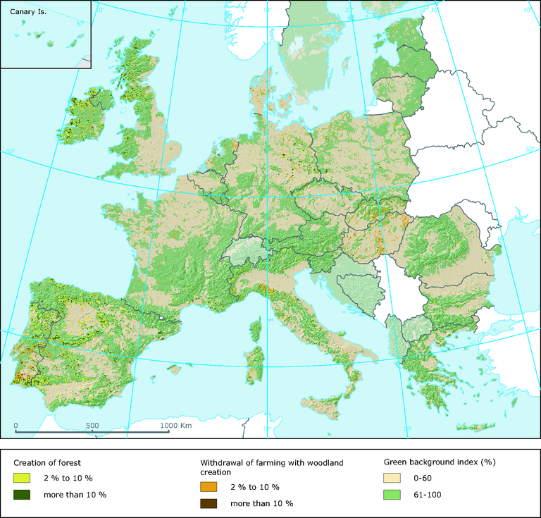
Afforestation of Europe
Afforestation areas in Europe covers surface 158,4 mln ha.

Slide 3
Durmitor

Slide 4
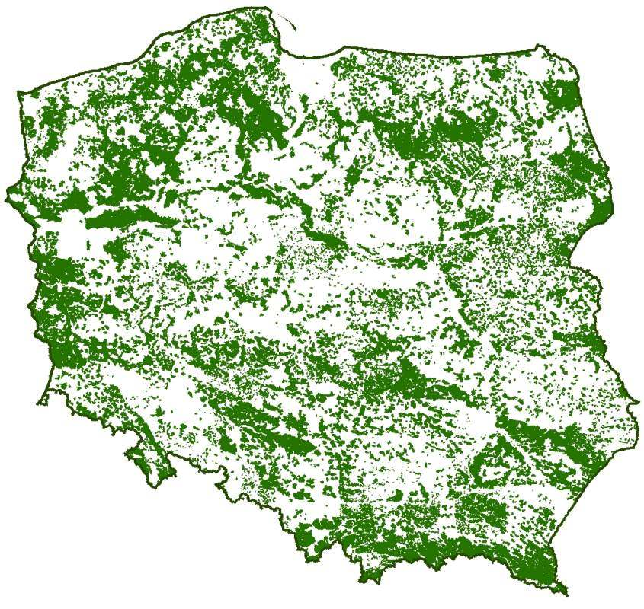
Afforestation of Poland
Poland is in European lead in terms of surface forests.
They covers on 29,4% territory of the country,
they grow on 9,1 mln ha area.
Afforestation of Poland

Slide 5
Solska

Slide 6
Forest application
Protection
of forests

Slide 7
Forests have many meanings for
people, animals and plants,
for example:
They are source of oxygen, thanks to we can live
They absorbs a lot of water, what prevents floods
They deliver wood, which is use everyday
They stopped dusties and other pollutions
They are “house” for many animals
They are place, where people willingly spend their free time

Slide 8
Forests are necessary to living and functioning
on Earth.
How we should protect them?
There are some basics rules,
which you mustn’t do at forest:
You mustn’t light the campfires, because it can cause a fire of part/whole forest
You mustn’t drop the litter around
You mustn’t smoke
You mustn’t make a lot of noise
You mustn’t cut down the trees massively
You shouldn’t feed animals
You mustn’t destroy animal “houses” (e.g. nests, anthills, holes)

Slide 9
The biggest fire…
The biggest fire in Poland and Europe was in 1992 near Solarnia village in south-west Poland. In this fire burned down 9000 hectares of forest.

Slide 10
For 17 days it was extinguished by 10,000 people. Element consumed 3 victims, 2 firefighters and the victim of a car accident that happened at the scene of the action.

Slide 11
Please use arrow to go to the selected slide ☺
Afforestation of Europe
Afforestation of Poland
Forest application
Protection of forests
The biggest fire…

Slide 12
Thank you very much ! ☺
Wyczarska Iza
Hycka Wiktoria
Panek Jakub
I LO im. Henryka Sienkiewicza w Łańcucie

