Slide 1
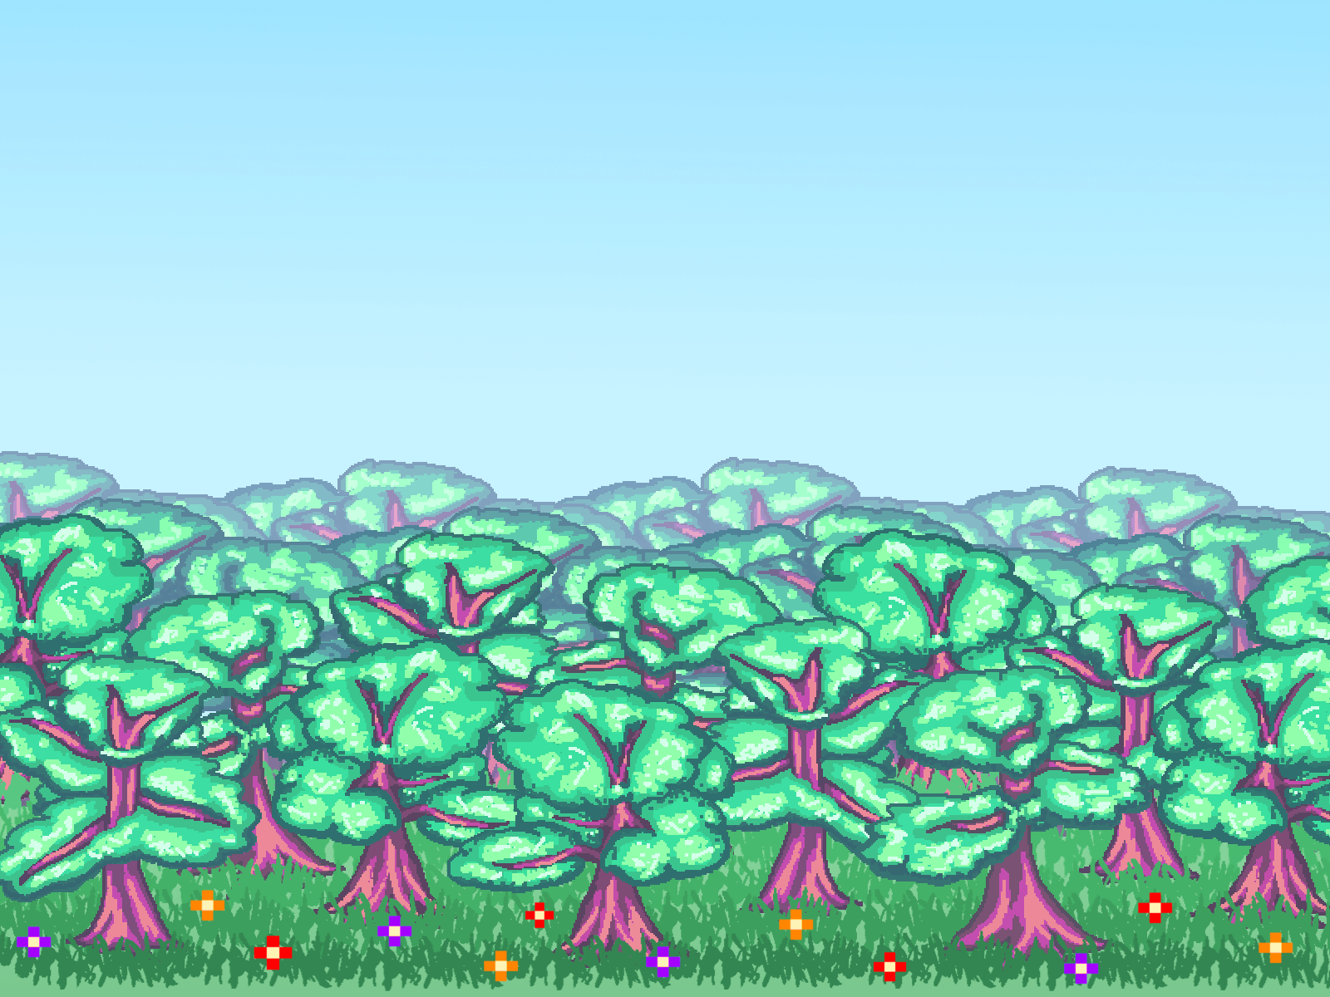
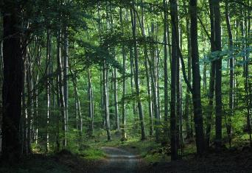
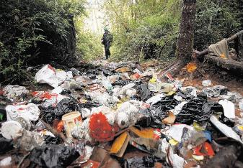
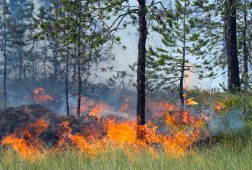
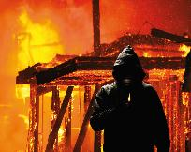
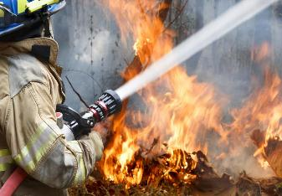
Forest fire protection in Poland and Europe
Forests in Europe
Forest functions and threats
Definition of Wildfire
Causes and effects of Wildfires
Tips against Wildfires
Authors and Sources

Slide 2
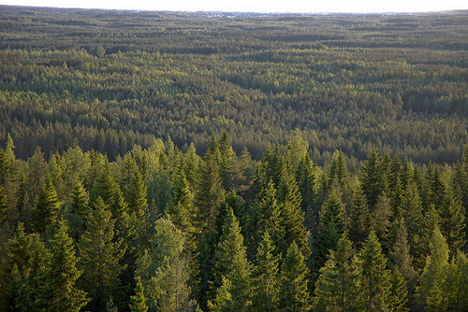
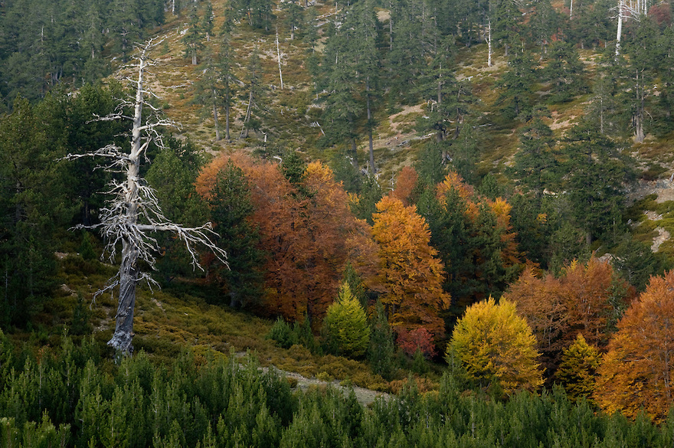
Forests in Europe
80% – 90% of Europe was once covered by forest. It stretched from the Mediterranean Sea to the Arctic Ocean. Though over half of Europe's original forests disappeared through the centuries of deforestation, Europe still has over 1/4 of its land area as forest, such as the boreal forests of Scandinavia and Russia, mixed rainforests of the Caucasus and the cork oak forests in the western Mediterranean.

Slide 3
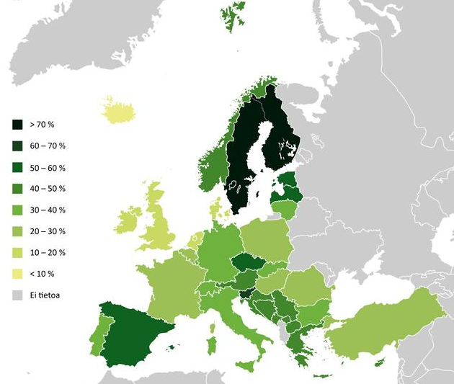
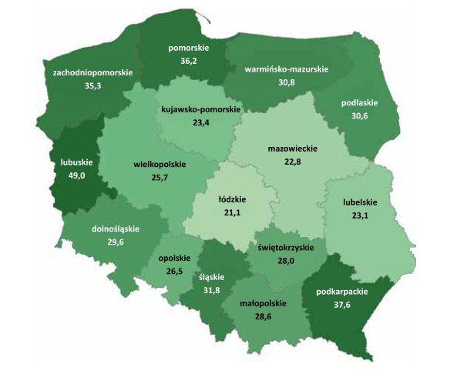
Here we can see percentage
of land area of different
European countries covered
by Forest.

Slide 4
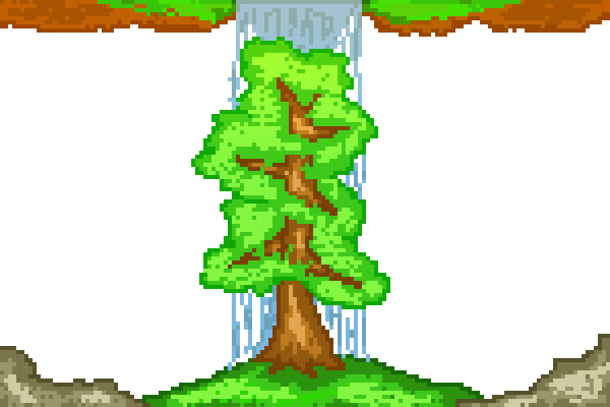
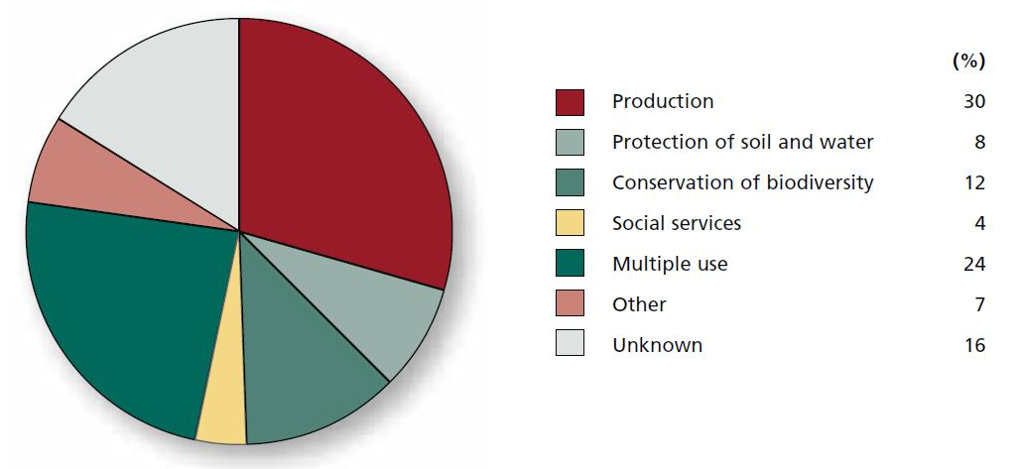
Why are Forests important and Why do we need Them?
PROTECTIVE FUNCTIONS
- protect from avalanches
- air-pollution filters
- protecting water resources
- influence on climate
- prevent floods
- reduce the speed of the wind
- prevent degradation of soil quality
SOCIAL FUNCTIONS
- create the environment
- improve environmental
awareness and culture of society
PRODUCTIVE FUNCTIONS
- produce oxygen
- provide various products (wood,
gum resins, food)
- provide habitats to diverse animals
species
- wood is a universal fuel ( is used
for many purposes, such as wood
fuel)

Slide 5
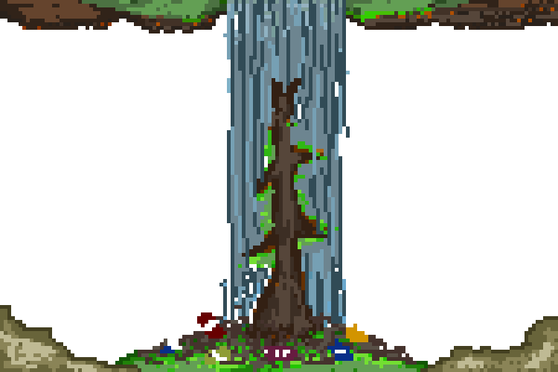
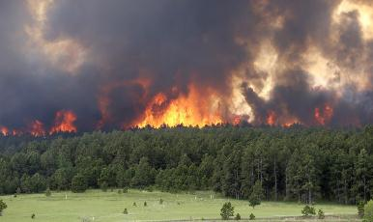
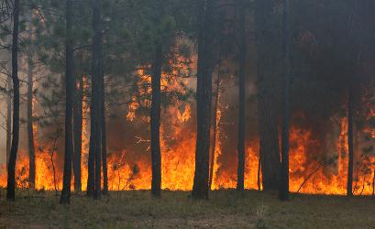
So what’s very dangerous for Forests?
- pests (rodents, insects, parasitic
mushrooms)
- droughts, strong winds
- fires
- intensive penetration of
forest areas by tourists
- Littering
- air pollution
- urbanization of the land
What we mostly want to talk about though, are Wildfires.

Slide 6
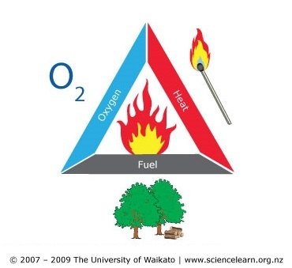
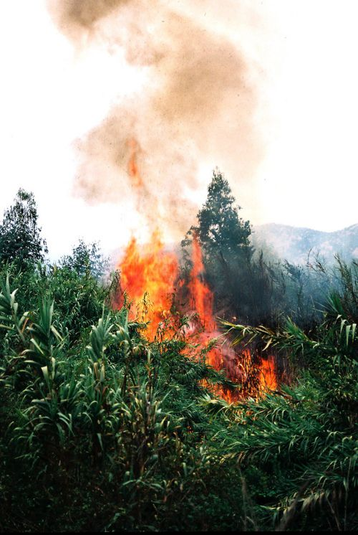
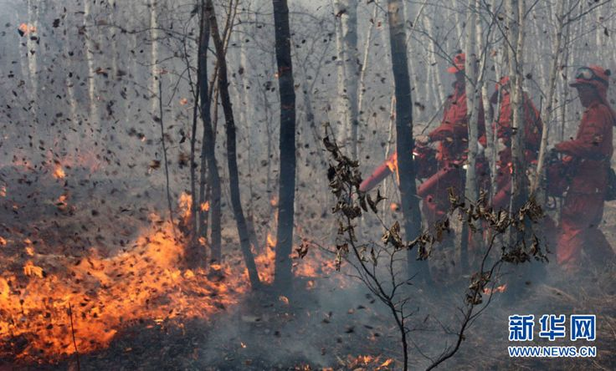
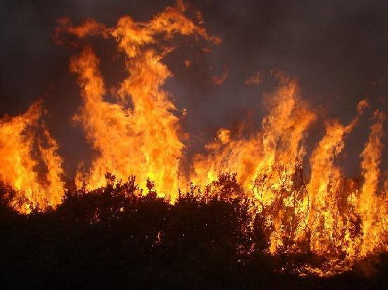
What are Fires then?
Fire - uncontrolled combustion in a place not specifically designed for this
purpose. If happens in Forest, then it’s usually called Wildfire.
The fire triangle
Oxygen, fuel and heat are needed
for fire to occur.
This is known as the fire triangle.

Slide 7
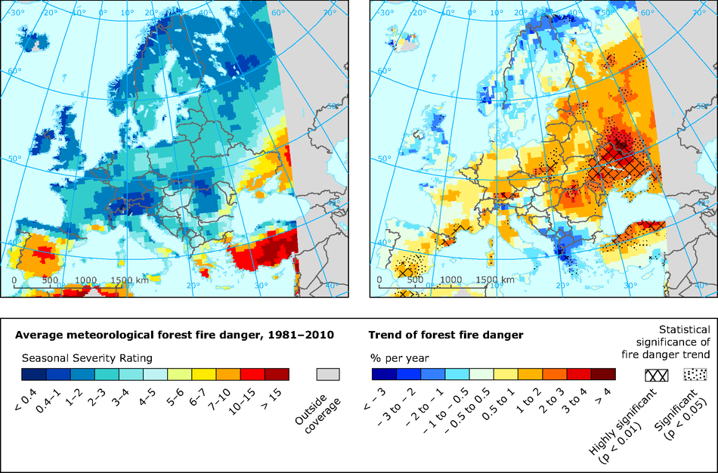
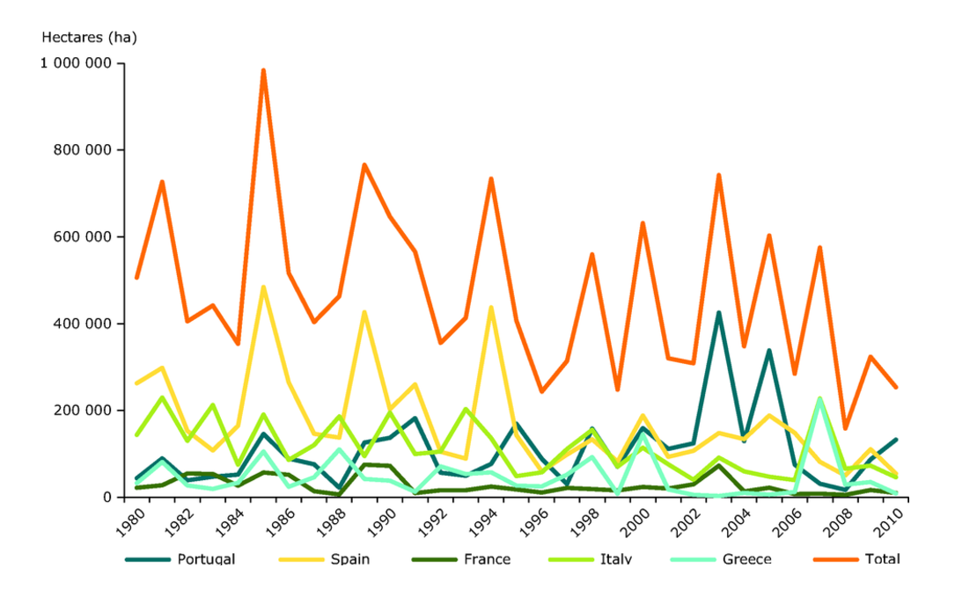
Europe map showing state and trend
of fire danger in certain countries
According to the European Firenews
Service, in the period between 1 April and 12
October 2016, 790 wildfires were reported
in Europe.
A graph of burnt forest area in five
southern European
countries

Slide 8
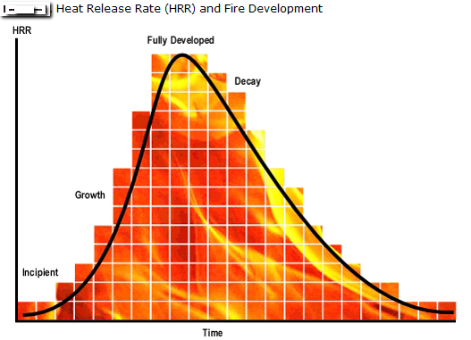
Phases of fire development
1. incipient
- chemical reaction between heat,
oxygen and a fuel source (ignition)
- rapid rise in temperature
- expansion of fire source
2. Growth
- full fire development
- temperature is about 800 - 1200°C
- the growth stage is where the structures
fire load and oxygen are used as fuel for
the fire
3. Fully developed
- when the growth stage has reached its
max and all combustible materials have
been ignited, a fire is considered fully
development
- hottest phase of a fire
- most dangerous
4. Decay
- the longest stage of fire
- decrease of oxygen or fuel
causes the end of the fire

Slide 9
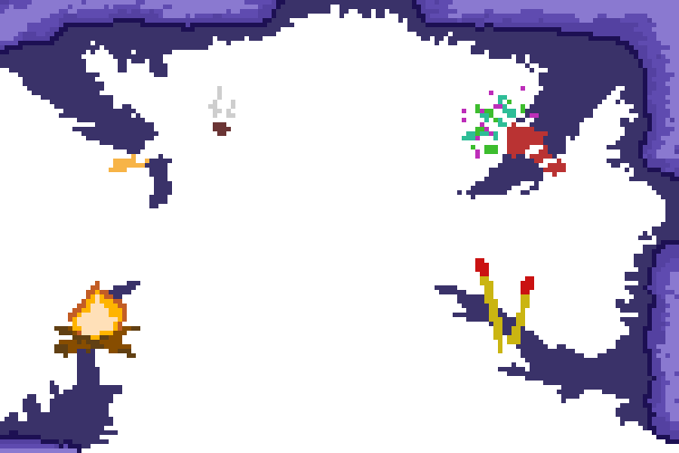
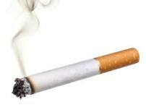
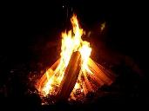
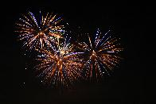
Never discard a cigarette on the ground
or throw it out a car window! Many
wildfires are caused by cigarette butts
being left on the land.
Every year inappropriately used
fireworks cause wildfires. It is
important to note that it is illegal to use
fireworks in forested areas.
Cigarettes
Fireworks
What causes Wildfires?
Campfires
Arsonists
Improperly doused or misplaced fires
mostly causes wildfires. Dangerous too
are campfires that have been left
unmonitored.
Arsonists use gasoline or kerosene to
set buildings, wildland areas or
abandoned homes on fire. Many
wildfires are caused by them.

Slide 10
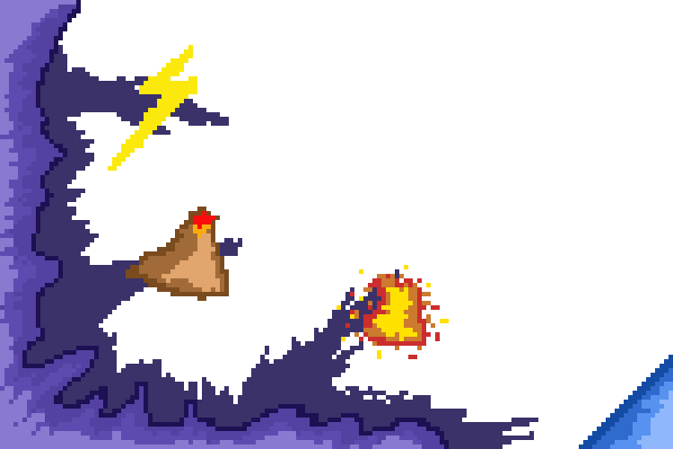
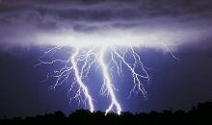
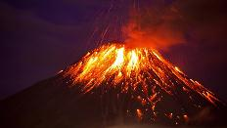
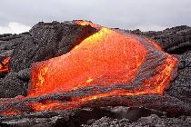
Mother Nature is responsible for Wildfires too
Lightening can cause wildfires, especially the type of lightning called “hot lightning”, which can last for a relatively long time. When it strikes, it can produce a spark which can set off a forest or a field.
Hot burning lava, from volcanic eruptions, also causes wildfires.
Lightning
Volcanic Eruption
Lava

Slide 11
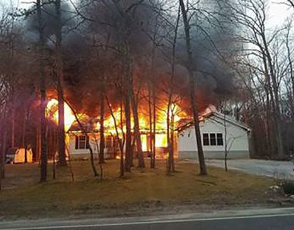
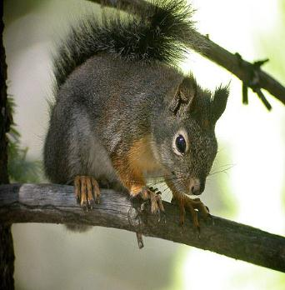
Effects of Wildfires
Animals lose their lives. It is sad but true fact that birds, squirrels, rabbits, and other wildlife animals are no longer a part of this great earth.
Animal Deaths
Homelessness
Wildfires take away homes.
People often lose their houses as well
if the fires are close enough to human
housing.

Slide 12
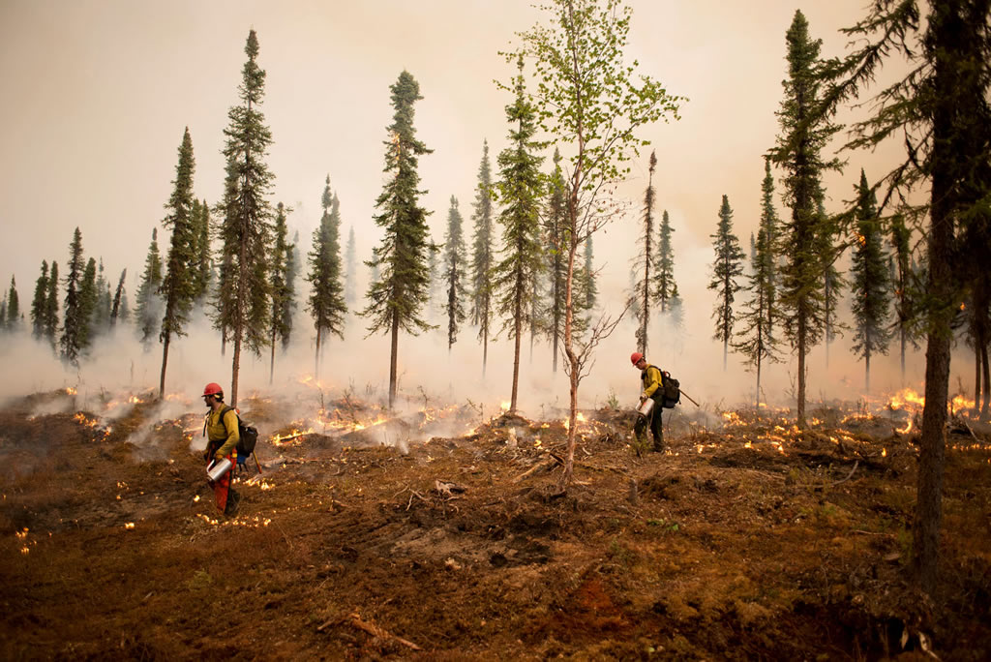
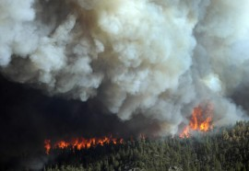
Forest Degradation
Forest fires are a major cause of forest degradation. Whenever forest fires are experienced, thousands of acres of trees are wiped out. Trees and plants help to produce oxygen in the world. The less trees and plants there are the less clean air we have to breathe.
Air Pollution
Large amounts of smoke is released into
the air which makes it difficult to
breathe, and also causes air pollution.

Slide 13
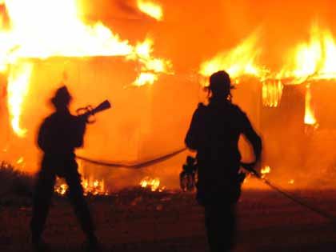
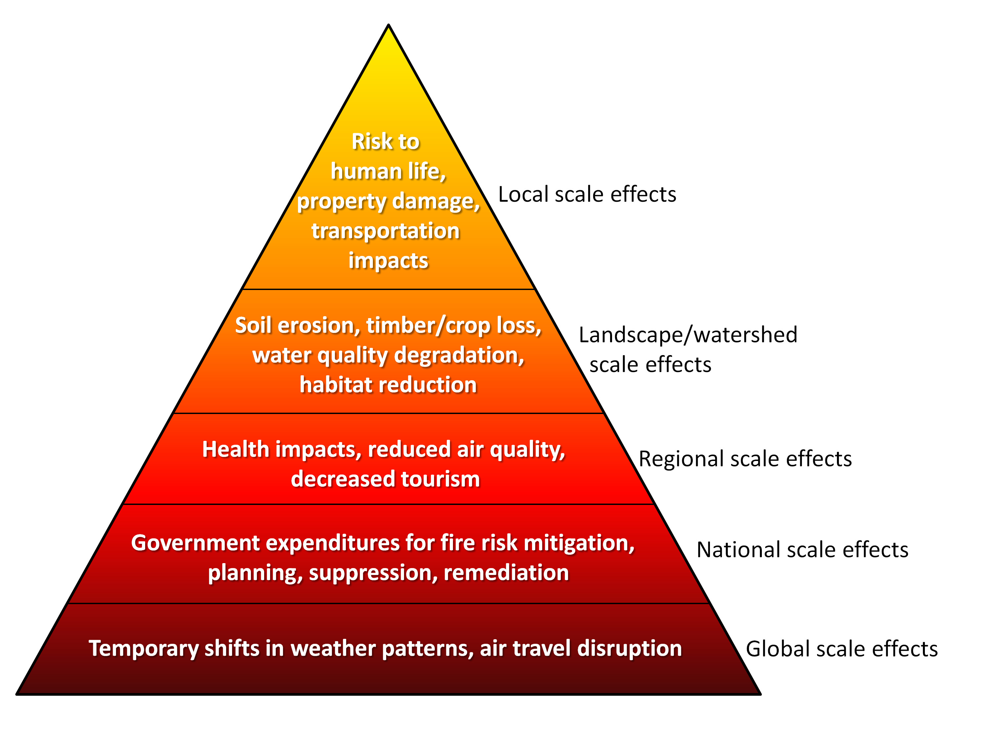
Loss of life and injury to people
Unfortunately, some human lives are also lost in
wildfires. Typically people who are fighting the fire or
who lose their lives trying to save others.
And other effects like:
Loss of jobs and incomes for agricultural workers whose animals/crops are destroyed.
Decline in the tourist industry, leading to loss of jobs. Access to recreational areas is restricted.
Loss of habitats for animals may lead to extinction.

Slide 14
10 TIPS!
How to prevent Wildfires?
1. Always be careful with fire
6. Learn how to use the fire
extinguisher in the car, at home, in
the office or school.
2. Never play with matches or lighters
3. Always watch your campfire
7. Keep your eye on the fire ALL the time
4. Make sure your campfire is
completely out before leaving it
8. Check the weather for winds and dryness
9. Do not burn anything unusual or
combustible.
5. Keep fire service and emergency
numbers handy.
10. Only use easily controlled locations for
burning

Slide 15
Summarizing
Fire - uncontrolled combustion in a place not specifically designed for this purpose. If happens in Forest, then it’s usually called Wildfire.
What causes?
Cigarettes
Fireworks
Campfires
Lightnings
Effects?
Deaths of many Animals
Air pollution
Homelessness
Main Forest functions:
- protect from avalanches
- air-pollution filters
- create the environment
- provide various products (wood,
gum resins, food)

Slide 16
All background arts were made by us!
Presentation made By:
Visual appearance
Translating
Finding Informations
Łukasz Chojecki
Ilona Mutke
Natalia Dera
Class: I n Zespół Szkół Ogólnokształcących i Ekonomicznych w Lubsku

Slide 17
Font: pl.fonts2u.com
Sources
https://watchers.news/2016/10/19/wildfires-in-europe-sentinel-2016/
https://olawa998.wordpress.com/2014/02/03/pozar-i-jego-grupy/
http://www.greenpeace.org/international/en/campaigns/forests/threats/
http://www.conserve-energy-future.com/causes-effects-and-solutions-of-wildfires.php
https://www.thoughtco.com/the-causal-history-of-forest-fires-1342893
Pictures
http://edition.cnn.com/videos/world/2016/03/04/ecuador-volcano-eruption-zc-vstan-orig.cnn
http://stuffpoint.com/thunderstorms/image/91948/lightening-picture/
http://www.sandatlas.org/types-lava-flows/
http://www.nj.com/salem/index.ssf/2017/03/cause_of_fire_which_left_family_homeless_undetermi.html
https://commons.wikimedia.org/wiki/File:Douglas_Squirrel_Lake_Forest_CA.jpg
http://www.earthisland.org/journal/index.php/eij/article/the_war_against_wildfire/
http://www.everylifesecure.com/fires/
https://earthzine.org/wp-content/uploads/2013/08/figure12.png
http://wild-wonders.photoshelter.com/image/I00007Du5prvvnq8
http://eutopics.eu/en/images/56/5636/1063/forest
http://www.eea.europa.eu/data-and-maps/indicators/forest-fire-danger-1/assessment
http://sedac.ciesin.columbia.edu/theme/population/featured-uses
https://www.sciencelearn.org.nz/resources/747-what-is-fire
http://journeytofirefighter.com/4-stages-of-a-fire/
https://pl.pinterest.com/ulissescarrilho/forest-fire/
http://www.telegraphherald.com/news/agriculture/article_eca34693-7e09-5d7e-b7f2-57a6f56e5c67.html

