Slide 1
Forestfireprotection
in Poland and Europe

Slide 2
Forests in Poland and Europe
About 65% ​​of European forests are exposed to fires. In Poland it is 83%. More frequent droughts at the turn of winter and spring and summer, spend and spread fire in the most often due to the recklessness of people in the use of fire. Every person is obliged to observe the rules of the forest and to take responsibility for the damage caused by absence from the forest.

Slide 3
Forests in Poland

Slide 4
Forests in Europe

Slide 5
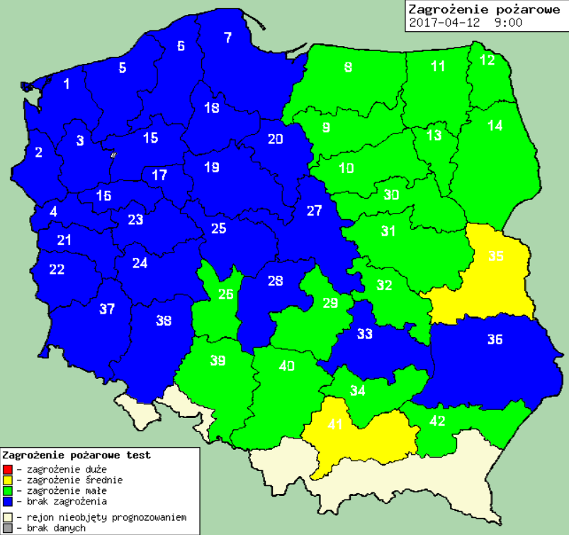
Map of current forest fire risk in Poland

Slide 6
Risk of fire August 13, 2016 in Europe

Slide 7
Forest functions
1.Natural: - produce the oxygen needed to live on Earth, - are a natural filter that absorbs all sorts of pollutants that enter the atmosphere, Among the trees are the life of various species of animals and birds.
2. Protective: - regulate the water relations in the soil, that is to store water, - reduce wind speed, prevent soil drying and soil erosion,
- prevent landslides.
3. Economic: - they are a renewable source of fuel, building blocks and industrial raw materials, - provide a place for recreation and rest, - are a workplace for some population groups.
That’s why we should protect the forests!

Slide 8
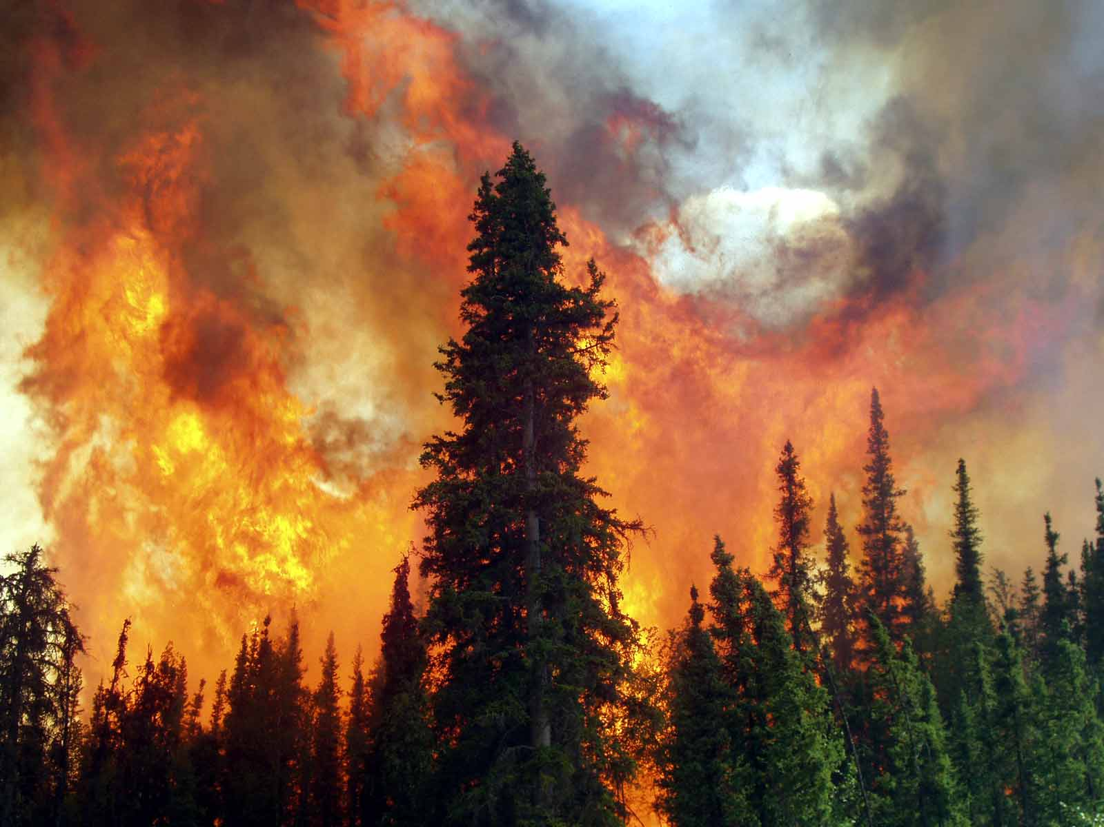
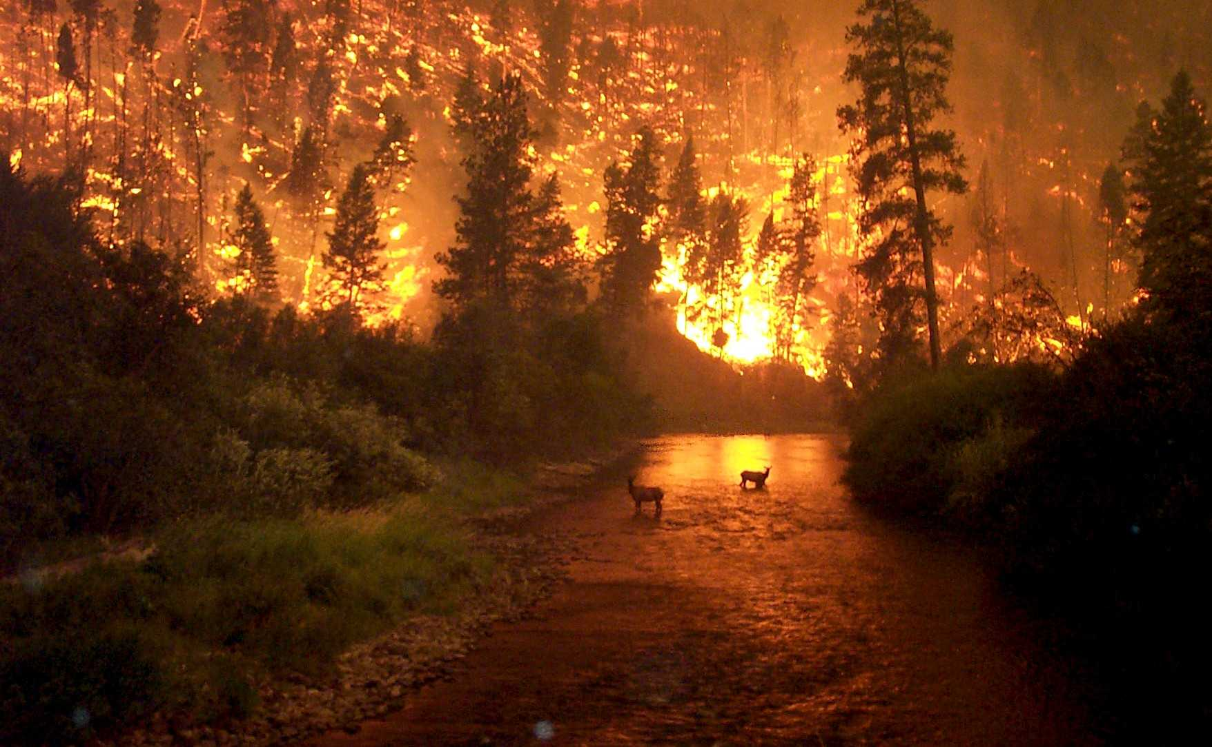
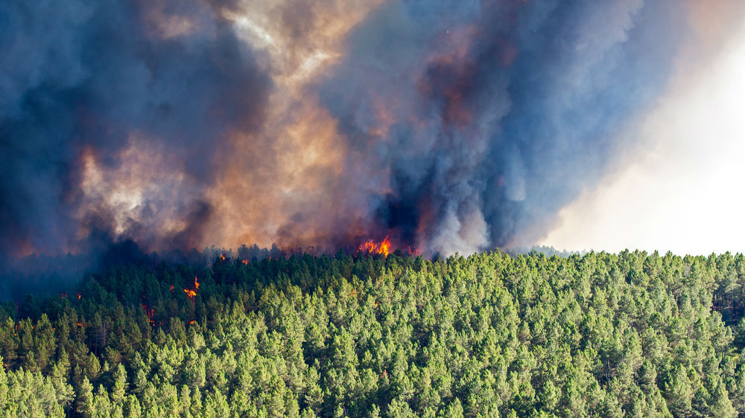

Slide 9
Prohibitions in the forest
In order to prevent the spread of any fire in the forest, it is important to make fire protection belts and to remove branches, brushes, uncut trees and post-mining waste at a distance of 50 m from the edge of the railway or public road. The ban on smoking in a forest is always in force, but droughts sometimes even impose forest entry prohibitions. Open fire can be used in the forest or within 100 m of its border - only in places designated or agreed with the forest owner. However, the danger is not just a fire, but also discarded glass bottles, which can easily create a fire point. Observe the warning signs posted on the forest along tourist and hiking trails, youth hostels and shelters. It is important to be cautious when passing through forest areas and don’t throw cigarette butts and other objects out of windows, it is irresponsible and threatens not only the trees but also other people as well as us.

Slide 10
How to protect them?
Forest protection involves the identification of hazards and the use of effective methods of protection against these hazards.
Fire protection belts;
Marking stations to draw water;
Prohibition of kindling fire in the distance of 100m from the edge of the forest, in areas of meadows, moors;
Construction of diagnostic stations;
Installation of cameras in the forest.
„FORESTS ARE LIFE
PROTECT THEM”

Slide 13
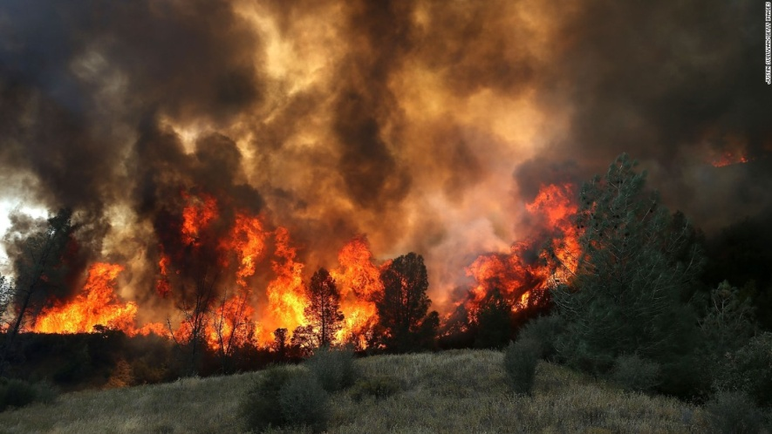
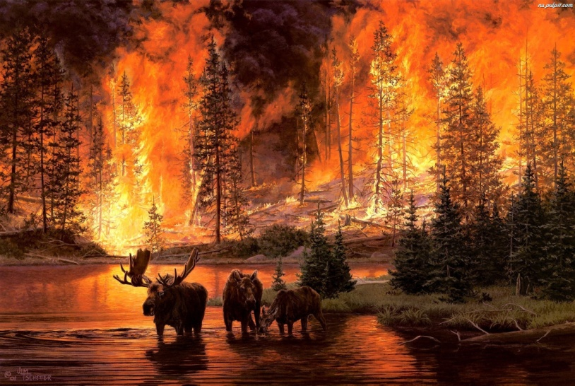
In case of fire, remember this number!

Slide 14
Thank you for your attention
Marta Stolarzewicz
Szymon Zając
Jan Konior
Class 2C
IT technician
Zespół Szkół Meczaniczno-Elektrycznych w Żywcu

Slide 15
The sources we used
http://www.czaswlas.pl/2011-09-14/sprzatanie_swiata_sprzatanie_lasow http://bazapozarow.ibles.pl/zagrozenie/
http://sciaga.pl/tekst/28558-29-ochrona_przeciwpozarowa
https://www.google.pl/search?q=lasy+w+polsce&espv=2&source=lnms&tbm=isch&sa=X&ved=0ahUKEwjp35j-wLLTAhWJZVAKHRtUAkIQ_AUIBigB&biw=667&bih=675#tbm=isch&q=lasy
https://www.google.pl/search?q=lasy+w+polsce&espv=2&source=lnms&tbm=isch&sa=X&ved=0ahUKEwjp35j-wLLTAhWJZVAKHRtUAkIQ_AUIBigB&biw=667&bih=675#tbm=isch&q=stra%C5%BC+po%C5%BCarna
https://www.google.pl/search?q=lasy+w+polsce&espv=2&source=lnms&tbm=isch&sa=X&ved=0ahUKEwjp35j-wLLTAhWJZVAKHRtUAkIQ_AUIBigB&biw=667&bih=675#tbm=isch&q=ochrona+las%C3%B3w
https://www.google.pl/search?q=lasy+w+polsce&espv=2&source=lnms&tbm=isch&sa=X&ved=0ahUKEwjp35j-wLLTAhWJZVAKHRtUAkIQ_AUIBigB&biw=667&bih=675#tbm=isch&q=pozar+lasow
https://www.google.pl/search?q=lasy+w+polsce&espv=2&source=lnms&tbm=isch&sa=X&ved=0ahUKEwjp35j-wLLTAhWJZVAKHRtUAkIQ_AUIBigB&biw=667&bih=675#tbm=isch&q=lasy+w+polsce+i+europie+mapa
https://www.youtube.com/watch?v=qbWiyp4_qNg
https://www.youtube.com/watch?v=_smyOW8JKSw

