Slide 1
Forestfireprotection
in poland and europe

Slide 2
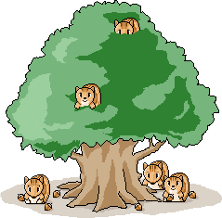
European forests
European Union countries with the forest area of about 157 million hectares constitute about 4% of the world's forests. The european forests have the largest forested area per inhabitant and the average volume in Europe (excluding Russia) is 155 m3/ha and is similar to the volume in the forests of EU countries which is 154 m3/ha.

Slide 3
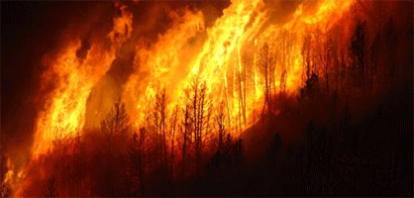
Forest fire in European countries
In mediterranean area natural fires are an integral part of ecosystems. The long time series of forest fire data have shown that more than 450,000 ha of forests burned on average each year. The main reasons of fires are forest management, extreme weather events and climate change, inadequacy of response and lack of material capacity.

Slide 4
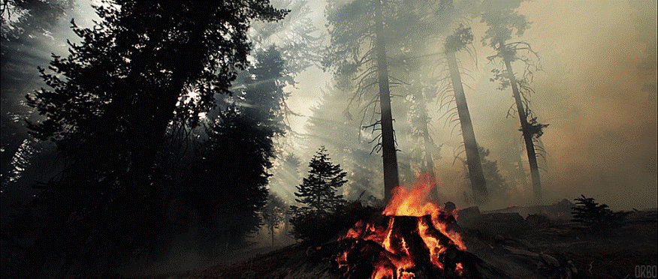
Forest fire in Poland
Usually every year are recorded about 10 000 fires, which are making demages in natural world, economical losses and they are dangerous for local inhabitants. Majority of it (about 90%) is the result of people bearing.

Slide 5
Poland’s flora
communities
Poland occupies the 55th place in regard to the forest area and is 0.23% of the world's forests. It's territory is covered by forest in 30.5%. The most interesting flora communities are:
Oak-hornbeam forests
Riparian forests
Alder forests

Slide 6
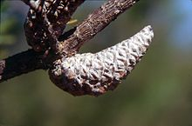
Pyrophytes
Plants which have adopted to tolerate fire. Passive plants have adaptations like hick bark, tissue with high moisture content, or underground storage structures (e.g. Cork oak). Active pyrophytes product olis which are inflammable (e.g. Eucalyptus)
For Pyrophile plants fire is necessary for their reproduction, because it releases smoke and increases temperature so it raises seeds dormancy.

Slide 7
Types of wildland fire
A wildland fire is a fire in an area of combustible vegetation that occurs in the countryside or rural area. Fire types can be generally characterized by their fuels as follows:
ground fires are fed by subterranean roots, duff and other buried organic matter. This fuel type is especially susceptible to ignition due to spotting,
crawling or surface fires are fueled by low-lying vegetation such as leaf and timber litter, debris, grass, and low-lying shrubbery,
ladder fires consume material between low-level vegetation and tree canopies, such as small trees, downed logs, and vines,
Crown, canopy, or aerial fires burn suspended material at the canopy level, such as tall trees, vines, and mosses.

Slide 8
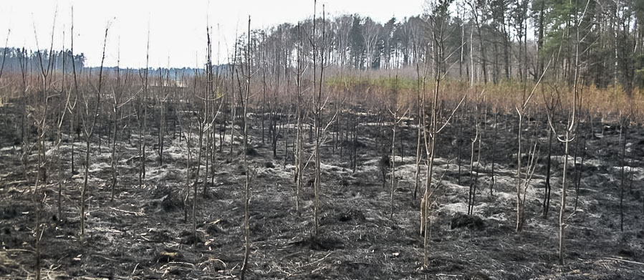
Changing after fire
Fire cause serious changings in woods. Firstivalal after fire the litght reache to the bottom of the woods. The ground is getting warmer and losing heat faster. When the forest doesn't have the plants which are growing on the ground makes it difficult to storage the water, which means the water is running down or swamps are arising. Also the graund become less porosity and lose nitrogen insted gets more chemical compounds of calcium, potassium and phosphorus from burn plants. The fires which was under then 100 C fertility of the soil is increase tempararily.

Slide 9
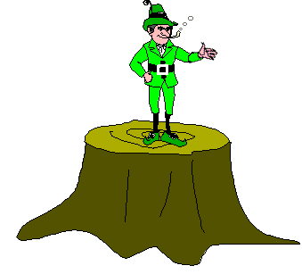
Forestfireprotection
obtaining a burning permit for burning grass, brush, slash or other debris in or within a prescribed distance of forest land,
a campfire permit and the landowner's permission for an open campfire, cooking fire or bonfire in or near forest land,
a work permit for any work in forest land involving two or more people,
burn only natural vegetation or untreated wood products,

Slide 10
clear the area around the burn pile of any flammable debris,
keep firefighting equipment handy - a connected water hose or at least five gallons of water and a shovel should be nearby,
don't burn if it's too windy to burn - if trees are swaying, flags are extended, or waves appear on open water,
be prepared to extinguish the fire if it becomes a nuisance,
attend the fire until it is completely out,

Slide 11
burn piles are at least 50 feet from structures and 500 feet from any forest slash,
smoking should not be done while moving from one place to another in forest land. Make sure your butt is out - "dead out!",
power saws must have a proper muffler and be accompanied by a round point shovel or fire extinguisher,
cars, trucks and machinery must have proper exhaust systems when operated in or near forest land. Exhaust spark arresters are a requirement on certain machines,
know your local emergency telephone number if a fire becomes uncontrollable.
Don't be a Dummy - Prevent Forest Fires with Smokey Bear & His Dummy

Slide 12
The biggest forest fire
In Eastern Europe and Center Europe after
the second world war
The fire took place in Kuźnia Raciborska (South Poland) in August 1992. Probably the cause of the fire was the spark from the wills of stoping train. The weather was very favorable the temperature was about 30 C, blew strong wind and the graund was dry. In firefighting action took part around 10 000 people.

Slide 13
Sources:
Karol Wiler, Paweł Wcisło ,,Ochrona lasów przed pożarami" 2013 Centrum Informacyjne Lasów Państwowych
Zbigniew Podbielkowski "Geografia roślin" 1991 Wydawnictwo szkolne i pedagogiczne
Praca zbiorowa pod redakcją Józefa Prończuka"Świat roślin" 1977 Państwowe Wydawnicto Naukowe
Jan Matuszkiewicz "Zespoły Leśne Polski" 2001 PWN
O.W. Archibold "Ecology of World Vegetation" 1995 Springer Science + Business Media Dordrecht
http://raciborz.naszemiasto.pl/artykul/najwiekszy-pozar-lasu-w-europie-pamietacie-1992-rok,2392457,artgal,t,id,tm.html
https://en.wikipedia.org/wiki/Wildfire
http://ypef.eu/files/YPEF%20Educational%20material%202017.pdf
https://www.bdl.lasy.gov.pl/portal/lasy-na-swiecie-cd
http://www.srodowisko.abc.com.pl/czytaj/-/artykul/chronmy-nasze-lasy-przed-ogniem
http://www.borealforest.org/world/innova/fire_prevention.htm
https://www.youtube.com/watch?v=cPJgYFVQxDI
https://pl.wikipedia.org/wiki/Po%C5%BCar_lasu_ko%C5%82o_Ku%C5%BAni_Raciborskiej_(sierpie%C5%84_1992)
http://www.osp.com.pl/mazowieckie/sokolowski/Repki/OSP-Szkopy/aktualnosci/wydarzenia/2137/21-rocznica-pozaru-lasow-w-Kuzni-Raciborskiej#

Slide 14
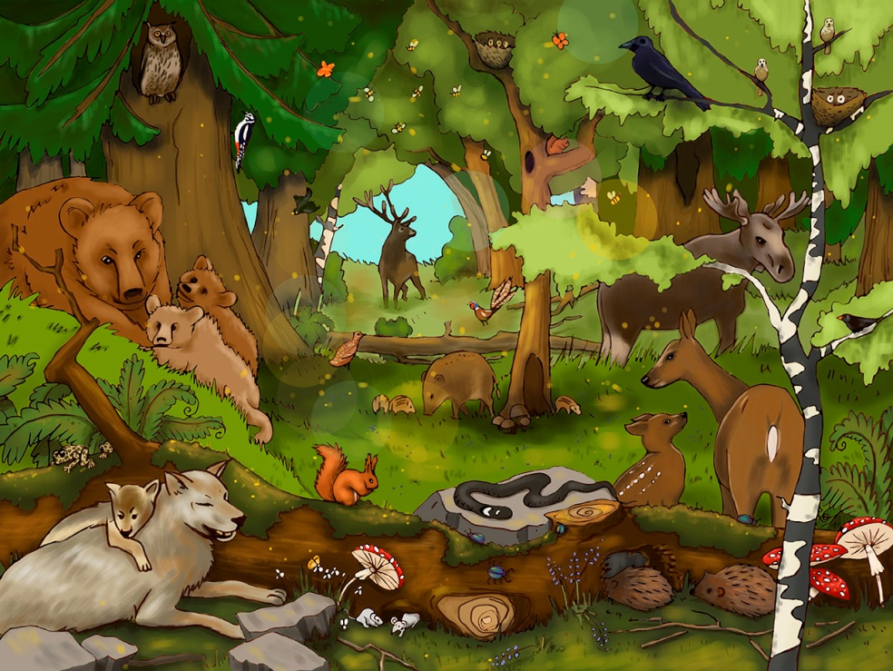
Images
https://www.google.pl/search?q=european+forest+fire+information&tbm=isch&source=lnms&sa=X&ved=0ahUKEwilsKGvprbTAhXFCywKHQPWDRoQ_AUIBygC&biw=1366&bih=613#tbm=isch&q=european+forest+map&imgrc=pEemDbWOaN7eGM
https://www.google.pl/search?q=Poland%27s+flora+communities&source=lnms&tbm=isch&sa=X&ved=0ahUKEwjnuqLepbbTAhXGOSwKHcF6CkgQ_AUICCgB&biw=1366&bih=613#tbm=isch&q=forest&imgrc=vwQ8rqmP64bAoM
https://www.google.pl/search?q=european+forest+fire+information&tbm=isch&source=lnms&sa=X&ved=0ahUKEwilsKGvprbTAhXFCywKHQPWDRoQ_AUIBygC&biw=1366&bih=613#imgrc=UX4PbMeWUBXIkM
https://r-scale-ca.dcs.redcdn.pl/scale/o2/tvn/web-content/m/p1/i/35309226eb45ec366ca86a4329a2b7c3/9a576f4c-e501-46b2-9b2a-c8e74178d178.jpg?type=1&srcmode=4&srcx=0/1&srcy=0/1&srcw=640&srch=2000&dstw=640&dsth=2000&quality=80
https://www.google.pl/search?q=Byblis+(plant)&source=lnms&tbm=isch&sa=X&ved=0ahUKEwjnnv-qqrbTAhXKKiwKHWEDBT4Q_AUICCgB&biw=1366&bih=613#tbm=isch&q=cork+oak&imgrc=8FcRz1L-coXA4M:
http://www.gify.net/data/media/90/ogien-ruchomy-obrazek-0419.gif
http://www.archiwum.moja-ostroleka.pl/uploads/archiwum/2014/05/ogien-gleba-wideo-jpg_25_05_2014_17_37.jpg
http://in-the-moonlight.blog.pl/files/2014/02/Las-marze%C5%841.jpg
http://www.tapetus.pl/obrazki/n/189107_piekny-las-pagorek.jpg
http://images.fondecranhd.net/forces-of-nature/11k3ii1kkd1.jpg
http://ri.pinger.pl/pgr241/5e56bd4800099e754fca4fc8/lesnik.gif
https://1.bp.blogspot.com/-1_381isawRk/VKB9UfTK8AI/AAAAAAAB9H0/RPr9LvdhilE/s1600/80.gif
http://krzewyzkrzewia.pl/photos/plantacja_tannenhoff.gif
http://images.clipartpanda.com/forest-clipart-lake-clip-art-rainforest-clipart.png
http://www.lasy.gov.pl/informacje/aktualnosci/o-odtworzeniu-lasu-po-pozarze/@@images/document_image
https://d-pt.ppstatic.pl/k/r/1/25/59/55d2256a87e80_p.jpg?1441347093
http://www.torun.torun.lasy.gov.pl/image/image_gallery?uuid=e26f0074-e850-4222-ab01-6fa271ae23da&groupId=427100
http://www.eszkola-wielkopolska.pl/eszkola/projekty/gimnazjum-pleszew/od_korzeni_do_korony/images//muzeum/drzewo.gif
https://media.giphy.com/media/QkqRmtkDhXCeI/giphy.gif
https://upload.wikimedia.org/wikipedia/commons/thumb/9/9e/Pinus_banksiana_cone.jpg/220px-Pinus_banksiana_cone.jpg
http://s2.manifo.com/usr/e/e2E2/e1/manager/las-maly.jpg
https://userscontent2.emaze.com/images/1e958856-2ca8-442b-9b82-26a364ff09b0/617ef7d9-3025-4b45-9607-115ff87b6ec5.gif

Slide 15
Authors
Julia
Ceranowska
Anna
Żuralska
Anna
Dąbrowska
II Liceum Ogólnokształcące z Oddziałami Dwujęzycznymi
im. Adama Mickiewicza w Słupsku
Kl. I

