Slide 1
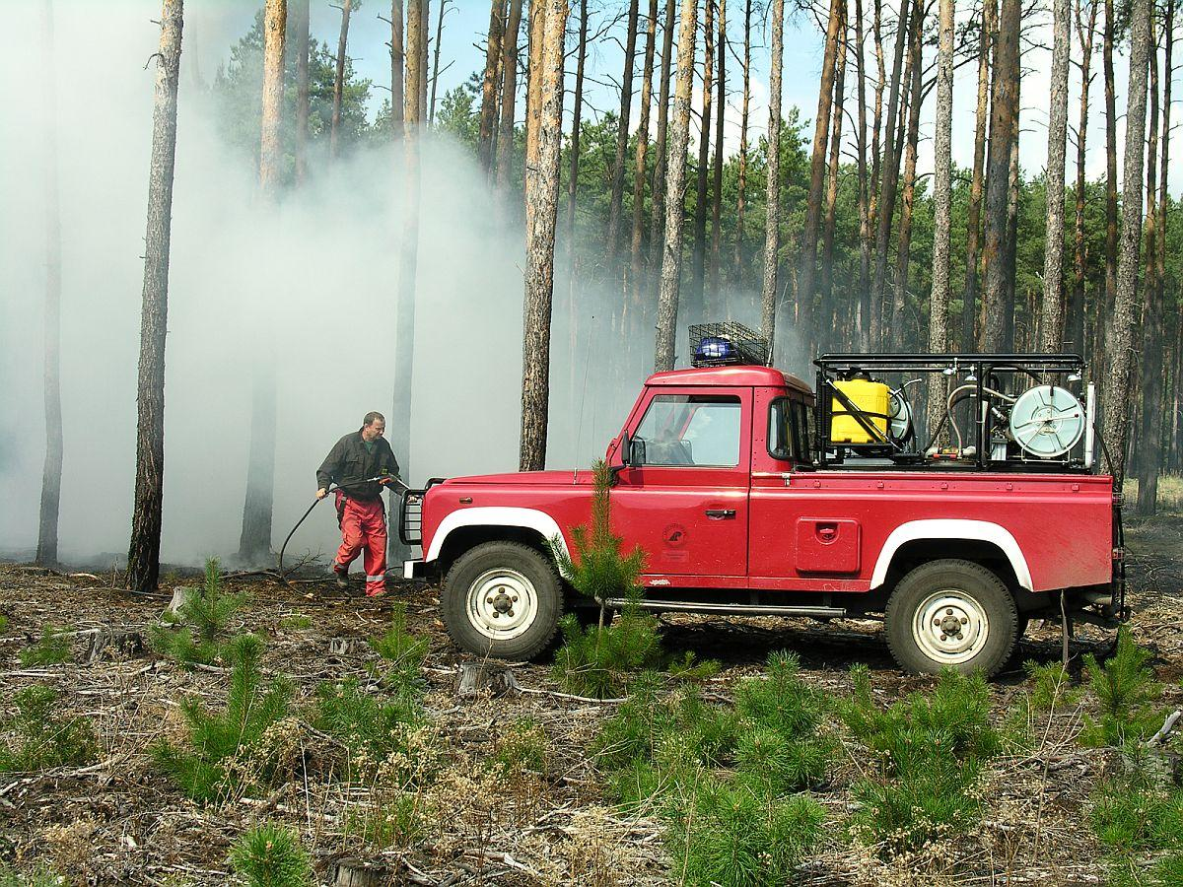
FORESTFIREPROTECTION
in Poland and Europe

Slide 2
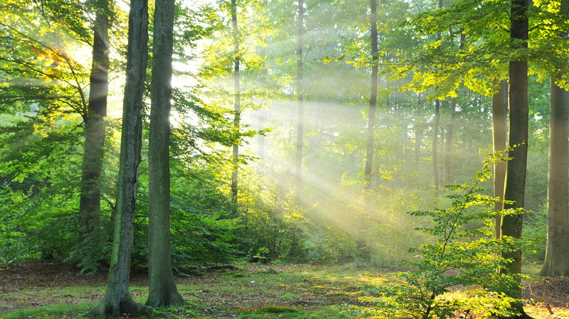
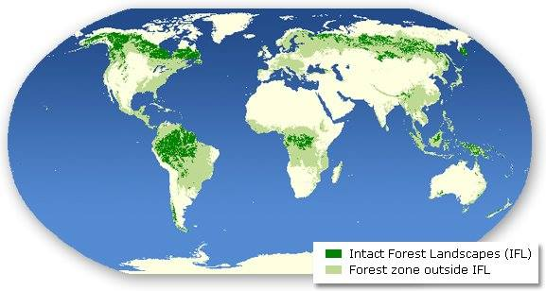
A forest is a large area dominated by trees. Hundreds of more precise definitions of forest are used throughout the world, incorporating factors such as tree density, tree height, land use, legal standing and ecological function. According to the widely used Food and Agriculture Organization definition, forests covered four billion hectares (15 million square miles) or approximately 30 percent of the world's land area in 2006.

Slide 3
WAYS TO PROTECT FORESTS
FROM FIRES
Every year, countless acres of forests are burned because of human carelessness. To help prevent fires in or near forest land during the forest fire season, the following steps should be followed:
Check local regulations regarding permit requirements and "burn ban" restrictions. These are available from your municipality, fire department or department of natural resources. They may include:
- obtaining a burning permit for burning grass, brush, slash or other debris in or within a prescribed distance of forest land;
- a campfire permit and the landowner's permission for an open campfire, cooking fire or bonfire in or near forest land;
- a work permit for any work in forest land involving two or more people.

Slide 4
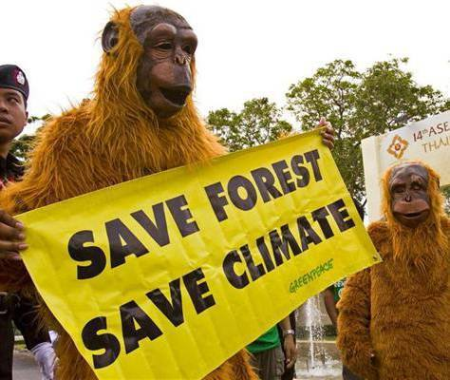
Burn only natural vegetation or untreated wood products.
Burn piles are at least 50 feet from structures and 500 feet from any forest slash.
Clear the area around the burn pile of any flammable debris.
Keep firefighting equipment handy - a connected water hose or at least five gallons of water and a shovel should be nearby.
Don't burn if it's too windy to burn - if trees are swaying, flags are extended, or waves appear on open water.
Be prepared to extinguish the fire if it becomes a nuisance.

Slide 5
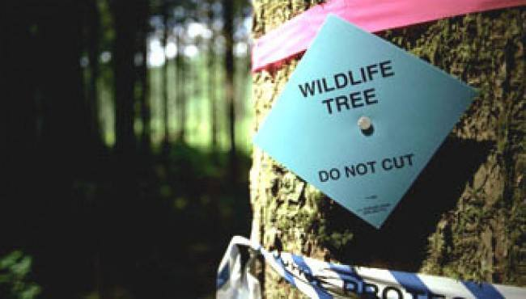
KEEP IN MIND

Slide 6
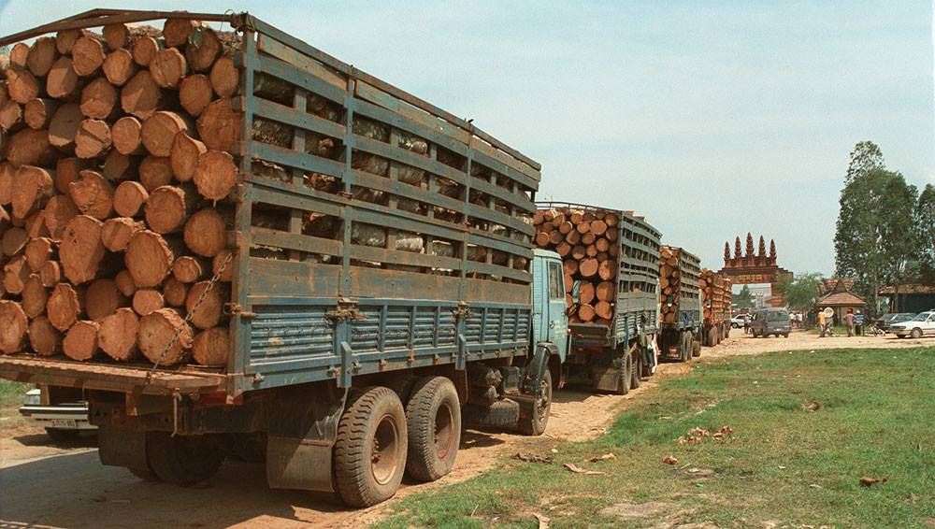
Attend the fire until it is completely out.
Smoking should not be done while moving from one place to another in forest land. Make sure your butt is out - "dead out!"
Power saws must have a proper muffler and be accompanied by a round point shovel or fire extinguisher.
Cars, trucks and machinery must have proper exhaust systems when operated in or near forest land. Exhaust spark arresters are a requirement on certain machines.
Know your local emergency telephone number if a fire becomes uncontrollable.

Slide 7
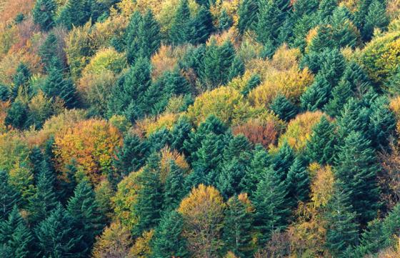
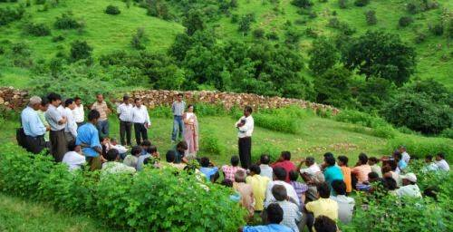
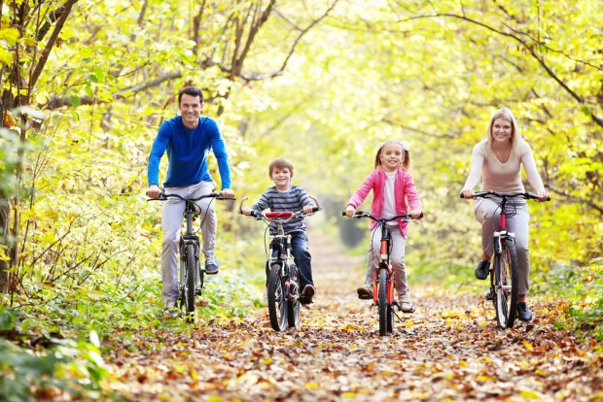
10 REASONS WHY FORESTS ARE IMPORTANT
1. They help us breathe.
2. People live there, too.
3. They block wind.
4. They clean up dirty soil.
5. They clean up dirty air.
6. They feed us.
7. They give us medicine.
8. They help us make things.
9. They create jobs.
10. They help us explore and relax.

Slide 8
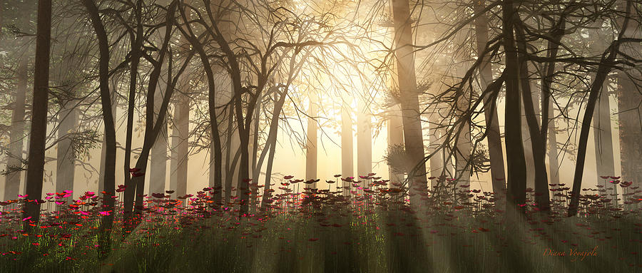
SOCIETAL SIGNIFICANCE
Canada has about 4,020,000 square kilometres (1,550,000 sq mi) of forest land. More than 90% of forest land is publicly owned and about 50% of the total forest area is allocated for harvesting.
These allocated areas are managed using the principles of sustainable forest management, which includes extensive consultation with local stakeholders. About eight percent of Canada’s forest is legally protected from resource development.

Slide 9
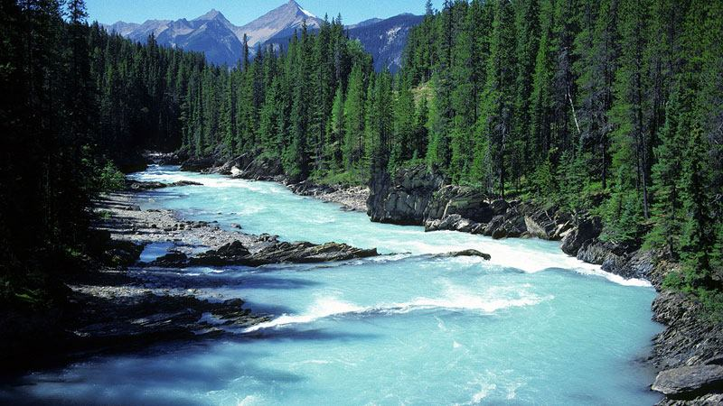
By December 2006, over 1,237,000 square kilometers of forest land in Canada (about half the global total) had been certified as being sustainably managed. Clearcutting, first used in the latter half of the 20th century, is less expensive, but devastating to the environment, and companies are required by law to ensure that harvested areas are adequately regenerated.

Slide 10
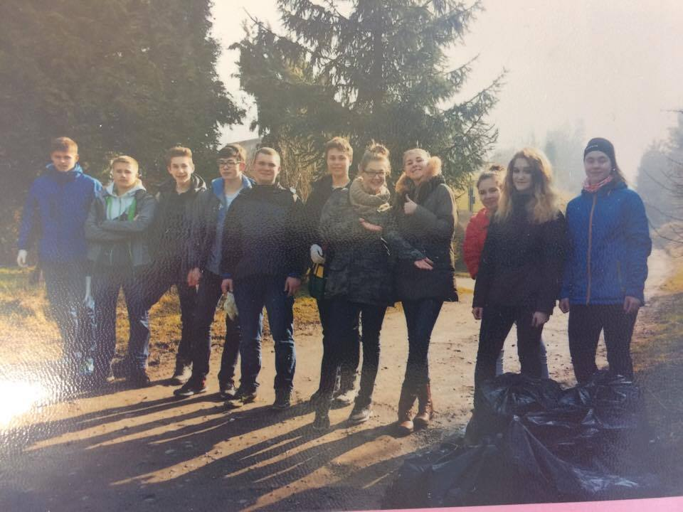
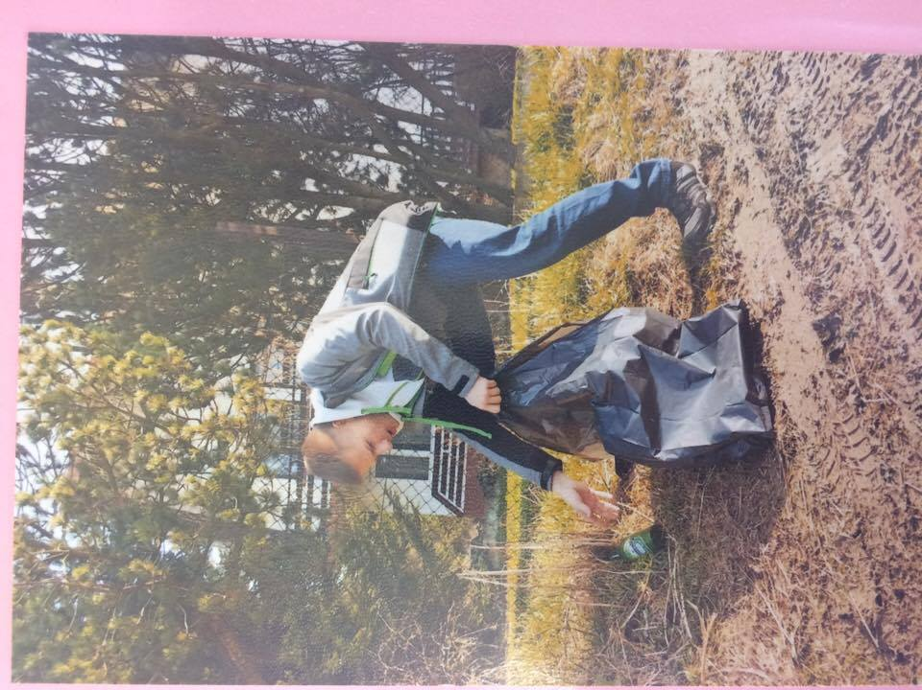
OUR „GENERAL CLEANING OF THE WORLD”
As a biophysical and geographic class, we regularly participate in the "General Cleaning of the World". This is an event organized by the Municipal Office in Żywiec.
Our garbage bags are filled with glass bottles that often cause fires.
We not only clean the grounds, but also enjoy the time and show the residents how should look happy environment.
We take care of our environment and make the forest animals happy!

Slide 11
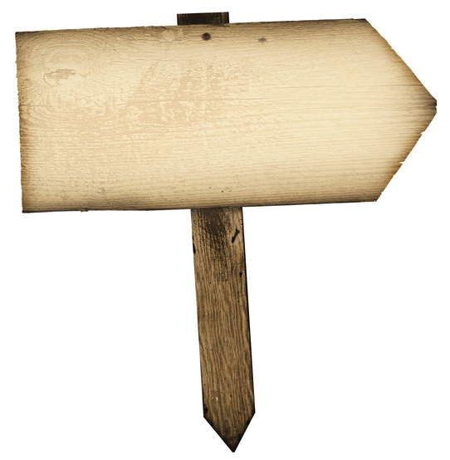
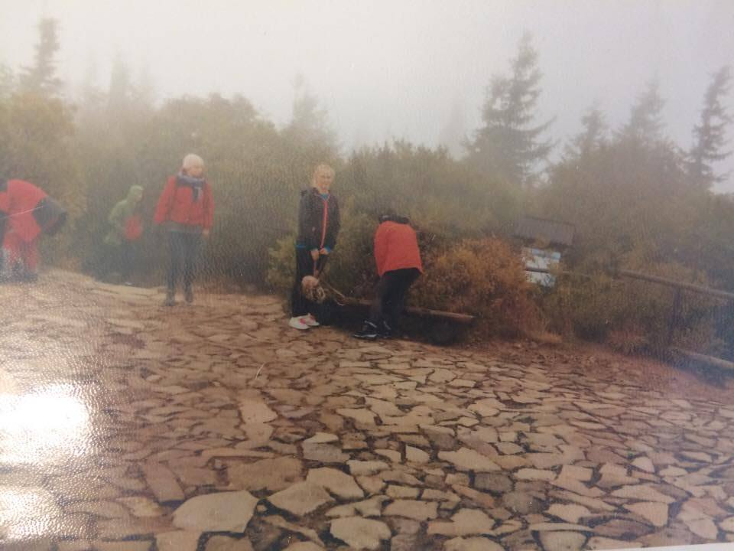
We often take part in the "Clean Mountains„ ecological meeting. This is a great chance to help nature and spend time with people who share the same passion.
ECOLOGICAL
REUNION

Slide 12
REMEMBER, YOU CAN BE A HERO TOO

Slide 13
INFORMATION SOURCES
www.lubsko.zielonagora.lasy.gov.pl http://www.borealforest.org http://www.greenpeace.org polskanarowery.sport.pl www.borealforest.org www.wfpa.org keywordsuggest.org TheWannabeSaint.com http://www.borealforest.org | Rgbstock http://www.rfa.org https://zadane.pl/ ClipartFest http://www.mnn.com http://www.ajitkumar.co.in https://en.wikipedia.org/wiki/Main_Page http://www.planeteplus.pl

Slide 14
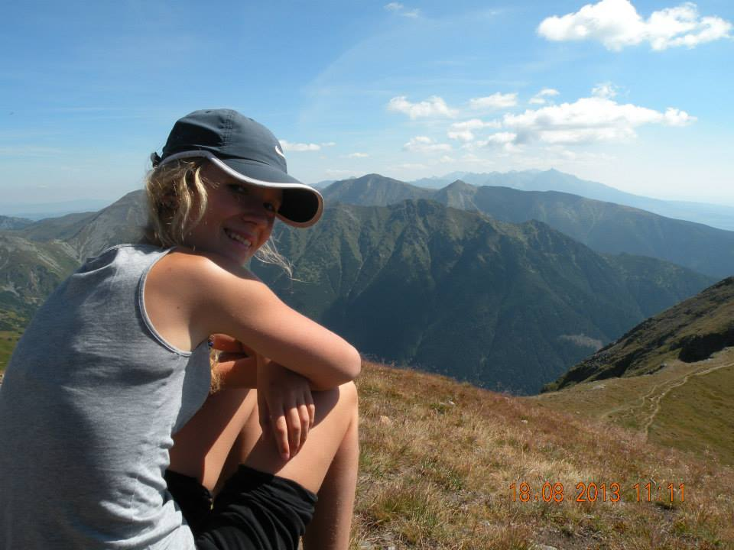
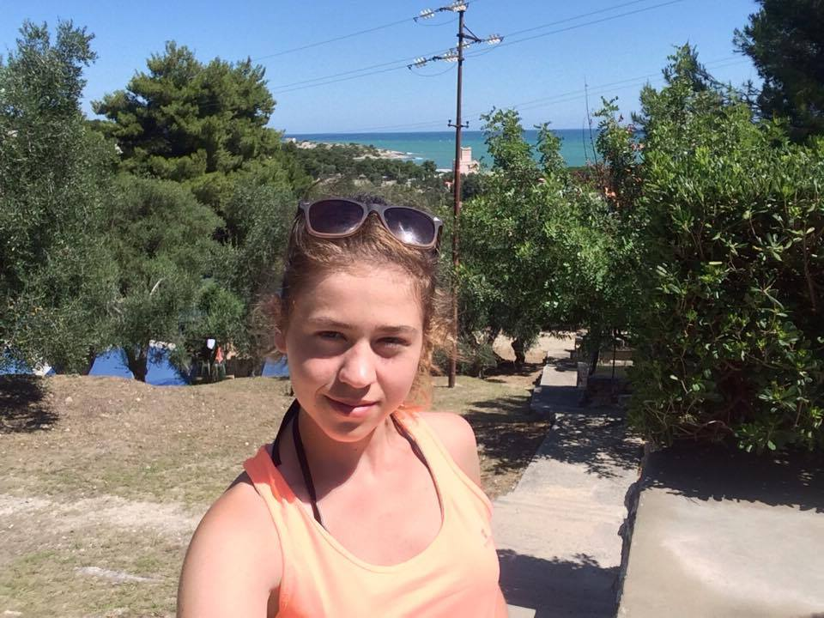
… because we love nature!
Marta Sadowska
klasa 2aLO
Klaudia Chwaja
klasa 2aLO
Angelika Łabas
klasa 2aLO
Zespół Szkół Mechaniczno-Elektrycznych w Żywcu Komisji Edukacji Narodowej, 34-300 Żywiec

