Slide 1
Forest in Poland and Europe
Characteristic and management

Slide 2
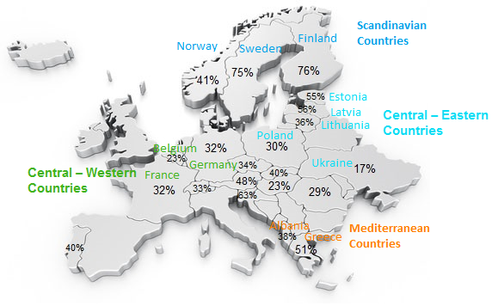
Forest area in % of land area

Slide 3
Climate Zones
1. In Scandinavian Countries :
Cool Continental Climate
Temperate Continental Climate
2. In Central– Western Countries :
Temperate Oceanic Climate
Temperate Continental Climate
3. In Central – Eastern Countries :
Temperate Continental Climate
Warm continental climate
4. In Mediterranean countries :
Cold semi-arid climate
Warm mediterranean climate

Slide 4
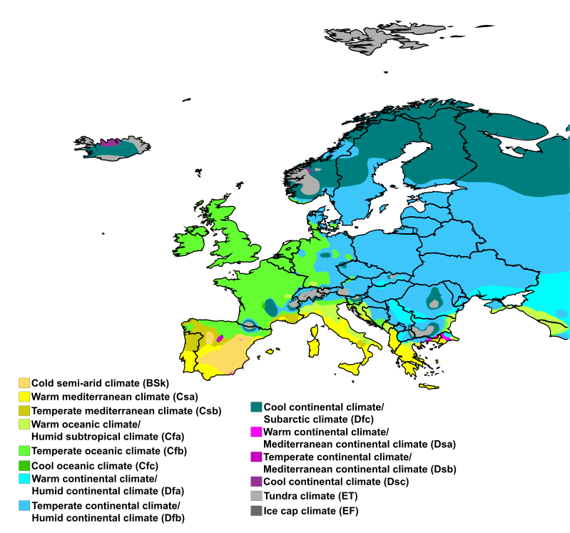

Slide 5
Types of forests in Poland

Slide 6
Countries area in km²

Slide 7
Forest area in km² of countries area

Slide 8
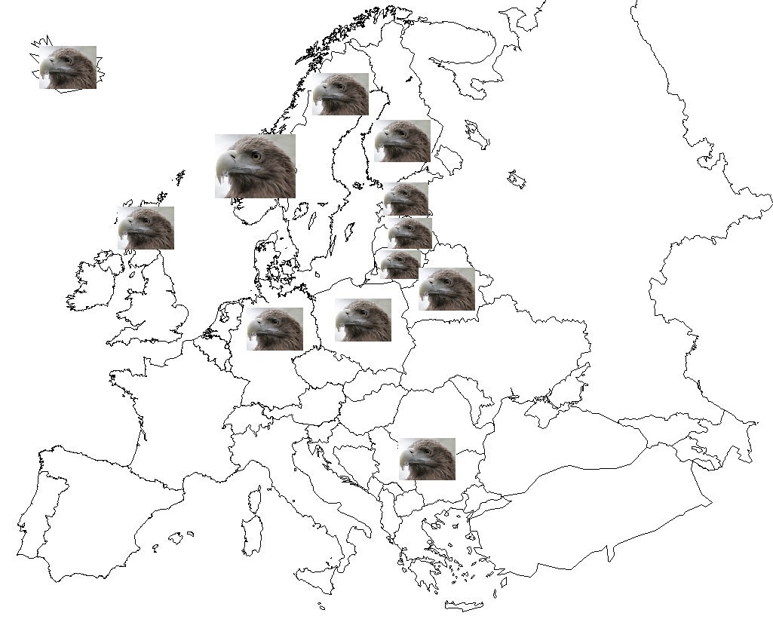
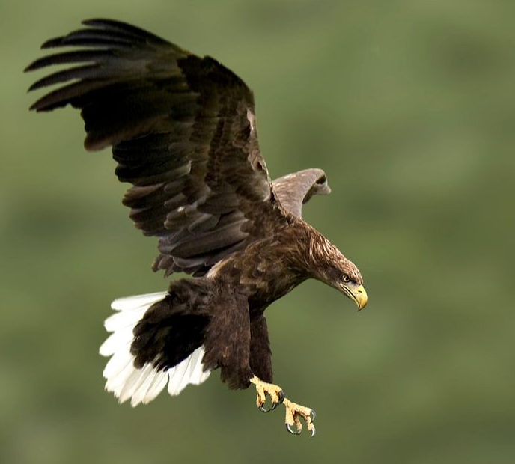
Occurrence of White -Tailed Eagle in Europe
White-Tailed Eagles live in Baltic Sea countries, United Kingdom and Scandinavian Peninsula. The biggest part of them live in Norway, secondary in Poland.

Slide 9
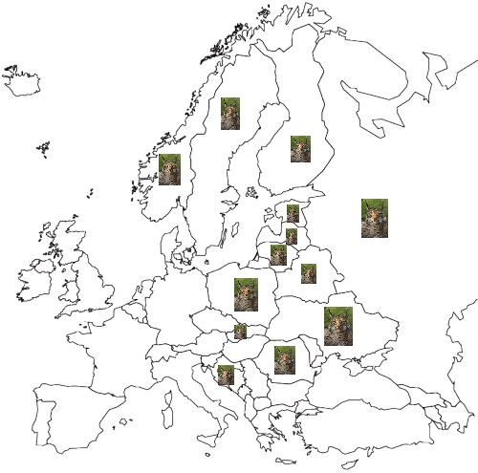
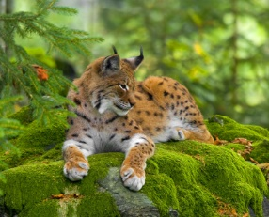
Occurrence of Lynx in Europe
Lynxes live in the east part of Europe, but the biggest part of them live in Scandinavian Peninsula mostly in Finland.

Slide 10
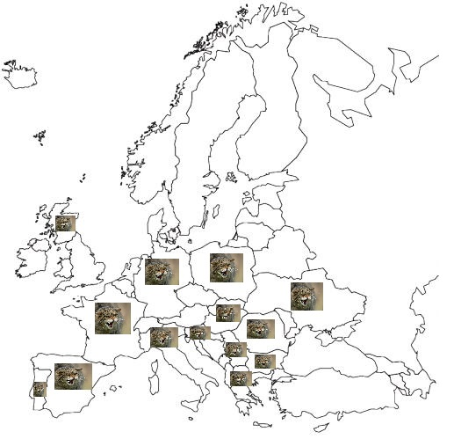
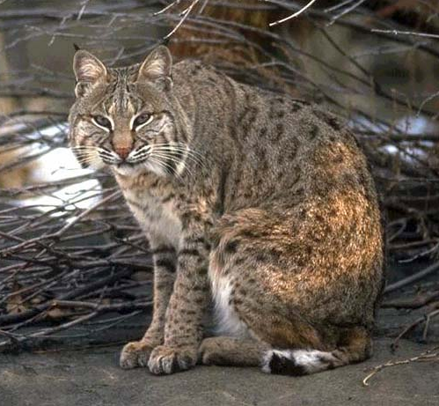
Occurrence of Wild Cat in Europe
Wild Cat lives almost in all Europe excepting Latvia, Lithuania and Estonia. You can’t also see Wild Cat in the Scandinavian Peninsula.

Slide 11
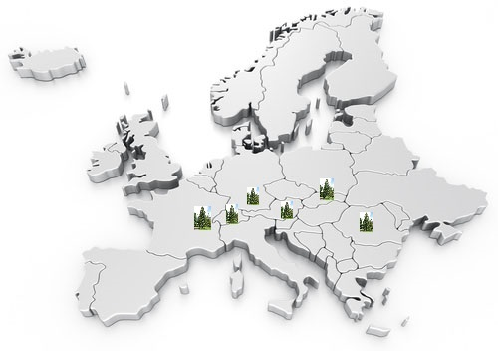
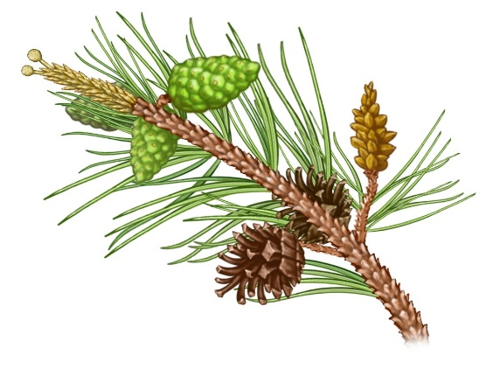
Occurrence of Larch in Europe
Larch mainly occurences in Alps and Carpathians.

Slide 12
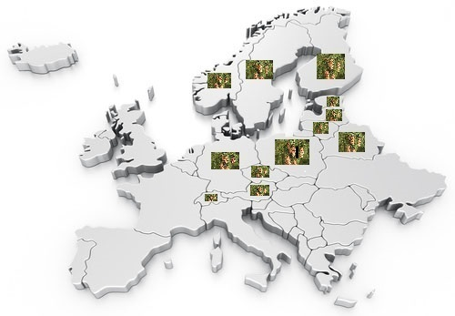
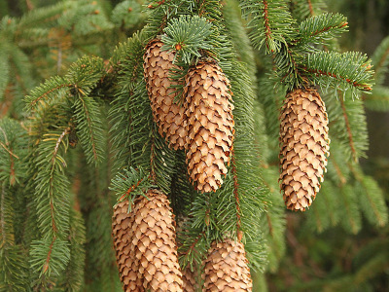
Occurence of Pine in Europe
Pine occurences in the Middle Europe. You can also see it in the Scandinavian Peninsula.

Slide 13
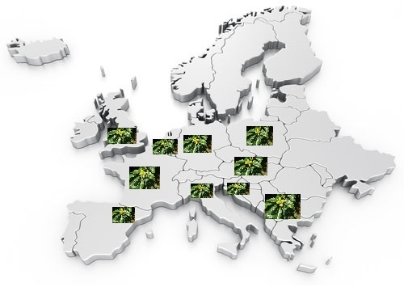
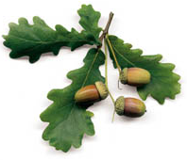
Occurence of Sessile Oak in Europe
Sessile Oak grows almost in all Europe excepting the east part of it. You can’t see Sessile Oak in the Scandinavian Peninsula.

Slide 14
Bibliography
Wikipedia.com
ypef.com

Slide 15
Nadia Fatyga Patrycja Grabarczyk Mateusz Roszkowiak Gimnazjum im. Adama Borysa w Witkowie ul. Poznańska 47 62-230 Witkowo Klasa 2B

