Slide 1
Forests in Poland and Europe. Characteristics and management.
Bialowieza National Park

Slide 2
The Bialowieza Forest
Some practical information

Slide 3
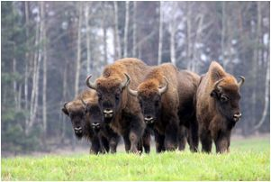
Discover of the national park
Was established in April 1919, when profesor Wladyslaw Szafer was exploring Bialowieza with the group of scientists. He wanted to find out if there are any European Bisons there. After the expedition they decided to try protecting Bialowieza Forest

Slide 4
Some more history
In 1811 ther was enormous fire, which destroyed big part of the forest area.
During the First World War Germans take control on the Bialowieza Forest and bulit 300 kilometres of railway, sawmills and they were hunting without limits in the forest. After war with Bolsheviks in 1920 Bialowieza forest belong to Poland again.
In 1986 the forest was recognised as a National Park with the area of 3200 hectare, however there are still actoins taken to protect all the forest.
Notes:
In 1811 ther was enormous fire, which destroyed big part of the forest area.
During the First World War Germans take control on the Bialowieza Forest and bulit 300 kilometres of railway, sawmills and they were hunting without limits in the forest. After war with Bolsheviks in 1920 Bialowieza forest belong to Poland again.
In 1986 the forest was recognised as a National Park with the area of 3200 hectare, however there are still actoins taken to protect all the forest.

Slide 5
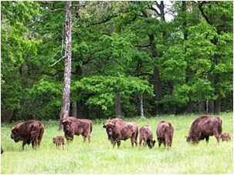
National Park at the moment
Bialowieza National Park is very unique place for all people, not just for ecologists. You can observe lots of rare animals and plants What is more this is the only place, where you can see European Bisons. Thousands of tourists from other parts of the world visite this magical place every year. On the next slide I would like to present some photos of the Forest.

Slide 6
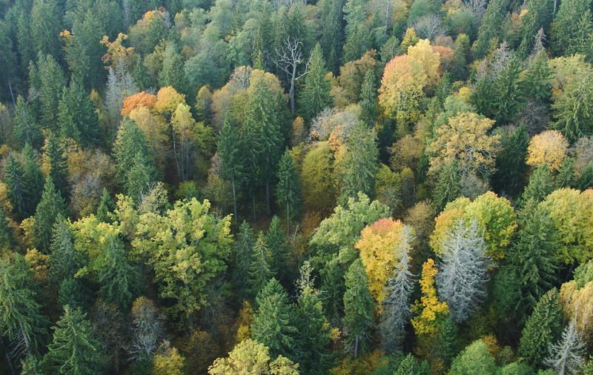
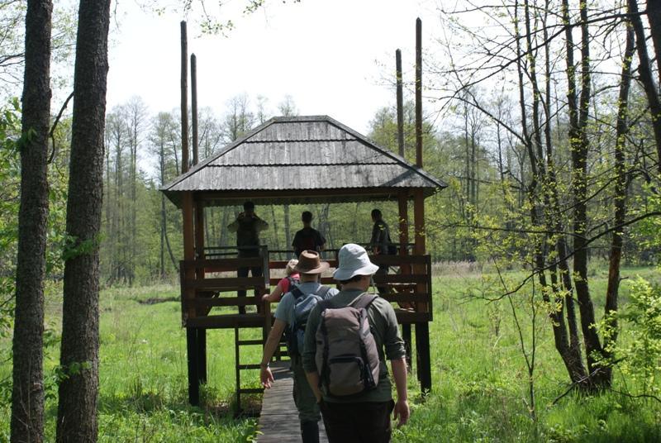
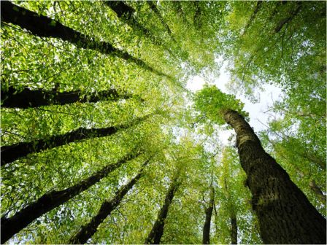

Slide 7
Animals from Bialowieza forest

Slide 8
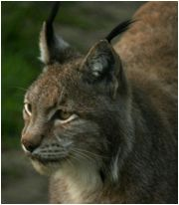
Animals species - lynx
It is one of the four species of medium-sized wild cats. Lynx has a short tail, characteristic black tufts on their ears, large, padded paws for walking on snow and long whiskers. Under its neck, it has a ruff which has black bars resembling a bow tie although this is often not visible.

Slide 9
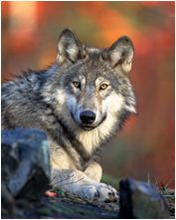
Animals species – Gray wolf
It is also known as the timber wolf or western wolf. It’s the largest extant member of its family. Its fur is usually light gray or black. We can say this type of wolf is one of the biggest ones. It is typical for this specie to have: round ears, broad snout, paws size from 4’’ to 5’’.

Slide 10
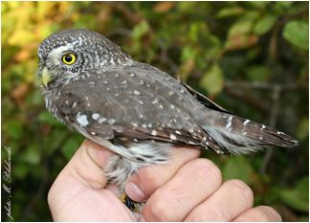
Animals species - Eurasian pygmy owl
It is the smallest owl in Europe. It is from dark reddish to greyish-brown. Its wings are spotted and it has half of a white ring around the back of the neck. Its flying is very similar to woodpeckers. Because of the big, rounded wings this type of owl can move in the air very fast and easy.

Slide 11
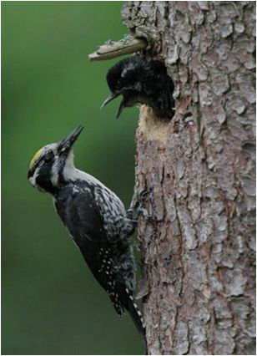
Animal species - woodpecker
We told you something about these type of bird, when we were talking about Eurasian pygmy owl, but now we would focous just on white backed woodpecker. It is the largest of the spotted woodpeckers. with wing-span 38–40 cm. This bird can fly very well. But the most unusal things are white bars across the wings and a white lower back. The male has a red crown, the female a black one.

Slide 12
A big disaster
A story about woodworms and Jan Szyszko

Slide 13
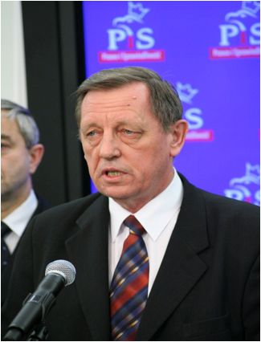
When it started…
Minister of Enviroment in Poland Jan Szyszko decided to increase a number of trees to be cut down. His decision was motivated by woodworms, which live (still!) in Bialowieza Forest. It will help our most beautiful forest to reborn healthier, won’t it…
Actually, it will destroy the last of the lowland forest in the Europe. There is no hope… Or maybe., we’ll see.

Slide 14
Just can help
Every person, who is intrested in ecology have to know, what Greenpeace is. This is the biggest eco-friendly organisation in the world. The members have begun an action called: „I love puszcza”. This manifest includes: issuing an appeal, new prophile photo for everyone who want to join the action and a recognition group in Bialowieza forest. Together we can help them!

Slide 15
Greenpeace organizated a demonstration on the roof of Ministry of Enviroment. Watch the film to see what this amazing people have done for our forest, air and national proud.

Slide 16
Sources
http://www.bialowieza.org.pl
http://whc.unesco.org/?cid=31&l=en&id_site=33&gallery=1&&index=49&maxrows=12
https://pl.wikipedia.org/wiki/Puszcza_Białowieska
http://www.greenpeace.org/poland/pl/
CREATED BY : Dagmara Sobczak from Junior High School in Topola Królewska, Year 3

