Slide 1
Niepołomice Forest
Piotr Despet
Witold Naglik
Bartosz Mazur

Slide 2
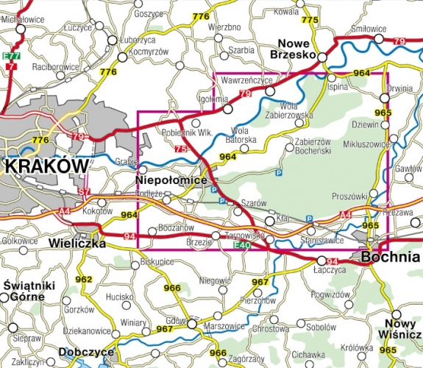
Location
Niepolomice Forest is one of the most beautiful wilderness area in Poland.
It is located in Małopolska 20km from Krakow, in the west side of Sandomierska Valley.

Slide 3
Features of area
Whole forest infolds eleven thousand hectares.
Northern part of forest consists of leafy trees. This part is segmented in three sections.
Southern part consists of coniferous forest.

Slide 4
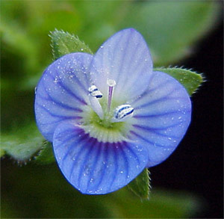
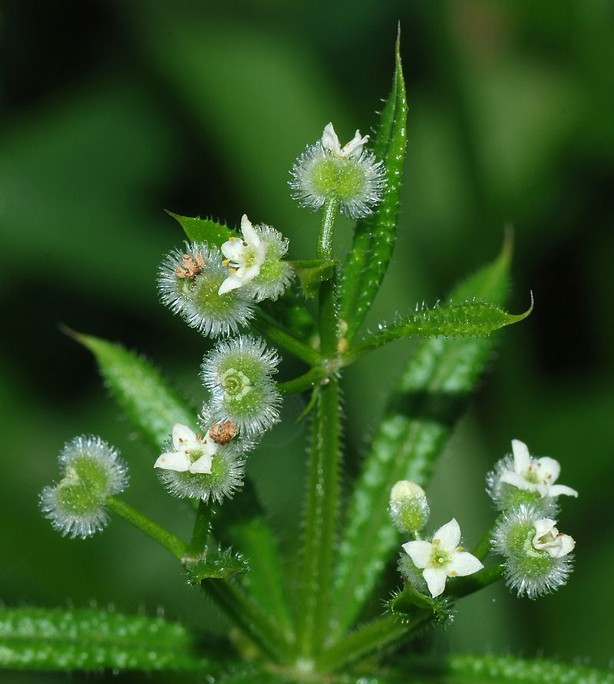
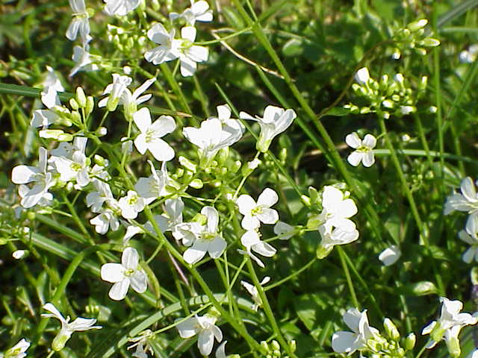
FLORA
The most common type of forest is confireus forest (about 45%). The second place is compased by moist forest (22%)
And next place belongs to mixed moist forest (12%).
Some interesting plants:
Arabis
Galium
Speedwell

Slide 5
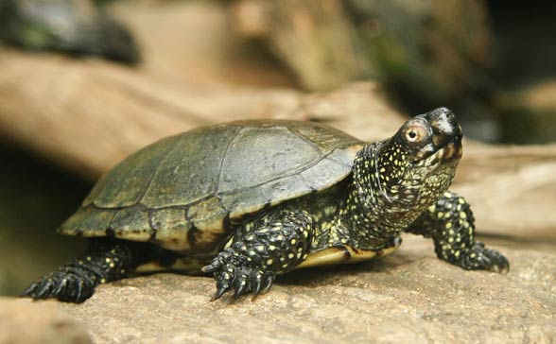
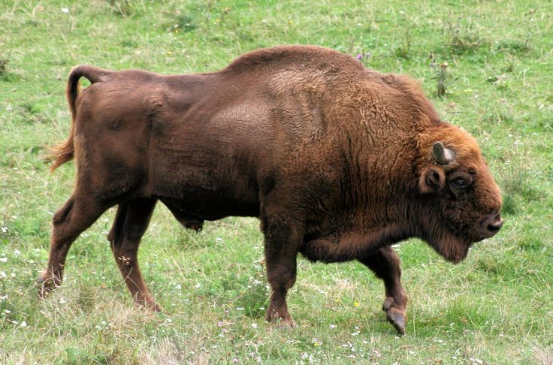
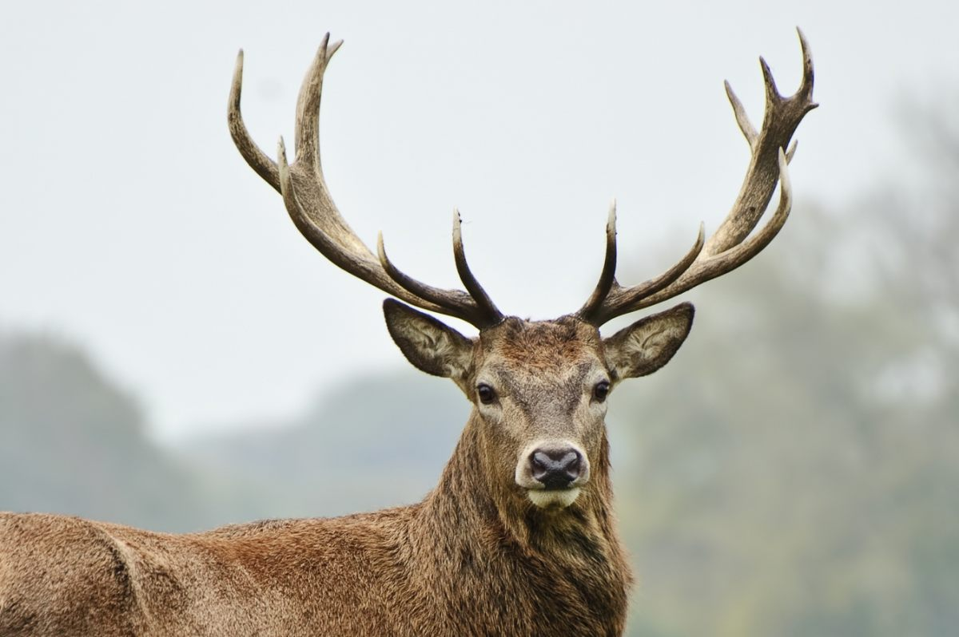
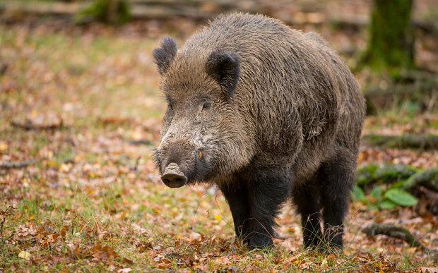
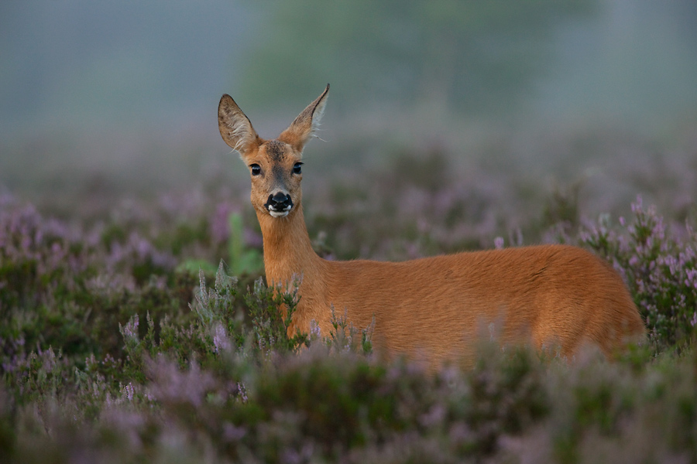
FAUNA
Niepołomice forest is full of wild animals such as:
-roe deer
-boar
-deer
Protected animals:
-european bison
-marsh turtle

Slide 6
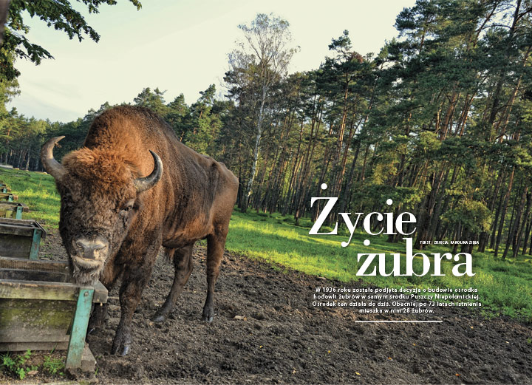
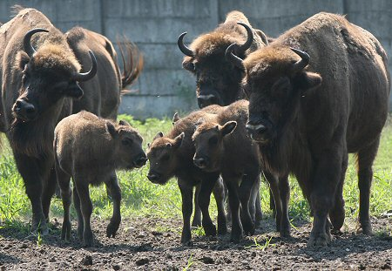
EUROPEAN BISON
Title of the king of Nipołomice Forest belongs to european bison. In the hearth of the forest there is a reserve of wisent, witch represents one of the most significant places of protecting nature at the area of the forest.

Slide 7
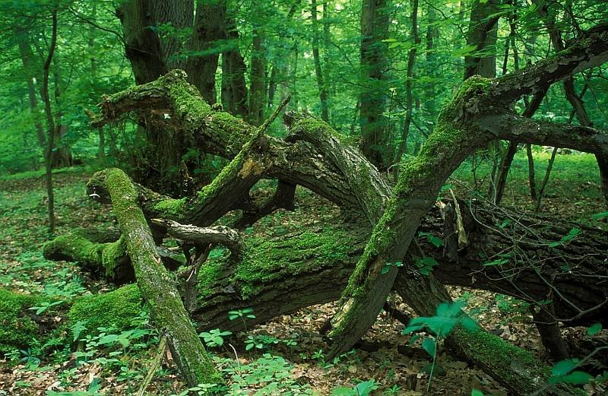
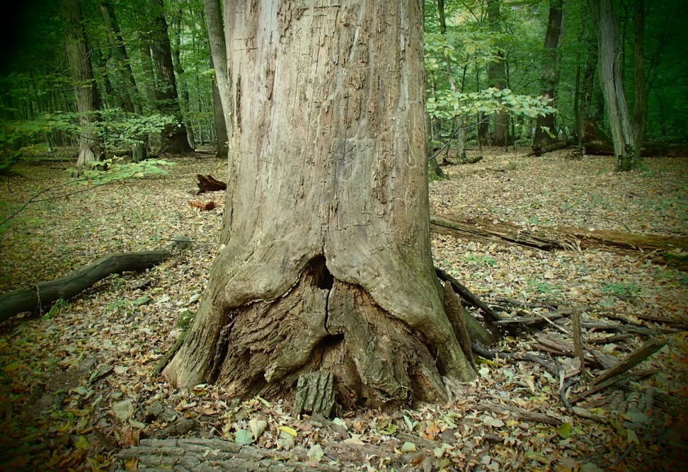
LIPÓWKA RESERVE
This is the oldest reserve in the Niepołomice Forest. It was created with the thought of protecting rare tristand, In his reserve, we can see trees such as hornbeam and alder

Slide 8
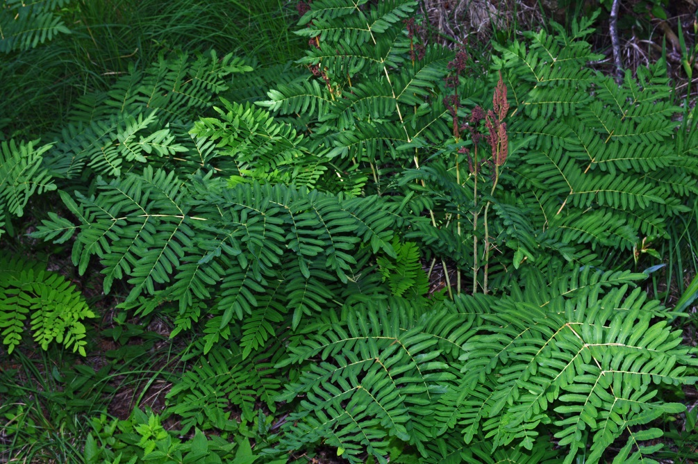
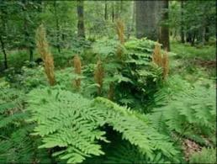
DŁUGOSZ KRÓLEWSKI
This is the trict reserve theat has been bulit to protect numerous uncommon flowers, mushrooms and lichen. The most important plant in this reserve is a fern named długosz królewski.

Slide 9
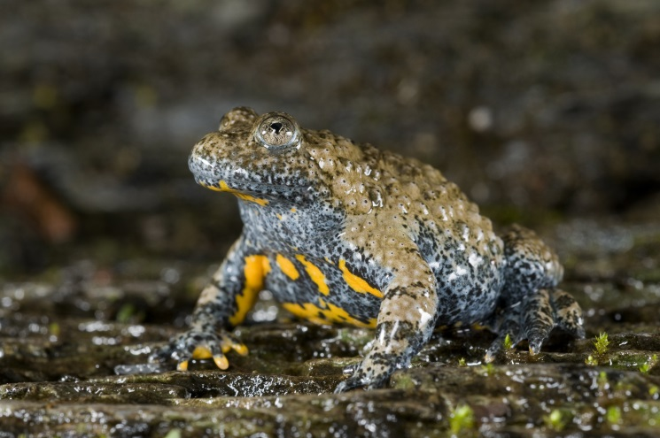
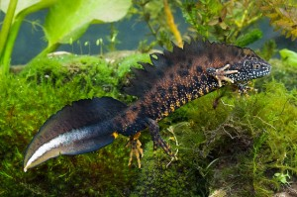
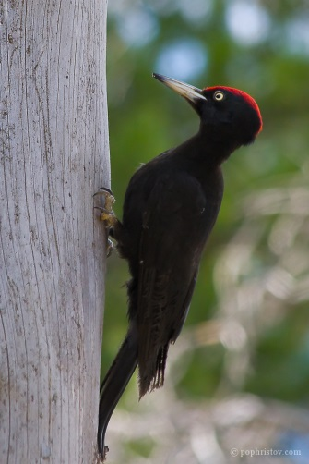
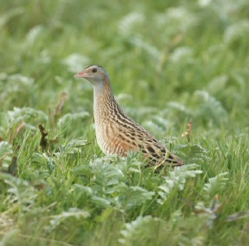
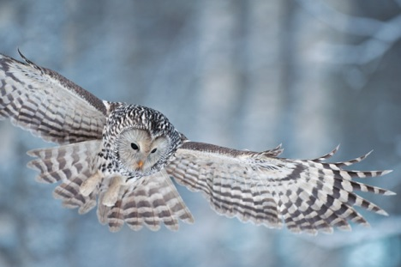
CIRCLE RESERVE
It is the smallest reserve in Niepolomice Forest that covers 3,5ha. It protects animals of Vistula oxbow such as: lowland bombin, crested newt, black woodpecker, corn crake, ural owl.

Slide 10
THANKS FOR ATTENTION

