Slide 1
Comparison of the use and renewal of forest resources in Poland and Germany

Slide 2
At the outset, it is worth presenting the ownership structure of forests in these countries, which are very different. In Poland, most of the forest land is owned by the state, whereas in Germany private forests are dominant. This will be an important reference point later in the presentation, where we will examine whether the type of ownership structure has a significant impact on the use and renewal of forest resources.

Slide 3
The exact ownership structure
POLAND
GERMANY

Slide 4
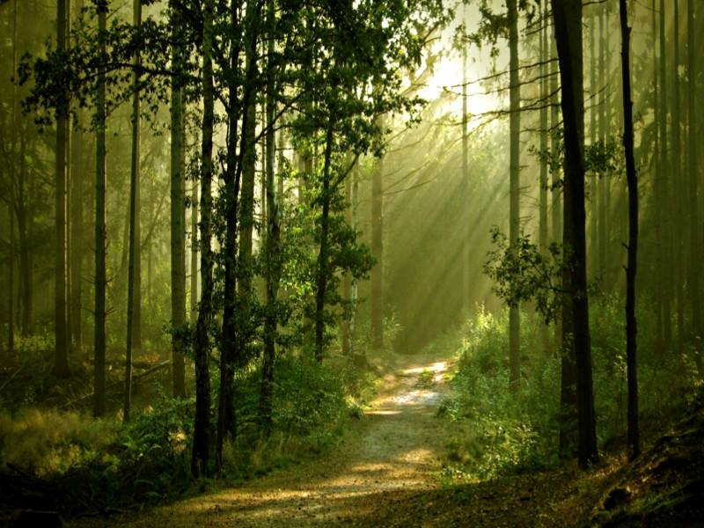
Forests area
In Poland:
9177,2 thousands of hectares, 29.4% of the country
In Germany:
11419,124 thousands of hectares, 32% area of the country
Data from:
Poland – 31.12.2013
Germany - 2012

Slide 5
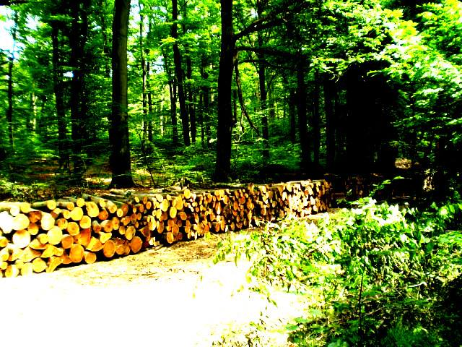
Timber harvesting
To make comparison meaningful, we divided the number of harvested timber by surfaces in those countries.
Poland:
3,67m³/ha
(data from 2010)
Germany:
4,9m³/ha
(data from 2011)
From this comparison it follows that in Germany is used for making approx. 1.2 m³ / ha more than in Poland.
Are there really more forests planted in Germany than in Poland?

Slide 6
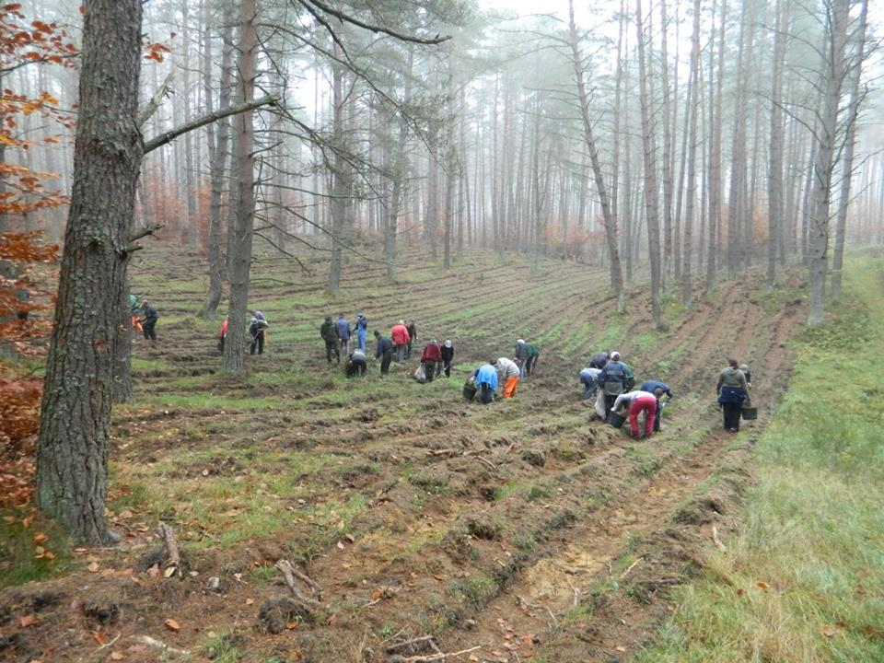
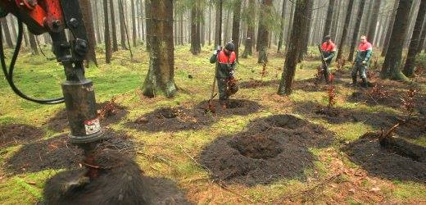
Growth forests
POLAND
18 207ha in 2013, which is 0,2% of the total forest area
planting forest in Poland
GERMANY
Approx. 5000ha per year (the lack detailed data) which is 0,04% of the total forest area
planting forest in Germany

Slide 7
Summary

Slide 8
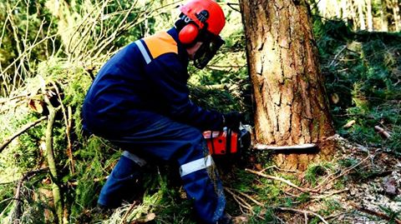
Our comparison shows that the ownership structure of forests has a significant impact on the exploitation and renovation / planting forests. In Germany, where private forests are dominant, there is a lot more timber produced from 1 ha, and much less forests planted in reference to the total surface. Whereas in Poland, where the state forests dominate in the structure, less wood is produced and more forests are planted. Let’s look for the reasons for these differences.

Slide 9
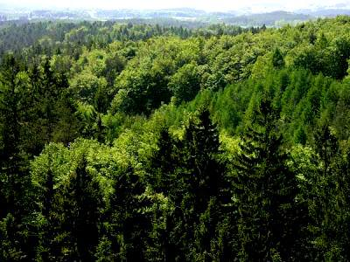
In Germany, the purchase or lease of the forests is a very popular form of capital investments. As a consequence, they are used for making large quantities of trees. The costs associated with the purchase of the forest quickly turned and that the forest at earns for itself. Of course, the owner is obliged by law to reforest the surface of cut out forest. In Poland, there are no large quantities of wood manufactured, because the forests in Poland are young (average age 60), and the state has no need for gaining big profits from forest exploitation.
High impact on the growth of forests in Poland have the EU subsidies, which the farmer receives for the afforestation of arable 6 and 5 quality class land. These grants were awarded in Germany much earlier, therefore there are less forests planted than in Poland. Forest economy of the country is also important. In the case of these two countries it is balanced, rational and based on the plan of forest management. In Poland it is easier to implement the assumptions of the plan because the forests are state-owned, which can also have an effect on the above comparison.

Slide 10
Let us consider which of the ownership structures is better? Polish or German?
To answer this question, let us consider it from the perspective of the state and the forest.
So, for the state German ownership structure is better, because the efficiency of management and timber production is greater. In turn for the forest better is Polish ownership structure, where leading sustainable development and the widely understood environmental protection profit the forest.
In our view, the ownership structure of Poland prevails over the ownership structure of Germany, as it is more important to the welfare of the forest, not the state.
The state does not provide us with oxygen, nor does it ensure the ecological balance, we must especially respect the forests. Of course, someone might accuse us that forests in Germany account for 32% of the country and can afford the minimum growth of forests. Well, this statement is wrong, because per one German citizen falls 0.14ha of forest, and in Poland on 1 citizen falls 0,24ha forest.

Slide 11
Closure
We hope that you liked the presentation. During its implementation we used the information provided on the website of:
National Forests: http://www.lasy.gov.pl/,
Wikipedia https://de.wikipedia.org/wiki/Wald_in_Deutschland We have also used the knowledge of our own, our own calculations, and the assistance of our colleagues from Germany, who we would like to thank.

Slide 12
Realization
Paulina Prokopowicz kl. IIc Grzegorz Dzimiera kl. IIa Szymon Czekała kl. IIa
II Liceum Ogólnokształcące im. Adama Mickiewicza w Raciborzu

