Slide 1
The Green Visionaries of Second High School in Cracow
Click to start the video

Slide 2
So that's how it all started
Click to start the video

Slide 3
What young people know about the forests in Poland?
We decided to check it out!
We asked our friends about some things…
Their answers (sometimes half-jokingly) were very interesting…
Click to start the video

Slide 4
Our lesson about forests in Poland
Well… Answers weren't always correct…
We wanted to change it.
We hit on an idea and conducted a short lecture on forests in Poland!
At the lesson, we raised different subjects :
Mariola said about a huge problem in Bialowieża National Park (bisons vs. bark beetle).
Katarzyna told the students about National Parks in Poland.
Kamil mentioned about the protected areas in Cracow.
We recommended our classmates visiting several forests in Cracow, that are perfect for a spring walk.

Slide 5
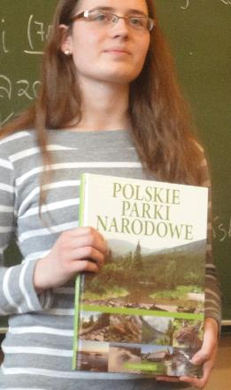
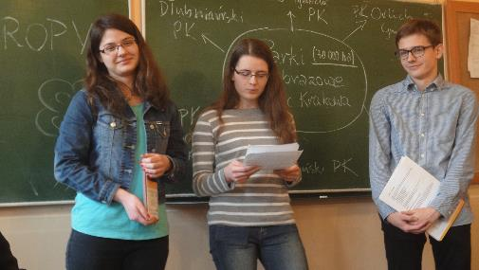
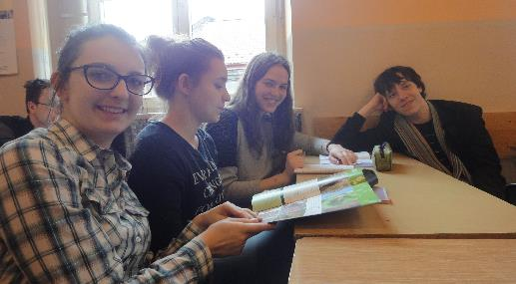
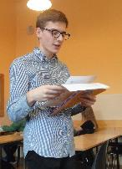
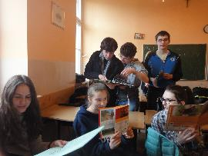
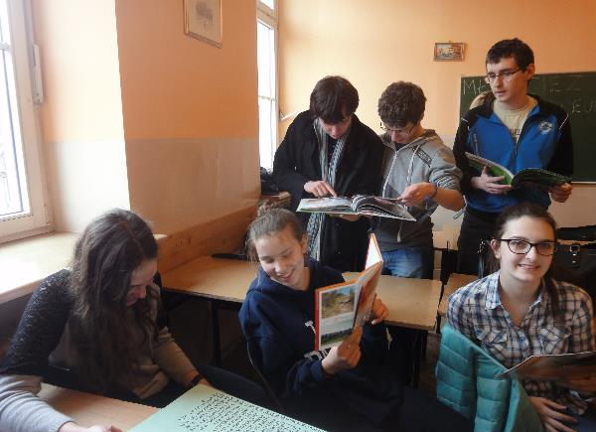
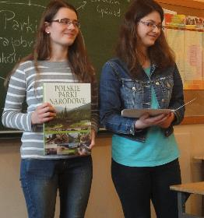
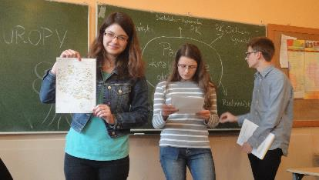

Slide 6
We are the best teachers in the world! ☺
After the lesson we asked once again…
Answers were satisfactory for us.
Our enterprise made sense!!!
Click to start the video

Slide 7
Bison vs. bark beetle
For a while we move about to Bialowieża National Park, because we want to say more about problem, which Mariola mentioned on the lesson.
Bialowieża National Park is the oldest national park in Poland. Its territory is a part of the Bialowieża forest. The bisons live there. Nowadays in Poland there are more than 1000 individuals. Bisons eat mostly plants from forest ground and spend 80% of their life for grazing. Unfortunately, in the Bialowieża Forest appeared bark beetles, which destroy another tree. Bark beetle attack mainly spruces. Bark beetles eat the wood under the bark of trees. They cause the death of the tree, even within one month.
Do you think that cutting the forest fragment save her?
Will the forest continue to be home to many animals, e.g. bisons?

Slide 8
Our information campaign
Bad living conditions of animals moved us to do an information campaign for residents of Cracow. We prepared two versions of leaflets. The first about wolves and the second about Bialowieża National Park.
“Do you know that in Poland live only 700 wolves?
From day to day their is falling down…
We must think what we can do…”
“Bison vs. bark beetle
Bialowieża National Park may cease to exist.
Can the cutting down trees infected by bark beetles save it?”

Slide 9
Our forest adventure
We were aware that the actions in the city among the people are important, but we also knew that we should get to know the forest environment. We should be close to nature.
One day, we met with Mr. Przemysław Szwałko. He is the forester, who with great passion and involvement told us many interesting things about Lasek Mogilski.
Now we want to show what we have learned.
Click to start the video

Slide 10
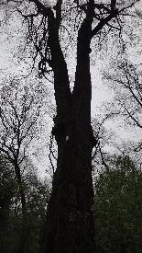
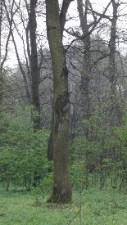
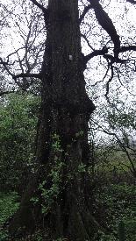
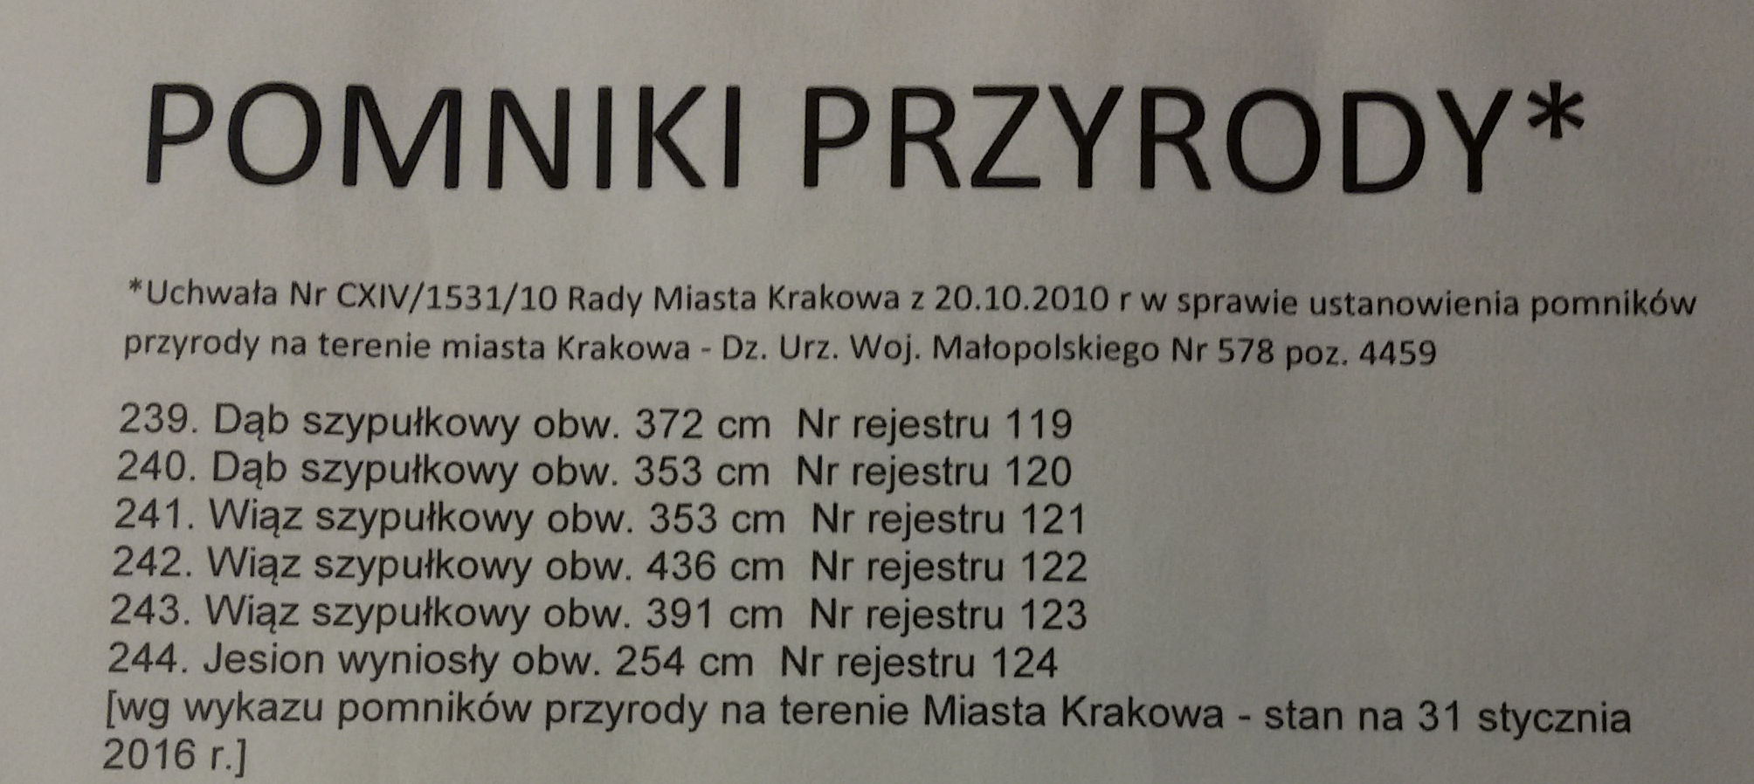
Be like a forester
Click to start the video

Slide 11
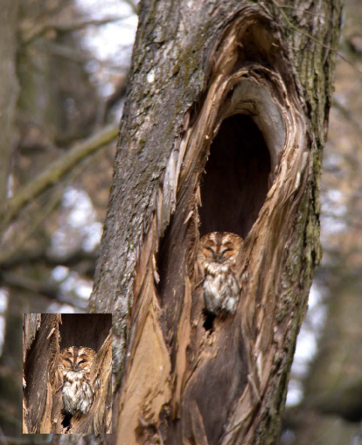
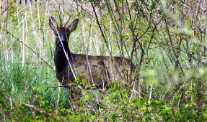
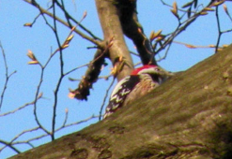
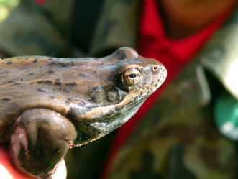
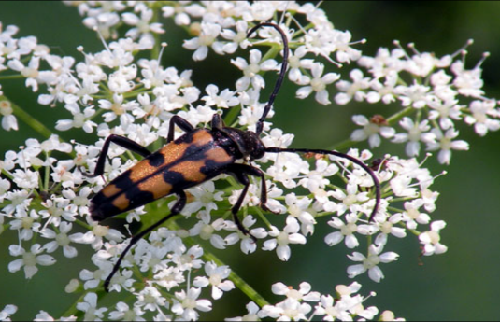
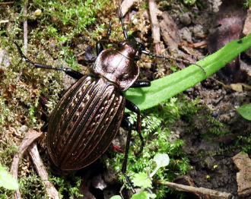
Lasek Mogilski as the perfect habitat for animals
Middle spotted woodpecker
Roe deer
Common frog
Tawny owl
Leptura quadrifasciata
Carabus ullrichii

Slide 12
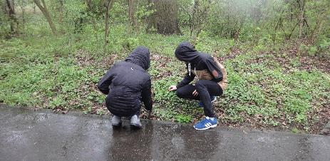
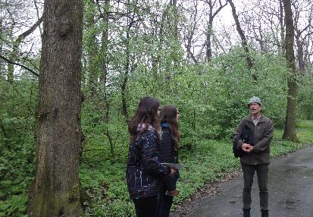
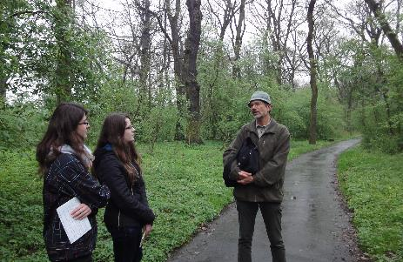
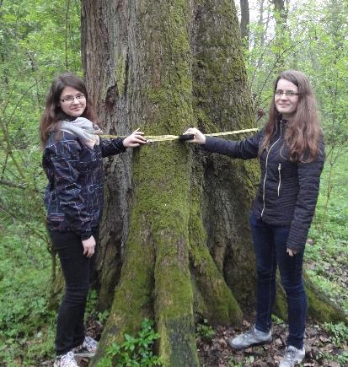
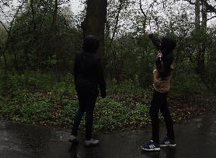
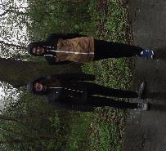

Slide 13
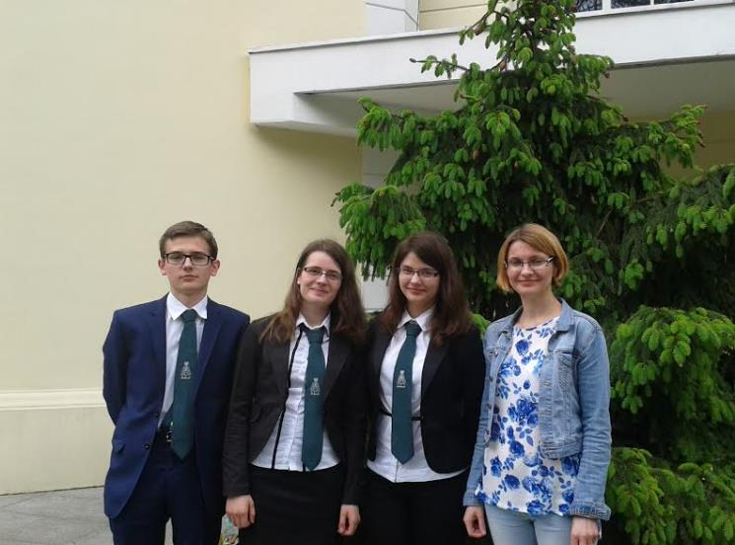
YPEF 2015 - memories
We will come back next year.
We start preparing right now ! :)

Slide 14
YPEF 2016 – next chance!!!
THE END

Slide 15
Bibliography and special thanks
Bibliography:
YPEF VI 2016 Booklet
Inwentaryzacja projektowanego użytku ekologicznego „Las Mogilski”
Bison theme photo – www.nationalgeographic.pl
Photos in the background are our own material.
Special thanks to:
Eliza Wojtasik – our teacher
Przemysław Szwałko – forester
Urząd Miasta Krakowa Wydział Kształtowania Środowiska
Students of Second High School in Cracow

Slide 16
Mariola Klaś
Katarzyna Leszczyńska
Kamil Sado
From Class „IIa”
II Liceum Ogólnokształcące im. Króla Jana III Sobieskiego w Krakowie

