Slide 1
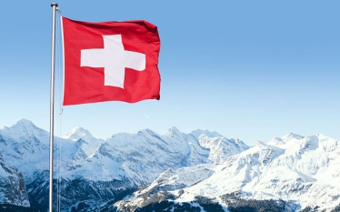
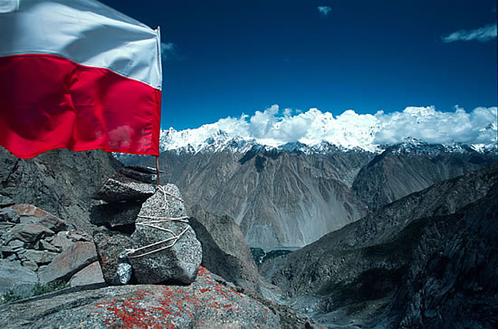
Forests in Poland and Europe. Characteristics and management
Comparison of Polish and Swiss forests
Kacper Ścibski
Julia Jawoszek
Marta Kowalczyk

Slide 2
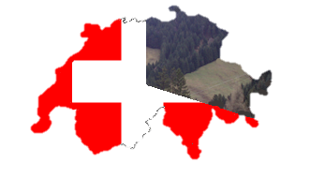
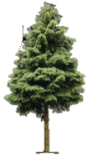
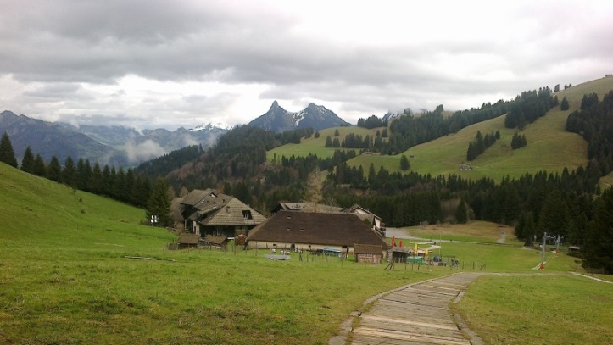
About forests in Switzerland
Forests in Switzerland are very important for all the environment. They cover around 41.000 km2 That’s approximately 33% of the country ‘s surface. The landscape is mainly upland and mountainous. Majority of forests grow 1.000 m over sea in the southern part of the country. Biodiversity is much richer in upland areas due to the preservation in economics and touristic reasons. Of course high parts of Alps are often inhabited by many species because of strict weather and climate conditions. Switzerland is famous for it’s beautiful mountain landscapes and the Swiss are really proud of them.
Forest area in Switzerland is increasing during for last 30 years.
Each year the forest cover is getting bigger and bigger for around 0,4% per 1 year
Forests in Switzerland are divided into many owners.
A typical Swiss landscape

Slide 3
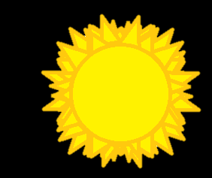
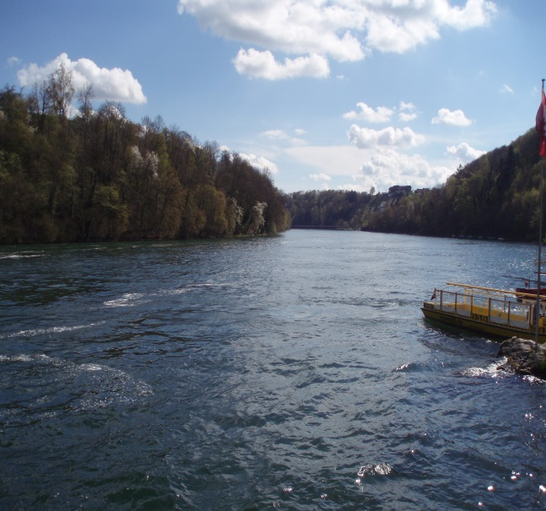
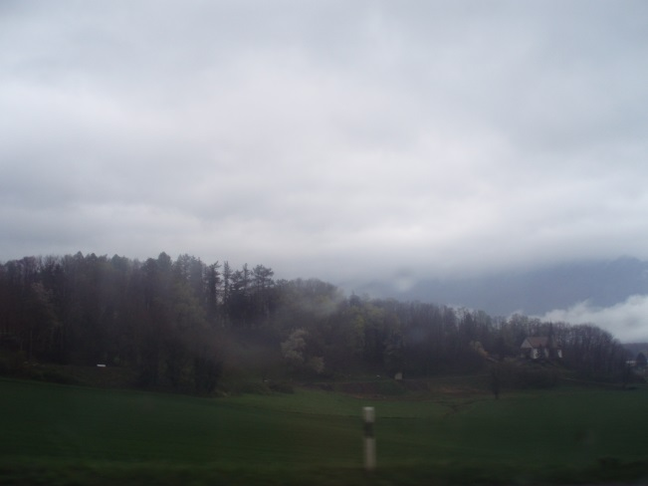
Climate of Switzerland
The Alps are like a climate barrier: Southern Switzerland (mainly influenced by the Mediterranean Sea) characterizes with a much milder climate than Northern part of the country.
Climate of Switzerland is heavily influenced by the Atlantic Ocean. The prevailing currents from the west directions deliver mainly a mild and breeze to this country. In summer, it has a cooling, in winter a warming effect. Most of areas enjoy an adequate amount of precipitation throughout the year. In addition, the cold and dry north winds can drop the temperature very quickly and make the sky clear
Thanks to all these facts Switzerland’s forest diversity are very different in some regions.
It’s raining men!
Rainy day...
The weather is different in several parts of Switzerland. It is common to move from a cold and cloudy landscape to a clear blue sky just in a few minutes.
Hallejulah!

Slide 4
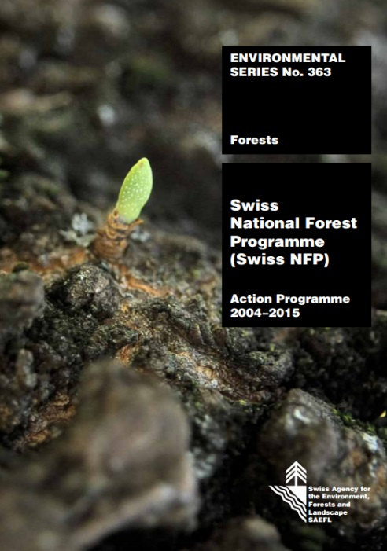
Protecting Forests in Switzerland
Forests in Switzerland have a several important functions. Some of them are economic but there are also many kinds of protective functions. We can distinguish forests which:
Protect water and soils
Are important for biodiversity
Are the place where people can rest
The Swiss National Forest Programme (Swiss NFP) is an action programme that defines and coordinates the Swiss Confederation’s forest-related activities up to and including the year 2015. It is based on the nationally and internationally recognized principles of sustainable forest management.
NFP provides 7 main tasks:
Protective forest and biodiversity as priority services
• Maintenance of forest ecosystem
• Improved structural efficiency in the forest sector
• Good market conditions for wood utilization
• Innovation through education, further training, research and development
• Cross-sectoral partnerships:
• Information and dialogue
Did you know…?
OFEV is an office which is responsible for forest management in Switzerland

Slide 5
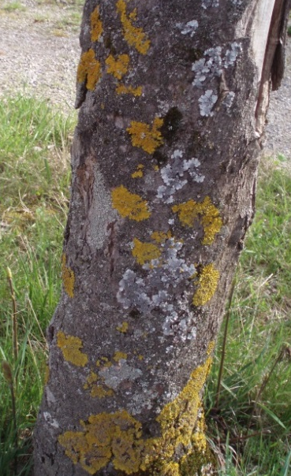
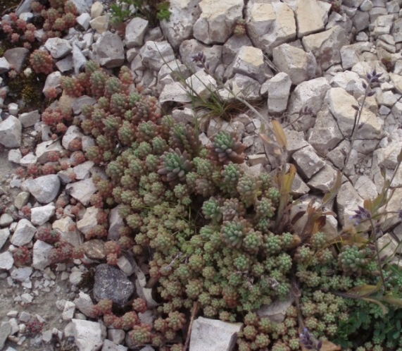
flora and fauna in Switzerland #1
Flora and fauna is very diversed in Switzerland, nearly half of the 40 thousand species of plants, animals and funghi are living in forest ecosystems!
Did you know…?
about 20% of species of plants, animals and funghi in forest areas (6 000 species) are found living on dead wood
Lichens on the trees in Switzerland
Did you know…?
In Switzerland there are 513 species of amphibians, birds, mammals and reptiles, of which 2,5% are endangered.
We can find many specious of lichens. Due to very clean air they can achieve a very big size. Some trees are inhabitete by one or more species of linches
Did you know…?
About two-thirds of all European mosses (1 600) live in Switzerland.
Forests are mainly located in the Jura and the Alp Mountains, where dense coniferous forests predominate
Xerothermic plants in the high Alps
Hedera helix

Slide 6
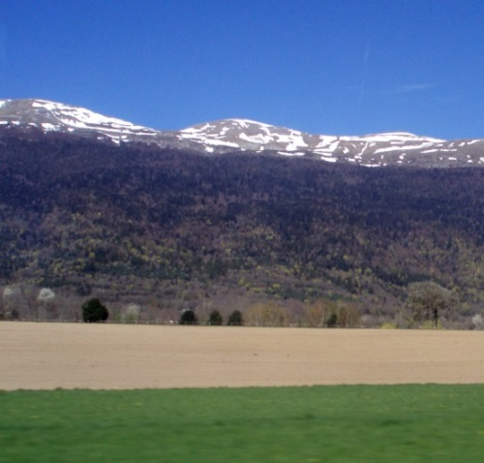
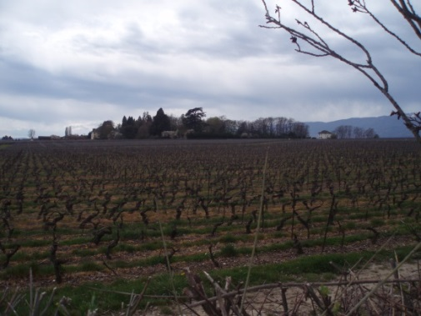
Forests in Switzerland in our opinion
One of us has visited Switzerland a week ago. Almost all of photos of Swiss forests were made by him. Let’s listen to his own opinion about Swiss forests and forestry…
Foothill’s climate and weather conditions are excellent for agriculture. It’s in Swiss tradition to have a piece of field and grow something here. Also many hills are used as vineyards. Grapes need much more sun than other plants so they are grown mainly on northern parts of hills. The majority of Swiss forests are located in mountainous parts of the country. People have a difficult access to them and soils are not very fertile. As we know, Switzerland was neutral in First and Second World War so that’s why around 14% of Swiss forests are still unaffected by human. I was traveling through Alpine States like Austria, Germany, France and finally Switzerland. Despite the fact that climate is really similiar in all these countries, I could find many differences in forest structure and in their appearance. It is really easy to distinguish altitudinal zonationes.
The Swiss Alps
Vineyard

Slide 7
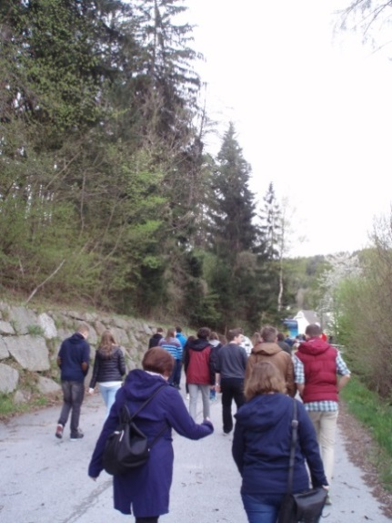
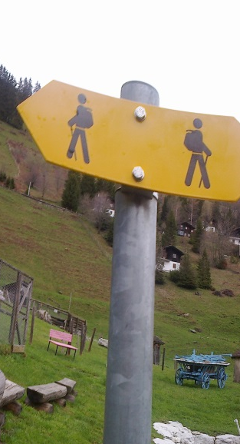
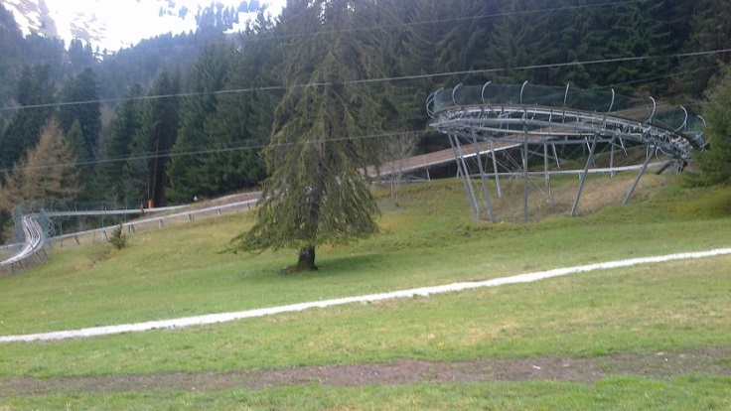
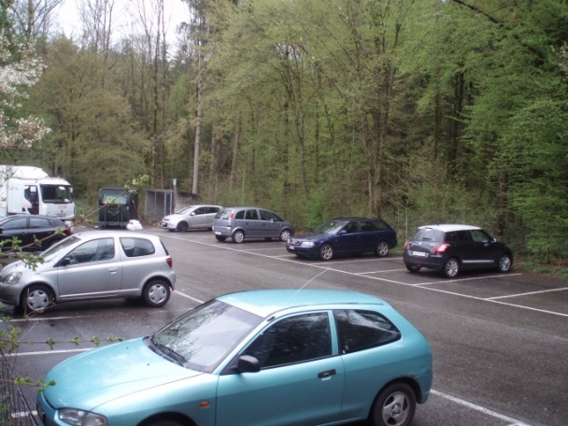
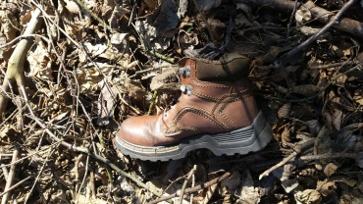
Social Forest functions in Switzerland
I was amazed how many people spend their free time on the bossom of nature. There are special parkings, and many attractions which are located In forests. We can find many paths made specially for tourists. People respect nature and don’t litter. Forests are really clean. I would like it to be the same in Polish forests...
Ecoturism has became very popular in Switzerland in the last years. It helps people to de-stress.
Forests provide healthy and safe place to spend time
S
P
E
F
wiss
ople
Parking somewhere in forest in Switzerland
in
ropean
☺
orests
Alps + Forests = Resort
Polish reality...

Slide 8
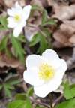
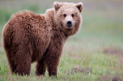
Swiss National Park
With its 80km of trails, the Swiss National Park is a hiking paradise!
The SNP is one of the best protected areas in the Alps. The visitors are able to witness the dynamic processes that lend this landscape its unique character. To keep this place undisturbed there are many strict regulations which forbide taking a dog with you, swimming in the lakes, leaving marked paths, throwing out litter and so on
There are 21 walking routes in the SNP in three grades of difficulty: easy, medium and difficult. Throughout the year the Park offers a variety of events, for example lectures of a wide choice of natural history topics during the Zernez National Park Days. There are many flora and fauna species in the SNP. If you have some luck, you can meet a wolf, a brown bear and a lynx or see several kinds of birds flying above your head such as a bearded volture or a golden eagle while hiking. And if you're observant enough you may notice plants like alpine clematis, poisonous striated mezereon among pines or representatives mountain avens on the Park's alpine meadows
Over 150 000 people visit the SNP each year and it's essential for all of them to respect all the regulations so that everyone has an equal chance to observe the wonders of nature – now and for years to come

Slide 9
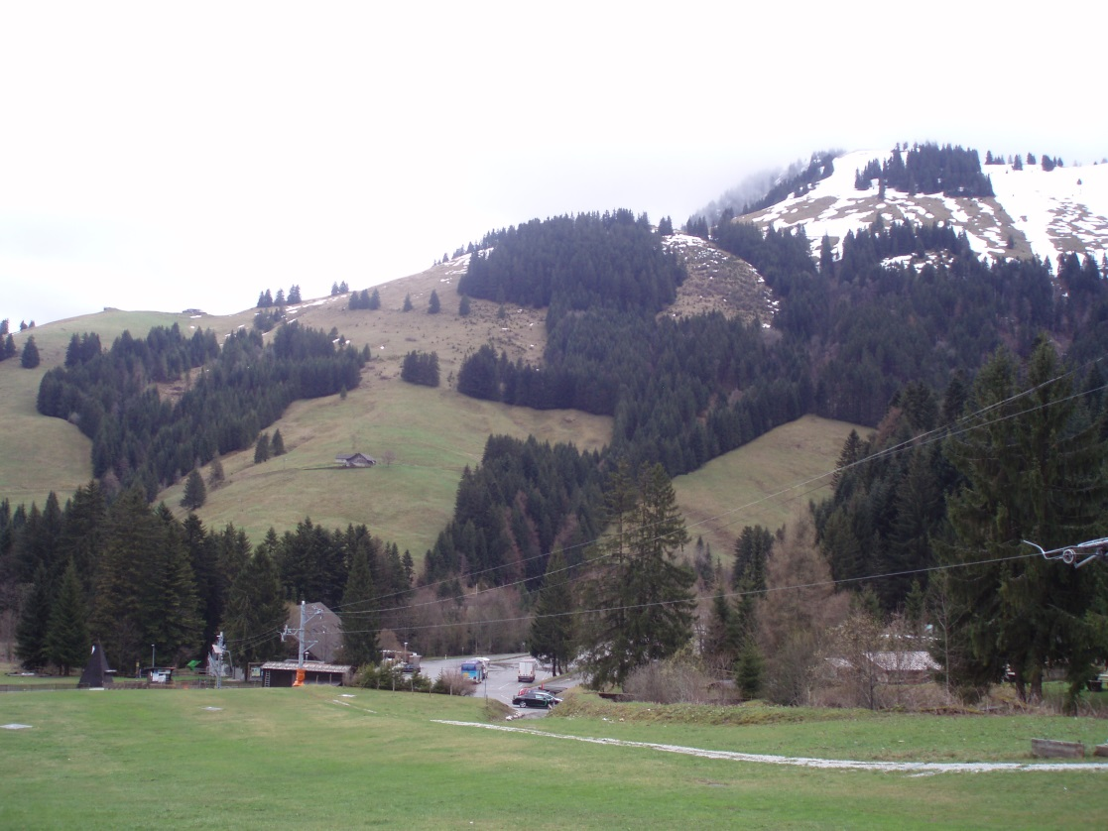
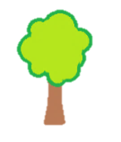
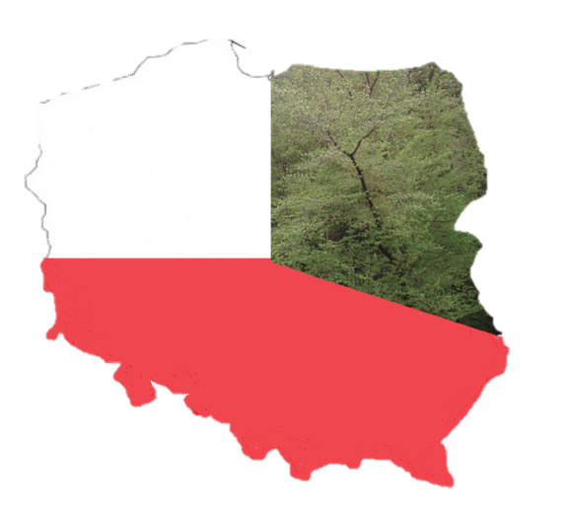
General Informations About Polish Forests #1
Forests cover about 30% of Poland’s territory.
Forest cover in Poland has diametrically changed since tye last 300 years. The main reason was development of industry and finally two World Wars. Now forest cover is increasing and in 2050 it will achieve the reach of approximately 33% of total Polish territory.
The most forested Voivodeships are:
Lubusz Voivodeship (49,2%)
Subcarpathian Voivodeship (38%)
Pomeranian Voivodeship (36,3%)
Majority of forests in Poland occur on the poorest soils. Most of them are aged 41-80
81,0% of Polish forests are public (The State Forests National Forest Holding owns 77,1% of all forest areas) and 19% belongs to private owners.
19%
41 – 80 years
81%
1700 1945 actually

Slide 10
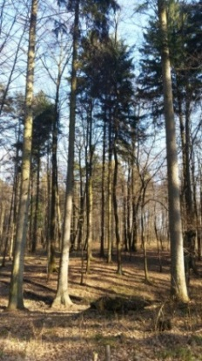
General Informations About Polish Forests #2
Did you know…?
State Forests are the biggest producer of wood in Poland. In 1990 there was cut down around 17 million m3 of timber but now around 35 million m3 is cut down each year. Despite this fact the cover of forests in Poland is increasing! Foresters seed approximately 500 million trees for one year – that’s more than 15 trees per second!
The dominating tree species is pine. As we already know, World Wars destroyed a great number of natural forests. Many of them burned or were cut down due to the need for wood. After fights society decided to reconstruct forests in a fast way. One of the fastest growing tree species is pine and that’s why now it dominates in Polish forests.
Nearly 50 thousand people is employed in forestry.
Pine forest
Did you know…?
The total volume of wood in Polish forests is approximately around 2,4 billion m3 – the 5th place in Europe.
P O L A N D

Slide 11
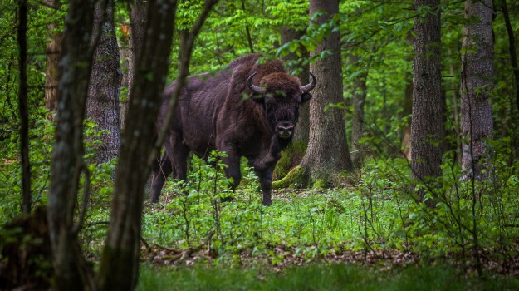
PROTECTION OF NATURE IN POLAND
The most important reasons for protection of nature:
Aesthetic – to admire and be able to relax
Economic – to obtain raw materials and develop the economy
Natural and scientific – to study the species for younger generations
Social – to rest
Purpose of nature protection:
Maintaining the stability of ecosystems and the sustainability of ecological processes
Changing attitudes of human about nature through educational activities, information and promotion
Popularizing knowledge about nature
The Act of 16 April 2004 about nature protection – passed by the Sejm of the Republic of Poland, regulates the legal issues related to the protection of nature in Poland
Did you know…?
Liga Ochrony Przyrody – the oldest environmental organization in Poland, was founded 9 Januar 1928. President of the Board of the LOP is PhD Ryszard Kapuściński.
The current Polish Minister of Environment is Jan Szyszko
Logo of Liga Ochrony Przyrody
A bison in Polish forest

Slide 12
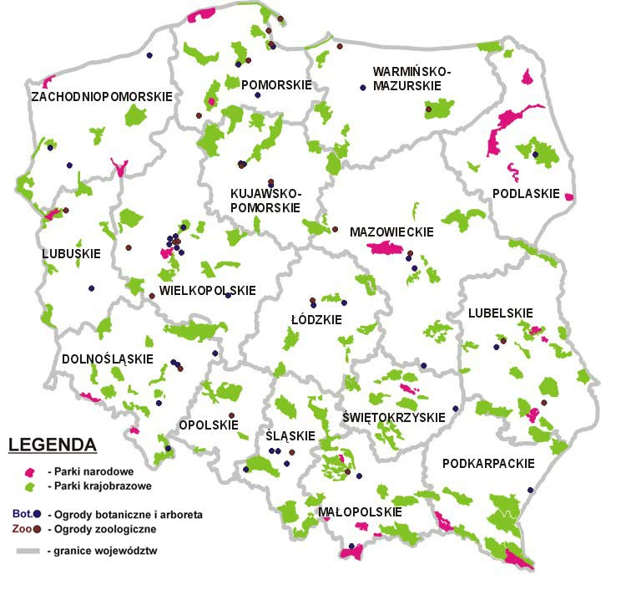
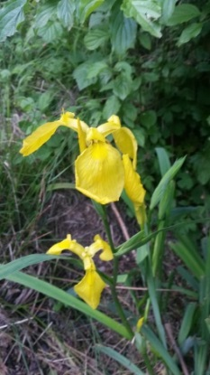
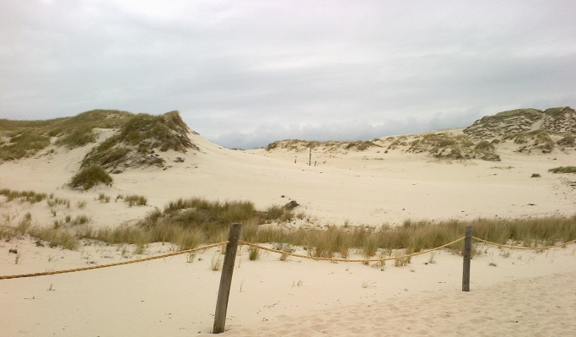
Protected areas in poland
Since Poland is one of the member of UE there have been established many Natura Reserves in the country. Tha smallest is Żwirownia Skoki and the biggest is Bory Tucholskie. We can distinguish Special Protection Areas and Special Areas of Conservation. They are independent and can cover the same area.
In Poland there are:
23 National Parks
122 Landscape Parks
And 1481 Nature Reserves
Majority of National Parks have a logo, that park for e. which mostly represents the famous animal inhabitet in g.
A bison in Białowieża NP or a ruff in Biebrza NP
Landscape Parks were established in case to:
protect the biodiversity
constitute areas for reserches
and due to ecological functions
Did you know…?
The smallest Landscape Park in Poland (Stawki) is located in Śląskie Voivodeship. It covers only 17,32 km2!
There are many interesting National Parks which are prety diversed. One of them is Słowiański PN where we can see moving sand dunes
Iris pseudacorus is an endangered species found in Stawki LP
Sand dunes
Green colour – Landscape Parks
Pink colour – National Parks

Slide 13
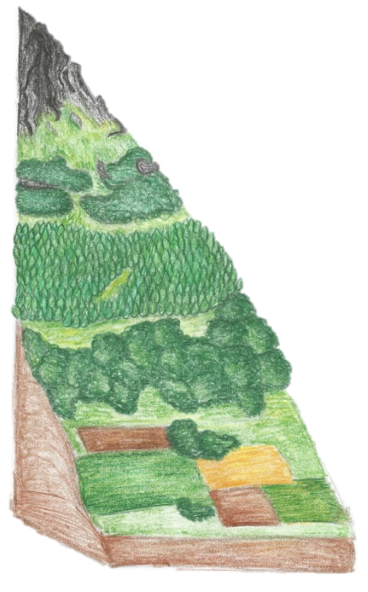
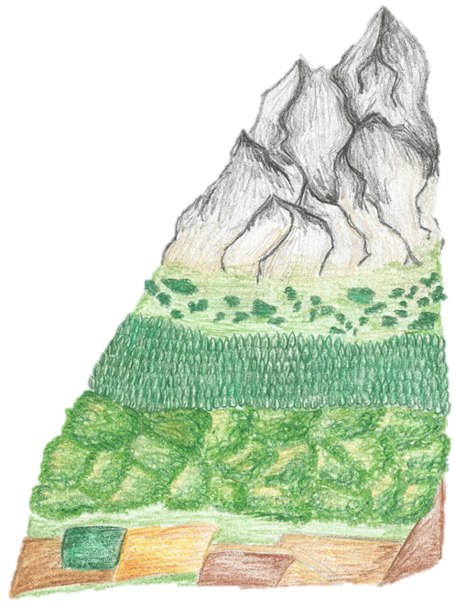
Altitudinal zonation
Mountains are covered by several types of plants. The lowest parts are usually used as fields where climate conditions are good for the agriculture development. Higher are covered by broadleaved specious. Coniferous dominate in high parts of mountain and the top is covered only by some linches, short shurbs or by snow. There are a several differences between altitudinal zonation in The Alps and in the Tatra Mountains.
The Tatra mountains
Snow, ice, debris
Grasses, herbs, linches
lower shurbs, mountain pine
Coniferous forests
Decidous Forests
Fields
The Alps
Snow zone
Alpine zone and
Subalpine zone
Montane zone
Foothill zone
2250 m
1800 m
1600 m
2700 m
1250 m
2100 m
1400 m
700 m
1000 m

Slide 14
A short Comparison of forests in Switzerland and poland
 | Poland | Switzerland
Forest cover | 30% | 33%
Prevailing tree | Pine | Beech
Number of private forests | 19% | 87%
Climate | Warm summers and cold winters | Warm summers and winters but olso Alpine climate
Number of National Parks | 23 | 1
Volume of annually harvested wood | 17 000 000 m3 | 10 500 000 m3
In conclusion, Poland and Switzerland may seem to have extremely different ecosystems but we can find
many similarities in them. Forests growing on the Swiss Upland are really similar to these which we know and forests in Alps often look very close to forests inthe Tatra Mountains. Despite everything they are both very interesting. We have achieved a comprehensive knowledge about them and now we can’t decide which forests are more beautiful!

Slide 15
Thank you fow watching!
We hope you liked our presentation and that it contained many interesting facts! :)
☺
We would like to mark that almost all of our photos were originally took in Poland or Switzerland only by our team and nobody didn’t help us in making our presentation.

Slide 16
Sources
https://www.google.pl/search?q=swiss&biw=1920&bih=955&source=lnms&tbm=isch&sa=X&ved=0ahUKEwiotLOukvPLAhWIECwKHRToD9wQ_AUIBigB#tbm=isch&q=tatry+flaga+polski&imgdii=_KgEcW0YgvQWNM%3A%3B_KgEcW0YgvQWNM%3A%3BYIkMArJv3hUB8M%3A&imgrc=_KgEcW0YgvQWNM%3A – blogger „feringo"
https://www.google.pl/search?q=swiss&biw=1920&bih=955&source=lnms&tbm=isch&sa=X&ved=0ahUKEwiotLOukvPLAhWIECwKHRToD9wQ_AUIBigB#tbm=isch&q=swiss+flag&imgrc=tTiDnDzo3UbWCM%3A- telegraph uk photo: AP/Fotolia
https://www.google.pl/search?q=swiss&biw=1920&bih=955&source=lnms&tbm=isch&sa=X&ved=0ahUKEwiotLOukvPLAhWIECwKHRToD9wQ_AUIBigB#tbm=isch&q=swiss+flag&imgrc=pylpiUmzXMra2M%3A - Wikipedia
https://www.google.pl/search?q=chmurka&espv=2&biw=1920&bih=955&source=lnms&tbm=isch&sa=X&ved=0ahUKEwihkubbhZnMAhVDWCwKHfZKCS4Q_AUIBigB#imgrc=pFaQewDnPVAImM%3A - przedszkole nr 34 w Płocku
https://www.google.pl/search?q=lasy+w+polsce&source=lnms&tbm=isch&sa=X&ved=0ahUKEwj3jcq8wJPMAhXLjSwKHXk4BTsQ_AUIBygB&biw=1920&bih=955#tbm=isch&q=leaf&imgrc=mnl3plGYrQoQTM%3A - Blogthings
https://www.google.pl/search?q=lasy+w+polsce&source=lnms&tbm=isch&sa=X&ved=0ahUKEwj3jcq8wJPMAhXLjSwKHXk4BTsQ_AUIBygB&biw=1920&bih=955#tbm=isch&q=drzewo+iglaste&imgdii=qhWiptNcO_rhFM%3A%3BqhWiptNcO_rhFM%3A%3B2kV-_T9qvlEkgM%3A&imgrc=qhWiptNcO_rhFM%3A- hulacki.netidea zdzisław hulacki
http://www.bafu.admin.ch/index.html?lang=fr- L’Office fédéral de l’environnement (OFEV)
http://www.earthsendangered.com/search-regions3.asp?search=1&sgroup=allgroups&ID=564 – Earth’sth's endangered creatures
http://www.perc.org/articles/property-rights-path-sustainable-development - Theroperty rights path to sustainable development Laura Huggins Terry Anderson
http://ypef.eu/lasy_w_szwajcarii - Young People in European Forests
https://fr.wikipedia.org/wiki/For%C3%AAt_en_Suisse– Wikipedia
http://www.swissinfo.ch/eng/wwf-switzerland-fights-for-europe-s-rare-species/2998636 - swissinfo, Vincent Landon
https://www.cbd.int/doc/world/ch/ch-nr-04-en.pdf - Eric Wiedmer, Jodok Guntern, Monika Burri (Gruner Ltd)
http://www.vogelwarte.ch/en/projects/monitoring/swiss-rarities-committee/rare-bird-species-in-switzerland.html - Vogelwarte
http://swiss-animals-plants-vegetation.all-about-switzerland.info/ - All About Switzerland
https://www.google.pl/search?q=logo+bia%C5%82owieski+park+narodowy&espv=2&biw=1920&bih=955&source=lnms&tbm=isch&sa=X&ved=0ahUKEwiKivDaoZ3MAhUHCywKHdmqDLsQ_AUIBigB#imgrc=HbMNacOI8s0gnM%3A
https://www.google.pl/search?q=logo+bia%C5%82owieski+park+narodowy&espv=2&biw=1920&bih=955&source=lnms&tbm=isch&sa=X&ved=0ahUKEwiKivDaoZ3MAhUHCywKHdmqDLsQ_AUIBigB#imgrc=ATcwjIzwt94LlM%3A Wikipedia
http://dinosaur-archives.boards.net/thread/163/bearded-vulture-gypaetus-barbatus Usser „Hatzegopteryx Triceratops”
http://abcnews.go.com/blogs/headlines/2012/06/alaska-hiker-mauled-by-brown-bear/ Ashley Jennings
http://gubrynowicz.pl/z-zubrem-do-lasu/ Katarzyna Gubrynowicz
https://www.google.pl/search?q=parki+krajobrazowe+w+polsce+na+mapie&espv=2&biw=1920&bih=912&source=lnms&tbm=isch&sa=X&ved=0ahUKEwifrv7Vq53MAhUKXCwKHSyaAYkQ_AUIBigB#imgrc=N6wyzb6wip8wTM%3A Wikipedia

Slide 17
Contestants informations
Name | Surname | Class | School
Marta | Kowalczyk | 1B1 | III Liceum Ogólnokształcące im. Adama Mickiewicza w Katowicach
Julia | Jawoszek | 1B2
Kacper | Ścibski | 1B2

