Slide 1
„EUROPEAN FORESTS – GREEN EUROPE”

Slide 2
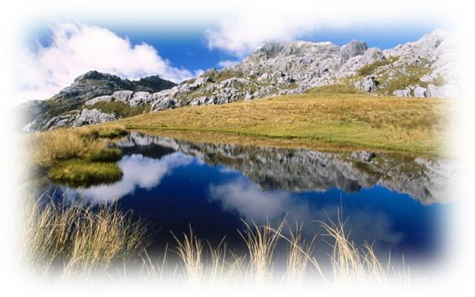
CHARACTERISTIC OF EUROPEAN FORESTS
The forest is the most complex ecosystem in the world.
It creates a kind of ecosystem in which interdependent of each other plants, animals, soil, water and climate, forming an indivisible whole.
Floristic composition and forest structure of the layers are conditioned primarily properties of the local forest habitat.
Forested areas have on the Earth's natural occurrence limits.
Forests serve multiple and very important functions. These are:
Ecological functions,
Economic functions,
Social functions.

Slide 3
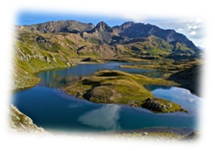
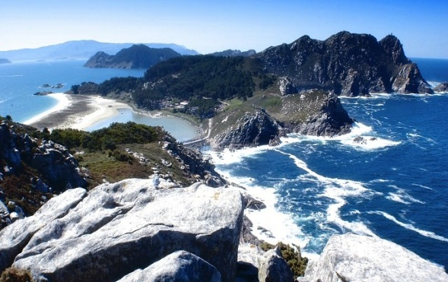
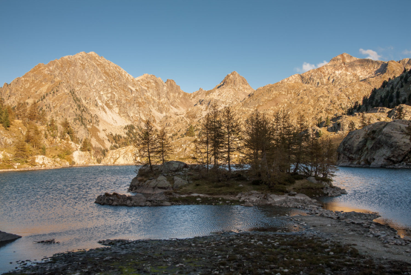
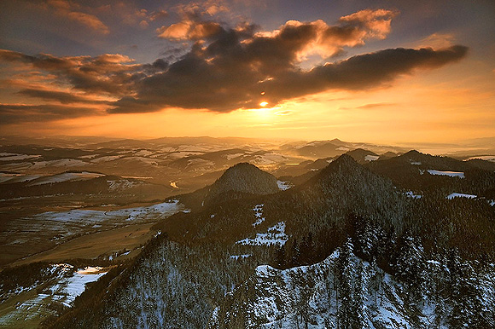
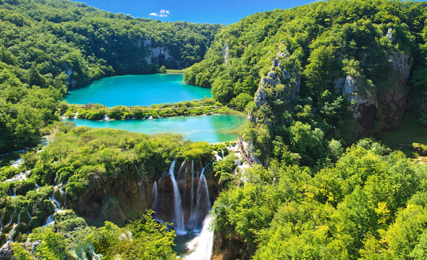
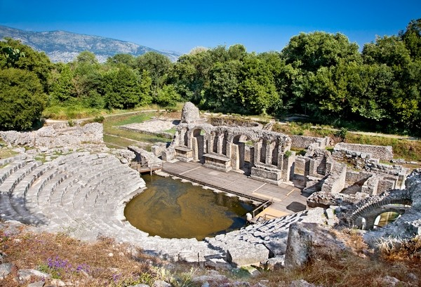
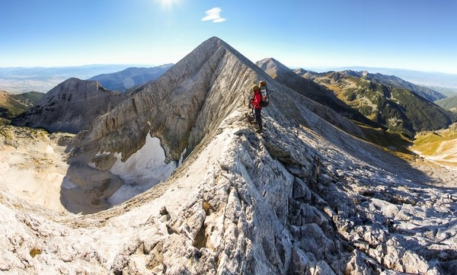
The most famous National Parks in Europe
Gran Paradiso
Islas Cies
Mercantour
Pieniński
Plitvice Lakes
Butrint
Piryn

Slide 4
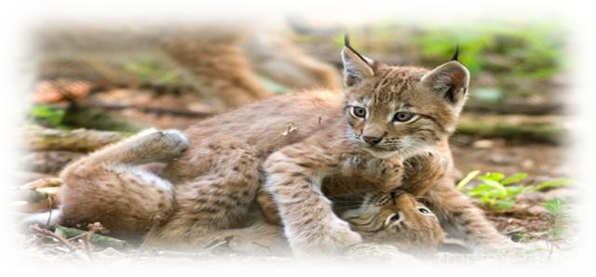
Unique flora and fauna in Poland
Poland stands out the most diverse and richest biocenoza forest in Central Europe. Among the vascular plant species can be found from different geographical regions.
Consequently, there are species of Eurasian and North American Arctic, Central European, Western European and Black Sea, even Mediterranean species.
The image of Polish fauna consist of species that arrived in various periods, starting from the last ice age.
In Poland there is approx. 33,000 species of animals.
Most are animals that spread easily and quickly, living all the moderate zone of Eurasia, such as the grass snake, hawk, red squirrel, roe deer and red deer. Some of them are typical of the deciduous forest zone and mixed.

Slide 5
Protected species in Poland and Europe
Poland:
Europe:
Mountain Goat - typical mountain animal.
European Bison - is the largest wild land mammal in Europe.
Lynx - biggest wild cat naturally occurring in Europe
Aesculapian Snake - In Poland you can find it in the south-eastern part of the country
The Gray Seal - a predatory marine mammal
Falcon - populated all continents except Antarctica.
Brown Bear - inhabits Asia, Northern Europe and North America.
European Otter - European otter - a species of small mammal; It occurs in almost all of Europe and Asia
Wolf - genus includes species found in Europe, Asia, America, Africa and Australia.

Slide 6
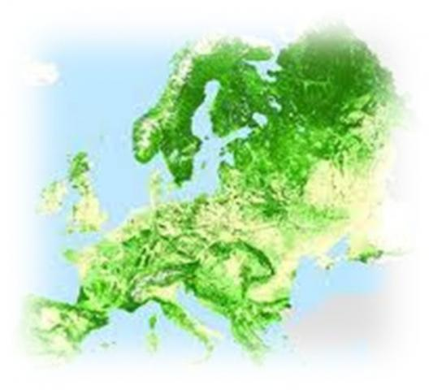
Woodiness of Europe
Forest cover a specific area (state, province, municipality) is the percentage of area covered with forests in relation to the whole area.
Countries with large forest cover are the Scandinavian countries. Forest areas of these countries is taiga. Small forest cover of some countries is caused by a cut forests or large share of natural areas treeless - steppes.

Slide 7
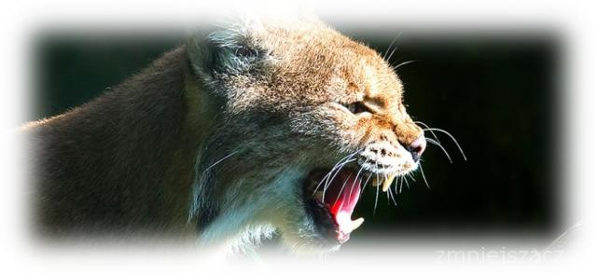
Natura 2000 in Europe
Natura 2000 - network program nature protection areas in the European Union. The aim of the program is to preserve certain types of natural habitats and species that are considered rare and endangered across Europe.
The basis for the Natura 2000 program are two EU directives - the Birds Directive and the Habitats Directive. The whole Natura 2000 network consists of 18% of the European Union.

Slide 8
the work was done by:
Natalia Bereza
Michał Struski
Mateusz Strzelecki
Uczniowie kl. III gimn.
Zespołu Szkolno-Przedszkolnego w Żelisławicach

Slide 9
SOURCES :
http://www.agenziacoesione.gov.it/it/Notizie_e_documenti/eventi/2015/febbraio/Documento_0002
http://hiszpania-portal.pl/islas-cies-park-narodowy-atlantyckich-wysp-galicja/
http://blog.kwark.pl/?p=20412
http://www.parki_css.republika.pl/pi7.html
https://pl.wikipedia.org/wiki/Parki_narodowe_Europy
http://matkaziemia.net/najpiekniejsze-parki-narodowe-europy-wsrod-nich-polski/
http://www.ekokalendarz.pl/dzien-dzikiej-fauny-flory-i-naturalnych-siedlisk/
https://zszembrzyce.wordpress.com/projekt-blizej-natury-2/dodatkowe-prace-wolontaruszy/dzika-europa/
http://www.dwordroblin.pl/pl/hotel/okolica/grzybobranie/
http://podroze.gazeta.pl/podroze/56,114158,10663021,polska-rys,,6.html
http://tylkoryby.pl/tag/flora-i-fauna-polski
http://www.fundacjakarpacka.org/aktualnosci-208-bieszczady-pelnikiem-zakwitna.html

