Slide 1
FORESTS IN POLAND

Slide 2
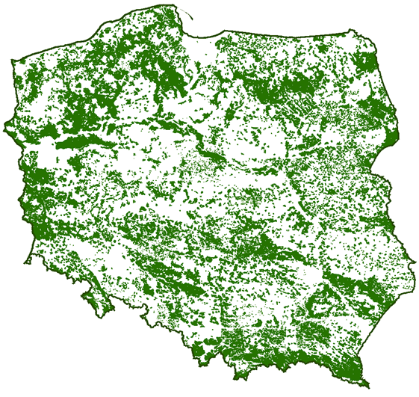
THE AREA OF FORESTS IN POLAND
Forests in Poland grow on 9 million hectares, which cover more than 28% of the country. The majority of them are national forests, more than 7.5 million hectares are administrated by Lasy Państwowe (State Forest) holding "State Forests". That is why it can be concluded that forester manage a nearly one-fourth of our country.

Slide 3
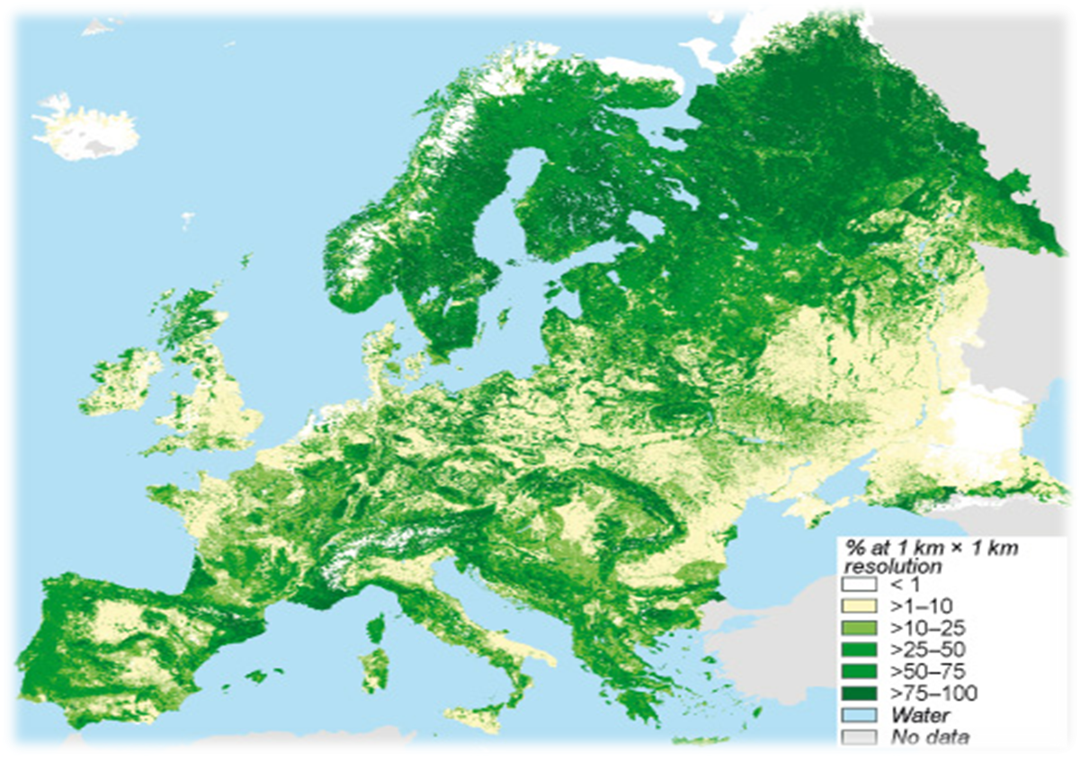
THE AREA OF FORESTS IN EUROPE
European forests cover about 32% of the continent.

Slide 4
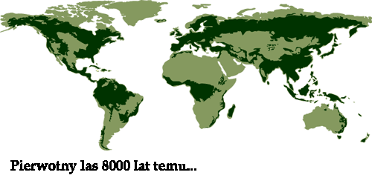
CHANGES OF THE WORLD FOREST AREA
PRIMARY FORESTS 8 000 YEARS AGO … AND FORESTS TODAY

Slide 5
What are the reasons of deforestation?
The main problem of reducing the area of forests is cutting trees.
In place of trees, fields (farmlands) or even new residential areas arise.

Slide 6
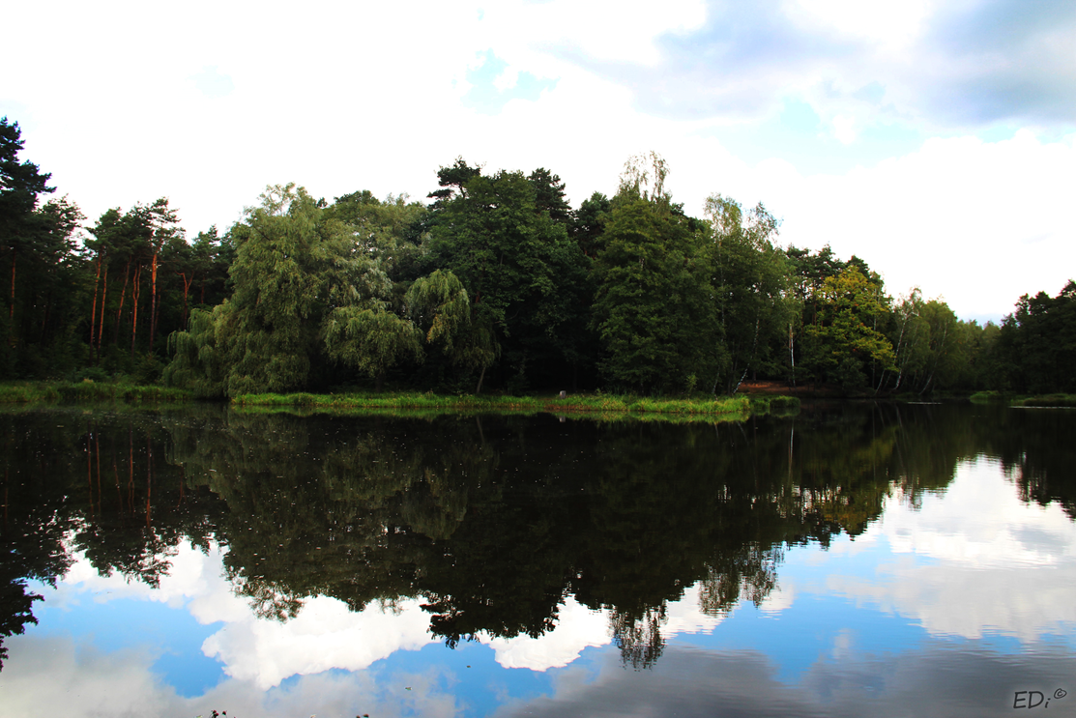
THE ROLE OF FORESTS
The main role of Polish forests is the possibility of recreation, relax and spending free time in the fresh air.
Moreover, forests protect people.

Slide 7
ANIMALS LIVING IN POLISH FORESTS
A lot of different animals live in the forests in poland. These include:
Deers
Hares
Foxes
Badgers
Bears (in the Tatra Mountains)
Wolves
Lynxes

Slide 8
TREES GROWING IN POLISH FORESTS
Leafy trees: birch-tree, linden, beech, oak, maple, willow.
Conifer trees: spruce, pine, fir.
In Poland there are mixed forests containing conifer and leafy trees.

Slide 9
THE PHOTOS OF POLISH FORESTS (Silesia – Rybnik, Lyski, Zwonowice, etc.)

Slide 10
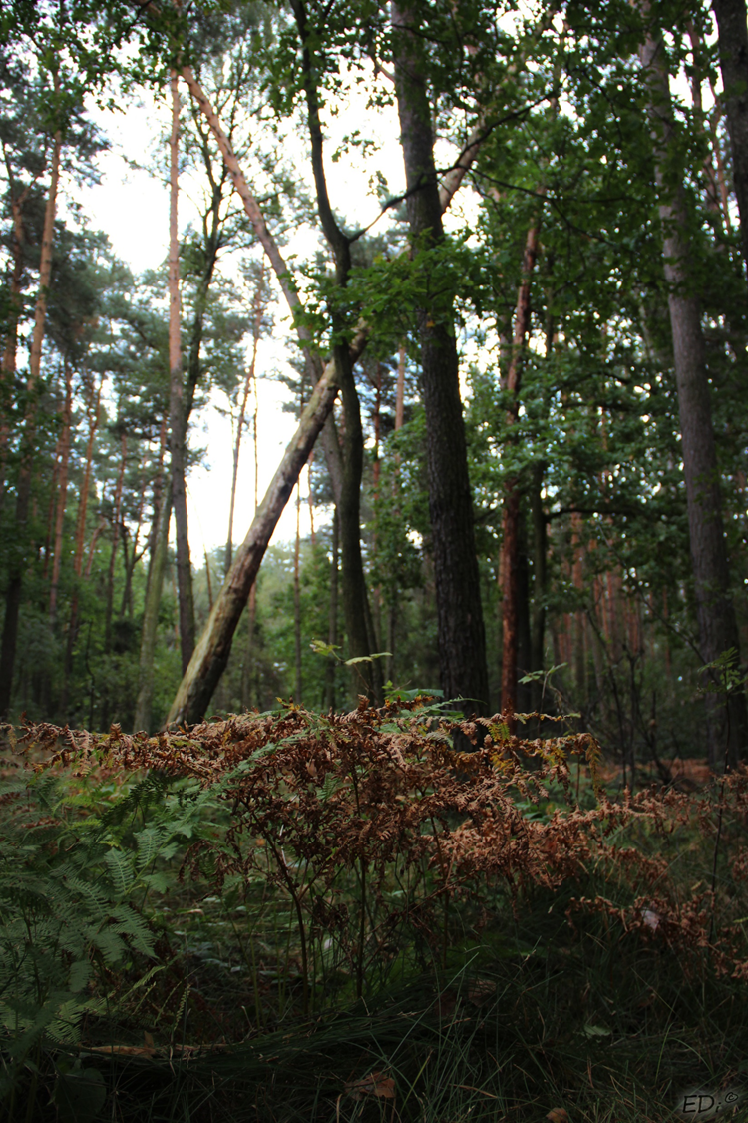
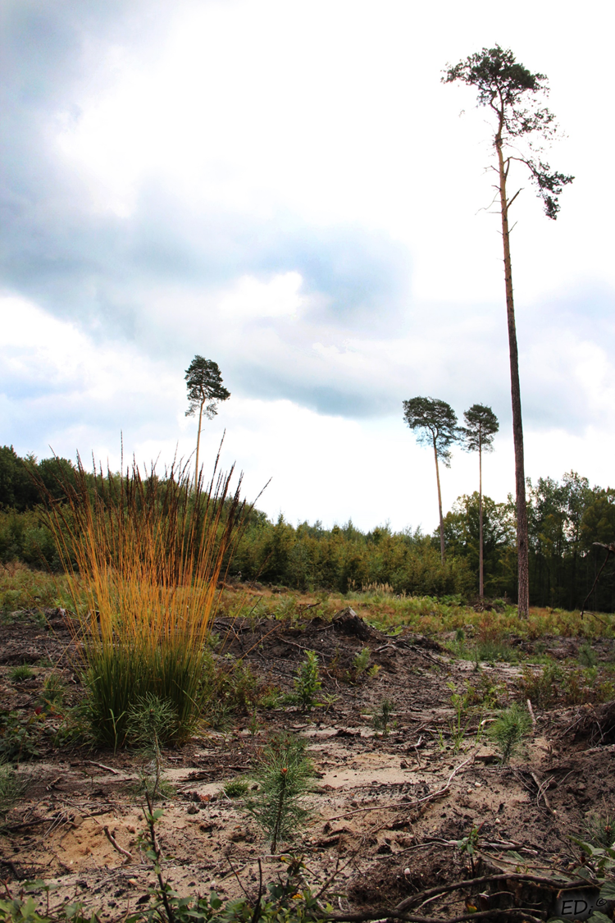

Slide 11
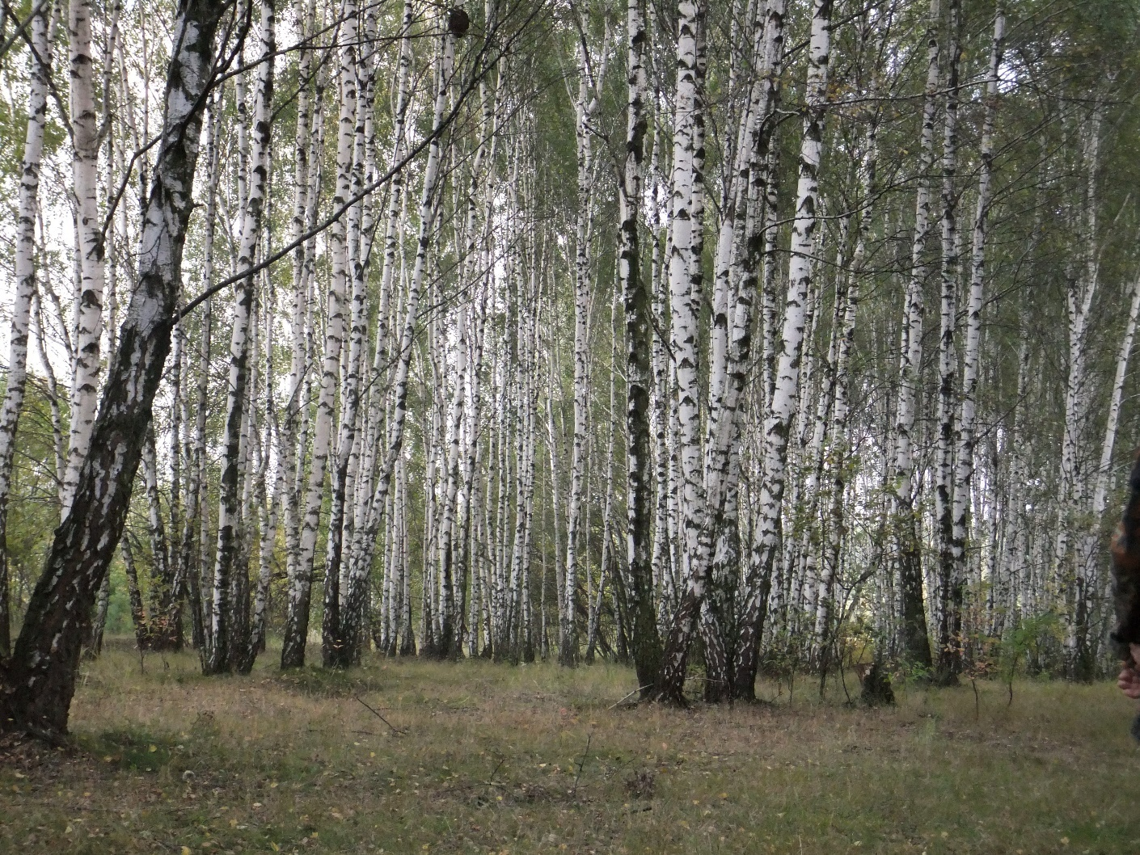
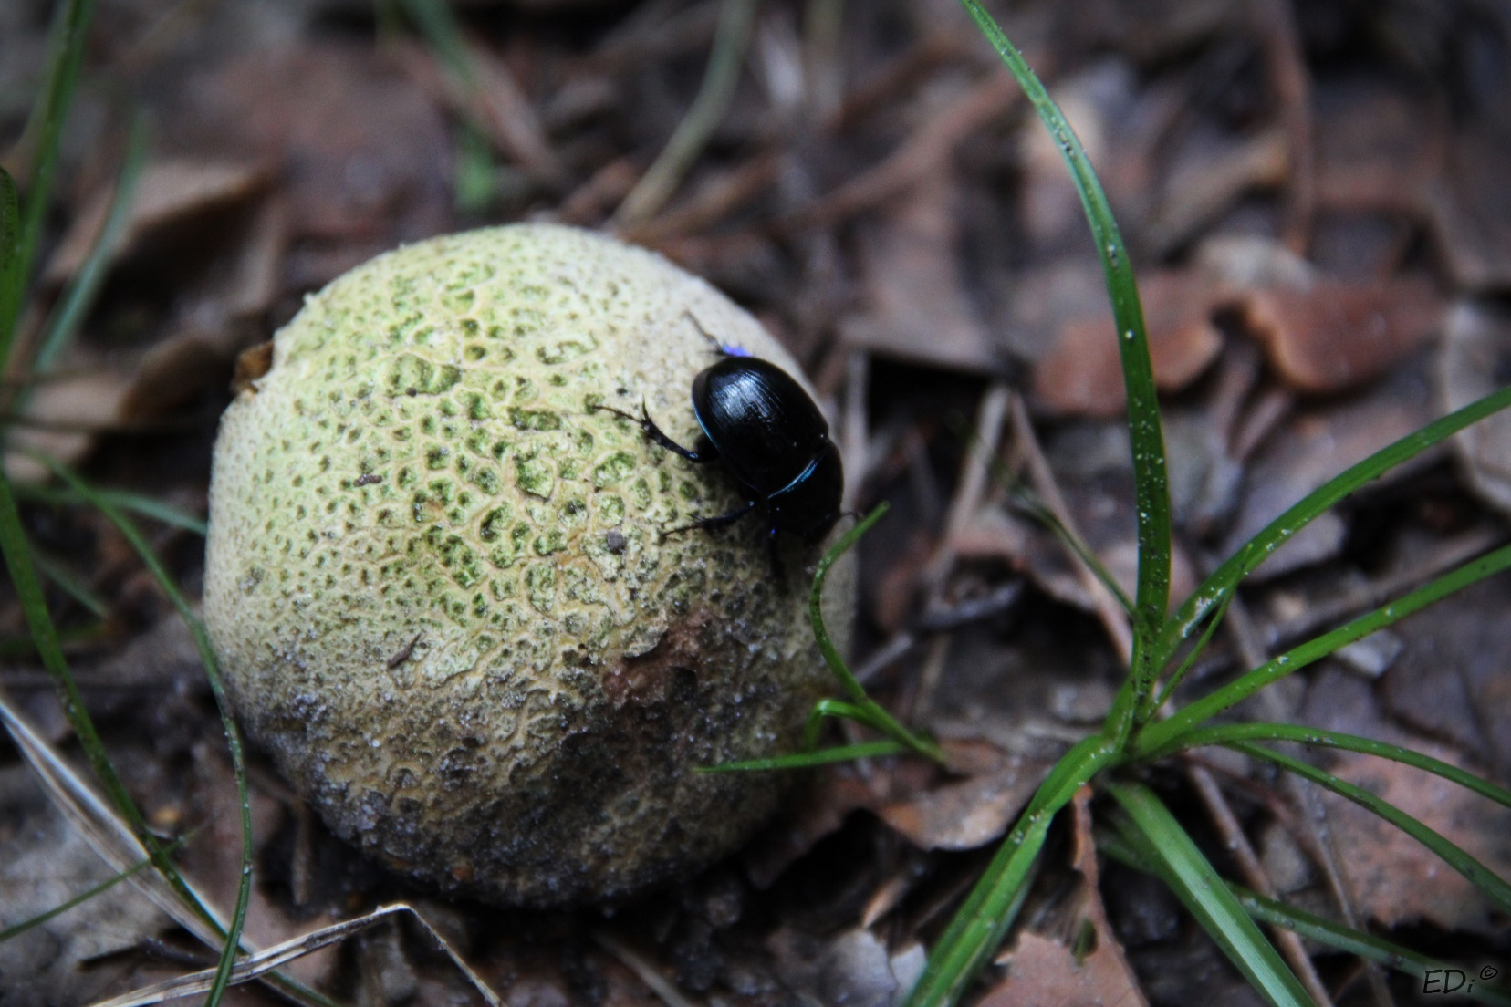

Slide 12
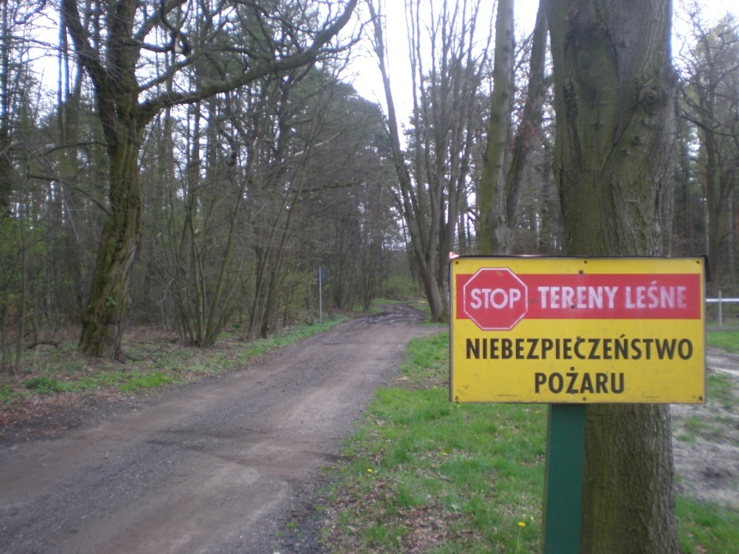
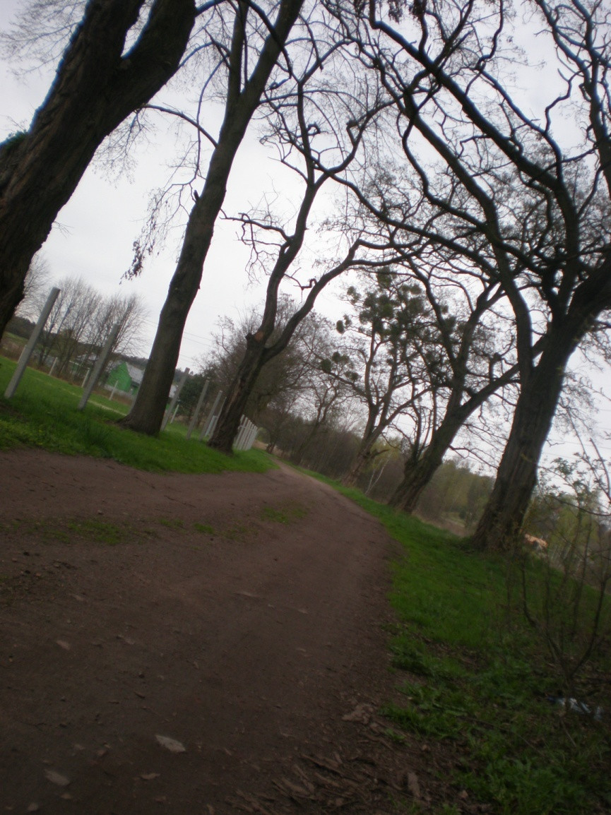
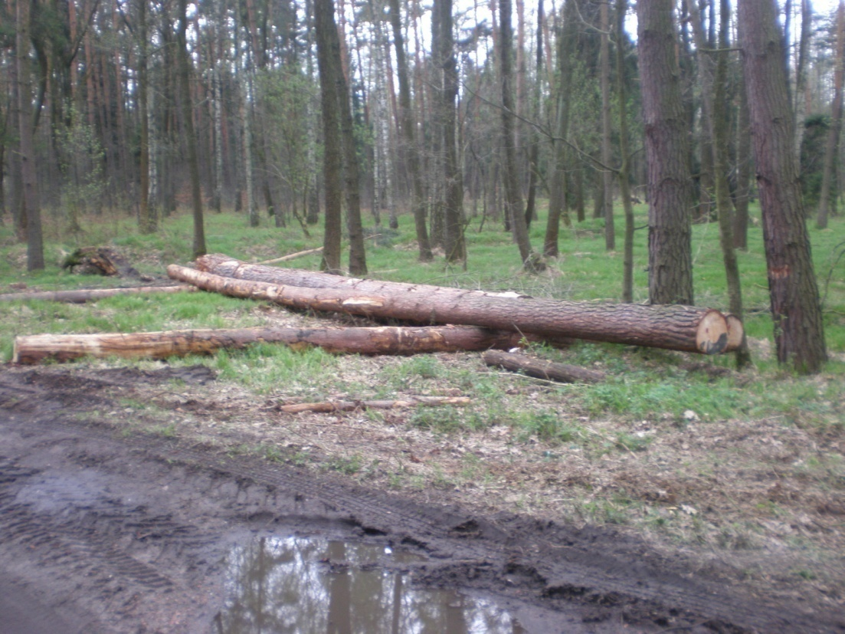

Slide 13
Do wykonania prezentacji użyliśmy naszej wiedzy, a także naszych umiejętności fotograficznych, korzystaliśmy również z zasobów internetu z następujących stron:
Zdjęcie 1 http://www.bdl.lasy.gov.pl/portal/Media/Default/HtmlWidget/2.png
Slajdy 2, 3, 4 zdjęcia google grafika:
Strona nadleśnictwa:
Zdjęcie 2https://zszembrzyce.files.wordpress.com/2011/10/imagesca6cw929.jpg
Zdjęcie 3 http://timiworld.friko.pl/obrazek.gif
http://www.rybnik.katowice.lasy.gov.pl/
Korzystaliśmy również ze słownika języka angielskiego
DZIĘKUJEMY ZA OBEJRZENIE NASZEJ PREZENTACJI ☺

Slide 14
The project has been made by
Natalia Polak, Konrad Brzęczęk, Krzysztof Dudek
Kl. I TH
Zespół Szkół Ekonomiczno – Usługowych w Rybniku

