Slide 1
„Forests in Poland and Europe. Characteristics and management”
Forests in Poland

Slide 2
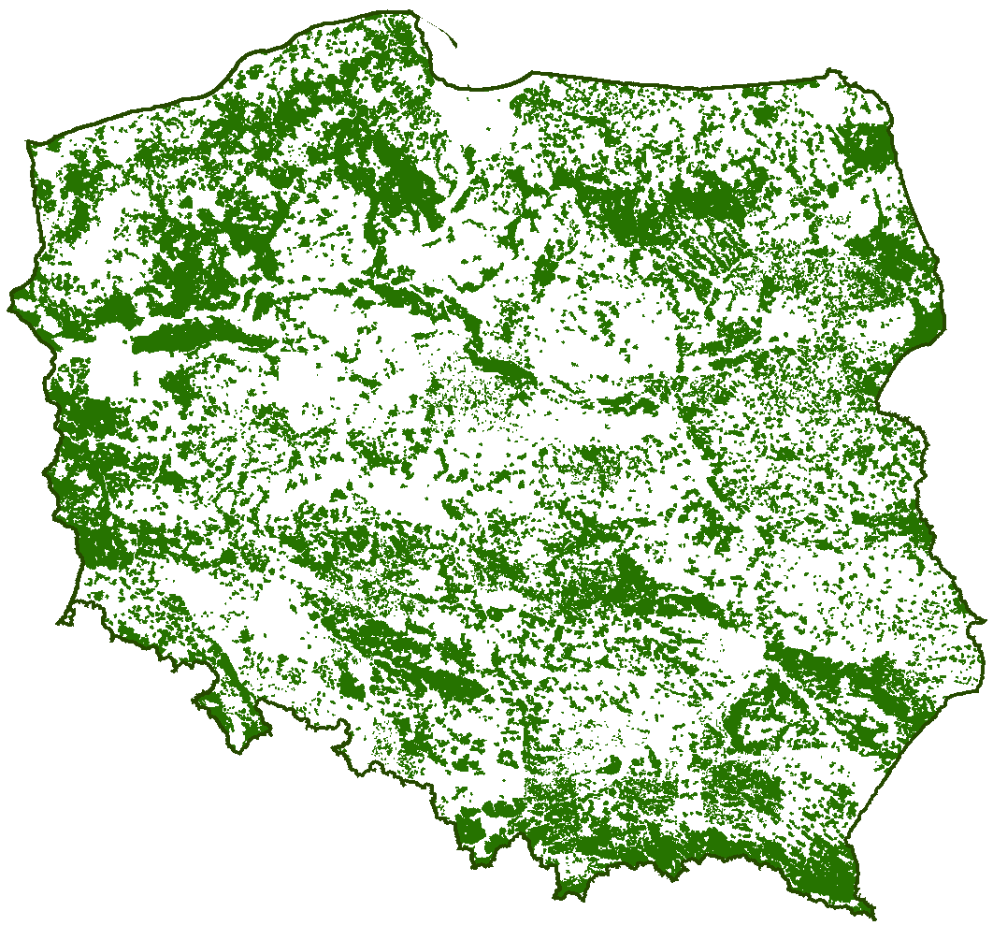
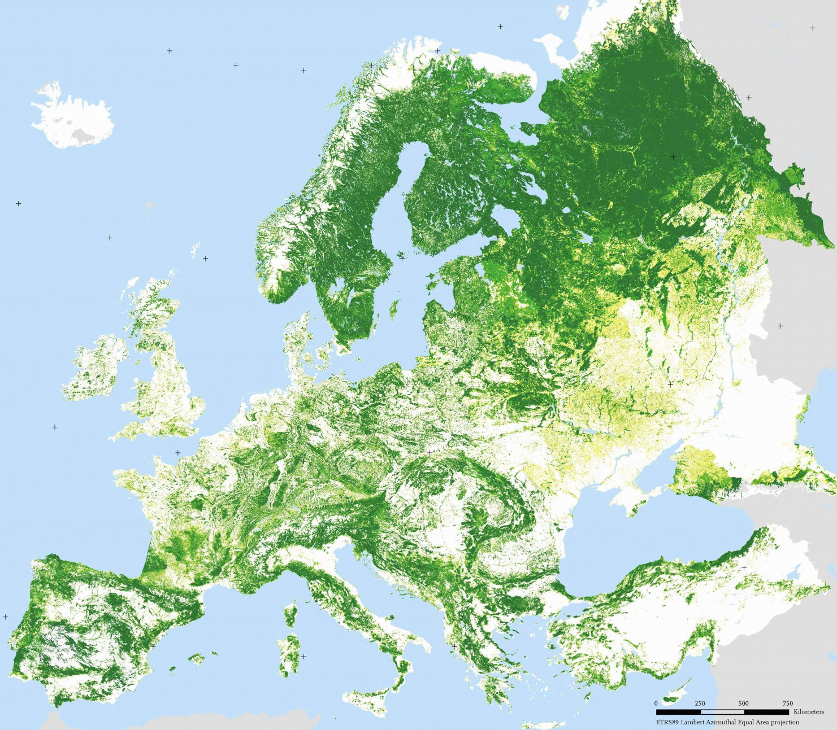
Afforestation Europe
POLAND
What does it mean ?
Afforestation – proces creating a forest on the surface other than the forest , for instance: marshes ,bogs and areas damaged by human activity.

Slide 3
Comparison afforestation between Europe & Poland
In Poland seeds more and more forests ever year. Afforestation of the country increased from 21 % to 29.2 % over/ within sixteen years and area of forests became bigger about 388000 hectare. Polish forests has got lots of plants, animal and mushrooms. There lives 65% all of animal species.

Slide 4
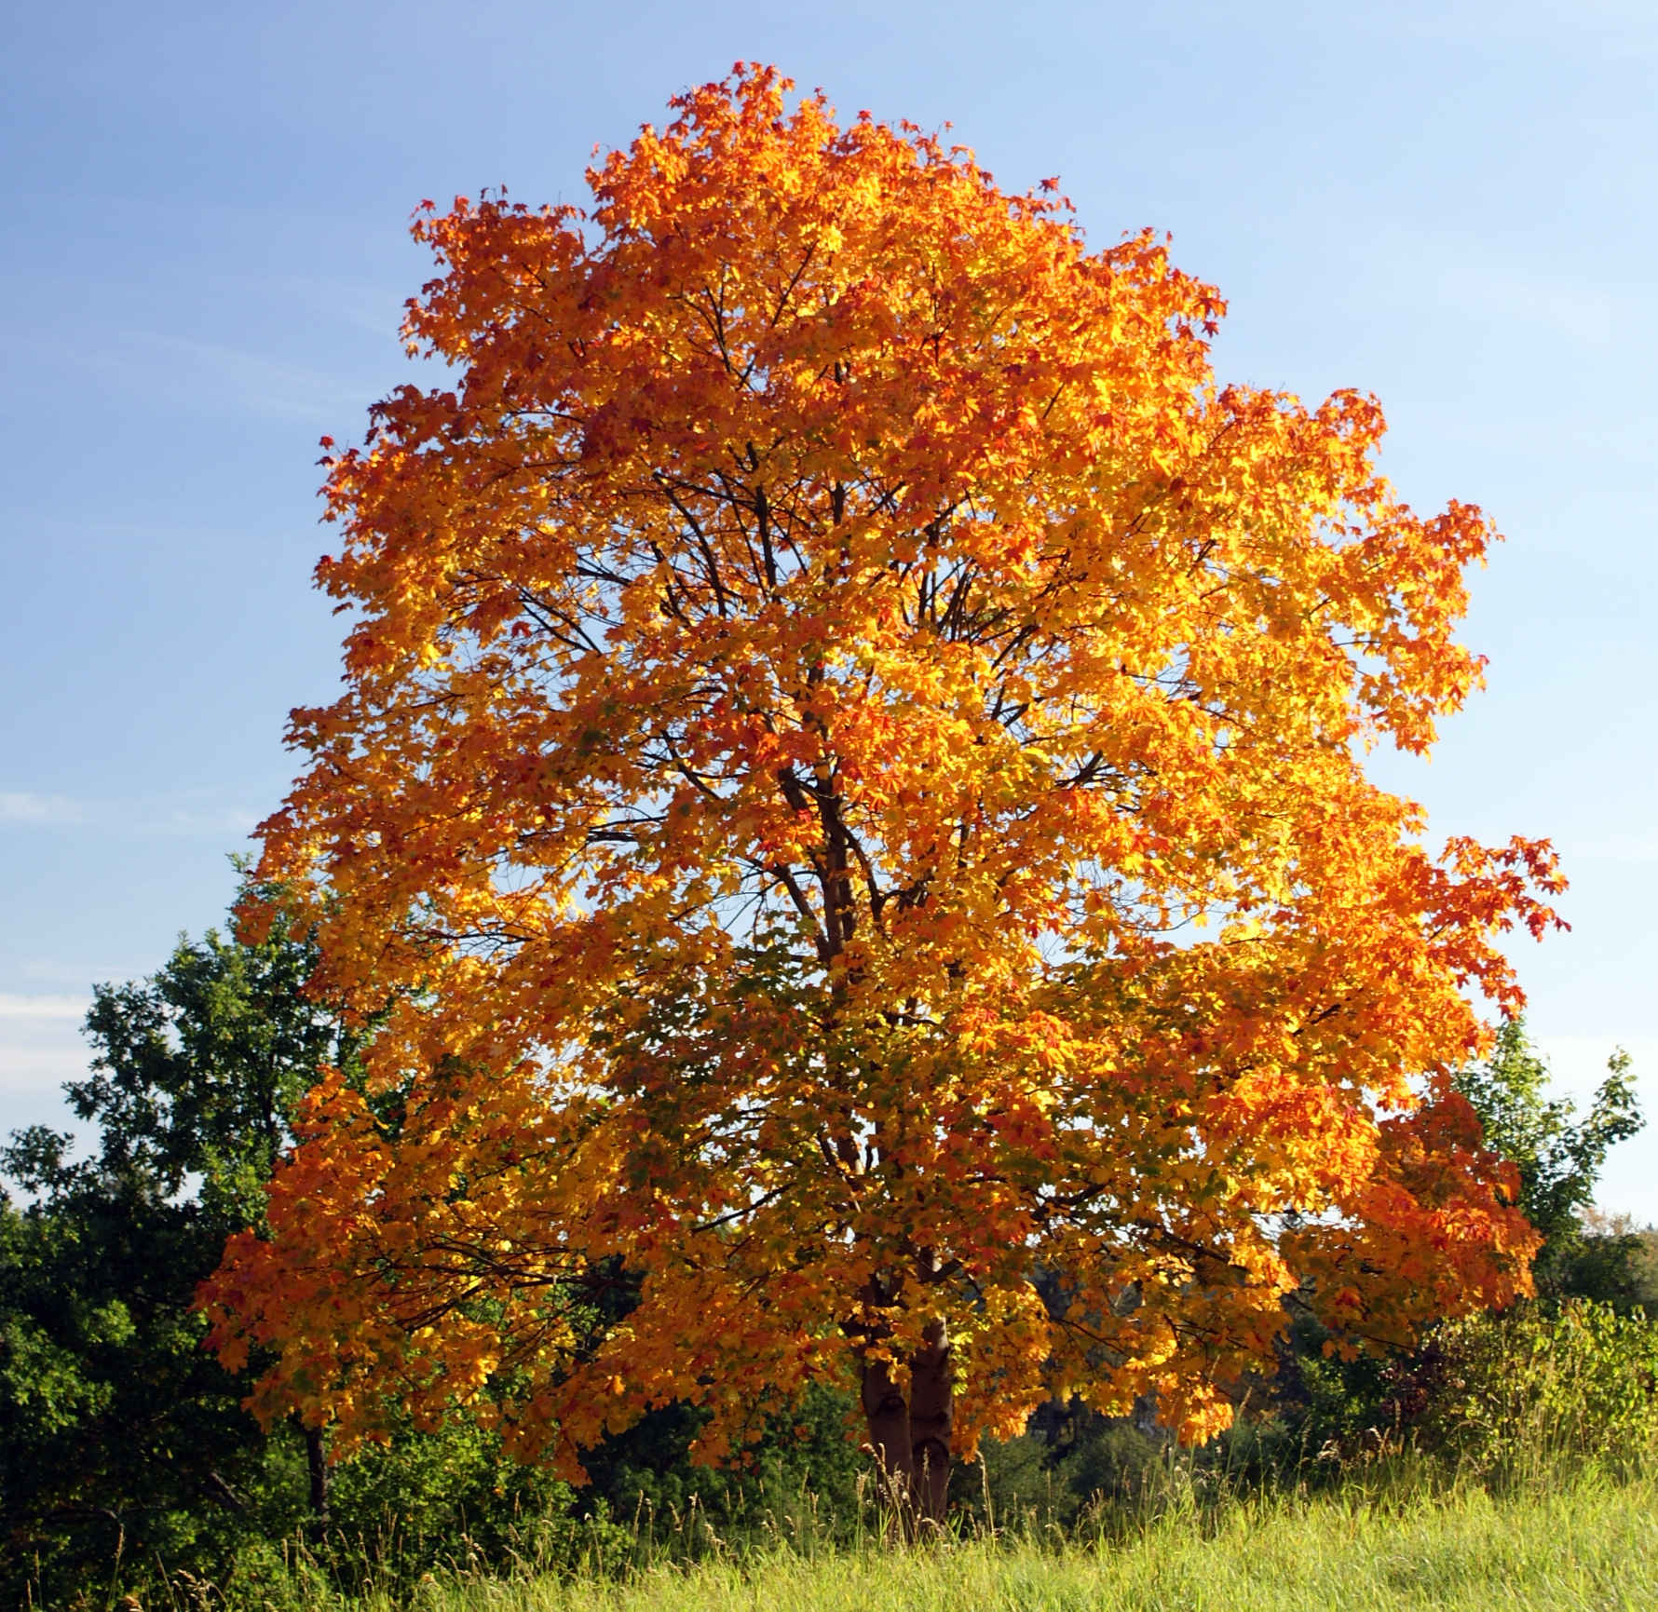
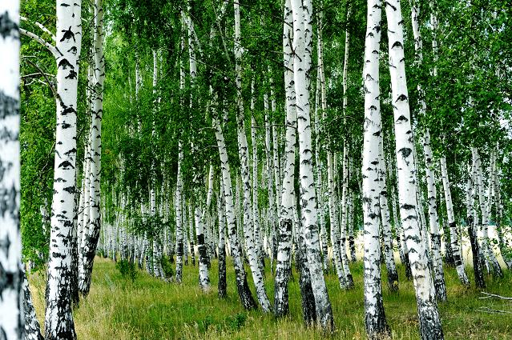
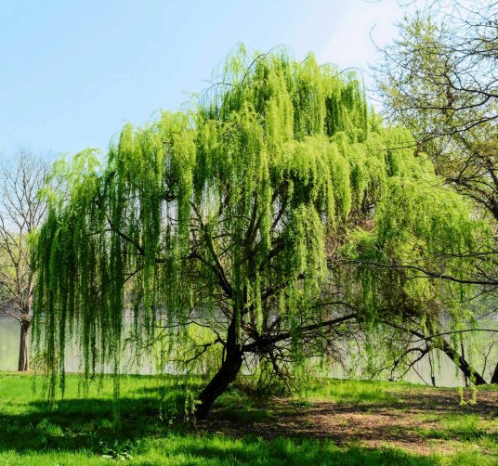
Flora
Polish forests systematically increasing the share of deciduous trees. That’s why area of ​​deciduous trees has increased from 13% to 28.2 %. In Poland more often we can meet oaks, ashes, maples, sycamores, elms, and birch, beech, alder, poplar, hornbeam, aspen, linden and willow.

Slide 5
TYPES OF FOREST IN POLAND
Oak-hornbeam forest
Coniferous forest
Riverine forest
Alder forest
Deciduous forests grows on fertile soils.
These forests grow on infertility soils and
mainly consist of coniferous trees.
Decidous forest are on wetlands.
It occures in the swamps, bogs and wetlands.

Slide 6
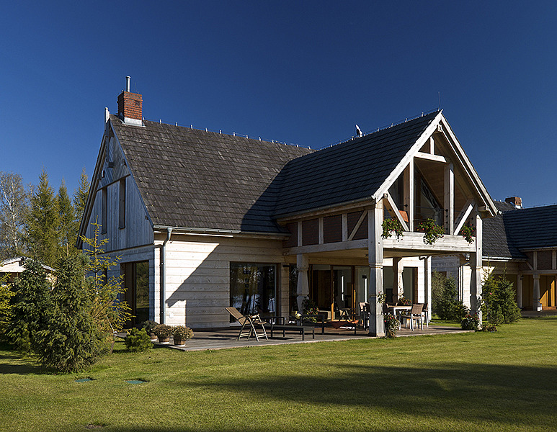
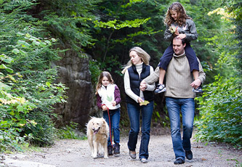
THE BENEFITS OF FORESTS FOR HUMAN - why the forest is needed?
Trees clean and freez air with carbon sequestration and they give oxygen, without which there would be no life on earth.
Wood is uses to build houses where lives people.
They helps us save well-being and health not only the possibilities to sightseeing (eg.walking) but also in other ways. Hockey sticks , cricket and baseball , and tennis rackets like many others produced from wood.
A large part of medicines is produced from the bark, leaves, fruits, flowers and roots.

Slide 7
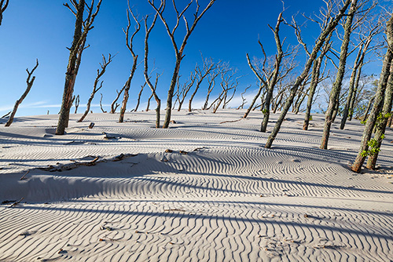
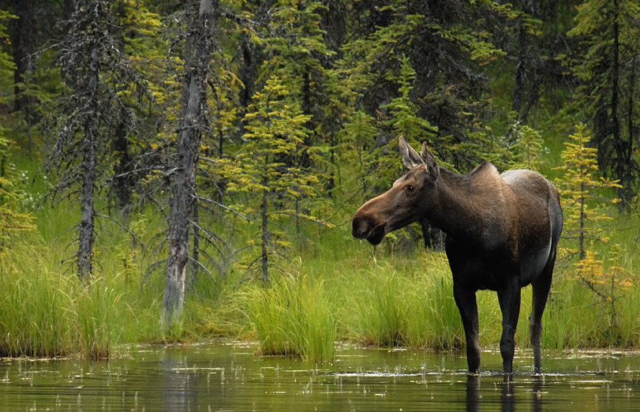
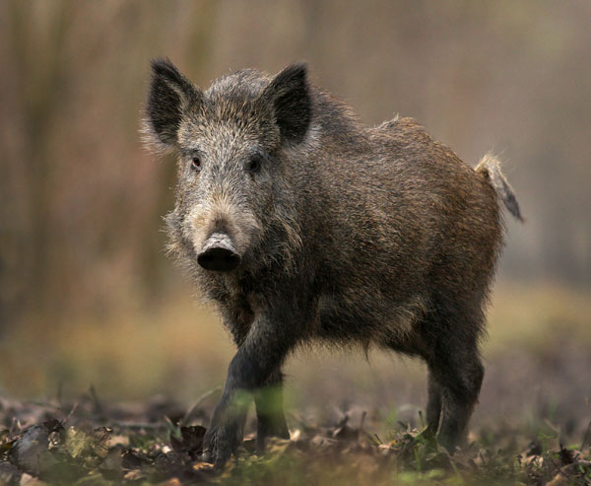
THE BENEFITS OF FORESTS FOR HUMAN- why the forest is needed?
Trees by the release of water vapor, are involved in the process of creating clouds which bring us rain.
They stops strong winds, which slows down the formation of deserts .
Forest are natural home for milon of animals, including boars and mooses.

Slide 8
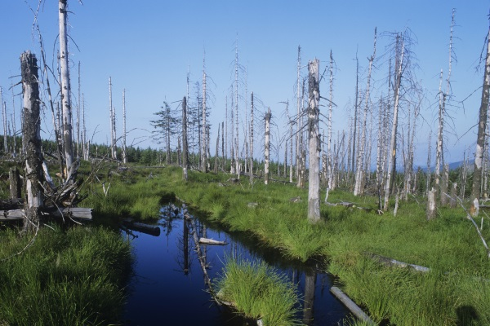
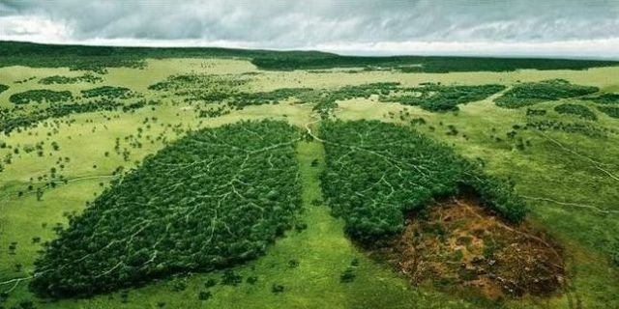
Pollution
Unfortunately in Poland are many strict industrial which are very contaminated and ecologically threatened. Belongs here of course Górnośląski industrial region, Legnicko-Głogowski, Krakowski, Szczeciński.
Most of this contominated areas are offiliated with a strong industrial development and big cities. But not always gore to be like that. For example – capital of Poland, Warsaw, which is area of ​​ecological hazard.
The clenest area in Poland are Green Polish Lungs (Warmia and Mazury). What is more serious threat is also acid rain.

Slide 9
The creators of the presentation are studensts who attend to first class of High school name of Ziemi Kujawskiej in Włocławek, POLAND.
WERONIKA CHOJNIAK
MAGDA GÓRSKA
DAWID GÓRSKI

Slide 10
Bibliography
https://www.google.pl
http://www.bryk.pl
https://en.wikipedia.org
http://www.erys.pl
http://www.bdl.lasy.gov.pl
http://www.lodz.lasy.gov.pl
http://www.lp.wi.pl
http://www.wykop.pl

