Slide 1
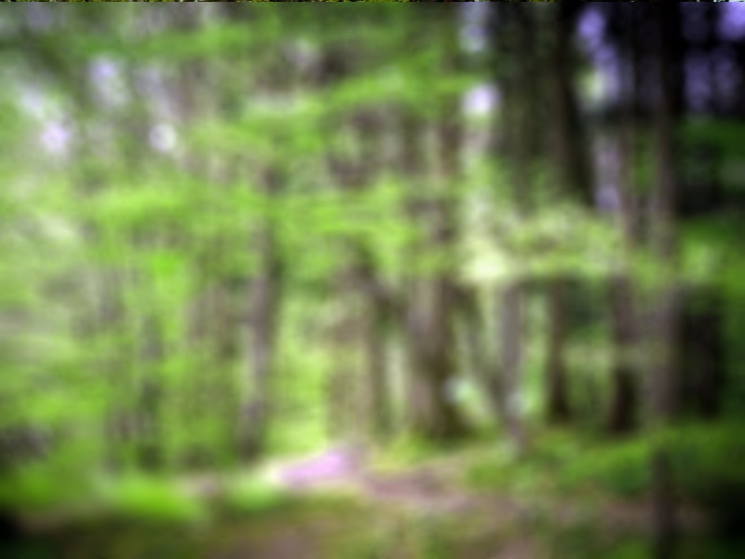
Forests in our region
VI YPEF
(Łódź voivodeship)
I Liceum Ogólnokształcące im T. Kościuszki w Wieluniu
Sandra Faińska kl. I Elena Panek kl. I Weronika Bartosiewicz kl. I

Slide 2
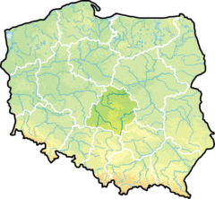
We live in central part of Poland in Łódź voivodeship
Forests on Łódź territory have a surfaces 386,1 thous. ha (all forests in Poland 9197,9 thous. ha).
Woodiness voivodeship is 21,3% and it is lowest in Poland.

Slide 3
Selected species of trees in % of forest area in Łódz Voivodeship

Slide 4
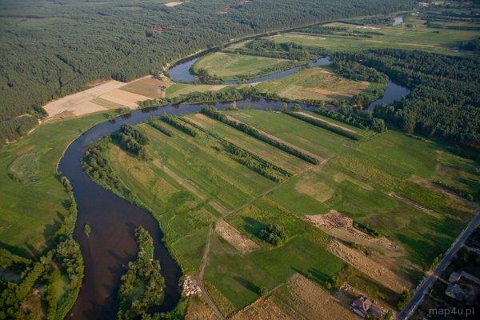
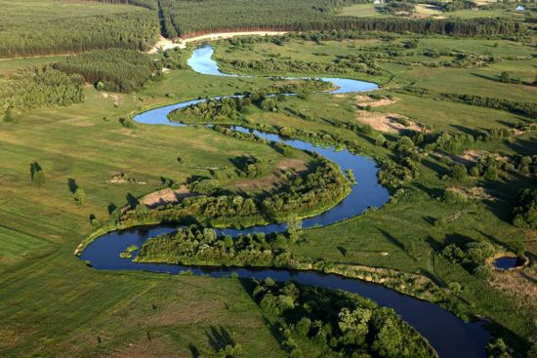
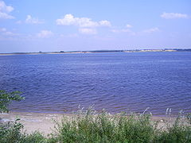
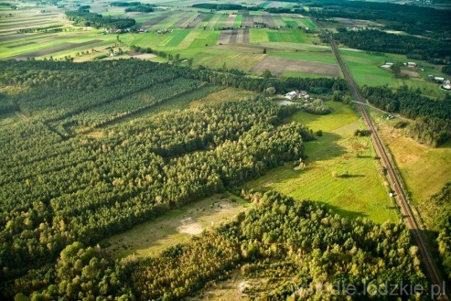
The Natura 2000 areas in the Łódź voivodeship
Special Protection Area
Zbiornik Jeziorsko
Pradolina Warszawsko-Berlińska
Dolina Pilicy
Dolina Środkowej Warty
IV.
III.
I.
II.

Slide 5
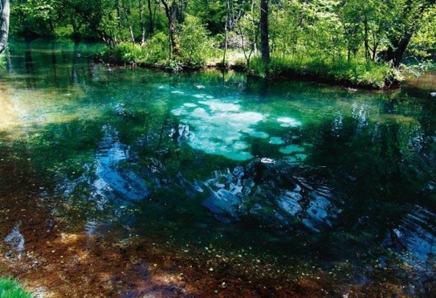
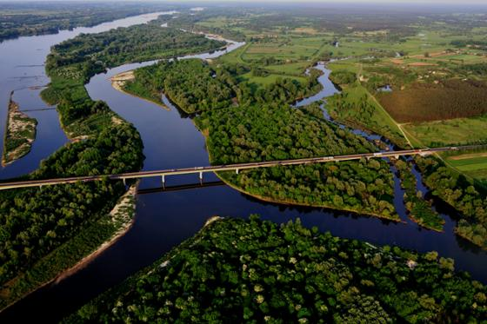
Site of Community Importance
Dąbrowa Grotnicka
Dąbrowa Świetlista w Pernie
Lasy Spalskie
Łąka w Bęczkowicach
Niebieskie Źródła
Pradolina Bzury-Neru
Załęczański Łuk Warty
Dolina Środkowej Pilicy
Dolina Rawki
Buczyna Gałkowska
Buczyna Janikowska
Cisy w Jasieniu
Dąbrowy świetliste koło Redzenia
Lasy Gorzkowickie
Grabia
Grądy nad Lindą
Las Dębowiec
Lasy Smardzewickie
Lipickie Mokradła
Lubiaszów w Puszczy Pilickiej
Dąbrowy w Marianku
Polany Puszczy Bolimowskiej
Słone Łąki w Pełczyskach
Torfowisko Żytno – Ewina
Wielkopole - Jodły pod Czartorią
Silne Błota
Szczypiorniak i Kowaliki
Wola Cyrusowa
Łąki Ciebłowickie
Święte Ługi
Torfowiska nad Prosną
Dolina Dolnej Pilicy
Grabinka
Ostoja Przedborska
Dolina Czarnej
Dolina Górnej Pilicy
V.
XXXIII.

Slide 6
Protected areas in Łódź voivodeship
Protected areas include almost 9% of territory voivodeship (about 1800 km²). Exist 89 reserves and 7 country parks (as listed below).
Bolimów Landscape Park (partly in Masovian Voivodeship)
Łódź Hills Landscape Park
Załęcze Landscape Park (partly in Silesian Voivodeship)
Przedbórz Landscape Park (partly in Świętokrzyskie Voivodeship)
Sulejów Landscape Park
Warta-Widawka Landscape Park
Spała Landscape Park

Slide 7
Załęcze Landscape Park (Załęczański Park Krajobrazowy)
It is located on Highland Woźnicko-Wieluńska near from ours locality.
Załęcze Landscape Park have a surface 14 750 ha, including 12 010 ha Protection Zone.

Slide 8
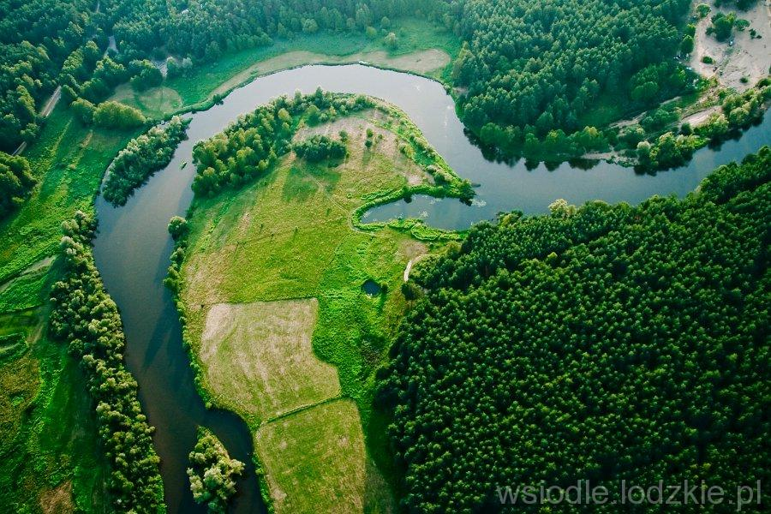
Highland Woźnicko-Wieluńska
Is situated nearer the south of Poland and it is area about 3 739km²
Upland is built of Jurassic rocks. Across highlands territory flows Warta river.
About 40km area of the valley between Lisowice and Kochale has been selected for the Natura 2000 areas and it was called Załęczański Łuk Warty.

Slide 9
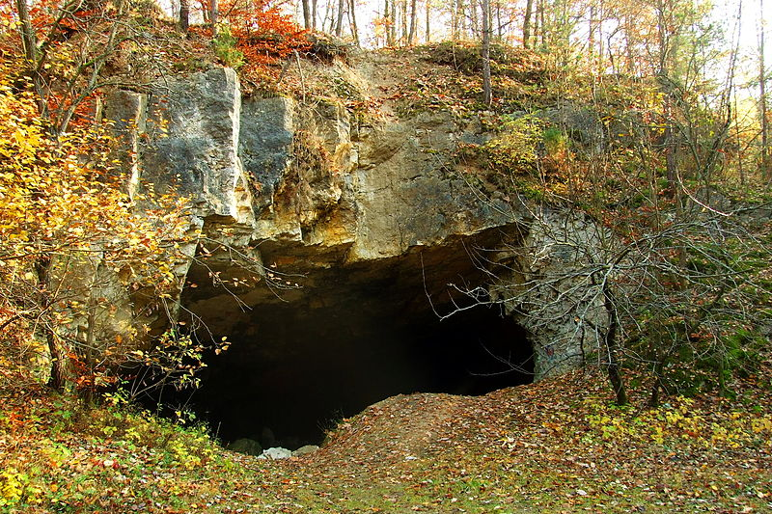
Highland Woźnicko-Wieluńska
Large difference of habitats (between highlands and lowlands with calcareous basis and with naturally character of the Warta river) cause large differences vegetation which grows here.
It also unique place for many species of bats for spending the winter. The largest accumulation where bats spend winter is cave "Szachownica"(" Chessboard").
Every year above 1000 bats hibernate here.

Slide 10
Made by
Sandra Faińska
Elena Panek
Weronika Bartosiewicz

