Slide 1
„Forest in Poland and Europe. Characteristics and management”.
„Forest in Poland and Europe. Characteristics and management”.

Slide 2
In our presentation we are going to equate the countries in the North and South from Poland
North | South
Latvia | Greece
Lithuania | Cyprus
Germany | Hungary
Belgium | Portugal
Finland | Romania
Norway | Slovakia
Sweden | Slovenia
Estonia | Ukraine
 | Albania
 | Czech Republic
 | Austria
 | Switzerland

Slide 3
North and…
South forests

Slide 4
Animals
 | Typical species: | Endemic species | Common species:
North | Reindeer, Badger, Otter, Moose, European bison, | European mink (Estonia) | Roe deer, Red deer, Wolf, Fox, Lynx, Wild boar, Brown bear, Fallow deer, Capercaillie.
South | Jackal, Wildcat, Mouflon, Vulture. | Gold-striped salamander (Portugal) Azores bullfinch (Portugal) Iberian lynx (Portugal)

Slide 5
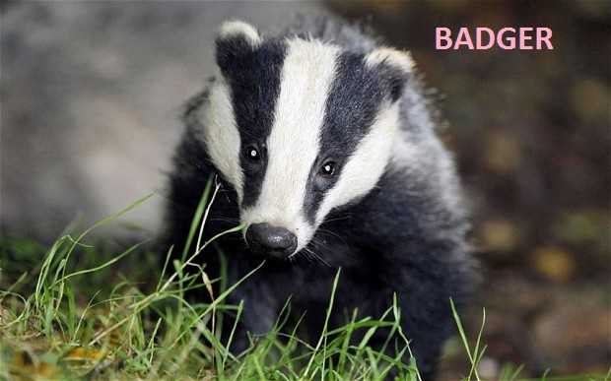
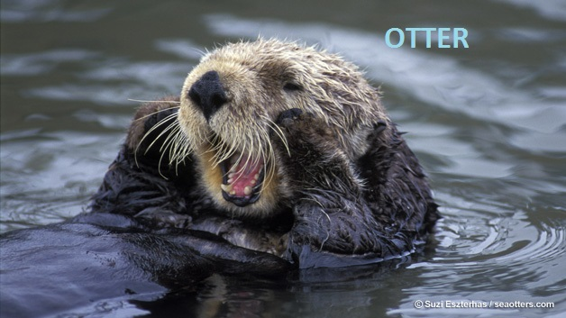
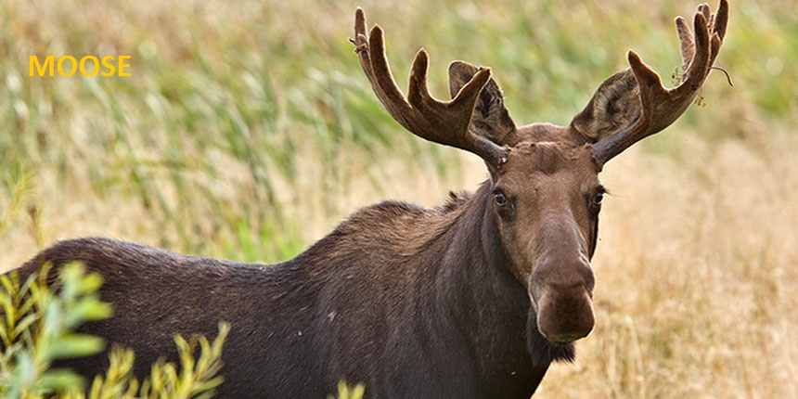
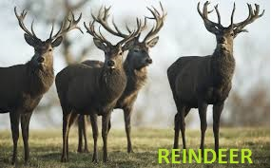
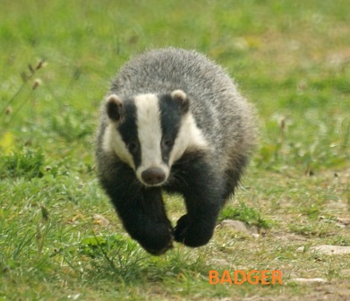

Slide 7
North and south climate

Slide 8
North and south soil

Slide 9
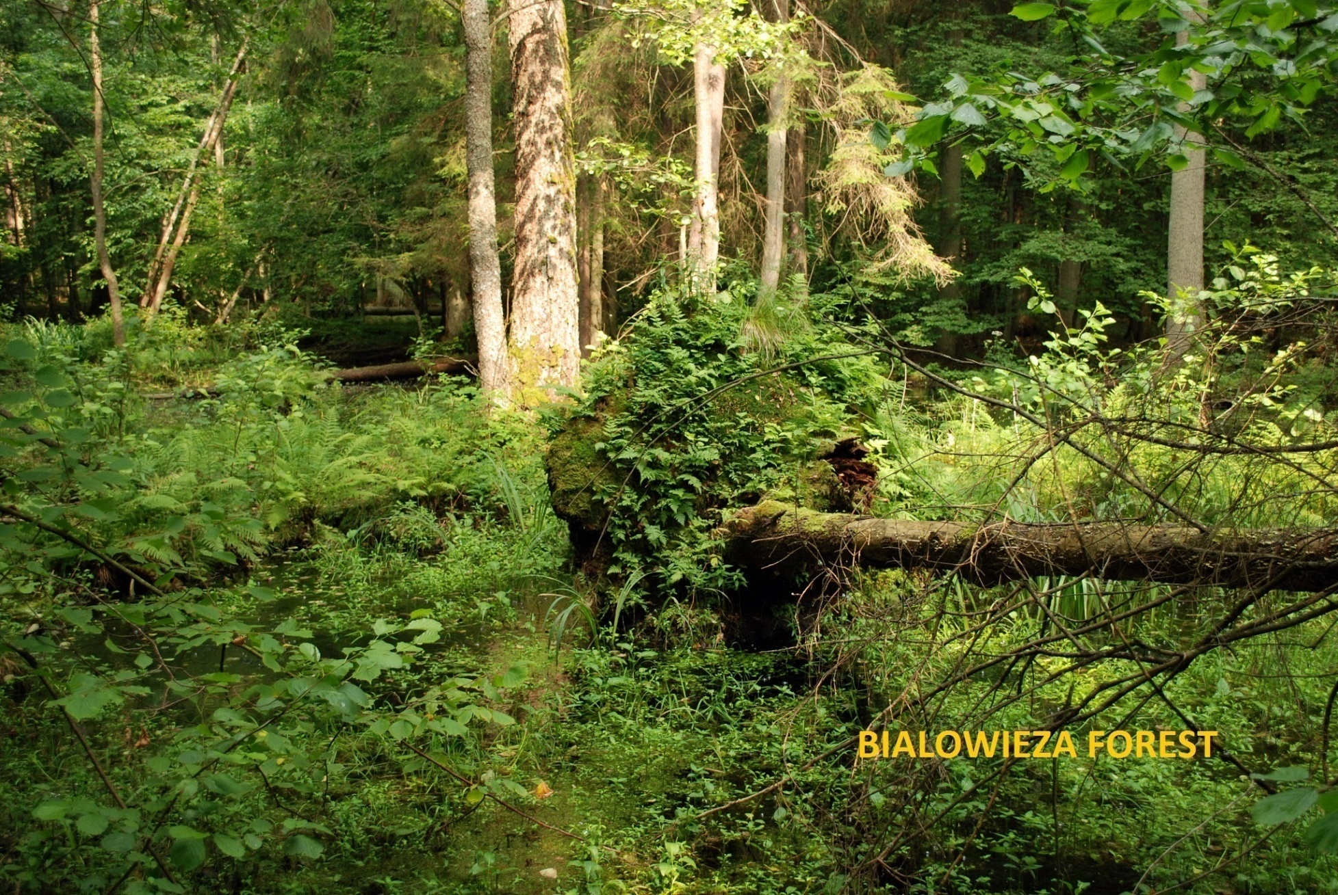
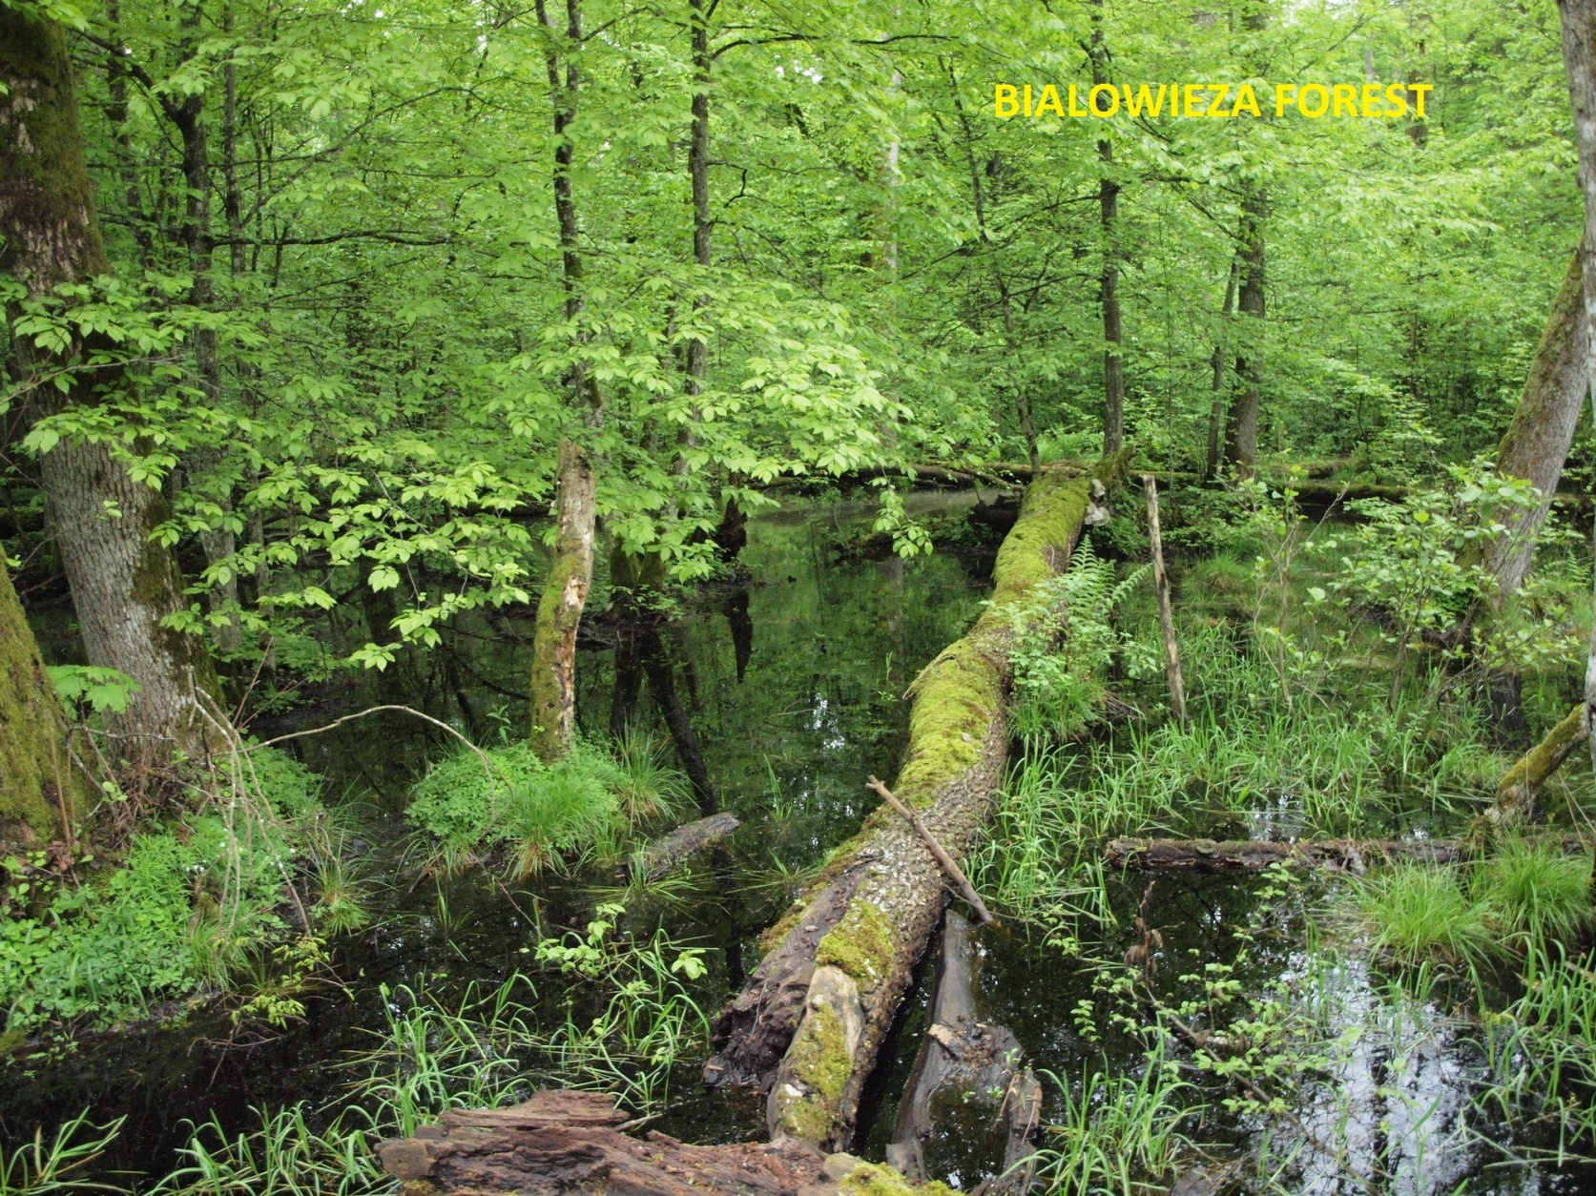
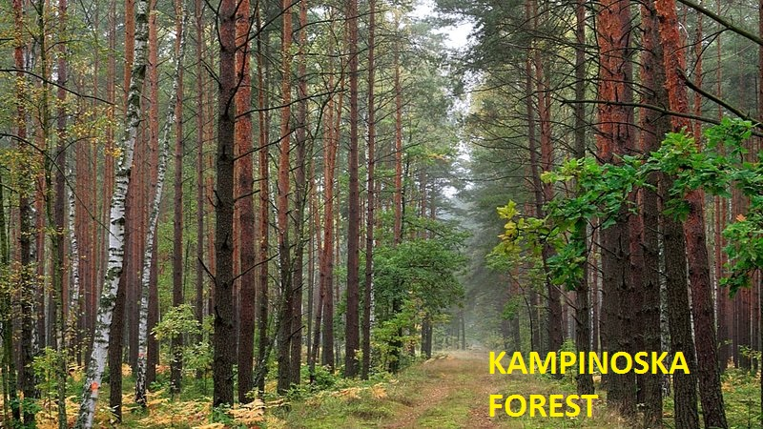

Slide 10
Bibliography
inhabitat.com
http://animaliaz-life.com/reindeer.html
www.wildlifetrusts.org
www.telegraph.co.uk
www.saveminnesotamoose.org
seaotters.com
www.businessinsider.com
srodowiskowiec.salon24.pl
commons.wikimedia.org
poznajpolske.onet.pl
natura2000.gdos.gov.pl
www.wikiwand.com
http://ypef.eu/
http://www.iww.uni-freiburg.de/
http://www.alfrc.org/
http://www.visitfinland.com/
https://www.thegef.org
https://discoveringbelgium.com
www.encyklopedia.pwn.pl
www.krzysztofgierak.pl
www.ap.krakow.pl
www.proekologia.pl
www.srodowisko.abc.com.pl
www.eea.europa.eu

Slide 11
Rozalia Kazienko IIG
Hiacynta Peregudowska IIG
Łucja Gaj IIG
PUBLICZNE GIMNAZJUM SIÓSTR URSZULANEK UNII RZYMSKIEJ WE WROCŁAWIU

