Slide 1
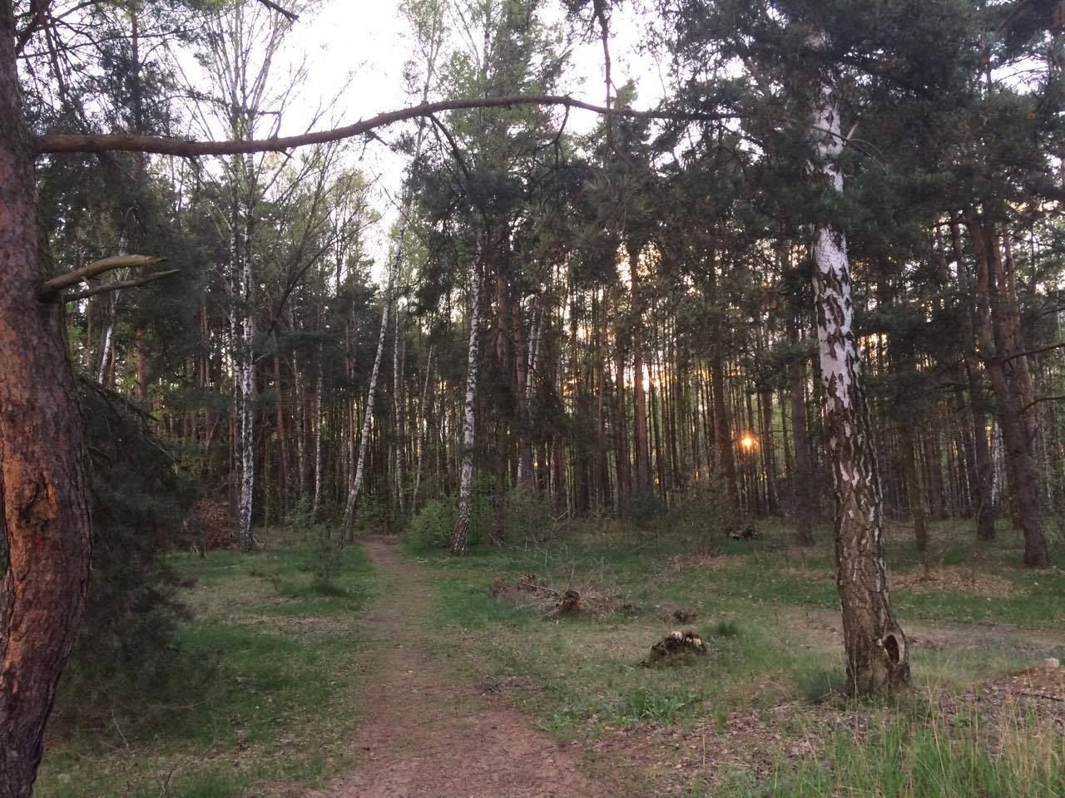
Forests in Poland and Europe. Characteristics and management
Threats

Slide 2
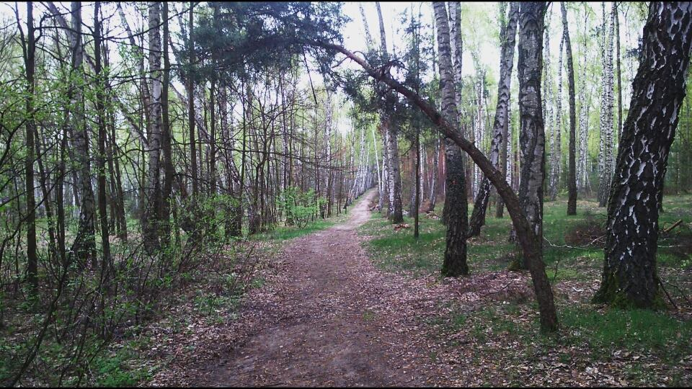
But...
Polish forests
are one of the most beautiful
places in the world.

Slide 3
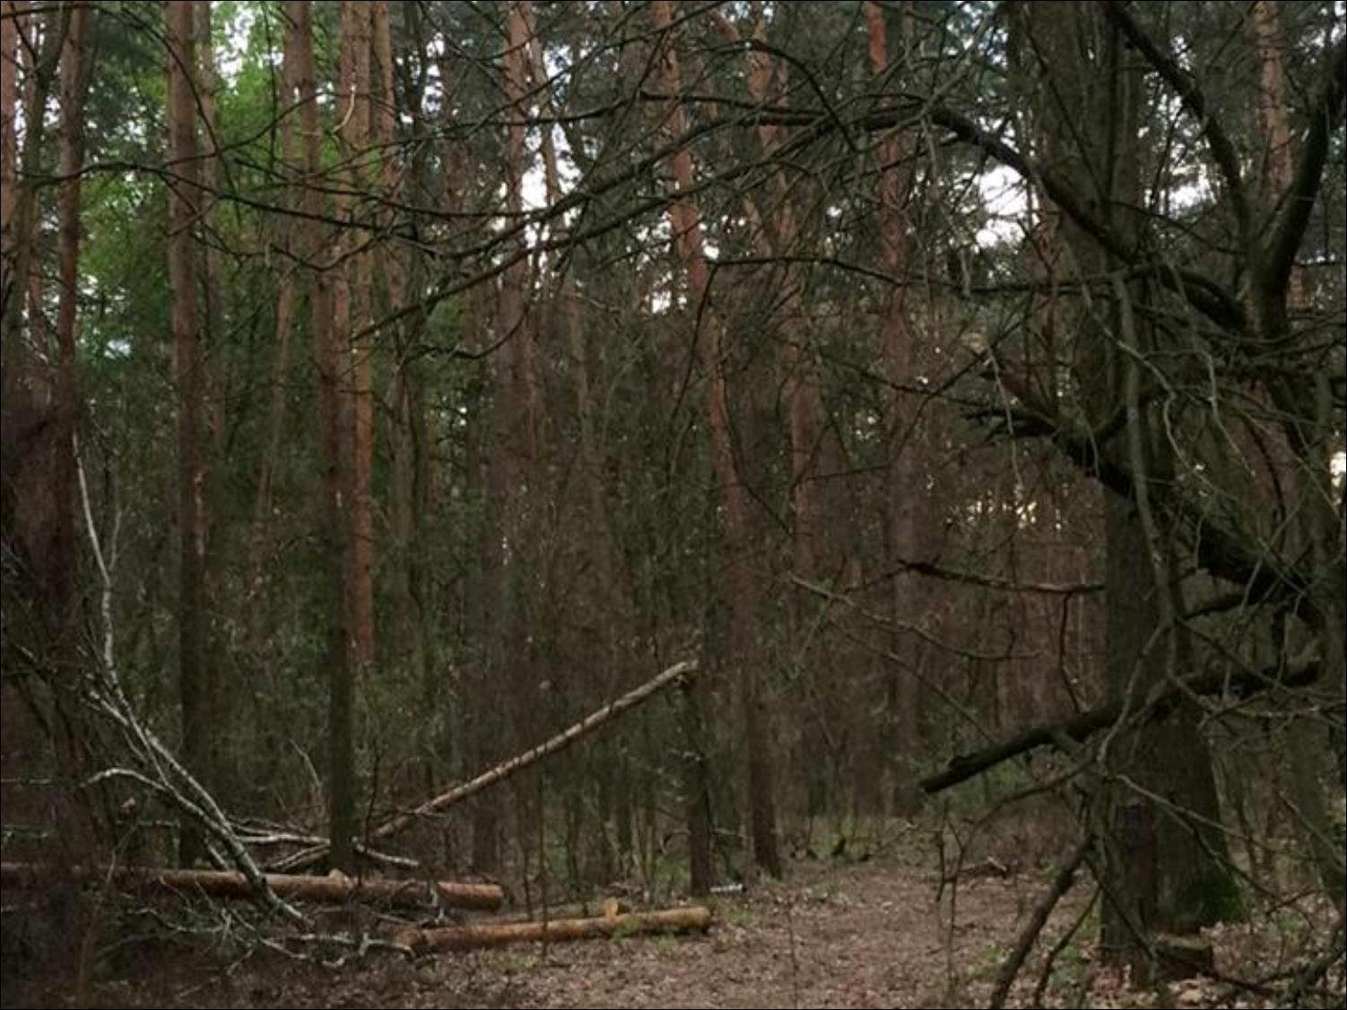
Increase in people's activity
One of the most popular example is human intervention in natural habitat- there are plenty wilderness that became fields. For centuries forests‘ve been burnt and cut out to make new fields, villages and cities. We don't cut only one tree, we kill many animals and other forms of life.

Slide 4
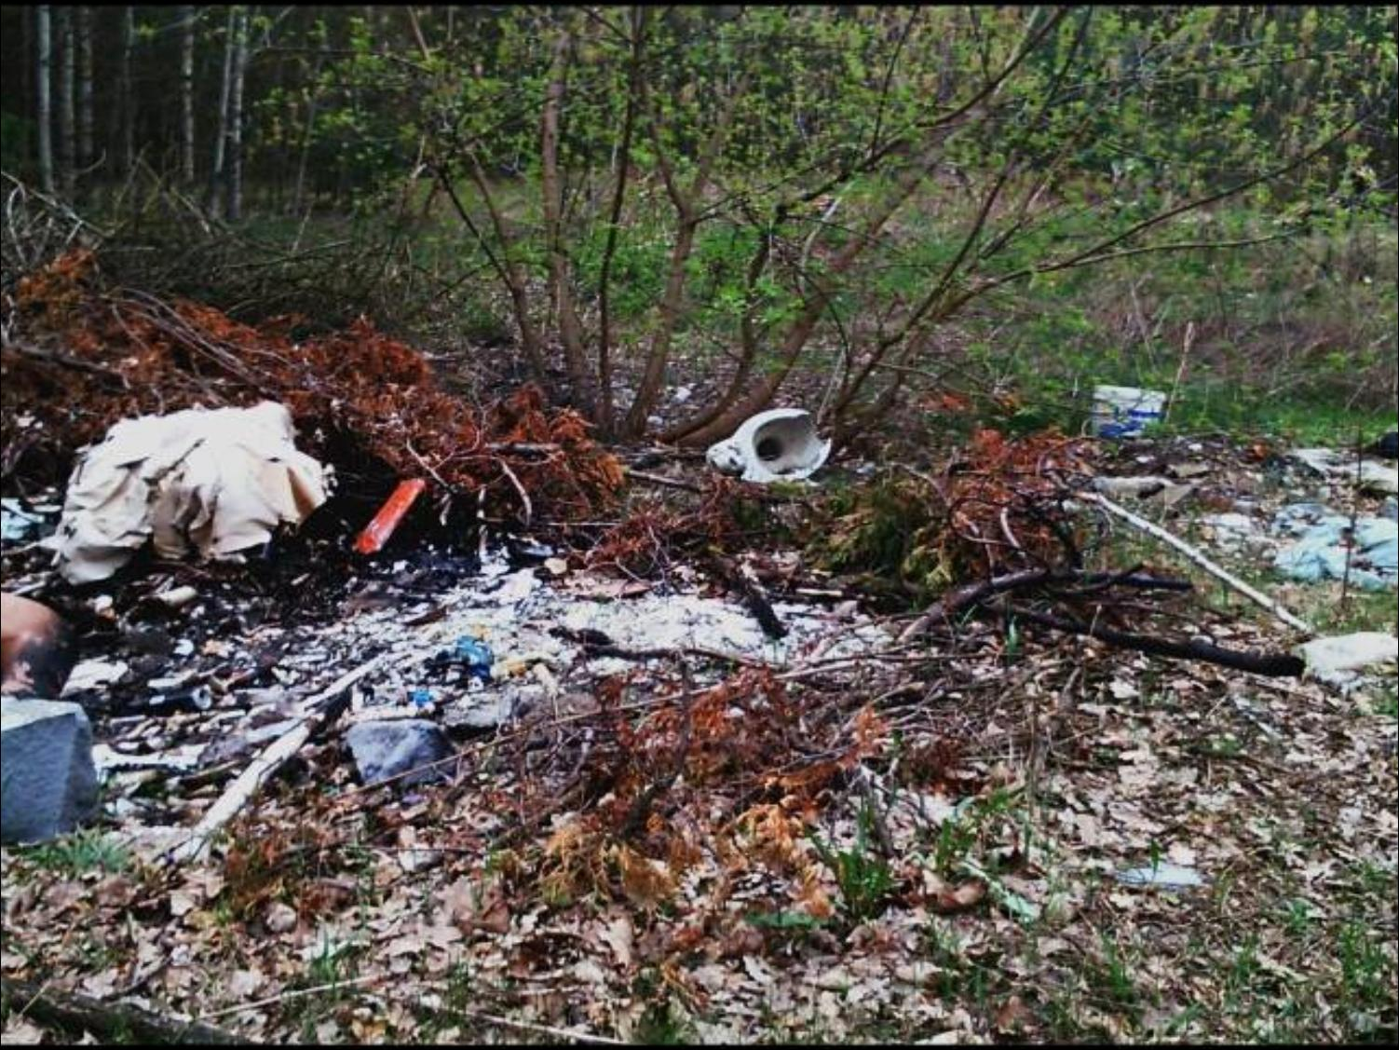
Littering woods
This act of vandalism is very common in Poland. You can find amount of trash in our woods.
Maybe just we don't have enough bins, it can be our habit or laziness, too.

Slide 5
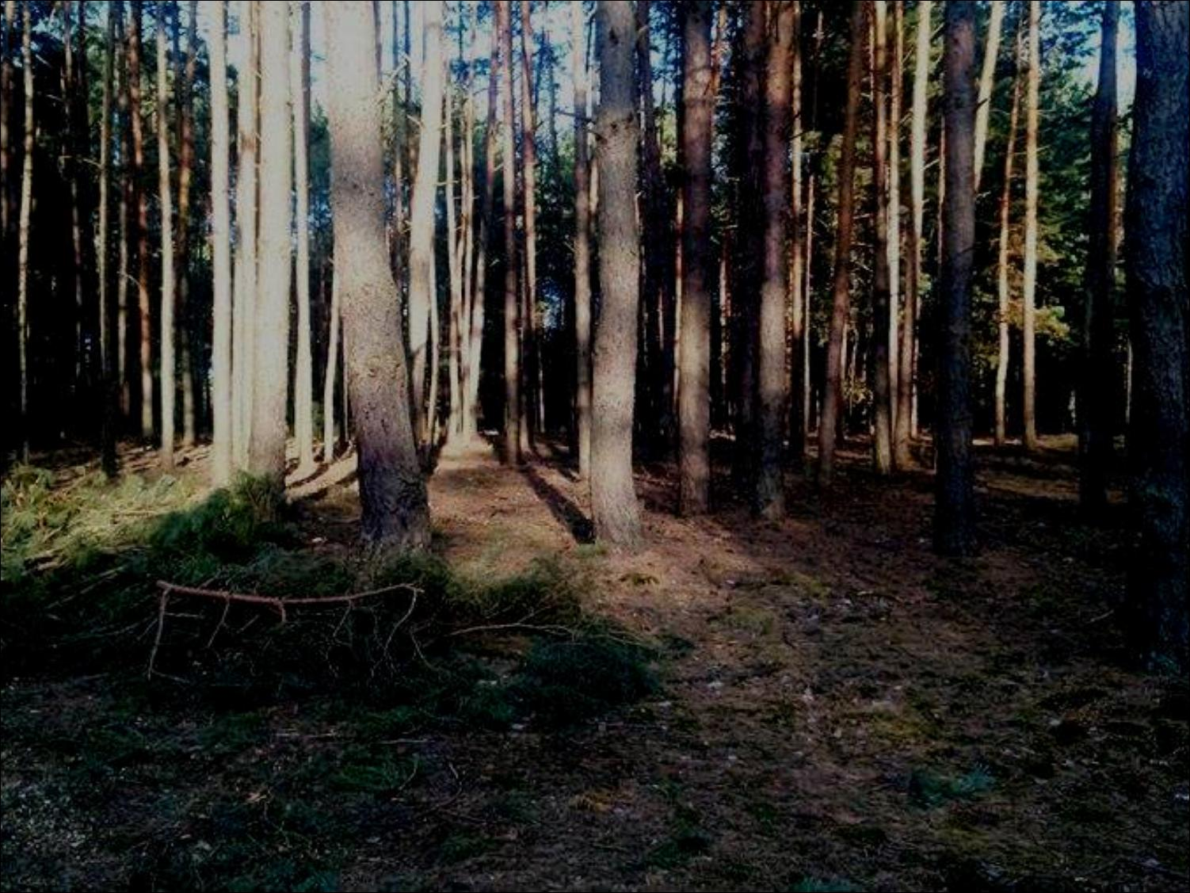
After II World War our country was destroyed.
Destiny of our environment was the same. Government tried to help with condition of our forests. Majority of woods have been replanted in wrong way- they weren't able to grow properly, because different species of trees didn't match ground and climate.

Slide 6
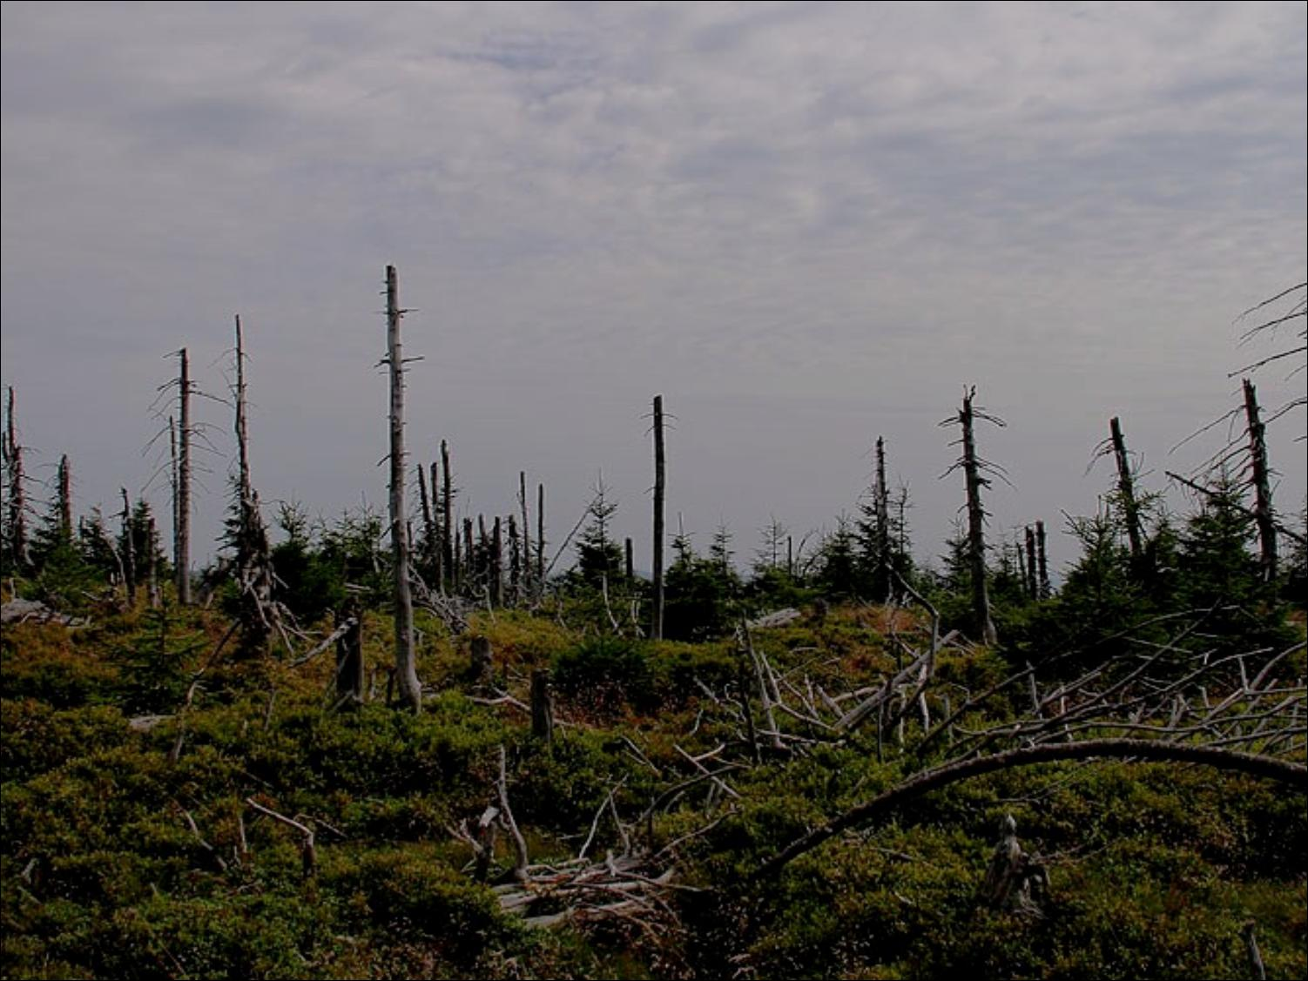
People around the world are presently in the throes of pollution. This also cause degradation of environment. Acid rains and dust damage all of European woods.

Slide 7
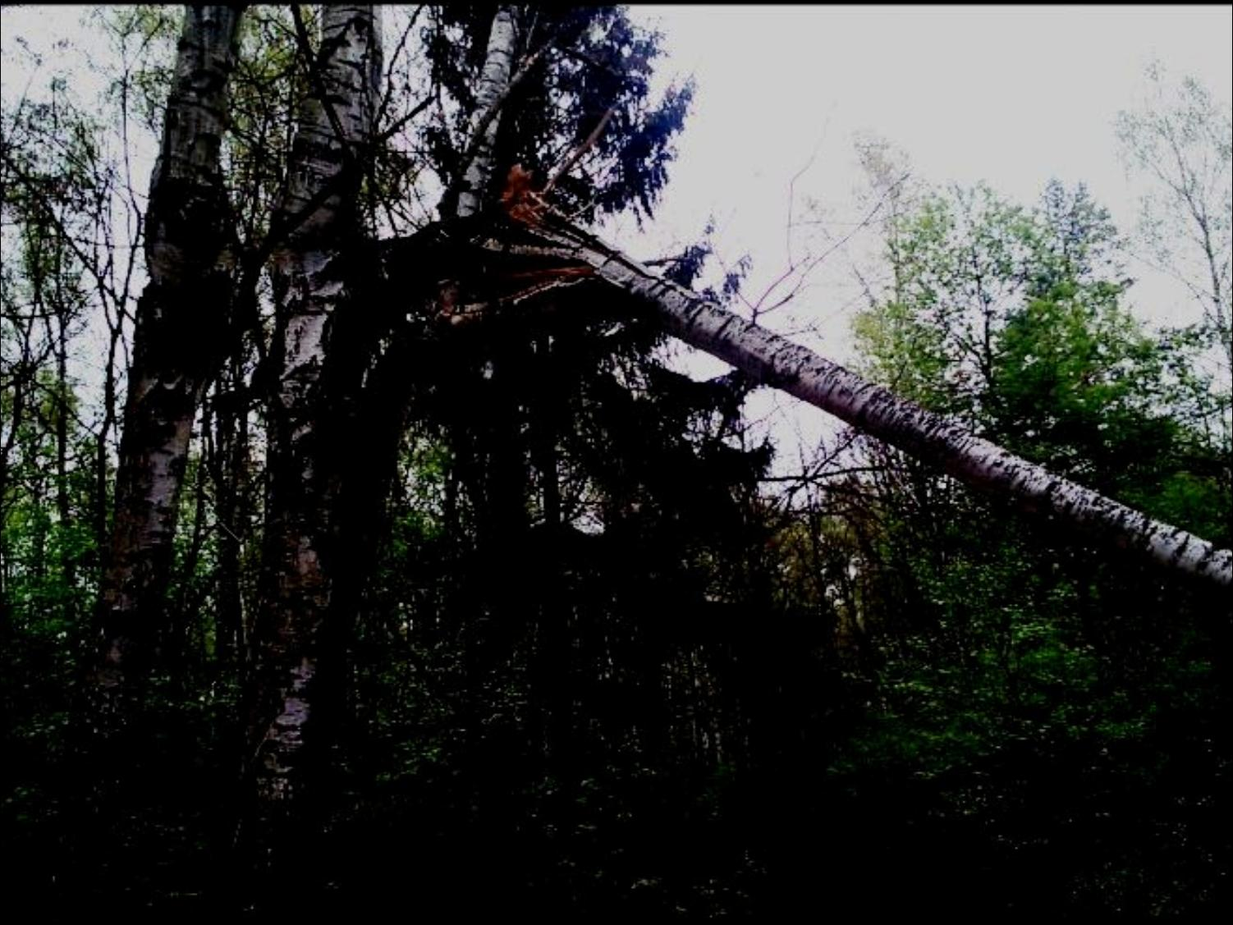
In polish mountains there is main natural risk- wind. Stong wind called "Halny" destroys thousands trees, they are broken, blasted and uprooted.

Slide 8
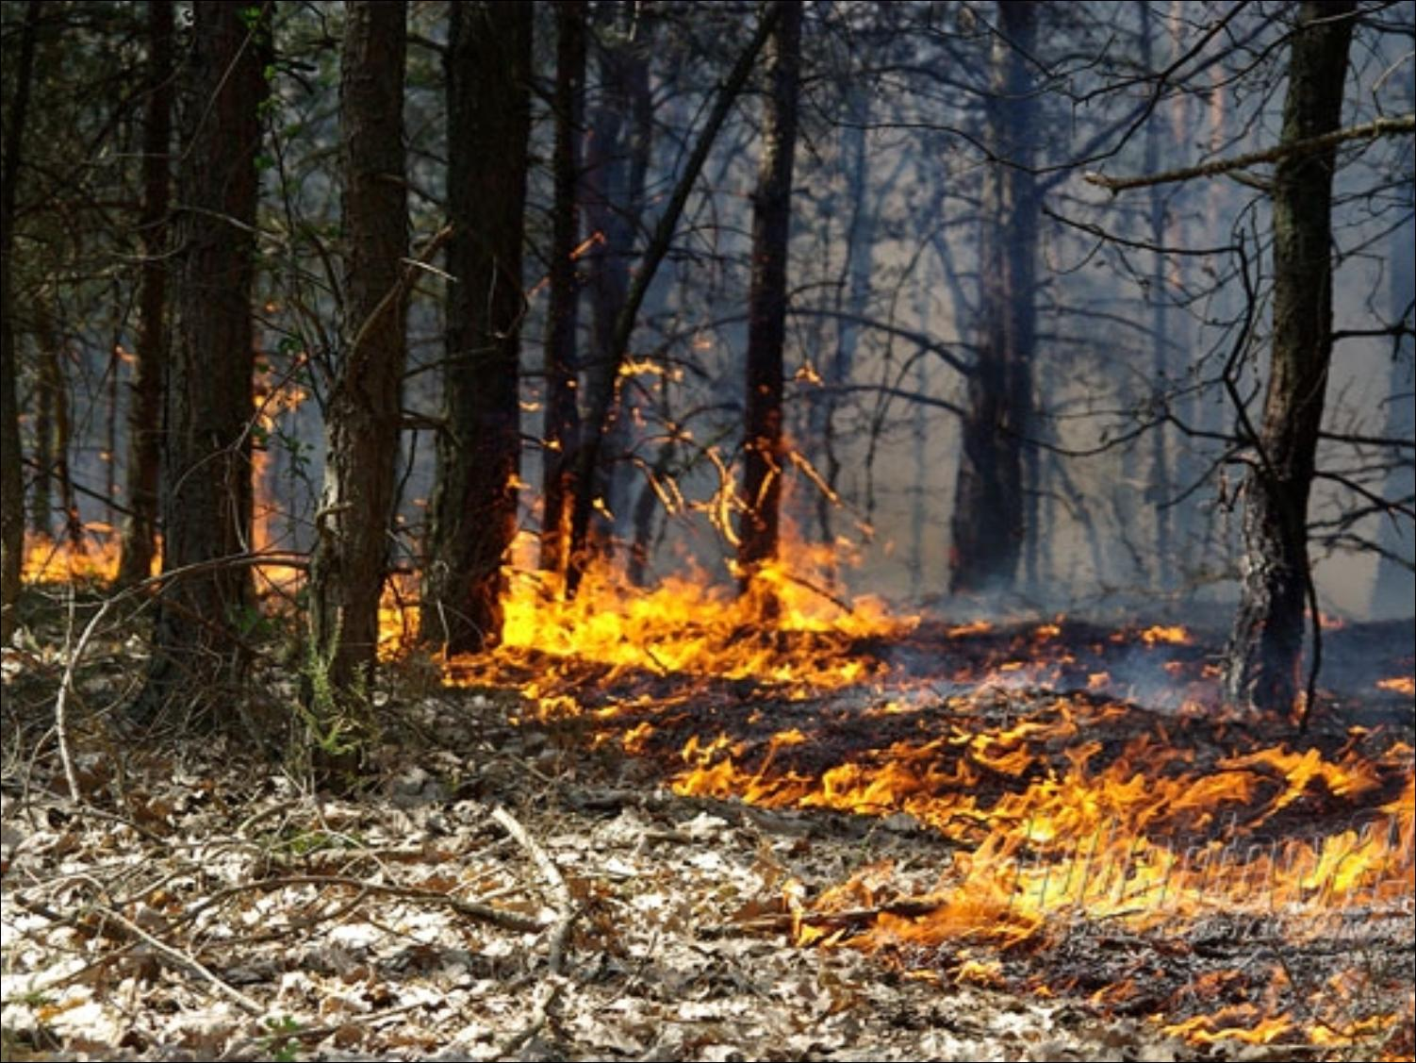
Drought
Because of drought trees die and forest floor
starts burning what cause that the forest catches the fire.

Slide 9
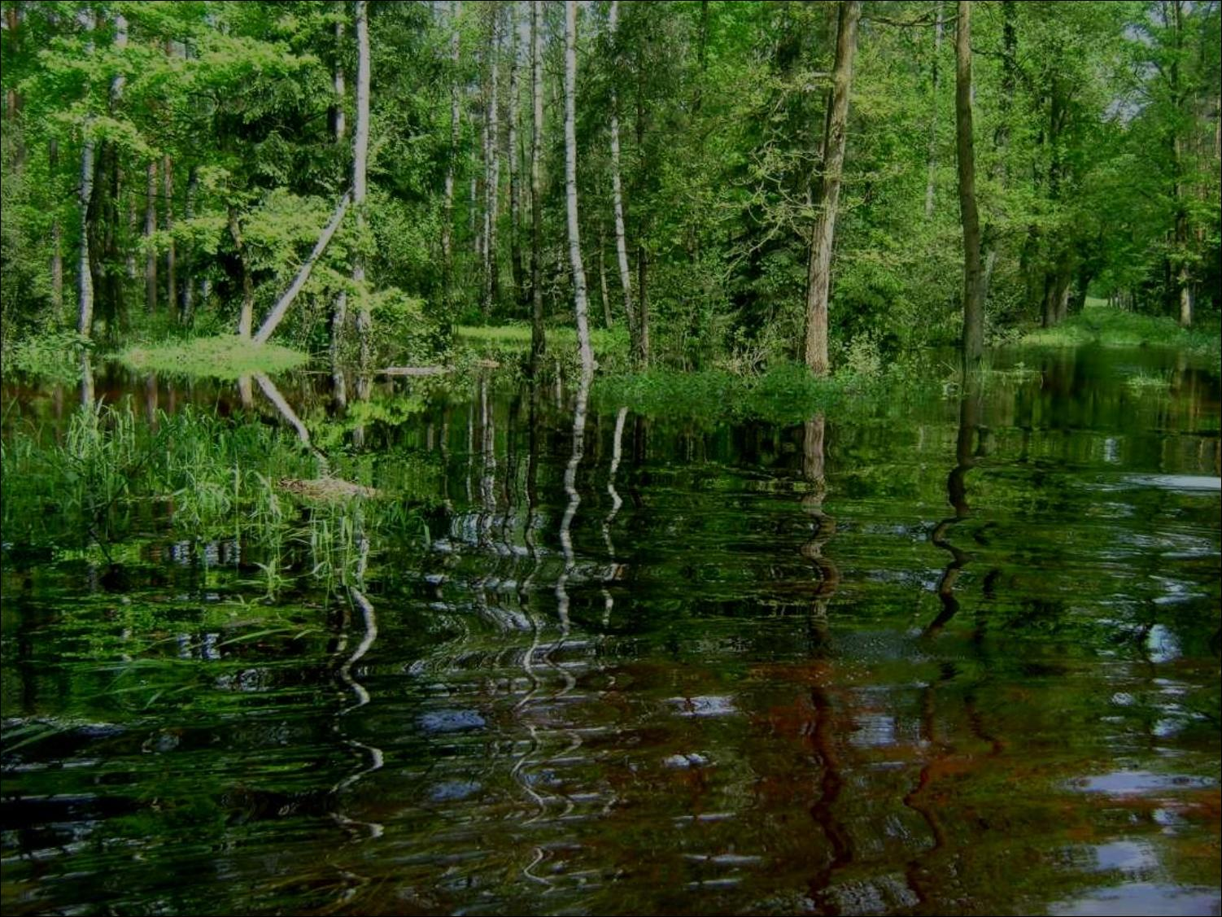
Flood
Flood water violently swims across and this
causes undermining and tearing off surface with plants and trees on it.

Slide 10
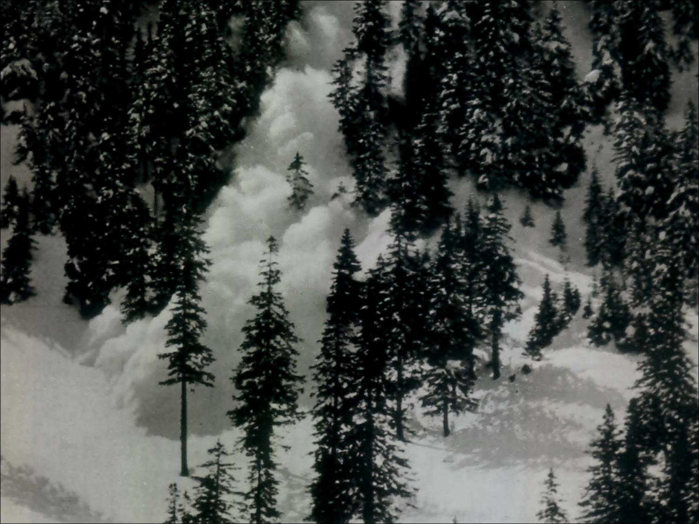
Avalanche
Snow cross forest and it causes breaking trees and very strong destroying wood
which is connected with rifting and spraining fibres.

Slide 11
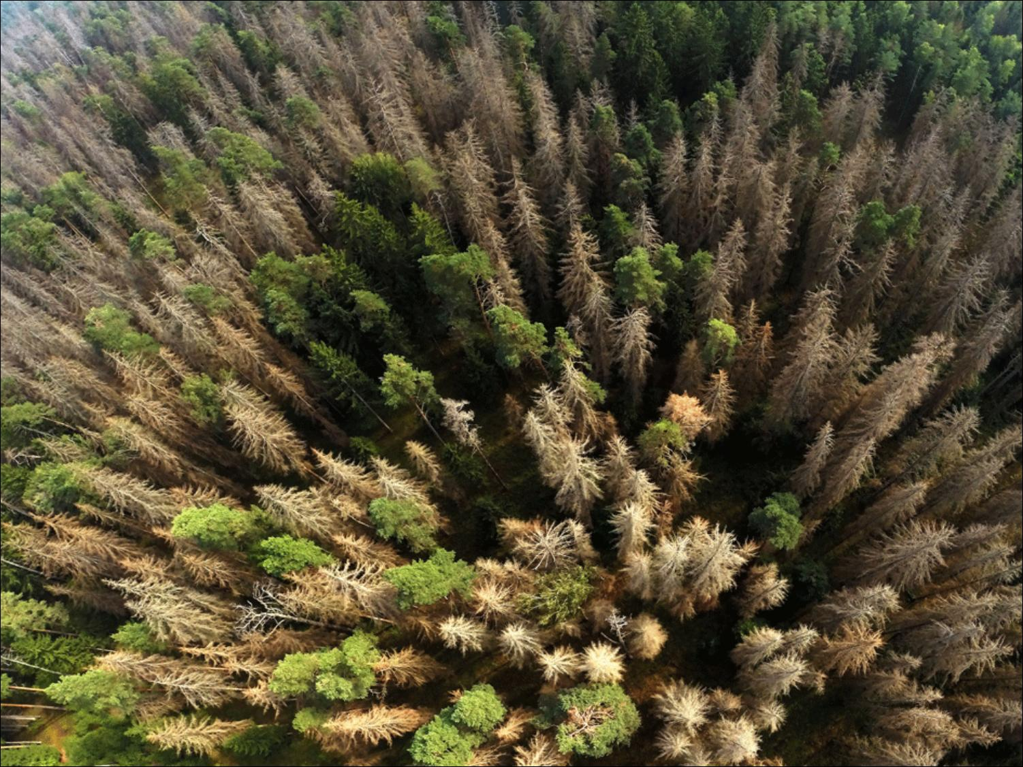
In Białowieża National Park woodworms are taking control of our pure, coniferous forest. They could infect whole forest. It would loss tousands of trees and part of old and wild polish nature.

Slide 12
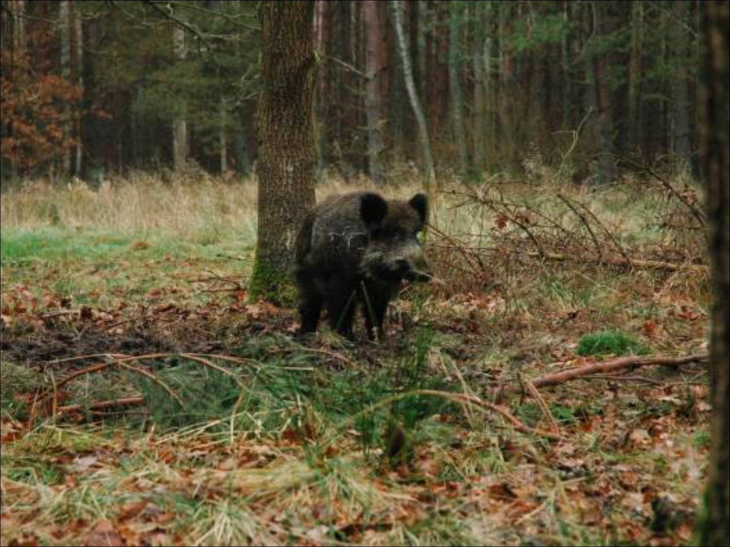
Animals are part of this ecosystem, but they also cause lot of damage. Deers eat bark, so trees are weakened and can be sick for rest of their life. If there are too many animals, forest will be overloaded.
Nature needs harmony.

Slide 13
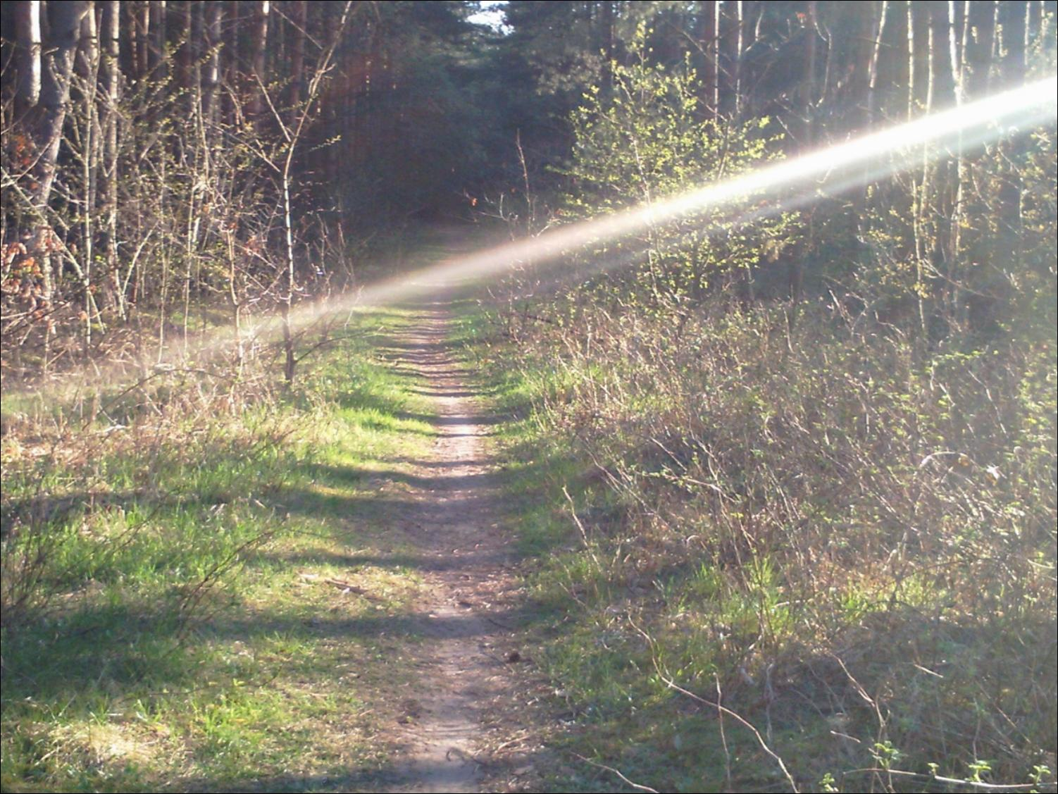
It is your own decision what you will choose - protect our environment or let people destroy it!

Slide 14
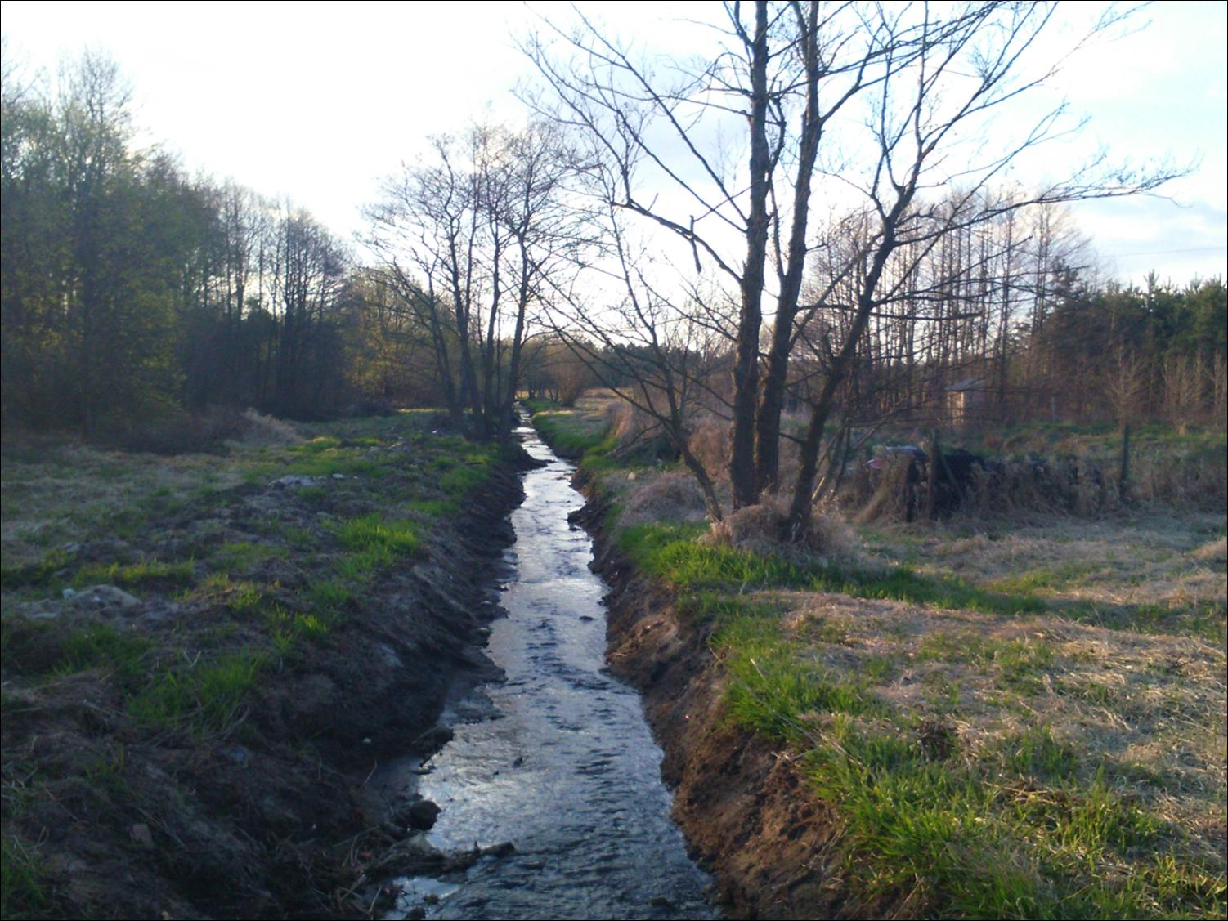
Klaudia Jurczak
Karolina Musiałek
Adrianna Babik klas 1c
Liceum Ogólnokształcące im. Armii Krajowej w Białobrzegach.

Slide 15
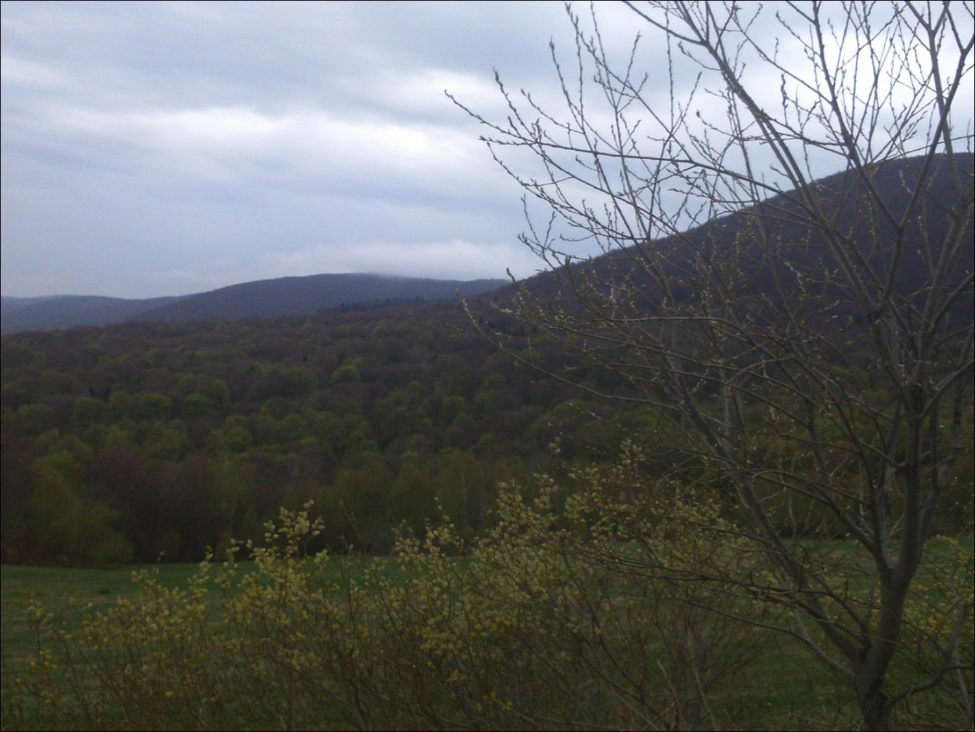
Bibliography:
www.rozanna.torun.lasy.gov.pl/
www.rme.cbr.net.pl/
www.lasy.gov.pl/
www.lubartow24.pl/
www.skimagazyn.pl/
www.kup.katowice.lasy.gov.pl/
www.vitoos.blox.pl/
www.baltyk.agnet.pl/

