Slide 1
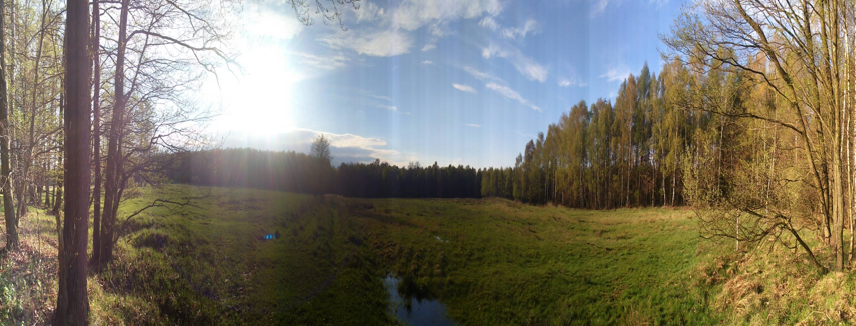
THE FOREST ISN’T ALL, BUT WITH OUT FOREST ALL IS NOTHING

Slide 2
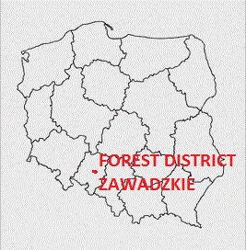
OURS FOREST DISTRICT

Slide 3
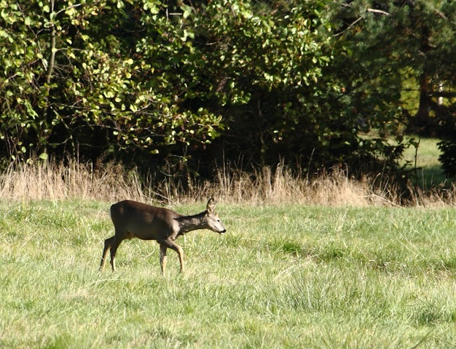
HISTORY COUNT’S FORESTS
In the area of Centre Europe, in the region of Silesian
Lowland there are about 19500 ha of national forests,
situated in forestry of Zawadzkie, it is possible to call these
forests count forests, because before Polish state took over
this forests it belonged to many counts and princes.
For example:
-Silesian Piasts
-countJerzy von Redern
-count Andrzej von Renard
-prince Otton Stolberg-Vernigerode

Slide 4
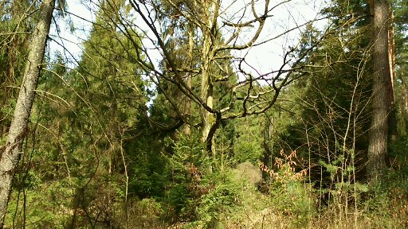
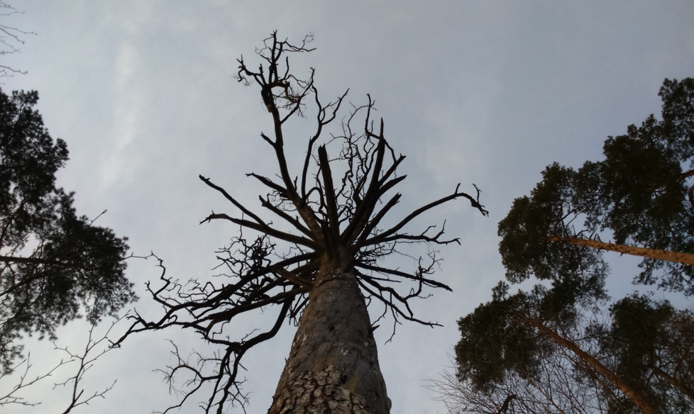
TREES AND THEIR LIFE
Young oak in avenue of oaks 300 years old pine ANNA

Slide 5
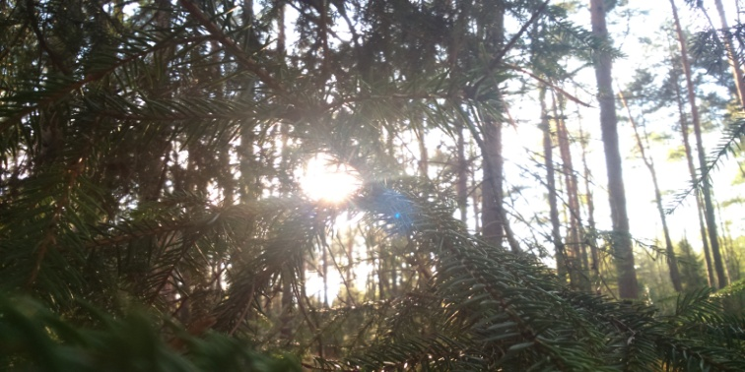
Woods of the forest district are a dense forest complex
which is fafourable for the economy. There are all Polish
species of trees with the majority of the pine, of which
some specimen are about 160 years. Until end of 18th
century it was possible to call it wilderness. At the
beginning of the 20th century a spruce dominated,
however in the 80s the condycions of the forest started
deteriorating, just like in the rest of the of central Europe. It
was due to the fires, snows, SO₂ and strong winds,
however a spruce bark beetle(Ips typographus) turned
out to be the worst.

Slide 6
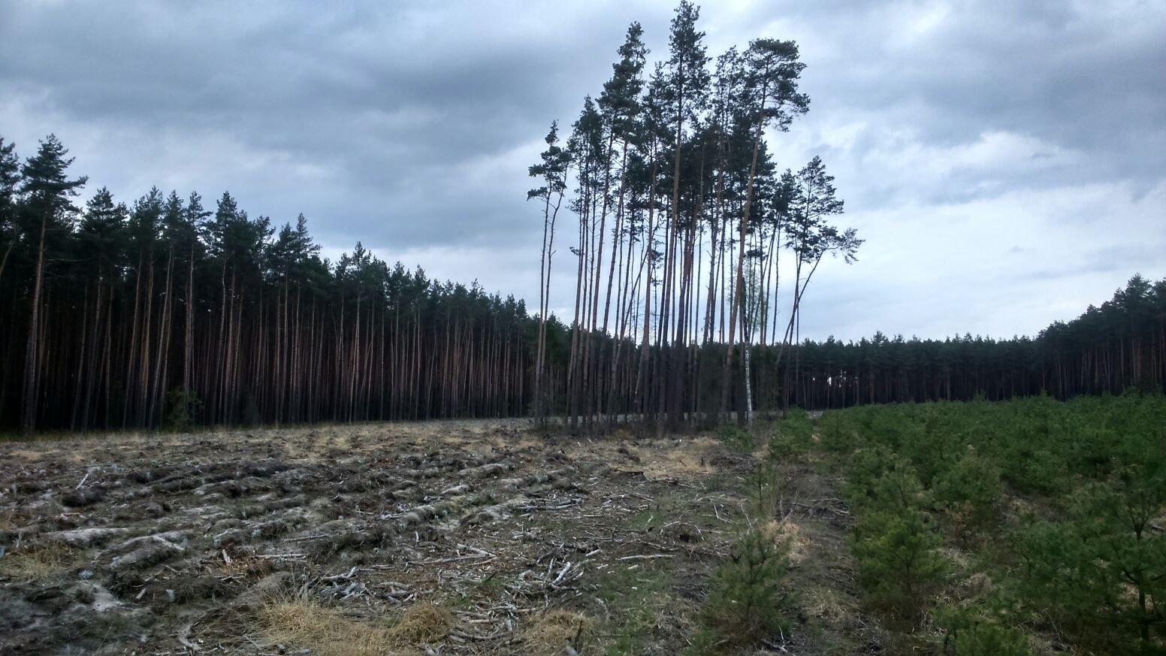
TREE ON SEEDS
At the Forestry Commission Zawadzkie as one of the few in
Poland the authorities decided to renovate the forest by
partial, natural restocking. Trees are in detail selected and
cut down from the east they are left single, most fine
looking for planting, so-called tree on seeds which are
cut out after 3 years.

Slide 7
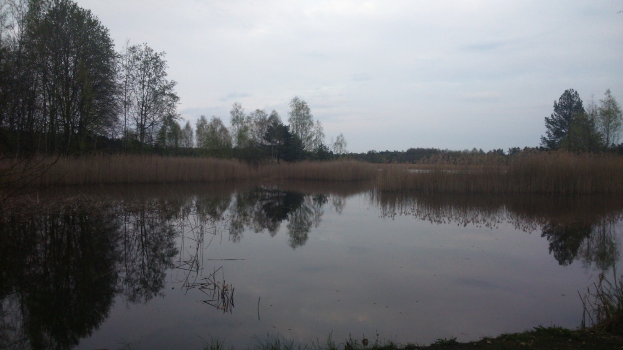
WATERS OF FOREST DISTRICT
Poland is being ranked
among poor countries into
aquatic resources, so one of
very important ways to for
amend its balance, there is a
small retention. It is cheap,
and at the same time
friendly way for the nature,
at our Forestry Commission
the following containers are
Appearing belongs:
• team of five cascade Pluderskich Ponds
• 14 fire- water reservoirs
reservoirs KASZTAL

Slide 8
THE OPOLE AMAZON

Slide 9
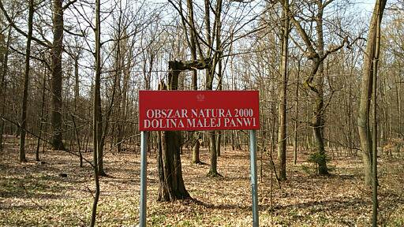
Amongst forests of the forest district a very beautiful Mala
Panew river runs across the along. It is a natural river of the
region the most with the numerous intricacies and old river
beds which allows for ecosystem natural processes. The
Mala Panew valley is portraying the Bearing valuable
fragments of the landscape and species of animals and
plants setling in ther. This valley belongs to areas Nature
2000, that is of the greatest form of the conservation of
nature.

Slide 10
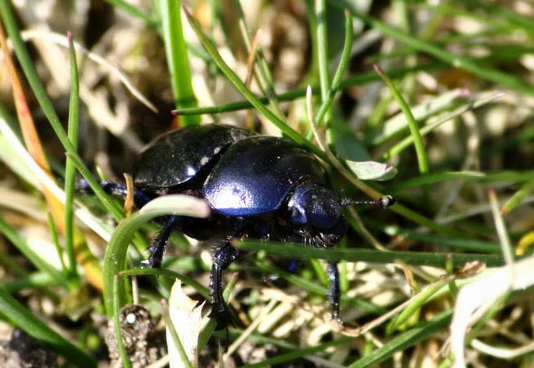
WHAT IN GRASS IS SQUEAKING AND NOT ONLY
The Zawadzkie forest district is a house of many
protected rare specimens of fauna as well flora:
-round-leafed sundew (drosera rotundifolia)
-Labrador tea (ledum palustre)
-water lilies (nymphaea alba)
-daphne wilczełyko (daphne mezereum)
-marsh harrier (circus aeruginosus)
-crested newt (cristatus)
-crane (grus grus)
-otter (lutra lutra)

Slide 11
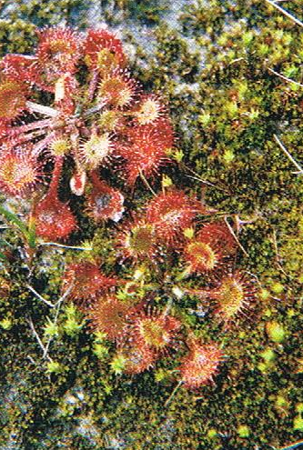
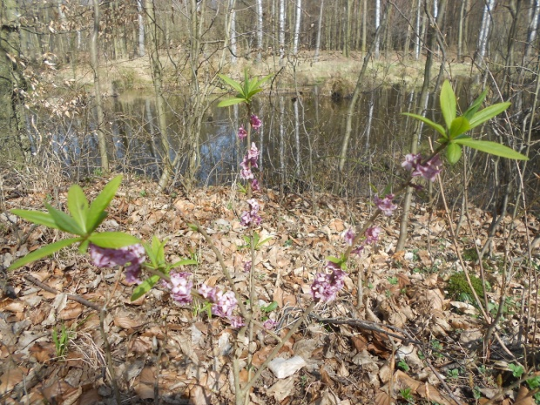
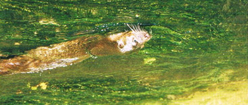
OURS TREASURES
Daphne Mesereum Drosera Rotundifolia Lutra Lutra

Slide 12
TOGETHER LET US CARE ABOUT THE NATURE
Forest district Zawadzkie belongs to the area, for which the
program of the conservation of nature has been drown at
years 2013/22. This program is aimed:
- making the natural resources even greater
- biodiversity conservation
- making an inventory of natural advantages
- showing next objects to the preservation order
- preferring technology of forest environmentally friendly works

Slide 13
In our area the conservations of nature takes
the form of:
- natural features of historic importance
-natural-landscape teams
- areas of protected landscape
- Nature 2000
-ecological use A Natural
-environmental Team
Place most beautiful and worth visiting is a
"under Oaks" which the 200 years old Avenue
of sessile oaks is in. Over 100 impressive oaks are
included in the avenue, whereas in their nearby
neighbourhood grows many single specimens:
six 200 years old of sessile oaks, and 8 300 years
old sessile oaks.

Slide 14
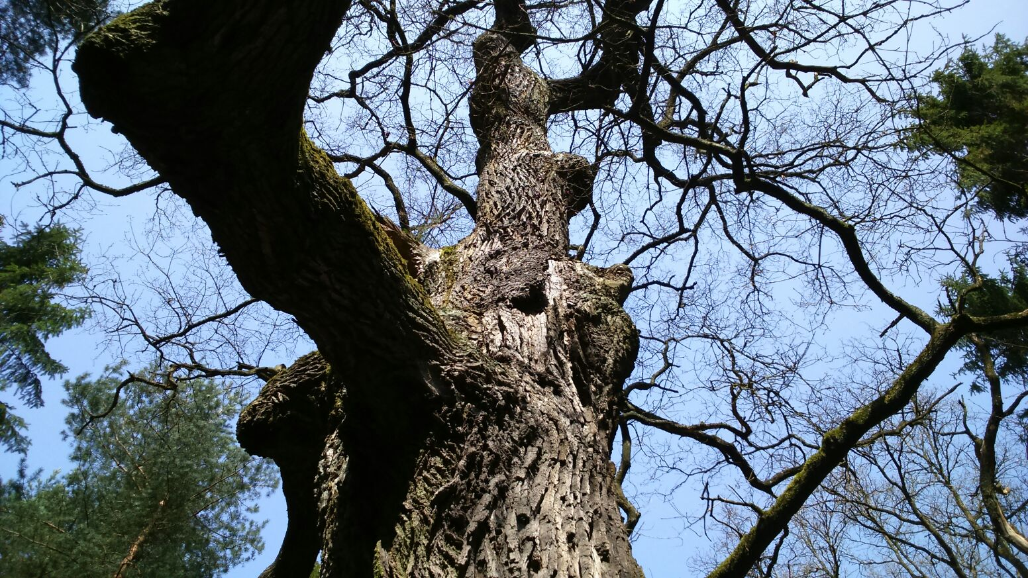
WELCOME TO " OAK ALLEY "

Slide 15
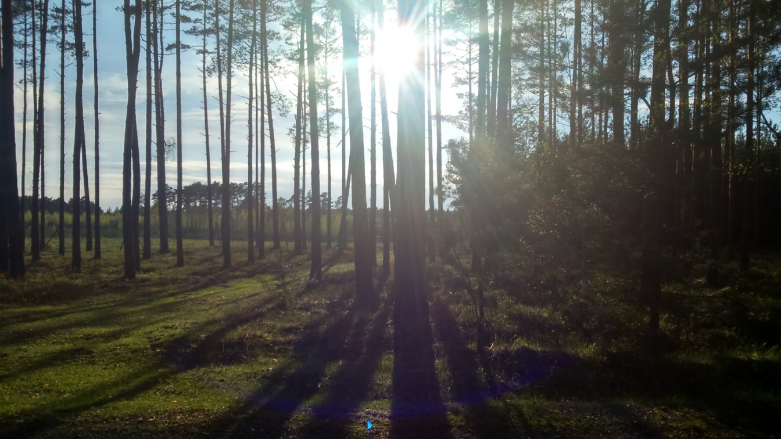
THE END
Made by:
Lukas Smyk
Philip Koprek
David Bonk

