Slide 1
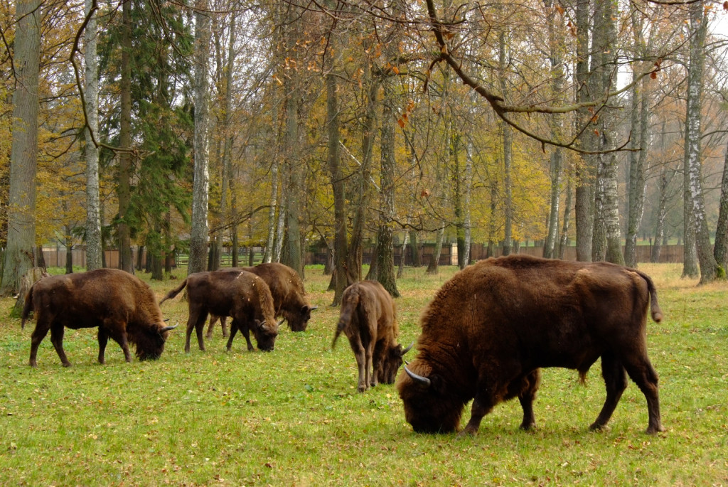
Bialowieza National Park

Slide 2
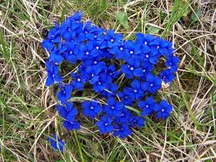
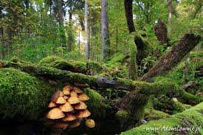
Location
Bialowieza National Park is located in the eastern part of Podlaskie Voivodeship, near the border with Belarus. The park is located in the central part of the Bialowieza Forest.

Slide 3
History Park
The park was created in 1921, when the part of the present area of the park was established as the Reserve Forestry.
In 1932, it was transformed into the
National Park in Bialowieza.
Since 1947, it has been called
the Bialowieza National Park.
Among all of the national parks in Poland,
it is the oldest one.

Slide 4
Symbol of the park
The symbol of the Park is the European bison.
Bialowieza Forest was the
last lowland for the European bison.
This park was its rescued from
the destruction.
Now in the Bialowieza Forest
lives the largest population
of the European bison in the world.
In Polish part of the forest
there are about 430 of them.

Slide 5
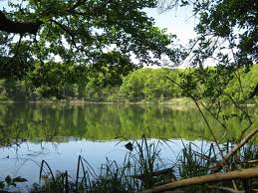
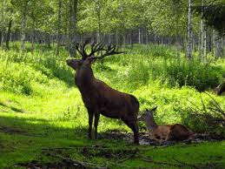
Protection of the Park
Strict protection
Active protection
Landscape protection

Slide 6
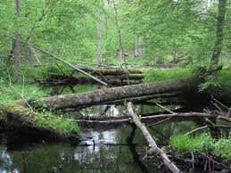
Strict protection
54.4% of the Park area is covered by the strict protection.
This strict protection
is based on giving
the total area to
natural forces itself
and stopping the direct
interruption of humans.
It allows the free course
of ecological processes.

Slide 7
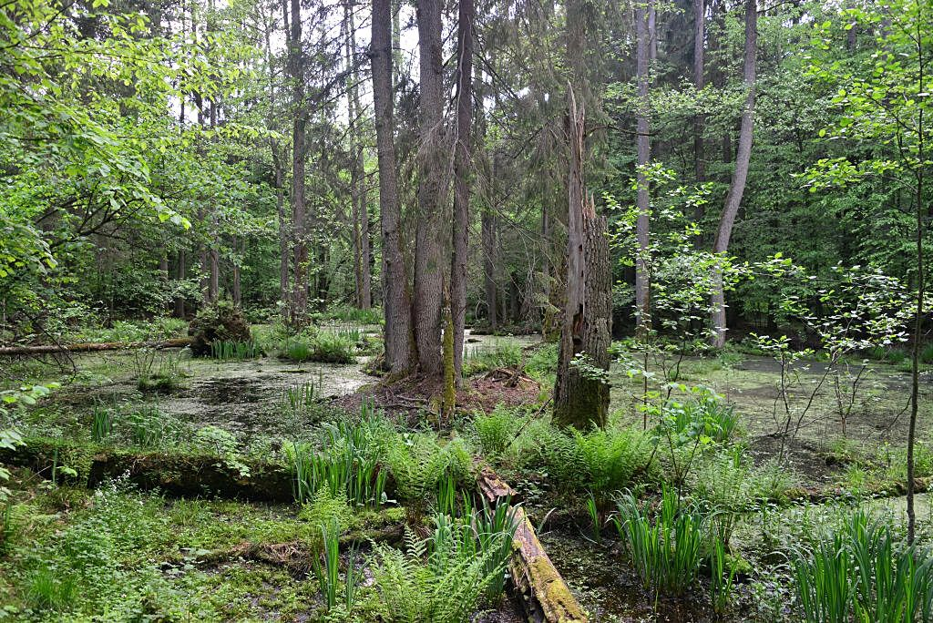
Active protection
It allows some interference of humans as a treatment to restore the ecosystem as similar as the natural one.
42.2% of the total
Park area is covered
by the active
protection.

Slide 8
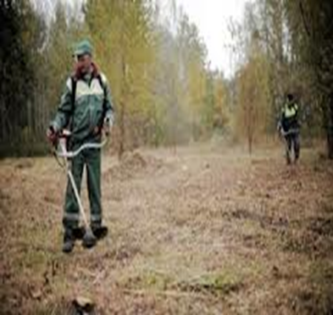
LANDSCAPE PROTECTION
According to the Law of the Protection of the Nature, it consists of maintaining the most important features of the landscape.
Here, the protection of the landscape is done by cutting treating trees and shrubing and mowing the meadows.
The total area of 3.4%
of the park has been
separated from
the Park area to protect
the landscape.

Slide 9
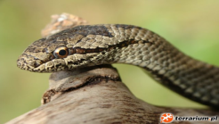
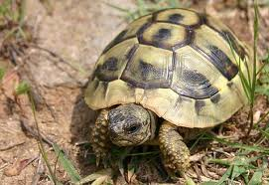
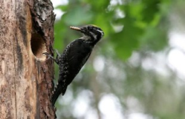
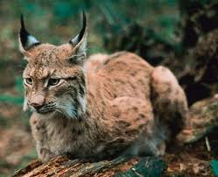
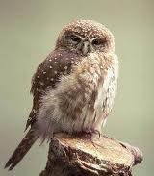
FAUNA
In wilderness, there are more than 12 thousand. species of animals.
In wilderness, there are:
58 species of mammals
250 birds
7 reptiles
13 amphibians
32 fishes
more than 9,000 insects
331 spiders
20 leeches

Slide 10
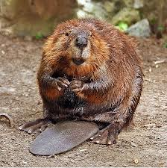
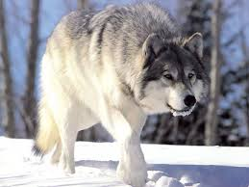
SPECIES OF ANIMALS:
Deers, roe deers, wild boars, elks,
Predators: wolves, lynx, foxes, stoats, polecats, weasels, raccoon dogs and badgers;
By the water you can meet otters or beavers;
Rodents: squirrels, bank voles, mouses, dormouses and the rare – a smudge;
From rare species of birds some deserve the speacial attention: crane, black storks, eagles, hawks - Sparrowhawk and pigeon, 8 species of woodpeckers, including the rare - three-toed woodpecker and pygmy owl.

Slide 11
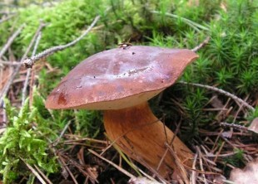
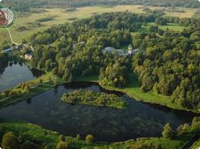
FLORA
Plants :
about 990 species, including flowering plants about 953, 37 species of ferns, 200 species of mosses, 54 species of liverworts, 200 species of lichens and mushrooms.

Slide 12
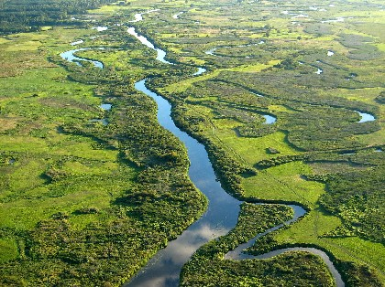
RIVERS
Through the Bialowieza River flows one river and two beakers.
The Narewka River - its basin section form the Bialowieza River to the Łutownia River is covered with the dense forest. On the Narewka River, there is a watershed which flows into the flat, marshy area. In the valley, there are wetlands and peats where can be seen the little forests but more meadows. Clays and sands predominate.
The Orłówka River– the right tributary of the Narewka River.
The Hwoźna River –
the left tributary.

Slide 13
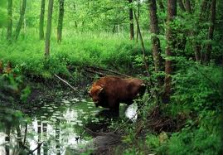
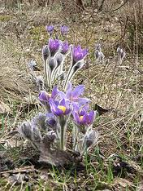
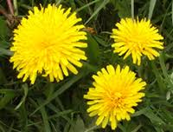
PLANT COMMUNITIES
There are about 166 of known plant communities of the Bialowieza Forest , including 74 of them found in the Park :
22 forests;
2 communities of brushwoods;
4 communities of aquatic vegetation;
Dozens of meadow vegetation and bogs.

Slide 14
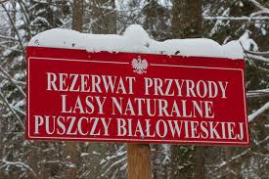
SUMMARY
The Park Bialowieza is a complex where the most important thing is to take care of the natural environment. Thanks to the efforts of many famous biologists these areas are considered as ones of the wonders of nature. Thanks to the wildness and mysteriousness, the park is a source of unlimited knowledge and the beautiful landscape of the forest where everything is regulated by nature itself.

Slide 15
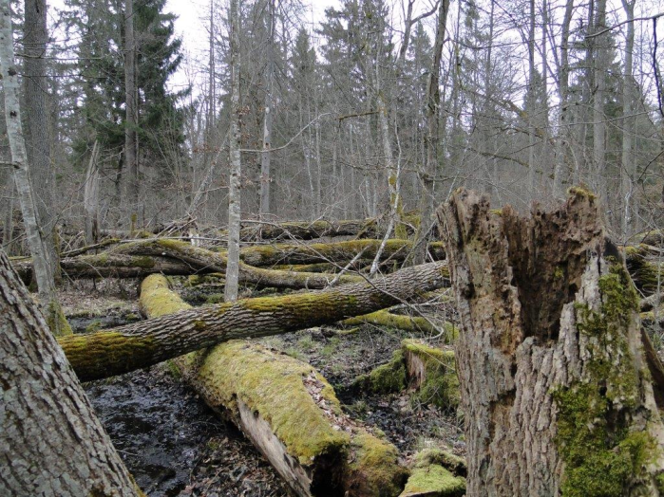
FRESH NEWS
In the Bialowieza National Park, there are the public consultations dedicated to the felling of the trees in the Bialowieza Forest. The new foresters’ plan assumes to get rid of up to five times more trees than it had been originally expected.
That is all about
the spruce bark
beetle attack,
which can result
in disappearing of
the entire population
of spruce in this park.

Slide 16
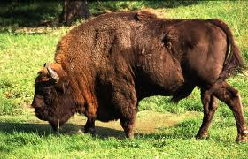
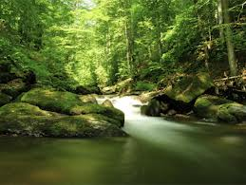
Thank You For Your Attention

Slide 17
Presentation performed:
Dagmara Traczyk
&
Aleksandra Kornet
Klasa 2b
Liceum Ogólnokształcące im. Armii Krajowej

