Slide 1
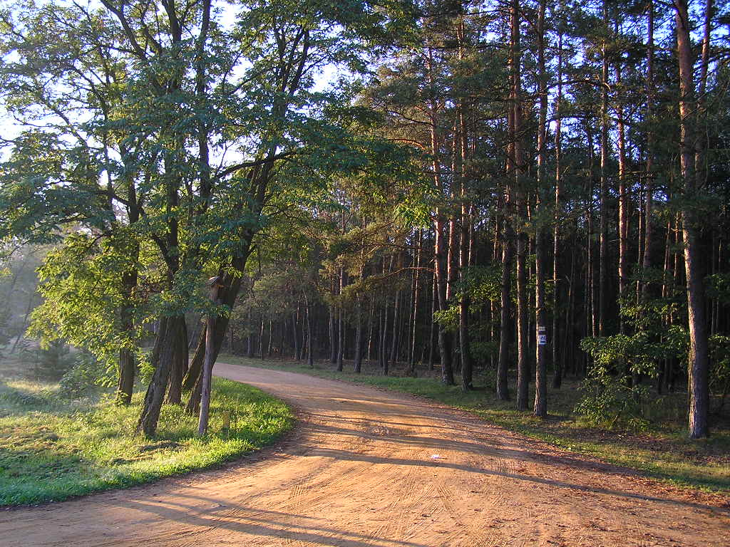
Kampinos National Park
Made by: Natalia Andziak
Weronika Kowalska Wiktoria Moroz
LO Grójec im. Piotra Skargi
Fot. Yarek Shalom, Kampinos National Park, near Palmir

Slide 2
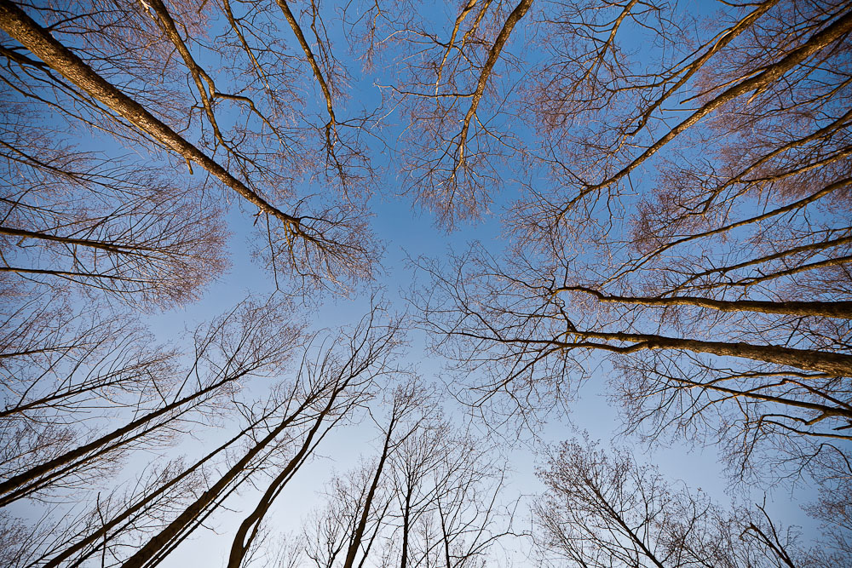
Description
Kampinos National Park was established 16 and 1,959 years thanks to the efforts of Jadwiga and Roman Kobendzów . It is located on the Plain of the Central , between the left bank of the Vistula and the Bzura , just off the north- western outskirts of Warsaw. Covers an area of ​​38 544.33 hectares, of which 72.40 ha falls on the Bison Breeding Centre in Smardzewice in the province. Lodz . Around the park extends protection zone on the area of ​​37 756 ha.
Fot: Paweł Gajewski

Slide 3
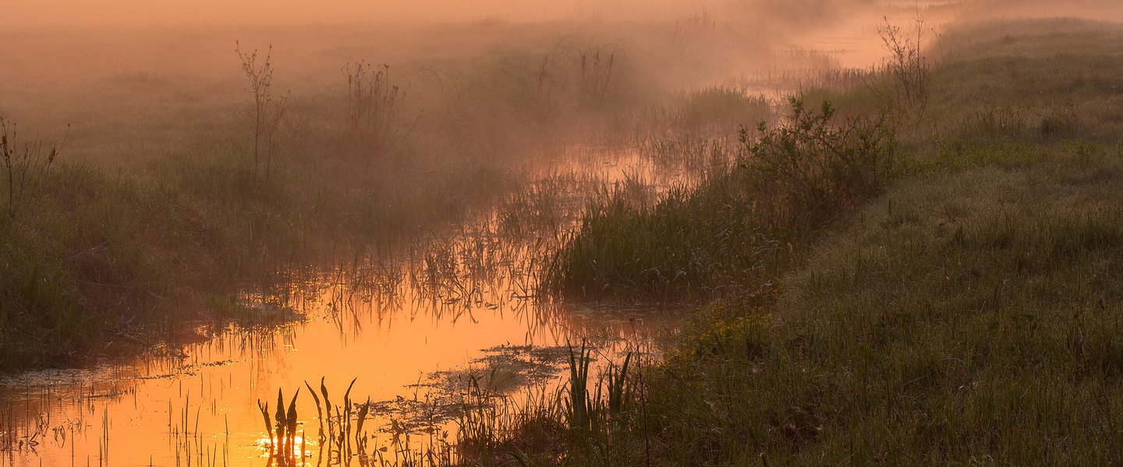
History
The purpose of the Kampinos National Park next to nature protection was the protection of monuments of history and culture located in the Kampinos Forest . Geographical location determined the wilderness that its history is especially connected with the history of wars and uprisings , what fate did not spare Poland. Each of these dramatic events were in the wilderness of your social - written patriotism , determined to fight for the Fatherland , heroism and blood - scenario.
Photo credit www.polska.pl

Slide 4
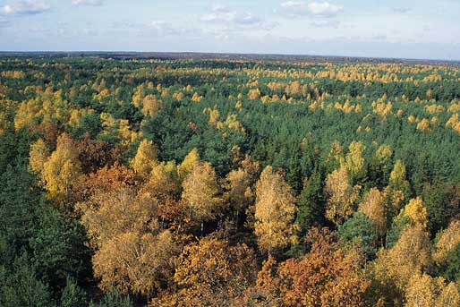
Most traces left but Kampinos World War II. Between 9-20 September 1939. He fought Bzura greatest battle of the September campaign: Polish armies "Poznan" and "Pomorze" clashed with German troops. After the initial successes of Polish forces, German troops began the attack, most of the Polish forces were encircled and defeated, part of the Polish troops broke through the encirclement and 14/15 IX crossed the Bzura in Brochów. The road through the forest to Warsaw was not easy, slow-moving sandy roads troops encountered numerous fortified enemy positions were decimated by German tanks and planes. September 19, broken branches paved the way for Warsaw reckless charge 14th Cavalry Regiment Jazłowiec the Wólka Węglowa. September marked trail soldiers are war cemeteries and graves scattered throughout the forest. In the forest and on the outskirts of killed approx. 9.5 thousand. soldiers, representing approx. 15% of the total losses of the Polish Army in September 1939.
Fot: View on the forest (Kampinos National Park)

Slide 5
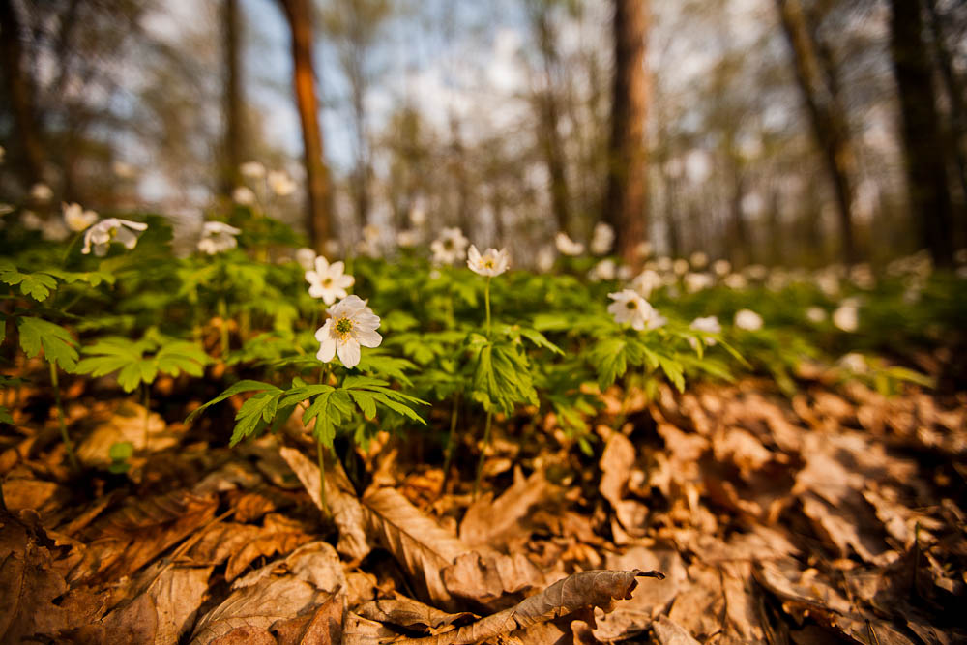
Nature
Kampinos Forest is a place of occurrence of the 13 lowland species of amphibians and 6 species of reptiles. The park and the buffer zone nests over 150 species of birds, among them a dozen pairs of black storks and cranes (some nest just a few kilometers from the borders of the capital), lesser spotted eagle, and since 2000 bald eagle. In open areas in large numbers is the corncrake, a species threatened with extinction on a global scale. Including the period observed here 215 species of birds. The place of wintering birds large amount of water is nearby Wisła. The presence of the Park for many rare and endangered birds, especially the Grasshopper and the corncrake, decided to declare 1999 the European Parliament this area as a bird refuge of European importance. Since 2004. Kampinos National Park is also a Natura 2000 area (PLC code 140001), both because of the richness of species of birds (Birds Directive), as well as the diversity of plant communities (Habitats Directive).
Fot: Paweł Gajewski

Slide 6
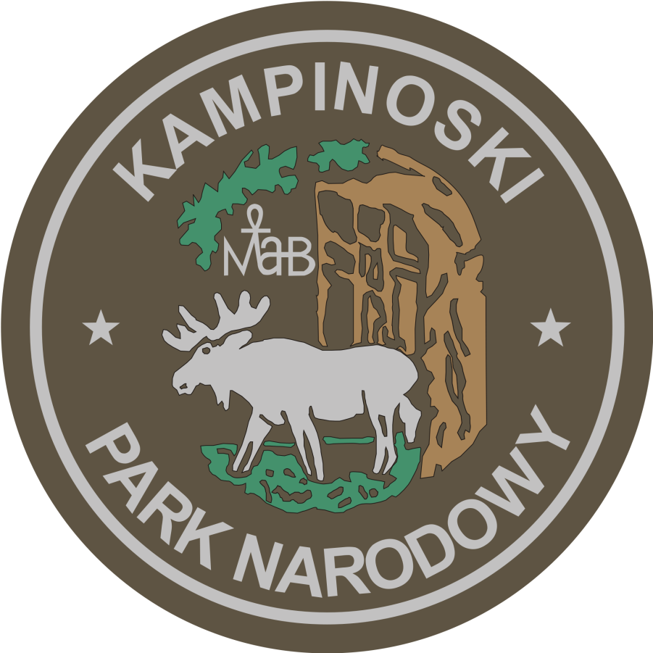
The current logo Kampinos National Park was established in 1974 . On the occasion of the 15th anniversary of the park. Its author was Mr. Jan Seremet . Over the years it has been only slightly modified.

Slide 7
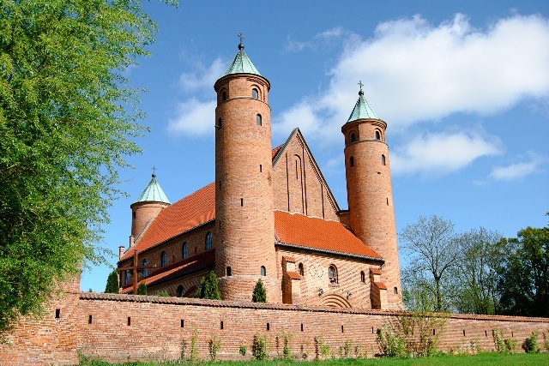
Monuments
Brochów Gothic-Renaissance church of defensive character from the half of XVI century in place of marriage ceremony of parents of Fryderyk Chopin and baptism of the composer.
Fot: www.e-sochaczew.pl

Slide 8
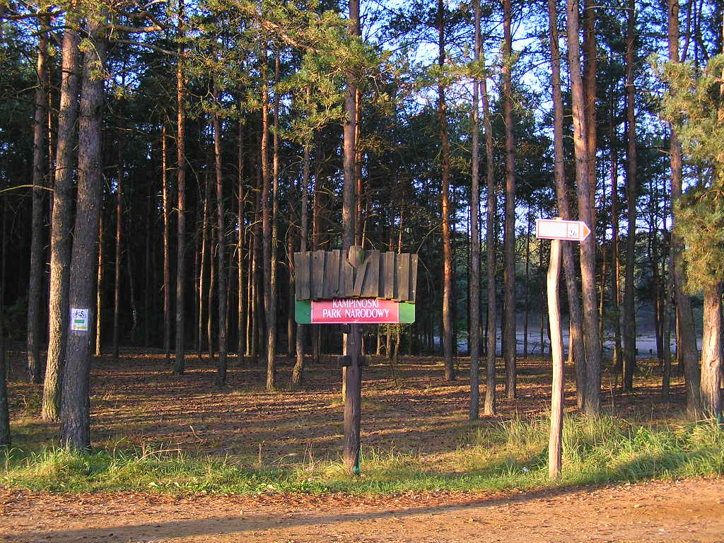
Tourism
The area of the Kampinos national park is being opened in educational, cultural, tourist, recreational sports and scientific purposes in the way which won't influence the nature of the park negatively. Making available means that people can to photograph or film to paid purposes and to use stores, creatures and elements of the nature in this purposes.
Fot. Yarek Shalom, Kampinos National Park, near Palmir

Slide 9
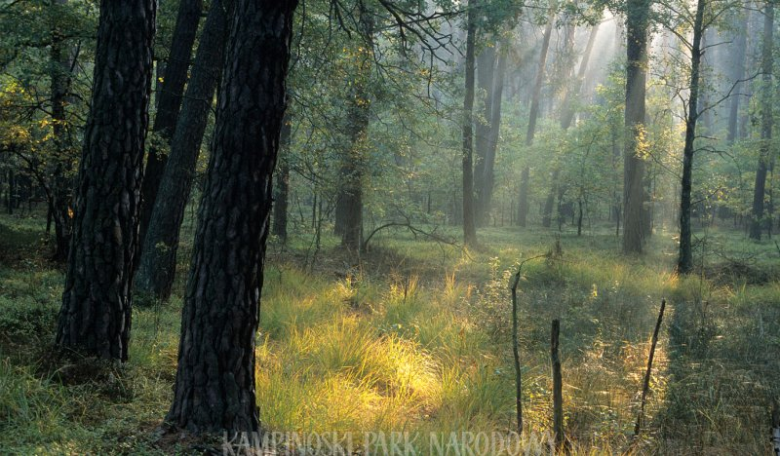
The conservation of nature
In order to keep the flora and the fauna, the diversity of biocoenoses and their mosaic and unique advantages of the landscape and the wealth of geomorphological forms, in the Park different manners of the conservation of nature. Many acts and regulations constitute legal bases of this protection.
Fot. Kampinos National Park

Slide 10
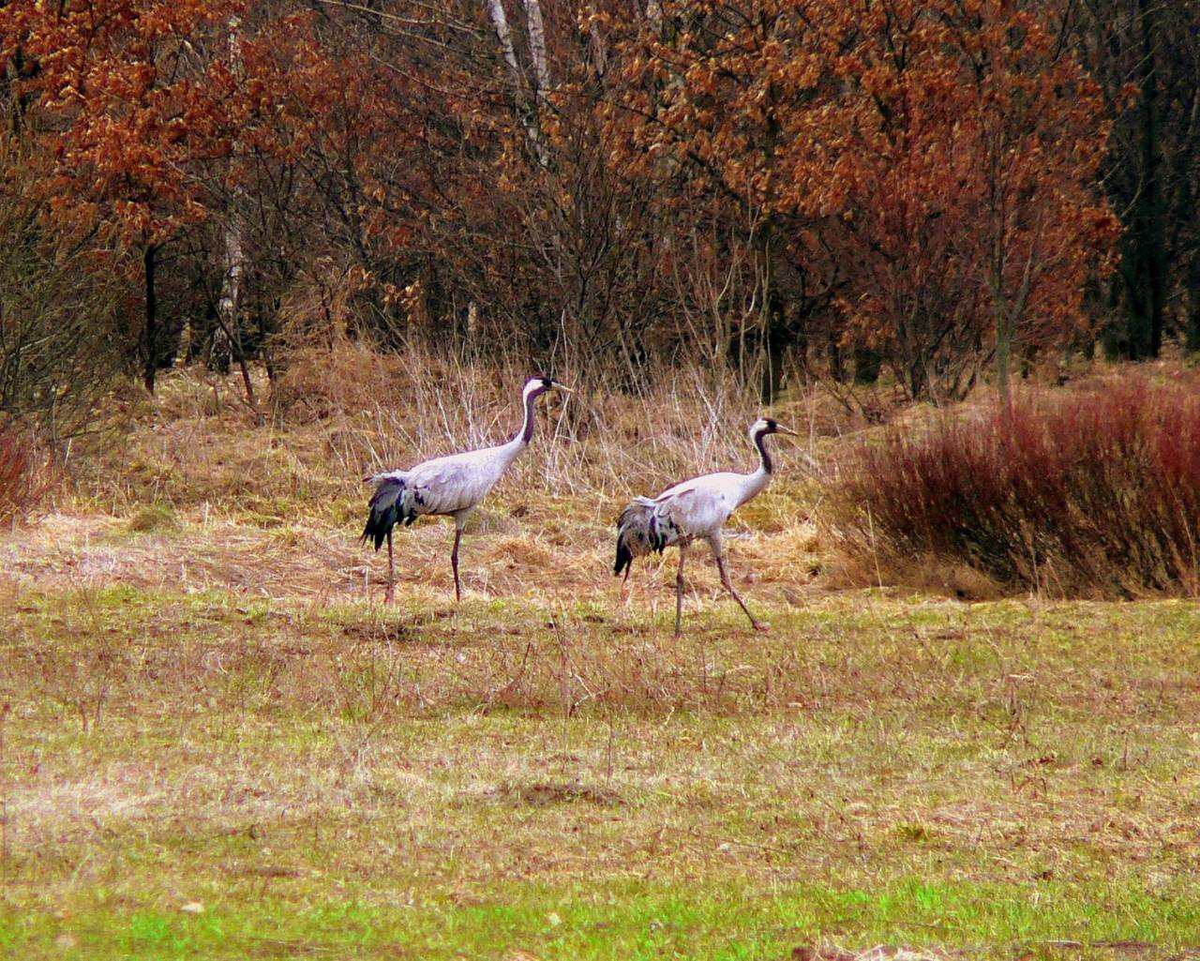
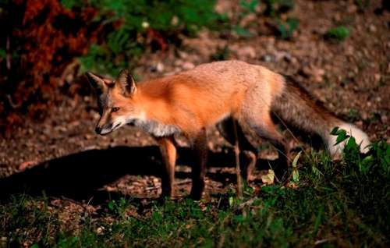
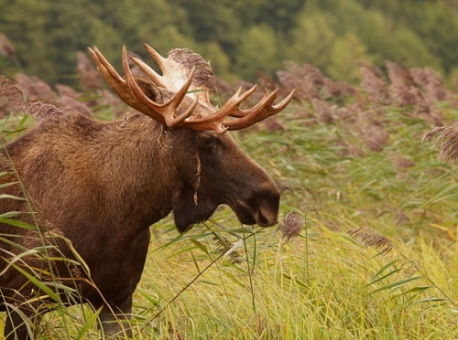

Slide 11
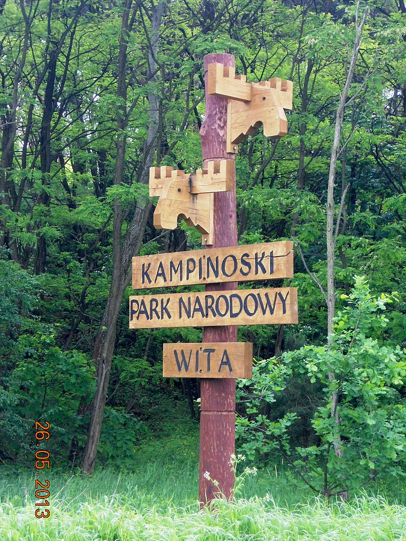
Education
The educational activity in KPN as similarly as in other individuals of this type is located in a course of the unofficial, after school education (national strategy of the Environmental Education), is providing all sorts, social and professional age groups with his action.
With basic aims of the environmental education carried out by the Kampinos National Park are:
creating the value of the natural legacy, the need for his protection and appropriate forms of the application,
acquainting with functions the national park and explaining protective actions conducted on his area,
facilitating the contact with the nature for visitors.
Fot. Jarbla, 26 may 2013r.

Slide 12
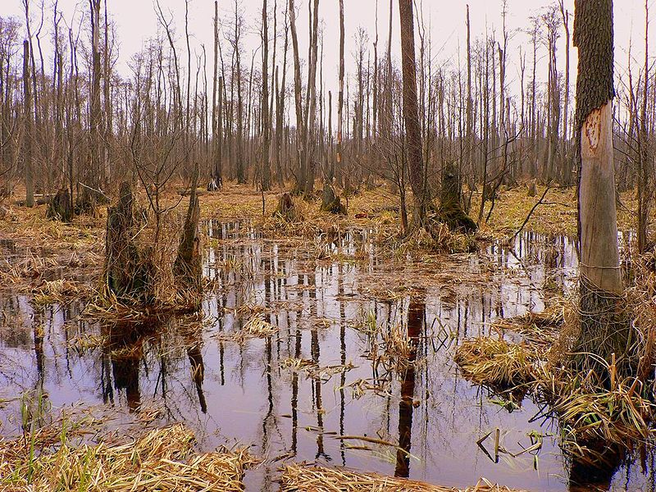
The soil and the geological structure
In the Kampinos National Park they usually appear sour and little rich soils produced of aeolian sands: the rust-coloured soil and the soil-grown-gliotic soil. It is possible to meet also: black soil, soil-grown-gliotic, peat soil, and with time of the fen soil river.
Fot. Wojsyl, Kampinos National Park, Bog in april

Slide 13
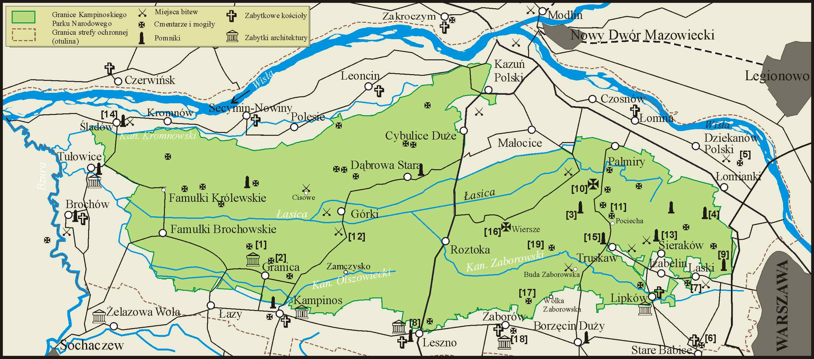
Putting the Park
Originally put in districts Nowy Dwór Mazowiecki, Pruszków and Sochaczew in the Warsaw province. He is extending to the north-west from Warsaw. He agrees with areas of the Kampinos forest.
Source:Kampinoski Park Narodowy - Topographical map 1:40.000 - Military Cartographic Plants

Slide 14
Sources
https://www.kampinoski-pn.gov.pl
https://pl.wikipedia.org/wiki/Kampinoski_Park_Narodowy
https://sites.google.com/a/gim1jaslo.edu.pl/polskie-parki-narodowe/lista-parkow/kampinoski-park-narodowy
Fot. Adam Lawnik, Kampinos National Park

