Slide 1
Protected species and their habitats

Slide 2
Table of Contents
Click on one of the links below to move to the slide.
Admission
Chamois
Wild bison
Fire salamander
Wolf
Lynx
Woodchuck

Slide 3
Admission
In the presentation we have representatives of the animal kingdom, as they are often threatened with extinction and mainly forests are their habitat.
Fate of animals triggers a lot of emotion. We are pleased with a view of a fox family in a forest clearing on a summer day . We wish that they were free and happy so we should protect all the animals and their natural habitats.
Return to Table of Contents

Slide 4
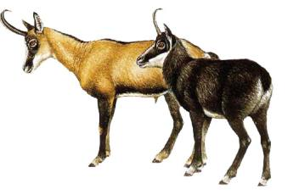
Chamois
Chamois is a typical mountain animal. It inhabits high parts of mountains from 1700 to 2200 m.a.s.l. - mountain pine floors, halls and crags. In Poland there are about 100 individuals.
Return to Table of Contents

Slide 5
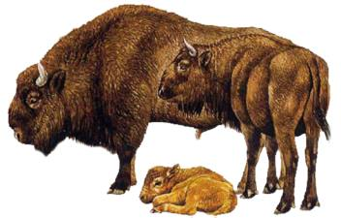
Wild bison
Wild bison is the largest land mammal in Poland. He lives in the forest environment. In 1919, last bison living in the wild died. Their population has grown from 12 bisons that live in zoos in Europe. Nowadays that counts 3,000 individuals.
Return to Table of Contents

Slide 6
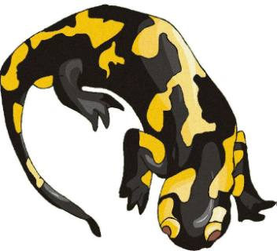
Fire salamander
Salamander is the largest European species of land amphibians. It is active mainly at night . It can be found in the mountains. It is protected .
Return to Table of Contents

Slide 7
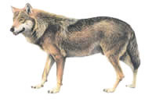
Wolf
Wolf is the second largest predator in Europe. It is a carnivorous mammal living in a herd. You can find it in the mountains and large forests. Currently in Poland there are about 500 individuals .
Return to Table of Contents

Slide 8
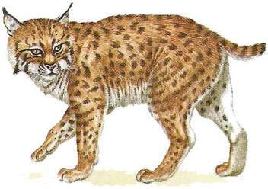
Lynx
Lynx is the largest wild cat in Europe. It inhabits large forest complexes, it is active mainly at night. In Poland there are about 200 individuals .
Return to Table of Contents

Slide 9
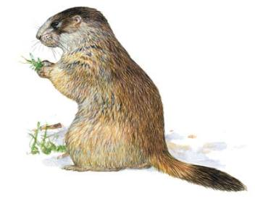
Woodchuck
Woodchuck is a herbivorous rodent, living in meadows and rocky slopes of mountains . It lives in colonies in underground burrows. This is a very rare animal. In Poland there are about 200 individuals .
Return to Table of Contents

Slide 10
Thank you for your attention
Julia Wilk
Wiktor Wesołowki
Agata Kwas
ucz. klasy Id Gimnazjum nr 1 w Chęcinach

Slide 11
Sources:
-http://www.ochrona-przyrody.edu.pl/zwierzeta/

