Slide 1
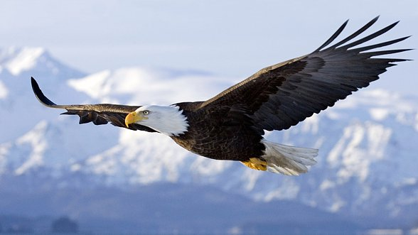
Album fotograficzny
So let’s go ;D
autor: Użytkownik

Slide 2
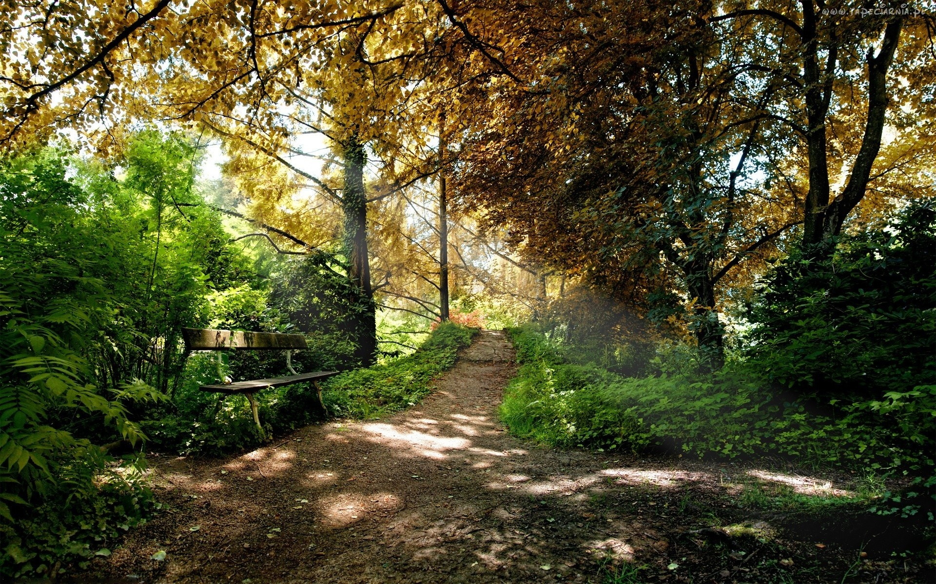
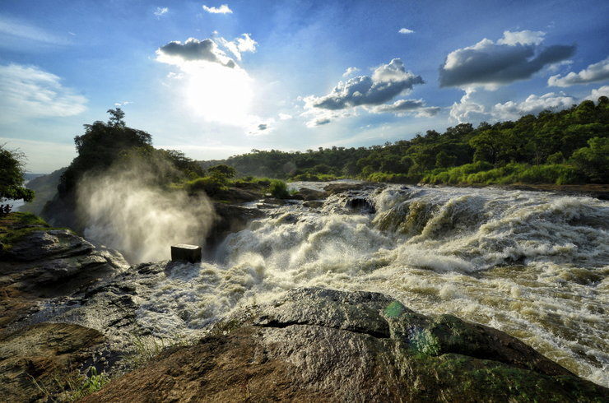
Chosen national parks in Europe.
In Europe a few hundred national parks were appointed. First rose from them in 1909 in Sweden. To the outbreak of the World War II the first national parks came into existence in 12 states (e.g. in Sweden from 1909 , France of 1913 yr, Spain of 1918 yr, Iceland of 1930 for Poland and Ireland of 1932 ,of Bulgaria 1934 ). A Russian Jugyd national park is the biggest park Wa ² km having area 18 917.

Slide 3
The history of the conservation of nature in Greece reaches the interwar period, when they started appointing the first nature reserves. In 1938 national parks protecting Olimp mountains and a Parnassus were appointed. At present he exists ten of "woody national parks", from which some have - as similarly as in France - central and outside zone. The conservations of nature are supplementing the system two "sea national parks" and 14 of "national parks", appointed from 2000

Slide 4
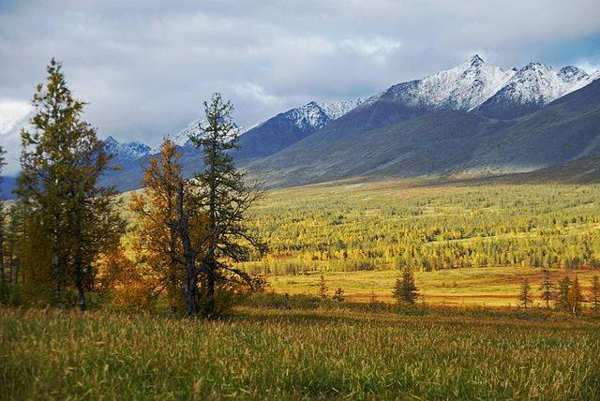
Russia has ones of the areas the largest in the most world of the wildlife. Appointed 5 May 1983 is the oldest park Soczinski national park. Since then 42 next couples were appointed.

Slide 5
National park "Jugyd wa" is spreading through area about the area about 18 917 ² km what is making him the biggest national park of Russia and due to the location biggest on the European continent. From an administrative point of view the park is located in the south-east part of Komi Republic. Over the half of the area of the park is covered with the taiga (about 51%), on the highest heights of protected areas it is possible to find areas of the tundra. Also an about 20 ² km of meadows exists, both alpine, as well as of meadows in river valleys. An about 180 bird species lives in the park, in it a few very rare,
He ranks among the Mammalia most often come across dwelling these areas in among others: hares mountain hares, reindeer, ermine, otters, elks, wolverine, pine martens, mustele, as well as animals from the family bearish and polatuchy.

Slide 6
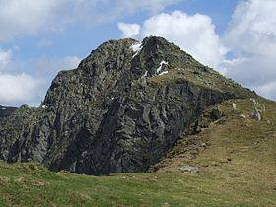
The appointed Tatra National Park in 1949 is oldest within the limits of Slovakia, as well as former Czechosłowacji. At present nine national parks exist within the limits of this republic.

Slide 7
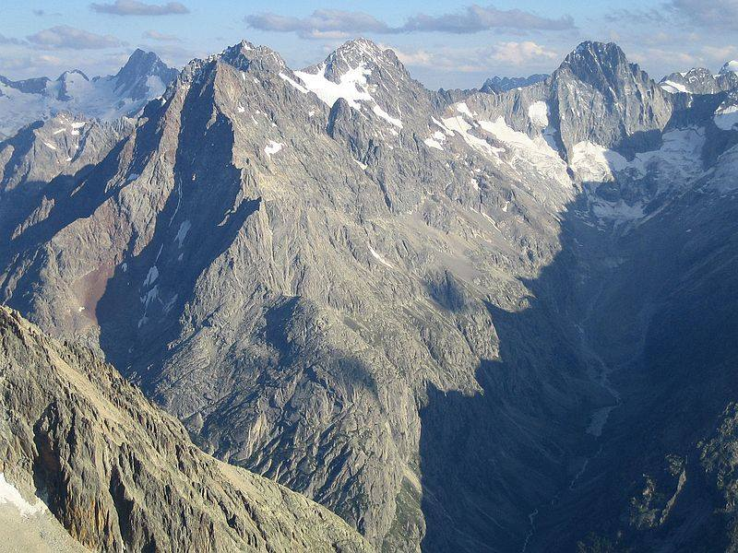
France was the second European country which the own national park appointed - in 1913 a "Bérarde national park" came into existence (he didn't survive the problem of the World War I, today on this area a yr appointed in 1973 is PN Écrins). Contemporary French national parks are resisting the yr on the law from 1960 They consist of the central zone (cœur) and of access zone (aire d'adhésion) having character of the landscape park. So far 10 parks were appointed, in it 7 in part European of you, and is planning quoting next two. Vanoise national park - oldest and probably the most famous national park in France. He was created in 1963. He is in the Graickich Alps. He is stretching out on the surface about 530 m2
Among others the following characteristic species of animals appeared in the primaeval fauna of these surroundings: brown bear grey wolf lynx euroazjatycki lammergeier golden eagle normal black grouse ptarmigan north chamois

Slide 8
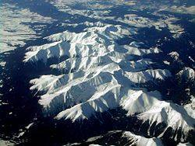
The Tatra National Park - Slovak equivalent of the Polish Tatra National Park, 1 January 1949 incurred The Tatra National Park is the oldest national park on Slovakia. he includes the part of the High Tatra mountains with the highest peak of the Tatra mountains, with Gerlach (2655 m asl), of West Tatra mountains and whole of the Biiiskich Tatra mountains. the Area of the park in 1949-87 years was 50 965 ha. In 1987 a park was increased by the almost entire Slovak West Tatra mountains, and the area was 76 883 ha. Today 74 284 is spreading through the park ha They are included in his main tasks: preserving the primaeval state of the natural environment through the in-depth protection managing using mountains at recreational, healing and sports targets.

Slide 9
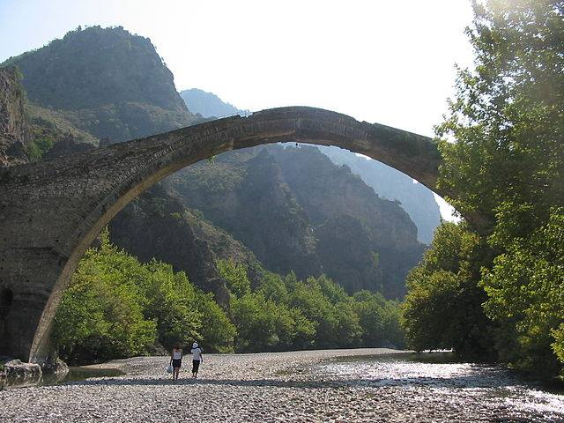
National park Wikos-Wjosa- national park located in north-east Epirze, in Greece. ² covering an area of 126 km. The park was established in 1973 and Timfi and a few Zagori small towns include Wikos ravine, Wjosa ravine, mountain. Here numerous mammals are often come across so as bear, foxes and deer. Fish is representing trouts here mainly. Forests consist of diverse species of plants.

Slide 10
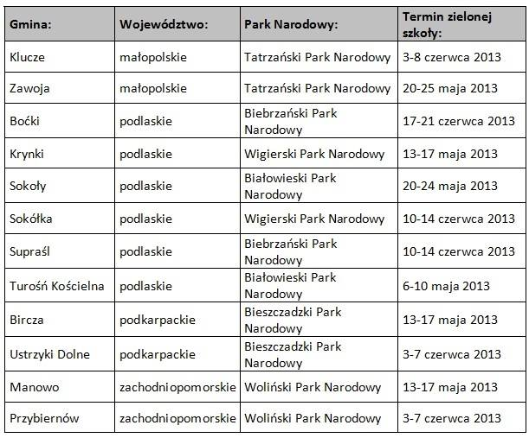
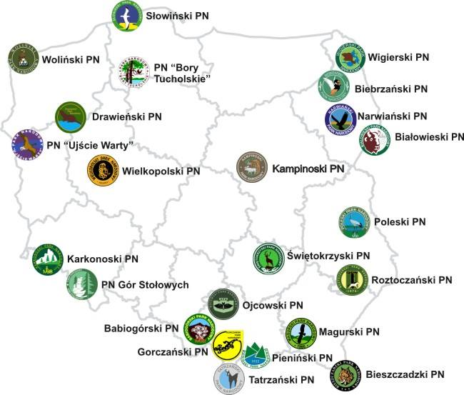
NATIONAL PARKS IN POLAND

Slide 11
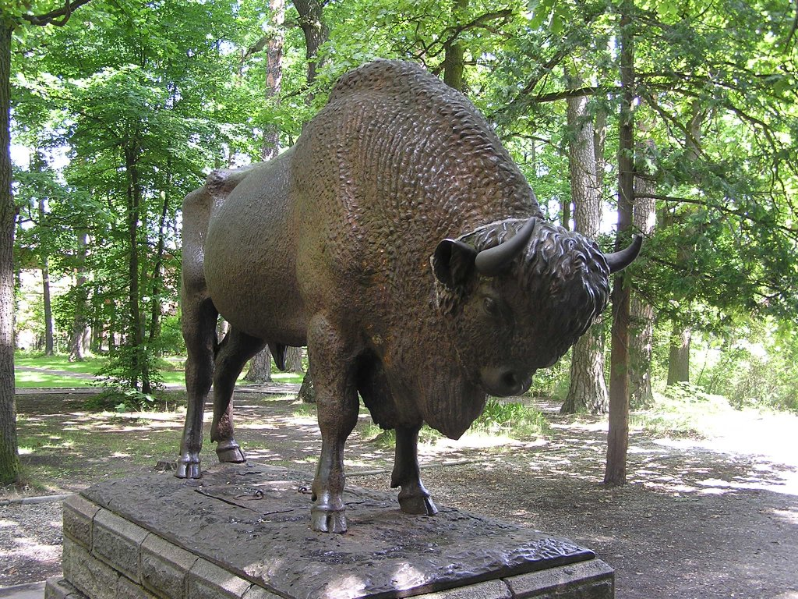
The protected area because of its advantages, mainly natural. In Poland, the wording of the Act on the Protection of Nature in 2004. "[1] covers an area of outstanding value for the environmental, scientific, social, cultural and educational, with an area of not less than 1000 ha, which are protected all nature and landscape values. the national park created to preserve biodiversity, resources, formations and elements of inanimate nature and landscape values, restore the proper state of resources and elements of nature, reconstruct distorted natural habitats, habitats of plants, habitats, animals or fungi. "
The protected area because of its advantages, mainly natural. In Poland, the wording of the Act on the Protection of Nature in 2004. "[1] covers an area of outstanding value for the environmental, scientific, social, cultural and educational, with an area of not less than 1000 ha, which are protected all nature and landscape values. the national park created to preserve biodiversity, resources, formations and elements of inanimate nature and landscape values, restore the proper state of resources and elements of nature, reconstruct distorted natural habitats, habitats of plants, habitats, animals or fungi. "

Slide 12
Białowieski Park Narodowy
Bialowieza National Park
national park located in the north-eastern part of Polish, in Podlaskie, created August 17, 1932 year as the National Park in Bialowieza reintroduced in its present form with the Regulation of the Council of Ministers of 21 November 1947, the first national park in Poland and one of the first national parks in Europe. Known for the protection of the best preserved fragment of the Bialowieza Forest, Europe's last primeval forest fragment and numbering several hundreds, the world's largest population of libertarian żubra.Obszar Strict Protection of the Bialowieza National Park in 1979, because of great significance for the culture and heritage of mankind, inscribed on the prestigious UNESCO World heritage List. In 1992. UNESCO extended the World Heritage status of the object on the adjoining to the east portion of the Belarusian national park "Bieławieżskaja Forest" subject to strict protection (4500 ha). The result in the Bialowieza Forest one of seven in the world and three European cross-border World Heritage object.

Slide 13
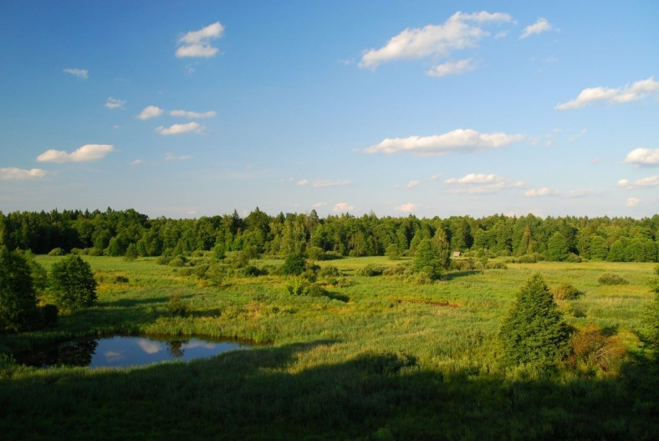
created in 1956, it is one of 23 national parks in Poland. It is located in the Malopolska province, in the district of Krakow. It is situated in the area of 4 municipalities: rock, Jerzmanowice-Przeginia, Great Village, Sułoszowa. It includes part of the Krakow-Czestochowa Upland - Prądnika Valley and the Valley Sąspowska and adjacent parts of the Jurassic plateau. It is the smallest of the Polish national parks. Its symbol is a bat. In the nineteenth century. Nature OPN suffered great losses - were cut entire stands, digging caves to extract accumulated in their manure, broken off rock formations. At the same time, however, it made here the first archaeological discoveries, scientists described the rare species of plants and animals, and the beauty of the Valley Prądnika attracted the first tourists. In the press there were voices about the need to protect this unique natural space, and enlightened landowners and entrepreneurs trying to prevent its further devastation by buying his land from private hands. Amateur-archaeologist Jan Zawisza, owner Ojcowa began buyouts of Wroclaw merchants who unscrupulously cut down forests, continued repurchases next owner John Krasinski, founded on the initiative of Adolf Dygasińskiego stock company bought the castle in Pieskowa at the end of the nineteenth century. Was established regional museum in the Fathers .
Father National Park

Slide 14
Tatra National Park
The park is located in the southern part of our country, in woj.małopolskim, near the border with Słowacją.Powierzchnia park is 21164ha of which was covered by strict protection 11514ha.Park covers the entire Tatry polskie.O creation of the park was thought already in the nineteenth century, and in 1865 first steps were taken to protect the chamois and świstaków.W finally, after many attempts park in Poland was established in 1955, and the Slovak side was formed in 1948r.Symbolem park is the mountain goat and the park is a mountain type. In the park there are very clear pietra climate plant, with features alpine-climate with increasing altitude lowers the temperature of the air, increasing the number of rainfall and shortens the growing season.
A major attraction is the rich material culture of the Tatra highlanders, their dialect, costumes, rituals, budownictwo.Wśród attractions we can still taste visiting museums, cemeteries, the oldest highland houses and chapels as well as to ride on the ski slopes of the beautiful.

Slide 15
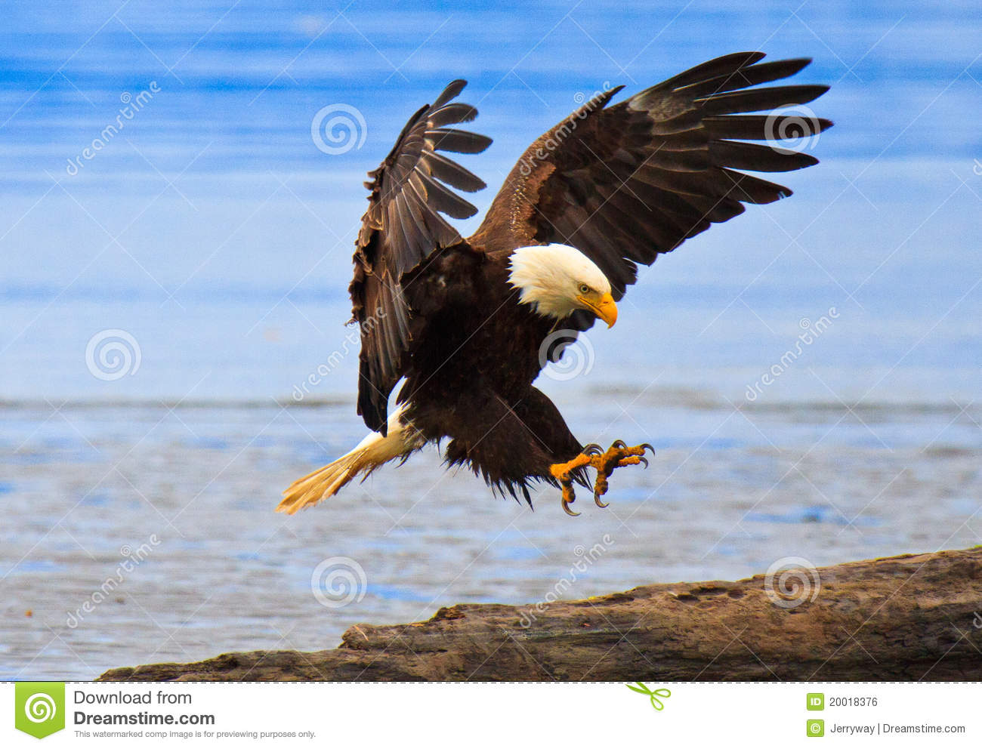
Konrad Lewna
Simona
Kreft
Sara
Graczyk
III Th :D .
ZSGŻiA Lębork
Dziękujemy za uwagę

