Slide 1
Forests in Poland and Europe. Characteristics and management
Work done by Paweł Mućko,
Adam Papis and Cezary Osiadacz

Slide 2
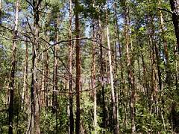
Forests and management (introduction)
Throughout Europe, especially Poland has many beautiful, large and rich forests. Environment in the areas where we live has a big impact on our economy and the life of among others the creation of furniture, wood production, the acquisition of raw materials, breeding and protection of life in the forest. Forests are also a tourism destination for many people.

Slide 3
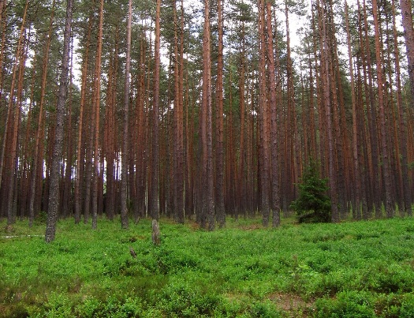
Forests in Poland
Forests in Poland cover about 29% of its surface. Almost 85% of our forests area are coniferous forests. On the impact on our woods is the location. Our forests are located on eurosiberan area which the arrangement of climatic and soil conditions mainly causes the developement of vegation boron. Most of our trees are pines.
https://encrypted-tbn2.gstatic.com/images?q=tbn:ANd9GcS1LsWnsk96MJaOQrXvmluh2oSY9sqHp5hq8Al43NnfKTT_uPDL

Slide 4
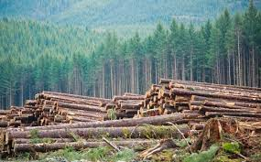
Forest managament in Poland
Most of our forest economy is built by production of wood. Our management is also based on farms, increasing woods resources. Additional elements of the forest management are: raising crops undergrowth, trees, medicinal plants and the implementation of non-production forest functions, related to the protection of air, soil and water. Forest management is conducted according to the rules:
general protection of forests,
durability maintenance of forests,
continuity and sustainable use of all functions of forests,
expansion of forest resources .
http://www.vancouversun.com/cms/binary/8954508.jpg

Slide 5
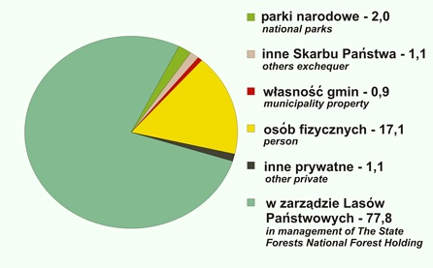
Forest Characteristics
Currently, the forest area in Poland is 9088 thousands in hectares.
In the structure of the habitats of forest habitats predominate boron occurring in 52.6% of the forest area, forest habitats occupy 47.4%. Lowlands, coniferous forest habitats and the habitats much richer, dominated by pine forests in mountain and upland - spruce.
http://ypef.eu/files/wykres.jpg

Slide 6
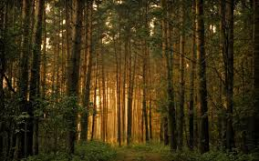
Forests in all Europe
European Union has a lot of habitats, forests and nature reserves. 35% of europe’s of land area is covered by forests.
http://www.efi.int/files/images/virtual_library/jrc_map.png
https://encrypted-tbn1.gstatic.com/images?q=tbn:ANd9GcSKswhm3kYXHYDhgOssHMcCjll3u242aVK3EJQghxhBNDB5yPh7JQ

Slide 7
Forest Management in Europe
Forest management in Europe is as simple as managament in Poland. Most of european countries are basing their managament of woods in making furniture with wood, production of wood, shred of trees, breeding and building. From one year to another, a number of trees and habitats are decreasing.

Slide 8
http://www.arange-project.eu/wp-content/uploads/multifunctionality.jpg

Slide 9
Forest characteristics in Europe
Eighty to ninety per cent of Europe was once covered by forest. It stretched from the Mediterranean Sea to the Arctic Ocean. Though over half of Europe's original forests disappeared through the centuries of deforestation, Europe still has over one quarter of its land area as forest, such as the boreal forests of Scandinavia and Russia, mixed rainforests of the Caucasus and the cork oak forests in the western Mediterranean. In temperate Europe, mixed forest with both broadleaf and coniferous trees dominate. The cutting down of the pre-agricultural forest habitat has caused major disruptions to the original animal ecosystems, and only few corners of mainland Europe have not been grazed by livestock at some point in time.

Slide 10
http://www.forestry.gov.uk/images/MOTIVE_map_small.gif/$FILE/MOTIVE_map_small.gif

Slide 11
All information has been taken from wikipedia and books.
Paweł Mućko
Adam Papis
Cezary Osiadacz
Zespół Szkół Miejskich nr 2
ul. Siennicka 17
05-300 Mińsk Mazowiecki
Gimnazjum, Klasa dwujęzyczna
III a

Slide 12
Thank you for checking our presentation

