Slide 1
Forests in Poland and Europe Characteristics and management
Discovering the secrets of our forests
Green Podkarpacie

Slide 2
Podkarpacie on map of Poland

Slide 3
Afforestation of Podkarpacie
Magurski
National Park
Bieszczadzki National Park

Slide 4
Podkarpackie’s forests in number

Slide 5
The Sandomierz’es wilderness is one of the greatest treasures of our region. In the past it was one of the largest forest in this part of Europe. It is still a wild place where in the future some spiecies could be reintroduced. It’s remains are located near by the well-known Arboretum in Poland- Bolestraszyce. It is a real bank of dieing out species of plants.
© by W. Sowiński

Slide 6
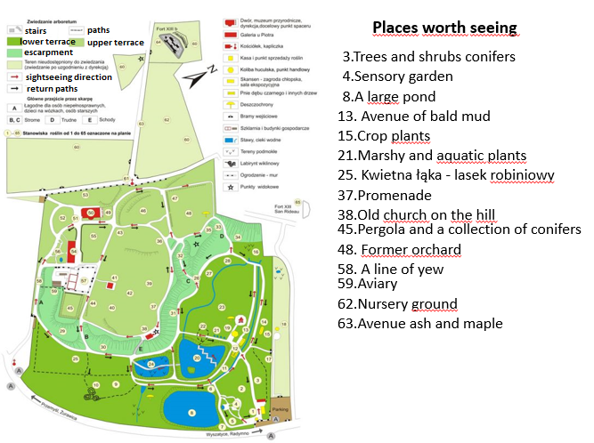

Slide 8
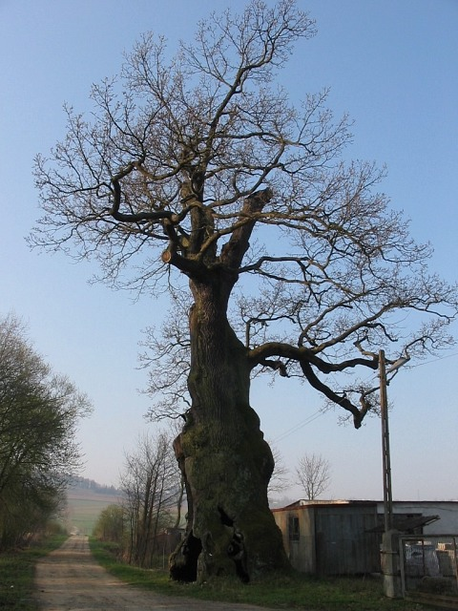
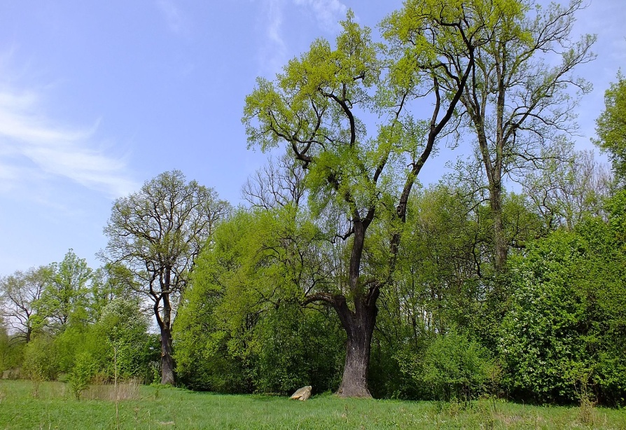
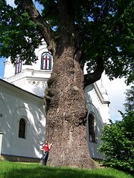
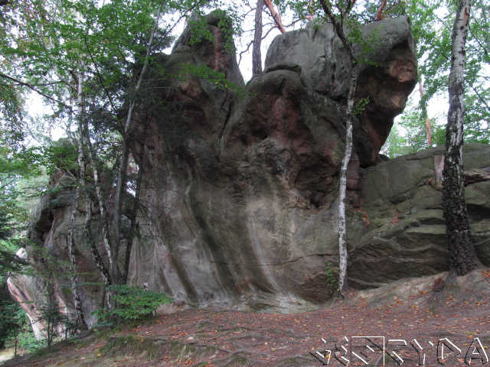
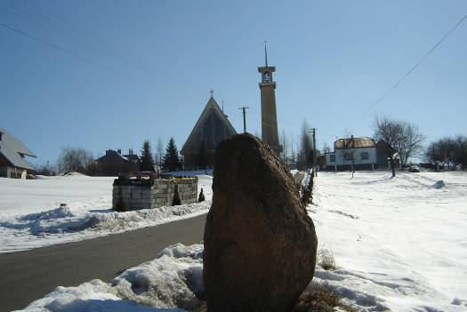
Natural monuments
2
1 Oak Aleksander
2 Oak Chrześcijanin
3 Oak Poganin
4 Stone in Strzegocice
5 Diabli Kamień
1
3
5
4

Slide 9
Within last few years in podkarpackie’s forest the number of wild animals is still growing up. It’s caused by the fact that more and more money is spending on protecting wild unhabitet areas where they exsist.

Slide 10
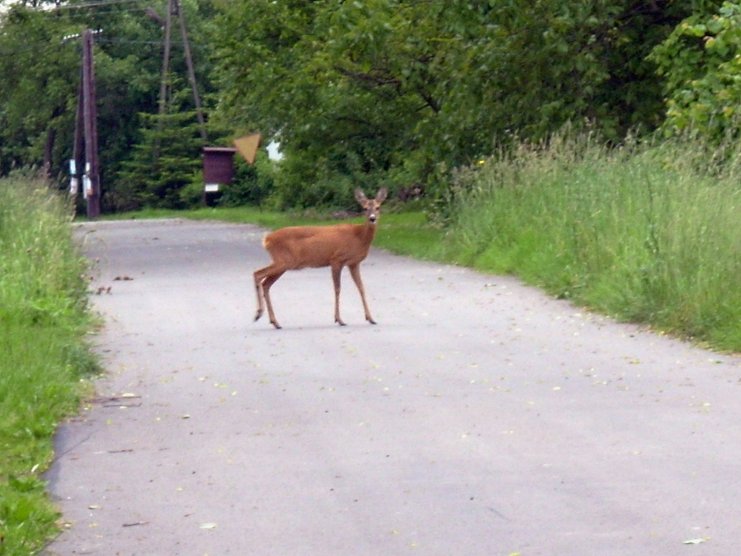
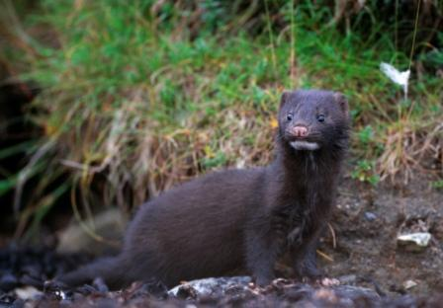
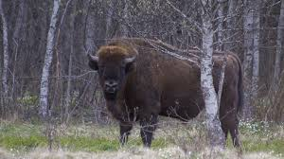
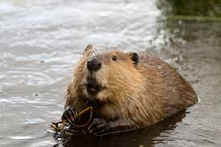
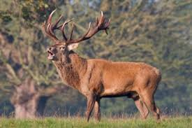
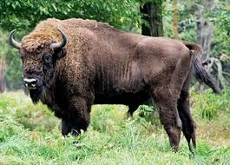
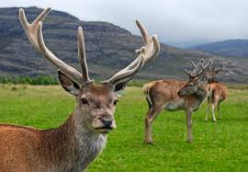
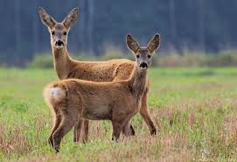
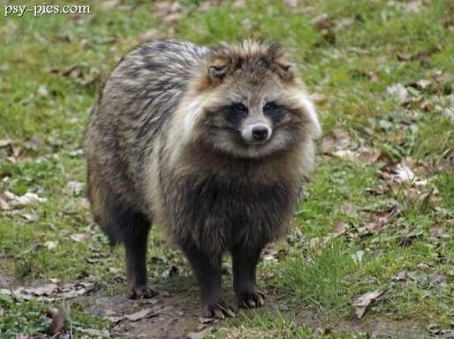
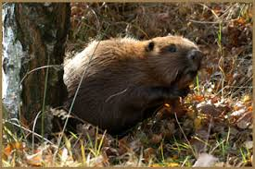
Podkarpackie’s herbivores
Unfortunately the number of invasive species, like American mink or Raccoon, has increased recently
One of the greatest succes is the fact that the number of Aurochs grown up strongly ( from 277 to 300 )
The number of deers, grown up ( now is 10 thousands)
The number of beavers increased by 1,3 tousand individiuals (now is 8,3 thousands)
The number of roes increased too ( now is 36 thousands)
American mink
©
Raccoon

Slide 11
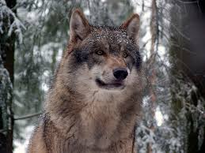
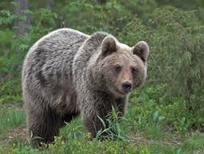
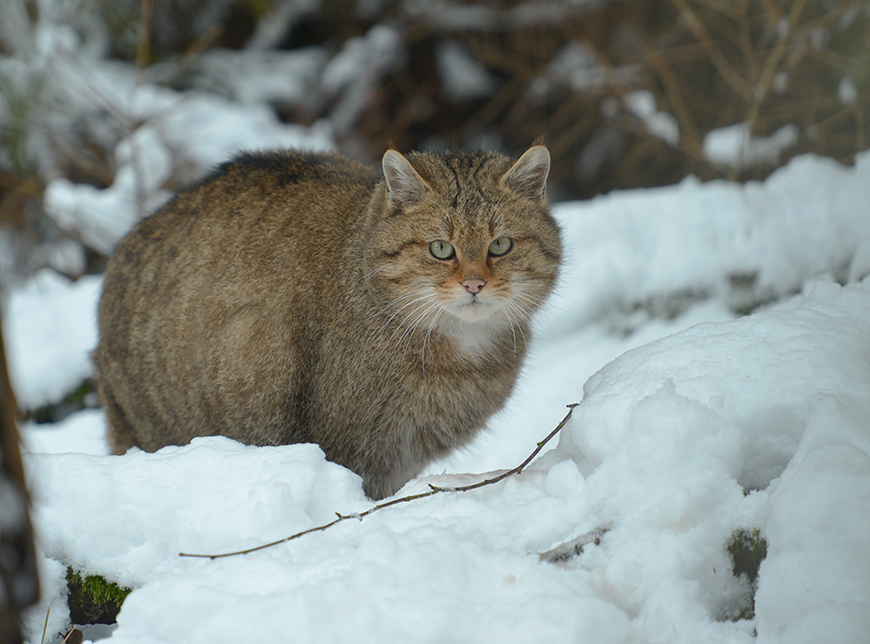
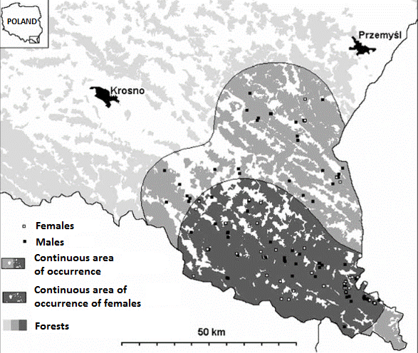
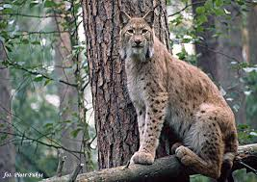
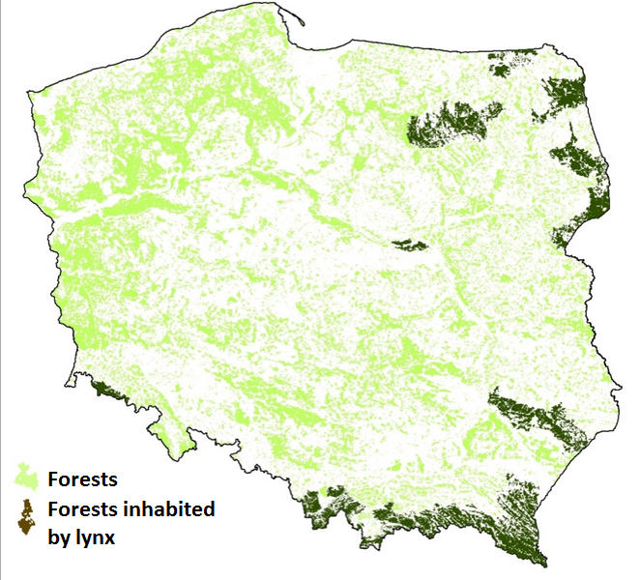
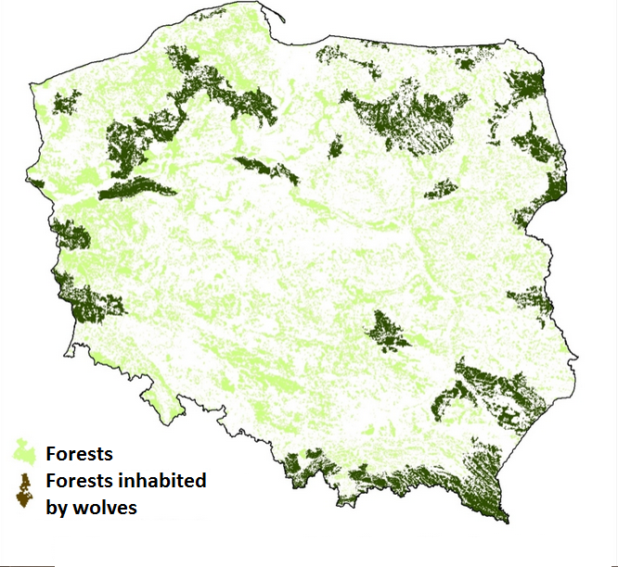
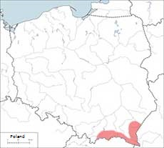
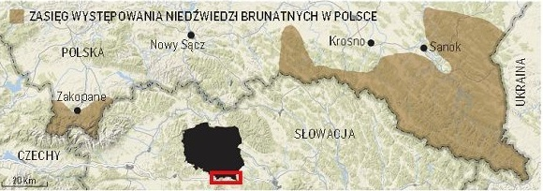
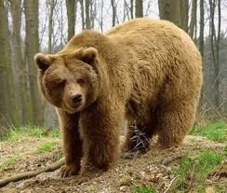
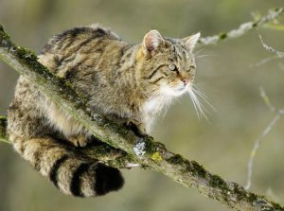
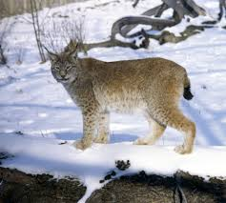
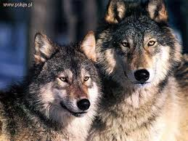
Podkarpackie’s predators
The existence of wildcat
The existence of brown bear
The existence of lynx
The existence of wolf

Slide 12
© by M. Myszak

Slide 13
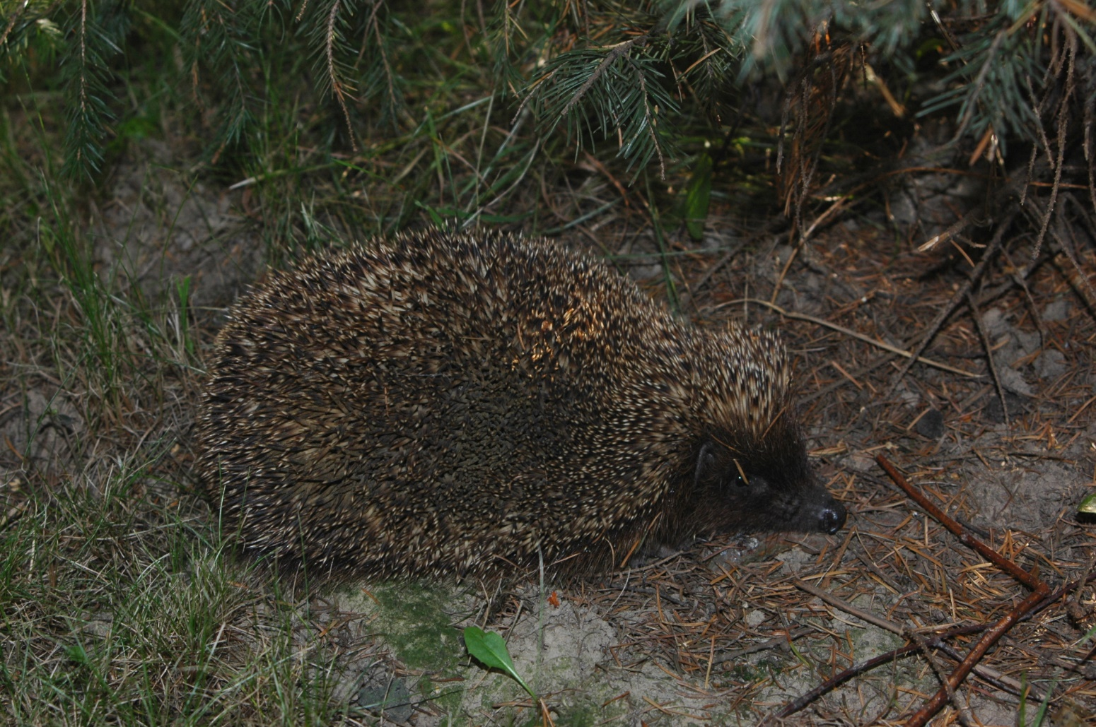
Thank you for watching our presentation!
©

Slide 14
Source of materials
1. Mammal Research Institute of the Polish Academy of Sciences Link to the website: http://www.zbs.bialowieza.pl/artykul/557.html
2. Official Site Arboretum Bolestraszyce
Link to the website: http://www.bolestraszyce.com/kolekcja-rolin-rzadkich-zagroonych-gincych-i-chronionych
3. Elubaczów.com-article http://www.elubaczow.com/2016/04/06/lesnicy-policzyli-dzikie-zwierzeta-na-podkarpaciu-coraz-wiecej-losi-i-bazantow/
©- Our own photos

Slide 15
Jucha Anna
Myszak Michał
Sowiński Wojciech
All members of our team attends to the same class IB in I Liceum Ogólnokształcące im. H. Sienkiewicza w Łańcucie

