Slide 1
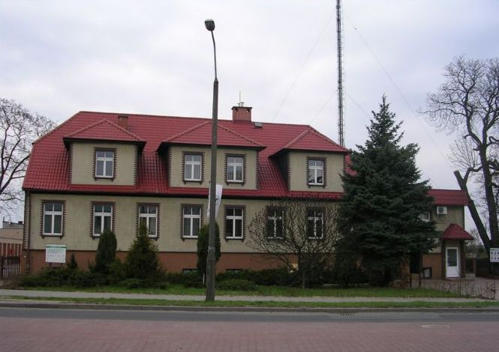
„Forests in Poland and Europe. Characteristics and management.” Skwierzyna forest district
Liceum Ogólnokształcące im. Ireny Sendler w Skwierzynie

Slide 2
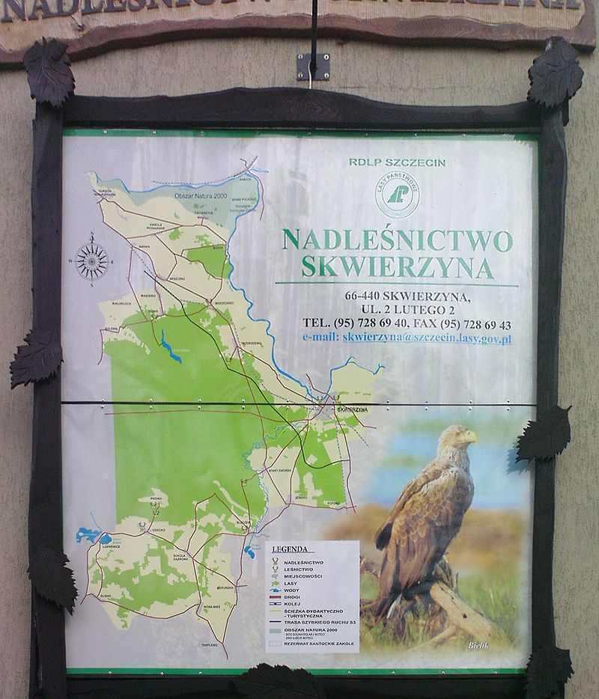
At present the Forestry Commission is managing the area over the 24 thousand ha what over the 23 thousand ha the forest area is determining from. The Forestry Commission is divided into 3 districts: - międzyrzecki: Bledzew, Skwierzyna city, Skwierzyna - gorzowski: Deszczno - sulęciński: Lubniewice, Lubniewice city The terrain of the Skwierzyna forest district was formed in the Quaternary mainly the Pleistocene in the period of last Baltic freezing. Structure geomorphological shaped Skwierzyna forest districts out oneself in the result of a calculation of the sequence of processes: - periglacial - portilacial - of processes occurring in the Holocene

Slide 3
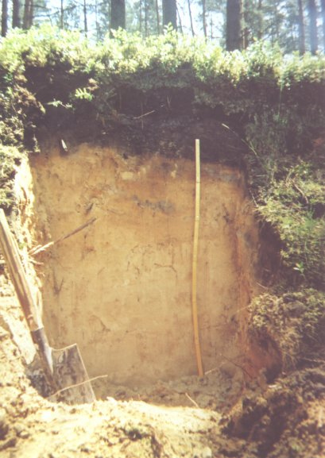
Soil
In the Skwierzyna forest district a soil is a dominating type of the soil podsoil and rust-coloured soil. In the eastern part of the forest district (area of the Forest of Notecka) a rust-coloured soil is dominating and podsoil. Little, of row of a few per cent, a fawn soil and a soil occupy areas peat-muck. Remaining types of the soil don't exceed the 1% of the area of the forest district.

Slide 4
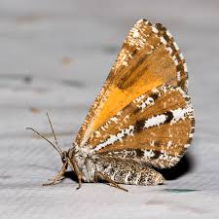
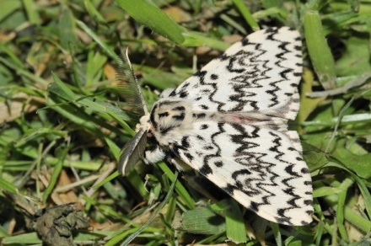
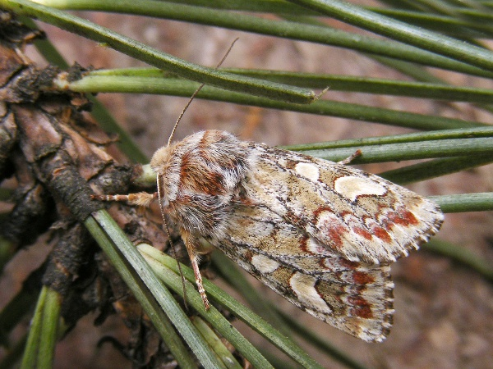
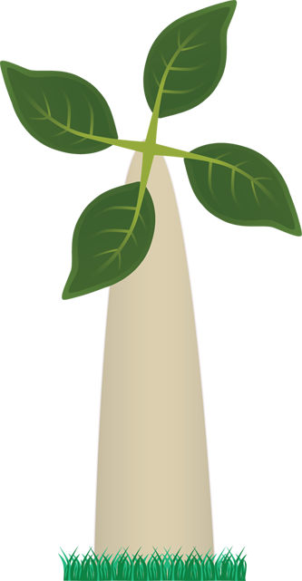
Biotic threats
Lymantria monacha
Bupalus piniaria
Biotic threats are spreading through the damage caused by life forms, causing damage to the tree stand. We recognize the damage caused above all as them through: - pathogenic fungi - insect vermin - game - broad beans
Panolis flammea

Slide 5
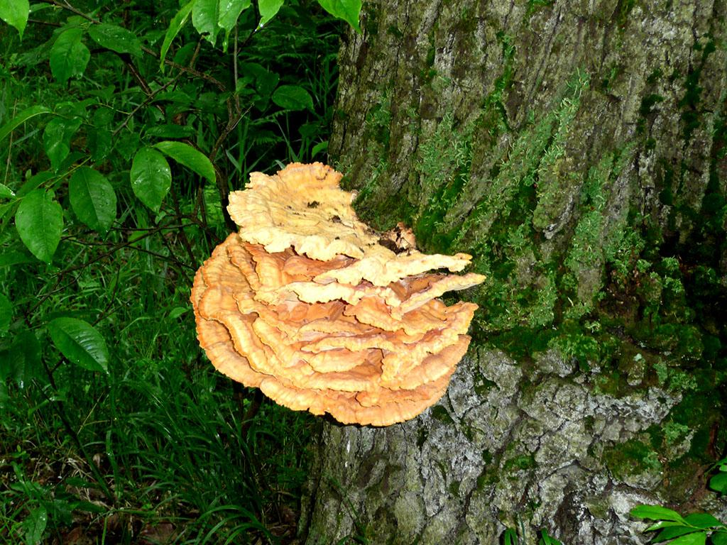
Pathogenic funhgi
The greatest threat from pathogenic mushrooms is appearing in the Skwierzyna forest district in tree stands on lands porolnych which more are exposed to the appearance of such illnesses like among others bracket fungus of roots or armillaria rot of roots. At the Skwierzyna Forestry Commission tree stands on lands porolnych threatened with the appearance of fungal diseases are found in a total area 3284.37 ha. As a result of conducted works urządzeniowych damage from pathogenic fungi was discovered on the surface of the over 1693 ha. Damage caused by mushrooms is most often recorded at the school and in tree stands on lands porolnych, where in smaller or large degree these tree stands are taken control by the bracket fungus of roots.

Slide 6
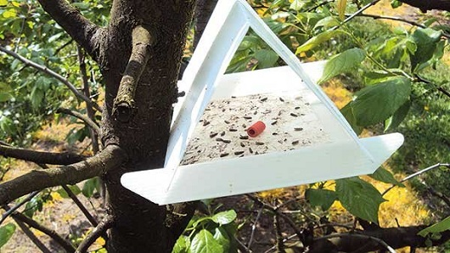
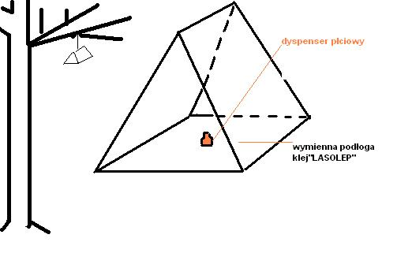
Insect vermin
The damage caused by insects constitutes ones of the greatest threats to the permanence of tree stands. It is regarding pine monocultures on sylvan settlements laid on the so-called bow mainly gradacyjnym, as a result of impoverishing the species composition and declaration associated with it which abilities of the self-regulation are deprived of the soil and settlements within the forest biocoenosis. As a result of conducted works urządzeniowych damage from insect vermin was discovered on the surface of the about 62.6 ha. The Skwierzyna forest district is located in the zone of the high threat through insect vermin, it is regarding vermin of the pine mainly. Amongst insect vermin stated in the previous decade to rank belongs: gypsy moth nun, lasiocampid coal tit, boreczniki, volute zieloneczkę and szeliniaka pine. Secondary vermin aren't posing a greater threat to tree stands of the forest district, out of appearing in the forest district one should exchange above all; przypłaszczka granatka and cetyńca bigger. For fighting forest harmful insects in the forest district traps are applied pheromone.

Slide 7
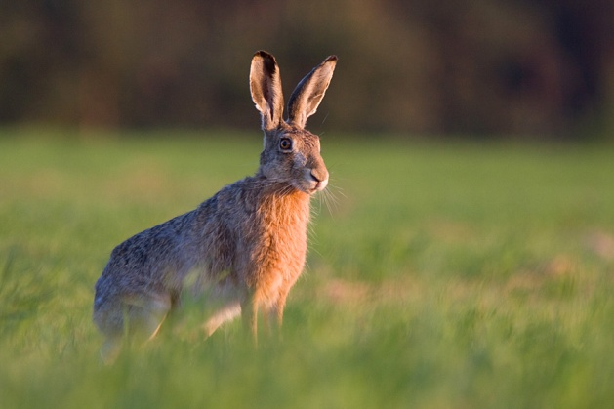
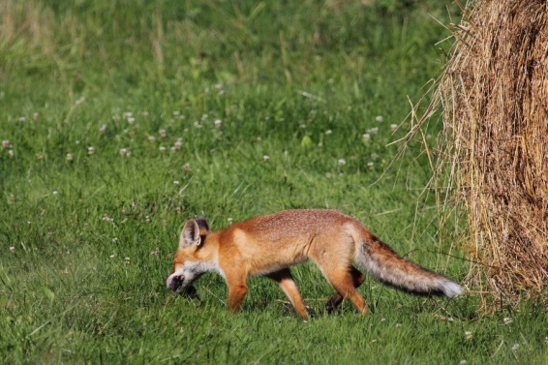
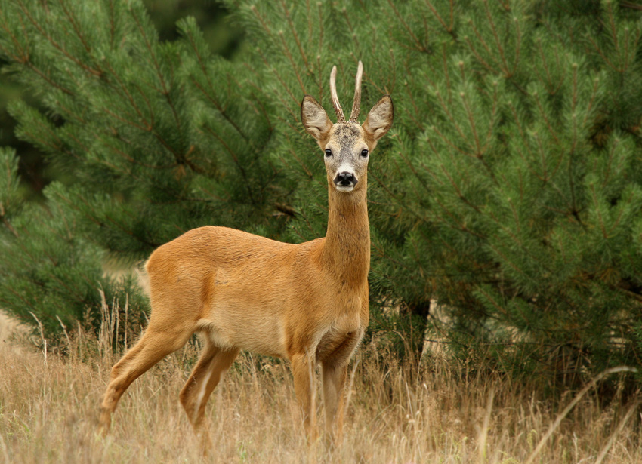
Wild game
Wooded areas of the Skwierzyna forest district constitute the place of staying the population of game animals - of the deer, the roe deer, the fallow deer and the wild boar. With effect of it a caused damage, mainly beating young growths with a truncheon and biting cultivations to death and the reduction in leaf-shaped main kinds are and domieszkowych in assumed cultivations and led giving a leg up production. The Forestry Commission will be in charge of a game management on ten controlled hunting zones leased by 7 hunters' associations. The forest district manager is verifying and is approving annual hunting farm plans sporządzne by individual hunters' associations. The Skwierzyna forest district has an approved Long-term Hunting Farm Plan set for years by 2008-2017, in accordance with the act.

Slide 8
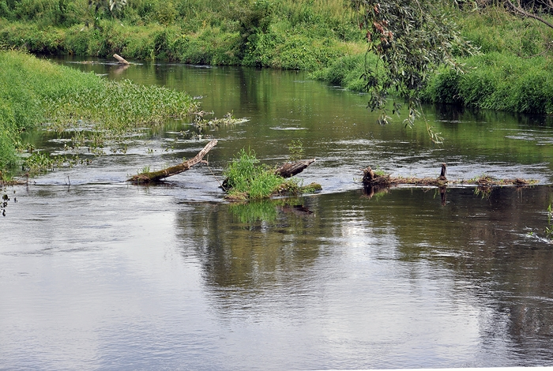
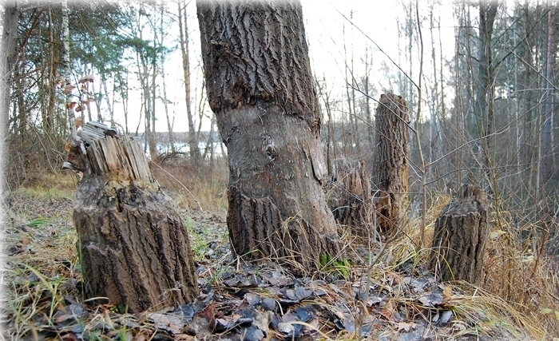
Broad beans
The European beaver is a kind provided in Poland with the species partial protection. He belongs to animals affecting the forming of the environment and influencing to increasing the biodiversity, the retention and reducing polluting waters. In final years in the Skwierzyna forest district damage to tree stands caused by beavers is becoming a relevant problem. This damage concerns mainly cracking and the woodcutting in the neighbourhood of flows and bodies of water, as well as building neighbouring tree stands there causing flooding.

Slide 9
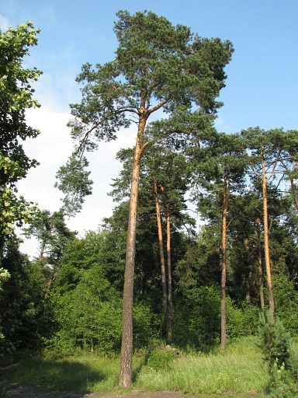
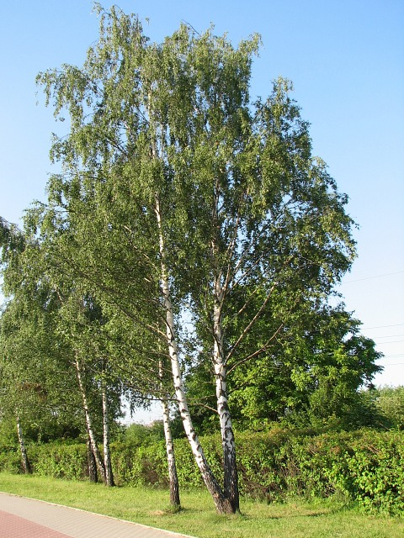
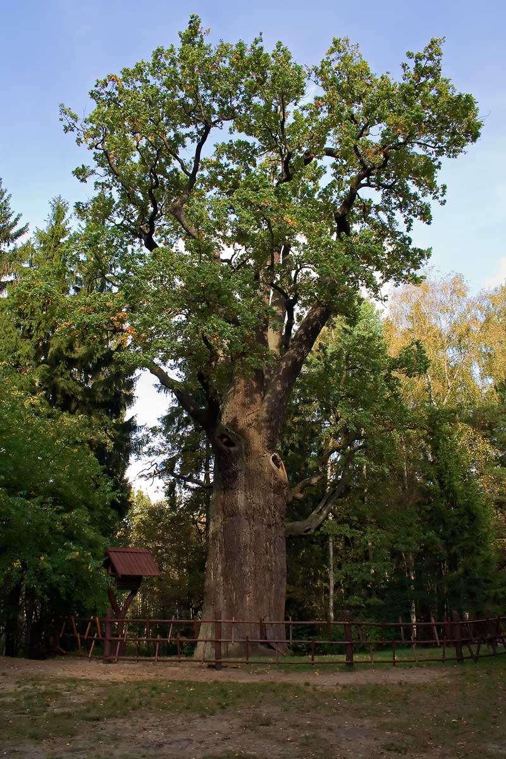
Tree stands
The medium age of tree stands amounts to 56 years, at affluence 235 m3 / ha. 13 kinds form tree stands of the Skwierzyna forest district:
pine - 97% of the area;
oak - ~ 1%;
birch - ~ 1%;
alder tree - ~ 1%;
remaining under the 1%.

Slide 10
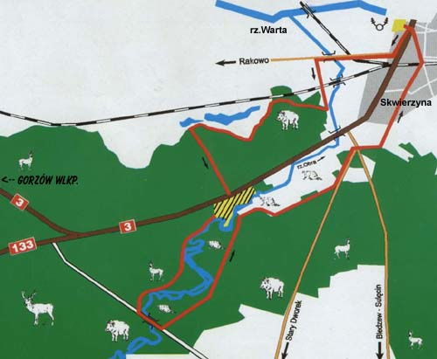
Tourism in forests
Here we live :)
Forests of the Skwierzyna forest district are an abounding area into historical-cultural objects. The area is located within the valley of the Warta and Obry. On her area organising canoeing flows, hikes, bicycle and horse rallyes is possible. Areas are also supporting of fan of wildlife, for photographers and ornithologists. Slags being in the commune: - walking e.g.: Trail of the beaver - bicycle e.g.: Euro R1 Route - horse e.g.: Sicieżka horse - water e.g.: Lubusz watercourse Threats: - theft of wood - littering forests - arduous bets for the environment - fires

Slide 11
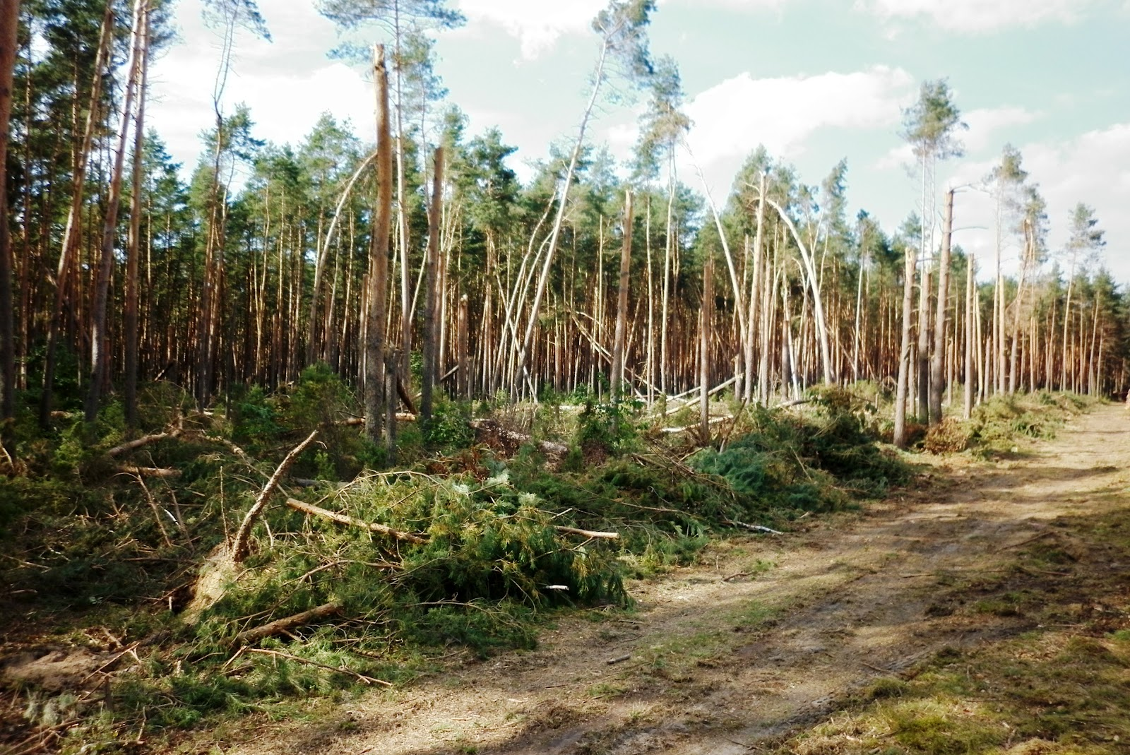
Abiotic threats
Abiotic threats are threats caused by atmospheric agents. They result mainly from putting the given area. In the Skwierzyna forest district an influence of climates is worn away Atlantic and continental and south-west. Main abiotic threats: - violent and short-lived winds - of disrupting the water management - spring frost Forests being situated by dual carriageways are exposed by the cars. Skwierzyna exhaust fumes to the pollution he is lagoon area and all fertilizers and pesticides taken away to fields to the purpose of the liquidation of vermin are polluting waters.

Slide 12
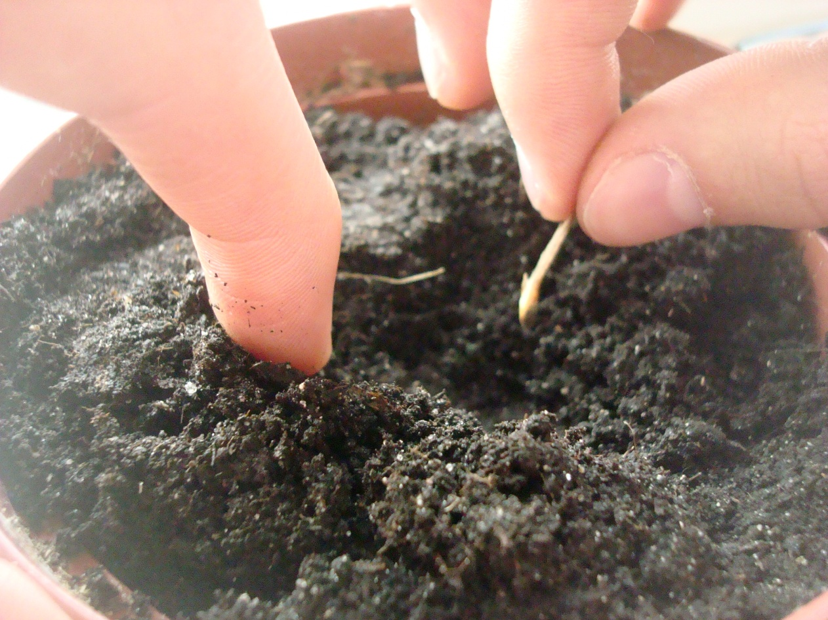
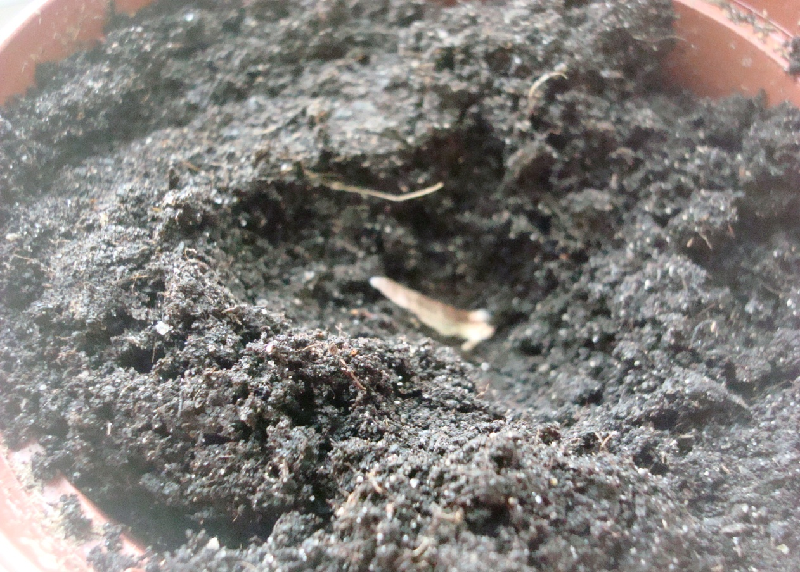
Experience
Influence pH for the germination of pine kernels
Experience:
The first flowerpot pH = 3, second pH = 5, third pH = 6 and fourth pH = 8. For two weeks we observed happening changes in flowerpots.
Observation:
In the first flowerpot nothing grew.
In the second flowerpot they sprouted 3 of 7 seeds.
In the third flowerpot they sprouted 3 of 7 seeds.
In the fourth flowerpot it sprouted 1 of 7 seeds.

Slide 13
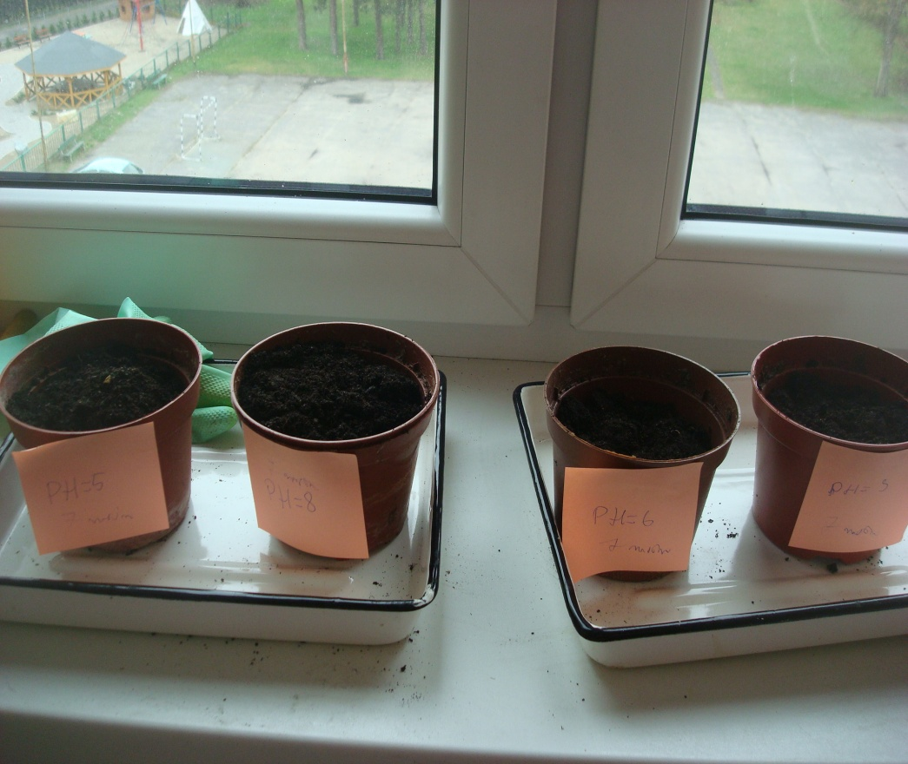
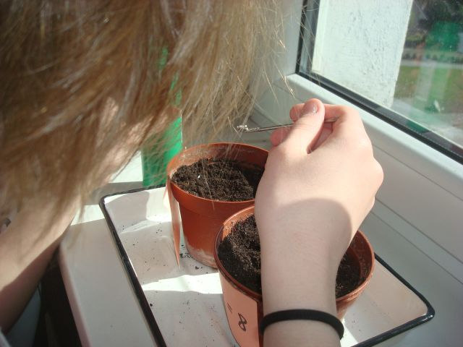
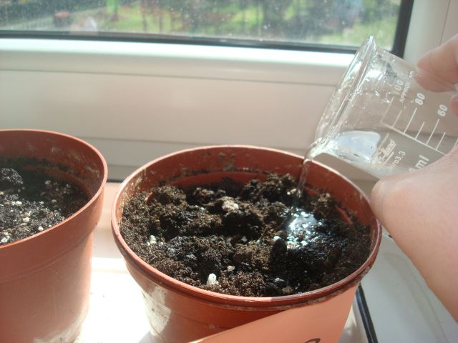
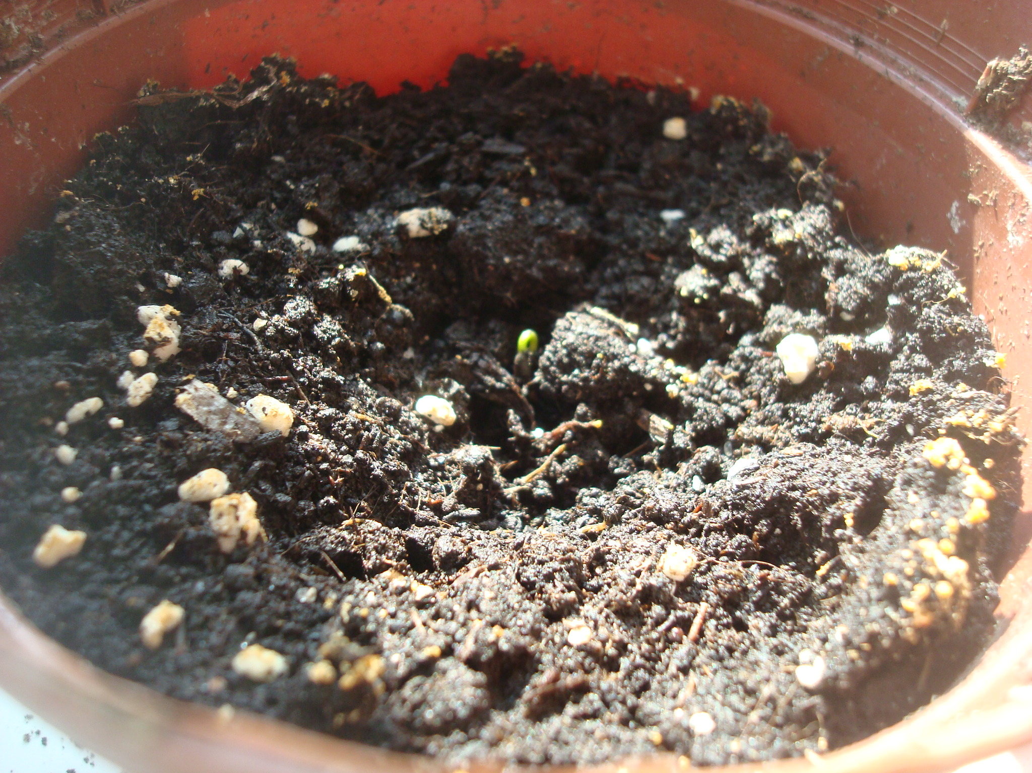
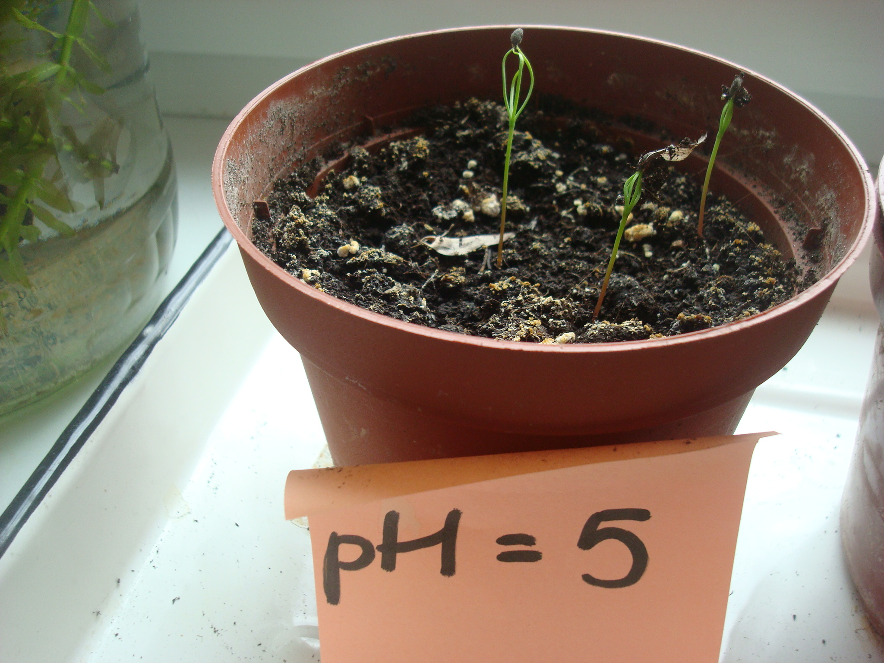
In four flowerpots we sowed for 7 pine kernels.
We added mycorrhizas and we watered with solutions about the different pH.
After two weeks developed small pine trees appeared.
After 3 days a tiny small pine tree sprouted, unfortunately only one.

Slide 14
conclusions
In natural conditions the pine is sprouting in the pH about 5. As a result of the air pollution and the soil rising pH (through some ions of metals, compounds of nitrogen) pines could cause worsening the seed germination. Thanks to the mycorrhiza the negative effect of increasing the pH can be smaller. For that purpose he has areas polluted e.g. in the vicinity of busy roads. It is possible additionally to apply renovating the tree stand of the pine in areas in which many roads are.

Slide 15
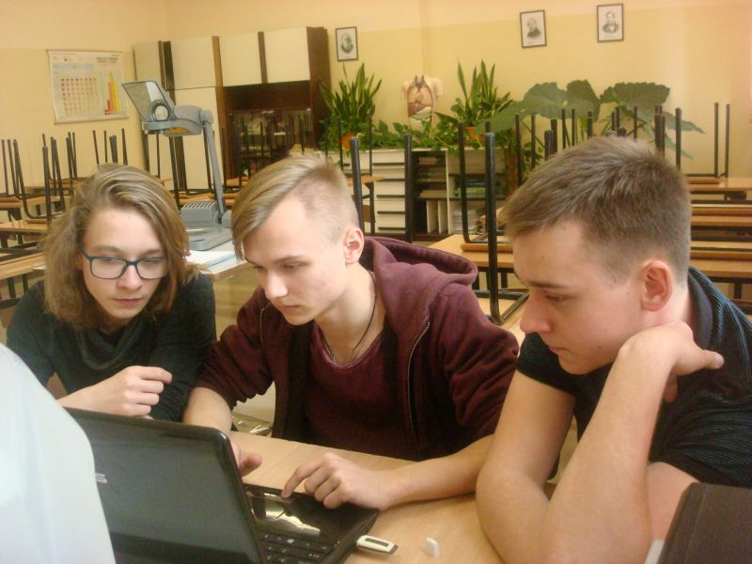
Authors:
Szymon Neca
Tomasz Zajadlak
Gracjan Puchan
Thanks for watching.

Slide 16
We used - google graphic - plan of organising forest, Skwierzyna forest district, state on 1 January 2016 - program of the conservation of nature publishing company Kromeko http://bip.lasy.gov.pl/pl/bip/dg/rdlp_szczecin/nadl_skwierzyna ( dostęp z dnia 7 i 14 kwietnia )

Slide 17
Zespół Szkół Ogólnokształcących w Skwierzynie
Liceum Ogólnokształcące im. Ireny Sendler
Authors:
Szymon Neca
Tomasz Zajadlak kl. 1A
Gracjan Puchan

