Slide 1
Buried in the spodic soils. The secrets of Sandomierz Wilderness.

Slide 2
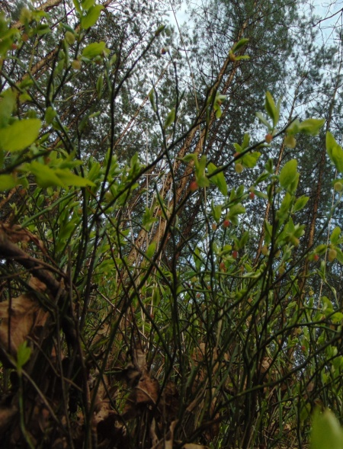
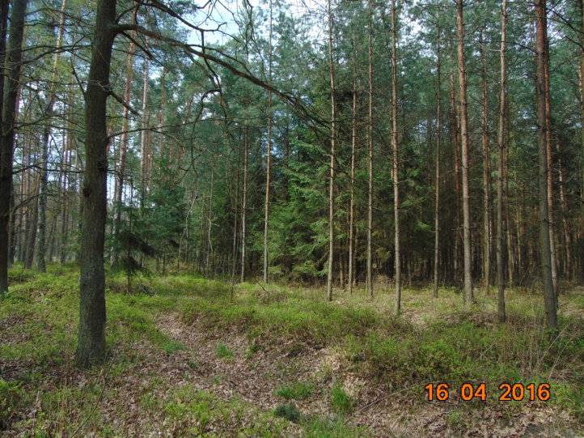
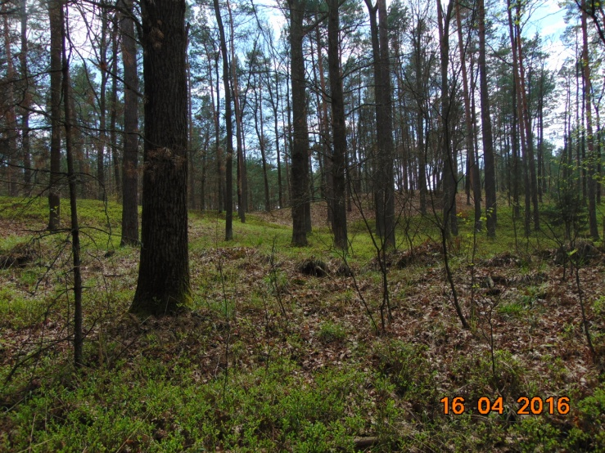
Sandomierz Wilderness– grand woodland located in south-eastern Poland. It is pretty meaningful for many Poles.
It’s visited by hundreds of Poles every day in recreational purposes.
These areas have been considered to be the conventional border between Poland and the Russian tribes.
During the World War II Sandomierz Wilderness
„was flowing” in blood.

Slide 3
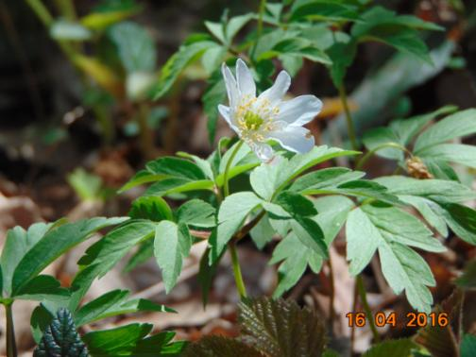
That’s the Anemone:
The Anemone nemorosa is a species, which has lived in Polish forests for centuries. In the past it was used by people in herbal and veterinary medicine.
Anemone is „takes a nap” thanks to osmosis in the night and during severe weather condition.

Slide 4
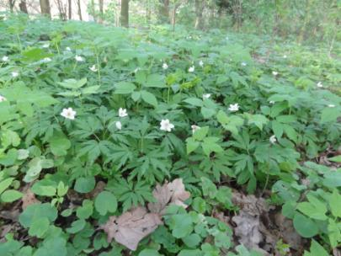
The Anemones decided to settle in Sandomierz Wilderness, mainly due to the fertile soils.
The Anemones have always disliked humans, so they chose one of the wildest areas in Poland.
But they were soon forced to live with humans.
On September 1st 1939 the German army crossed the Polish borders and made the Anemones accept the new „neighbours”(guerillas).
In 1940 the Anemones in Pustków in Sandomierz Wilderness were witnesses to the creation of the German labour camp.

Slide 5
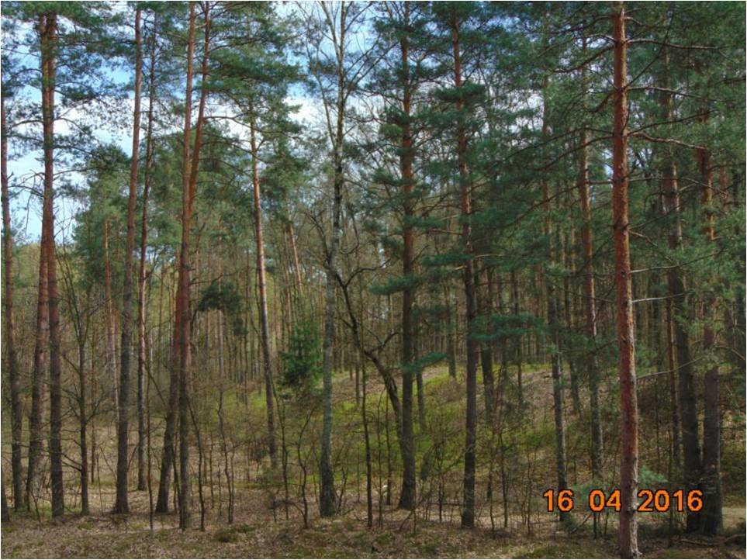
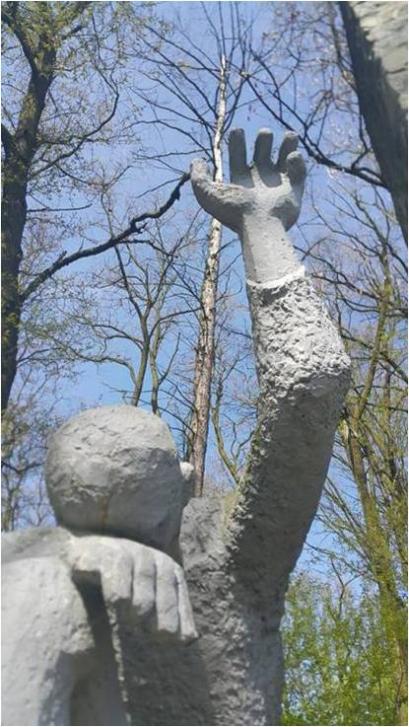
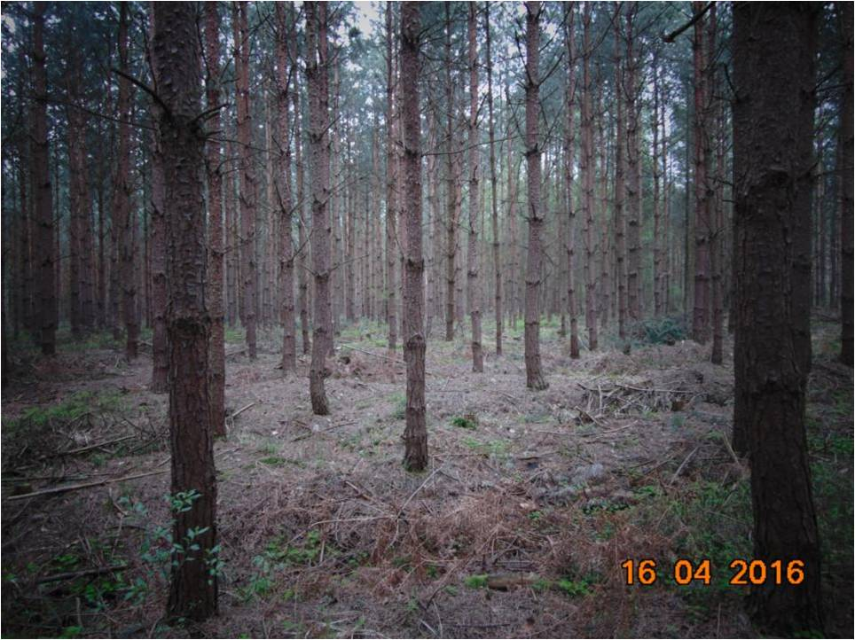
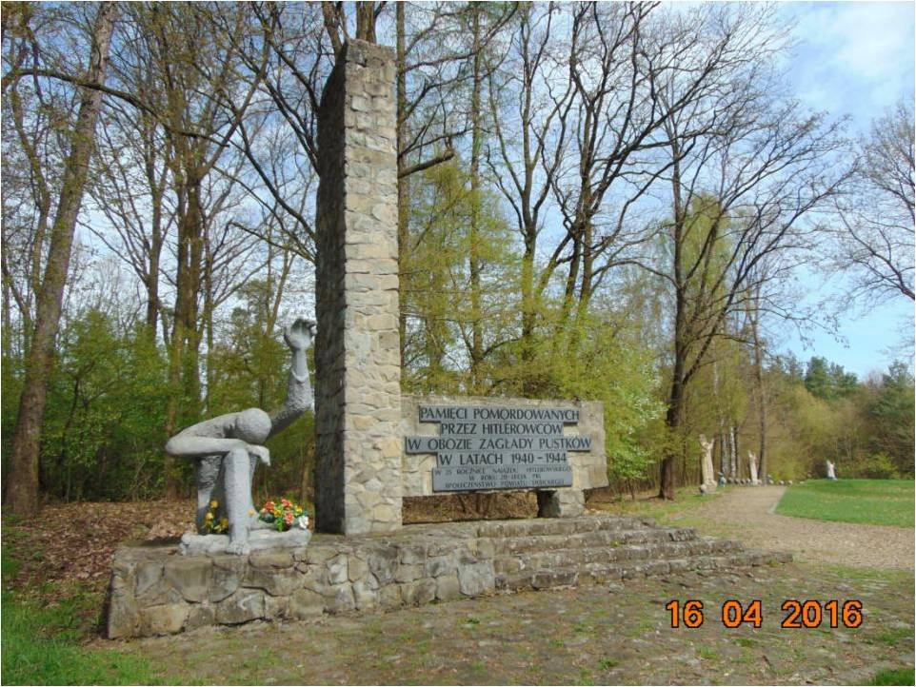
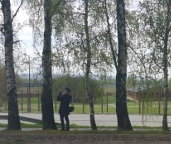
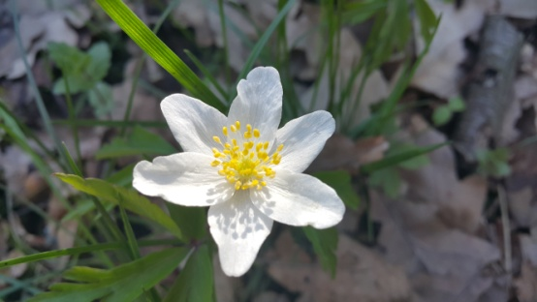
While sentries in the camp lasted day after day,
the Anemones and other species knew that they could feel safe.
But later, the Germans started digging holes, so they deprived some Anemones of their habitat.
The Anemones had to grow amongst humans corpses. They realised, that the Germans were not their allies.
The forest was to never be the same again.

Slide 6
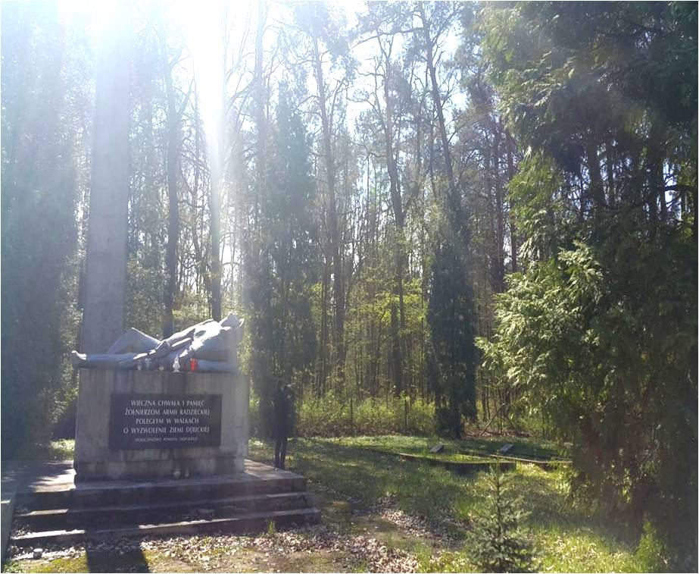
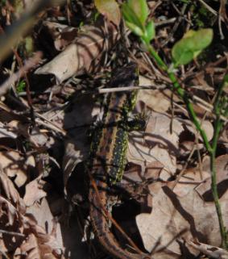
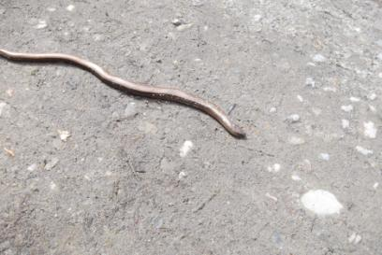
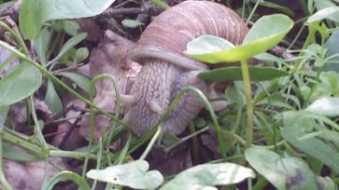
The Anemones grew anxious, when the Red Army entered the forests. The soldiers of both battlefronts were falling dead onto the ground, that was home to the anemones.
People turned out to be the enemies again. Animals were in constant movement.
The blindworm is the only
lizard whose extemities
are residual. It feeds on snails,
litlle reptiles and insects.
The escargot is one of
the edible snails in France.
Polish forests are an
important provider of
snails.
Escargot pollinates
Anemones.
Lacerta agilis is one of the few popular species of lizards in Sandomierz Wilderness. In spring, these lizards have a period of reproduce.

Slide 7
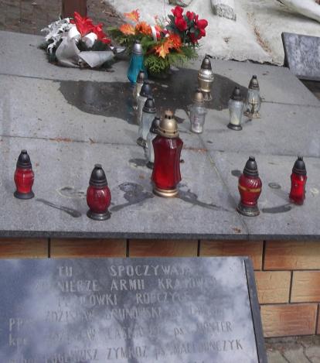
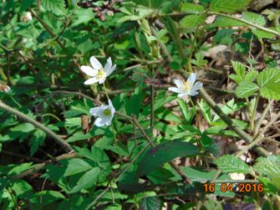
The Anemones had to recreate their habitats, but they weren’t able to do it. The expectations about the new order
which The Red Army promised to
introduce were shatterred in one moment.
The Anemones understood, that the
Germans were not their only enemies
desiring to rob the rich areas of Poland.
Anemones are a spring delicacy of roe deer and aren't harmful to it, although they contain alkaloids.

Slide 8
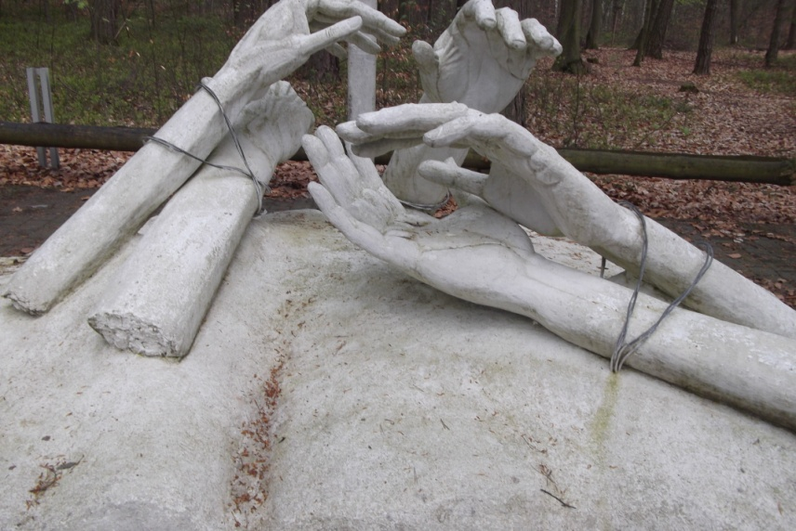
Liberty appeared to be a false facade.
Anemones jumped out of the frying pan into the fire.
Soviet Union nationalized the territories of animals and plants and then deprived them of their habitat to build the dugouts.
A stork
Storks live in the Poland and flies out in the warm on winter.

Slide 9
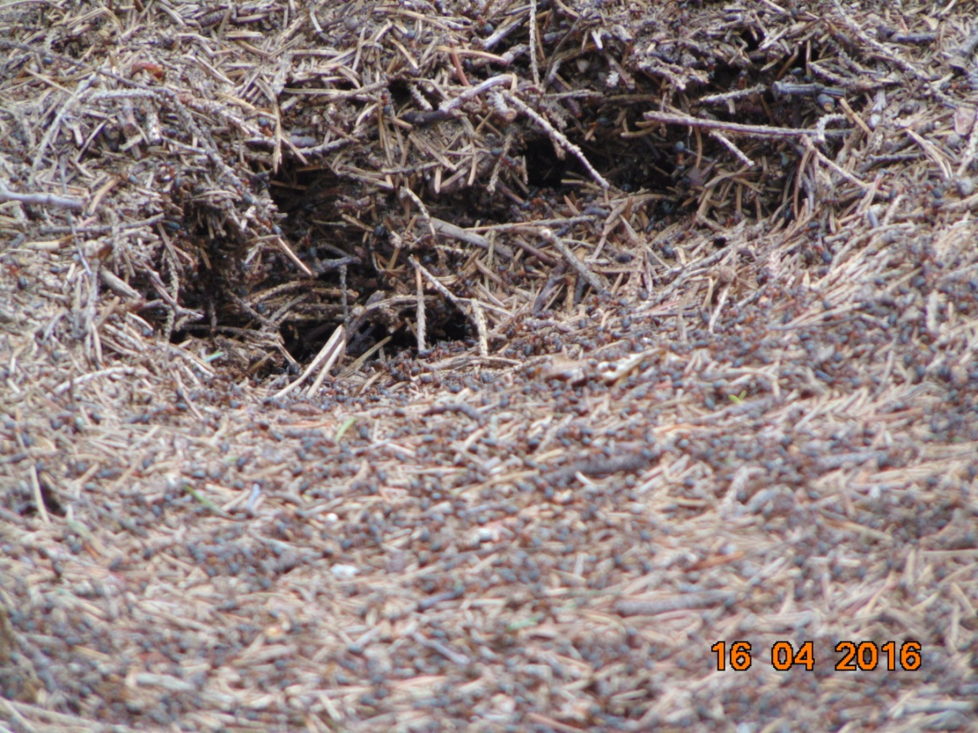
The situation repeated once again.
The ground was submerged in blood.
The elite of Polish youth,
intelligence and all
the best people were
buried in the
ground…

Slide 10
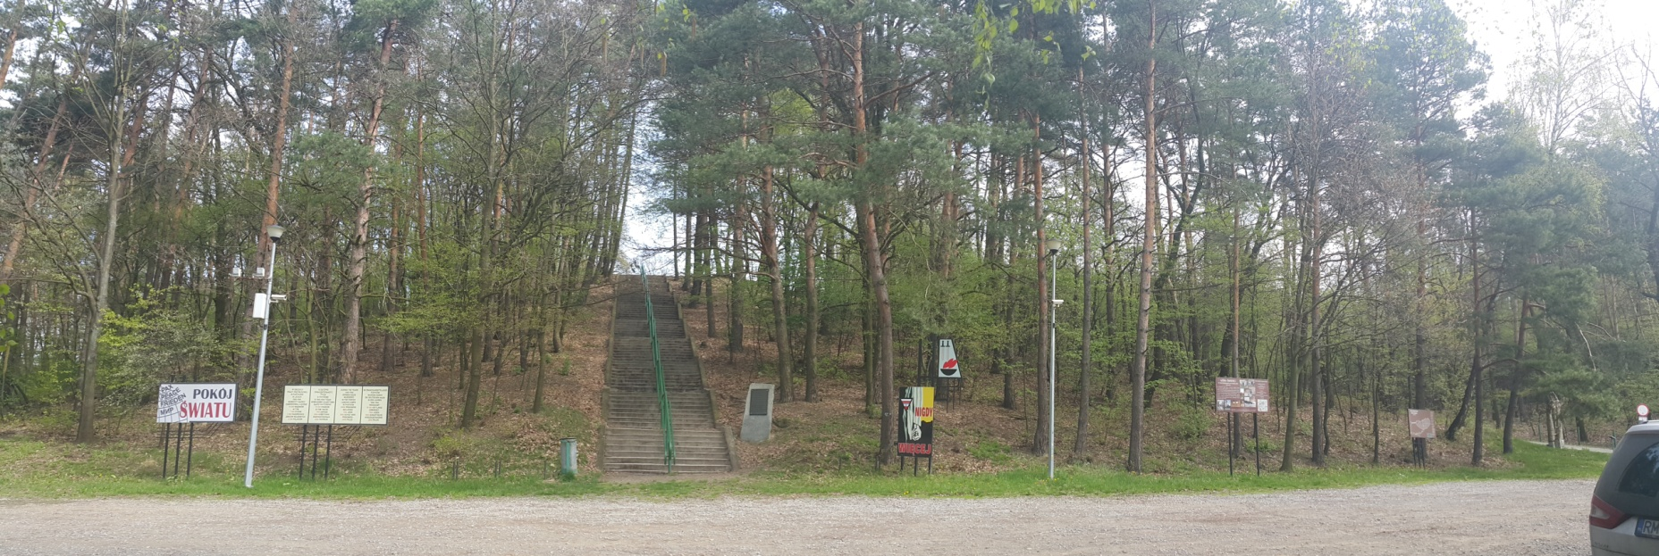
The Mountain of Death - is the area in Sandomierz Wilderness. At first it was the German labour camp which was converted into the camp of death. It has been renovated and become a museum.
It is located in Pustków (Dębica county). Nearby there are a few diffrent meaningful places like Blizna (there are the German bunkers) and Ocieka (there are fragments of a rocket laucher).

Slide 11
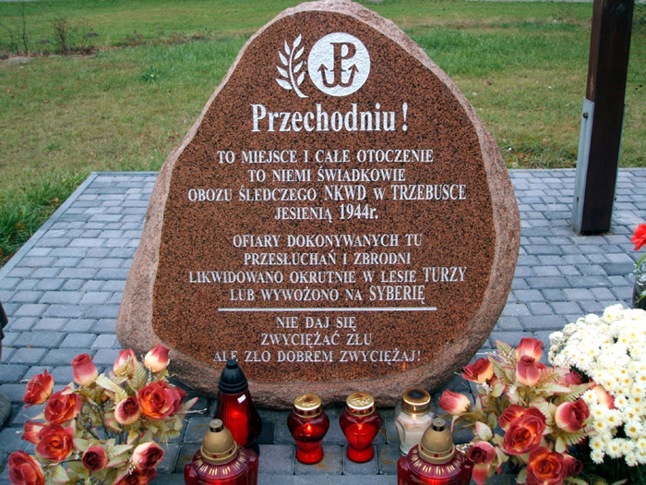
NKVD camp in Trzebuska – is the place near Sokołów Małopolski where Home Army Soldiers were held captive by the Soviets in 1944. Then they were relocated and murdered by them.
This Massacre is really similar to the one that happened in Katyn Forest.

Slide 12
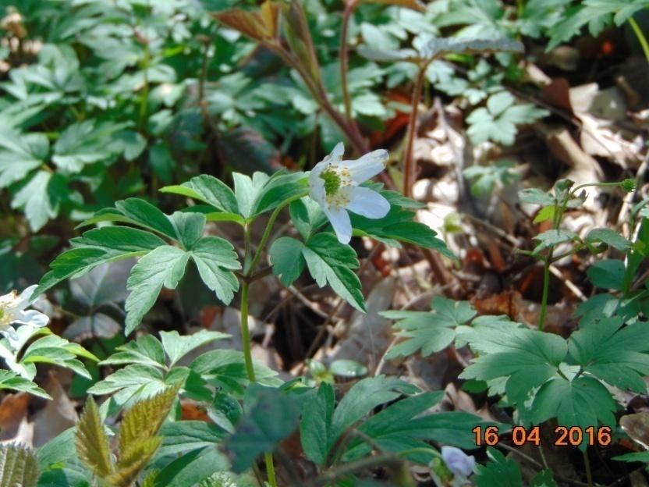
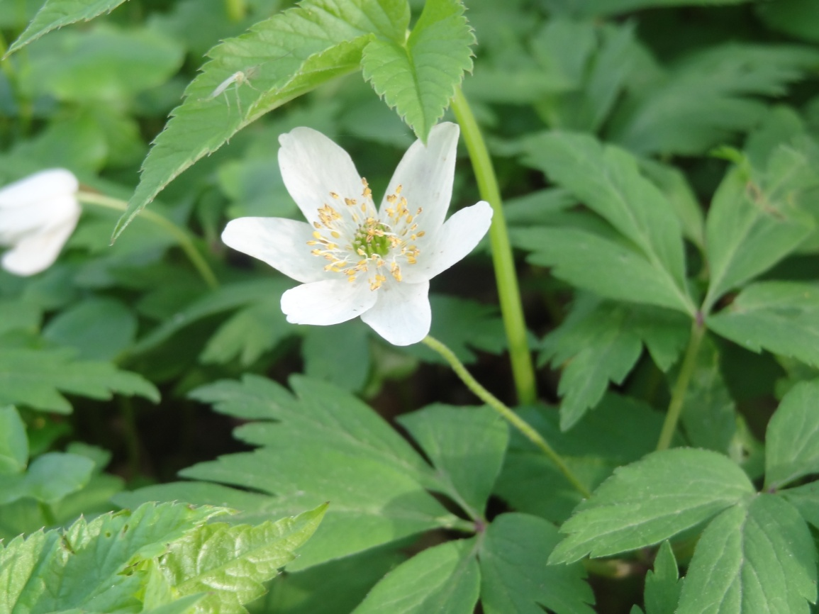
Today Anemones are safe.
We’ve found them and we encourage You to do the same. The Anemones Nemorosa inhabit European forests and enhance their unique beauty. They are also the silent witnesses to the European difficult development and its turbulent history.

Slide 13
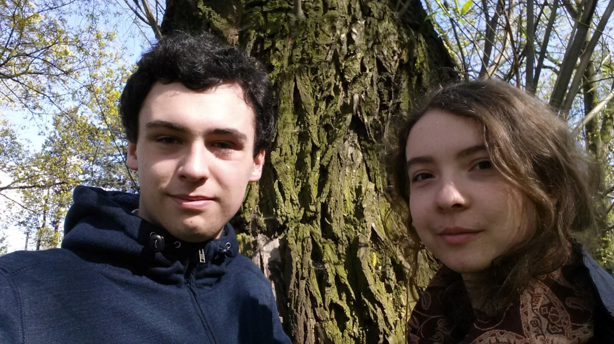
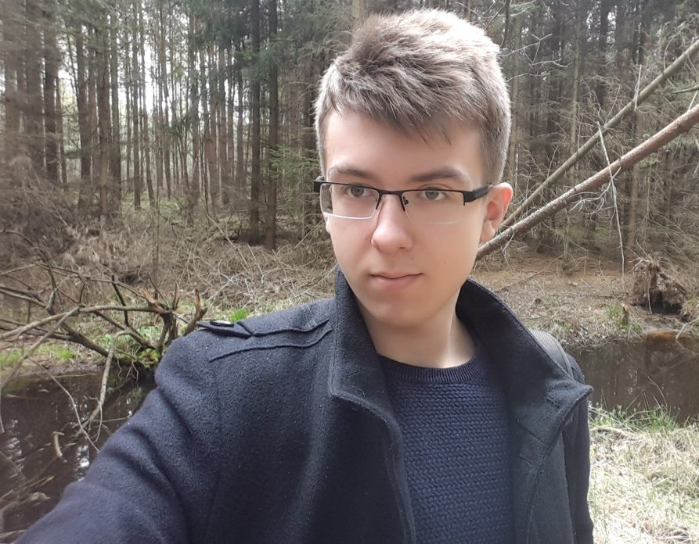
Sandomierz Wilderness is a magnificient place, where You can find hundreds of original species and also:
US

Slide 14
THE END We are waiting for You in Sandomierz Wilderness
Bibliography:
Our photos, experience and knowledge
Slides’ background: http://dn3xvn5nu3tgm.cloudfront.net/fotki/upload/32/37/66/3237661341567681s2.jpg

Slide 15
Made by: Pasierb Karolina Tomczyk Ireneusz Ziobro Michał
Students of: St. John Paul II High School of Prezentki in Rzeszów
class: I B
In the custody of: mgr Janina Ostasz
In the need of: Young People in European Forests Competition.

