Slide 1
Forests in Poland and Europe. Characteristics and Management
Aneta Król, Paulina Rybińska, Konrad Kołodziejczyk IIIA

Slide 2
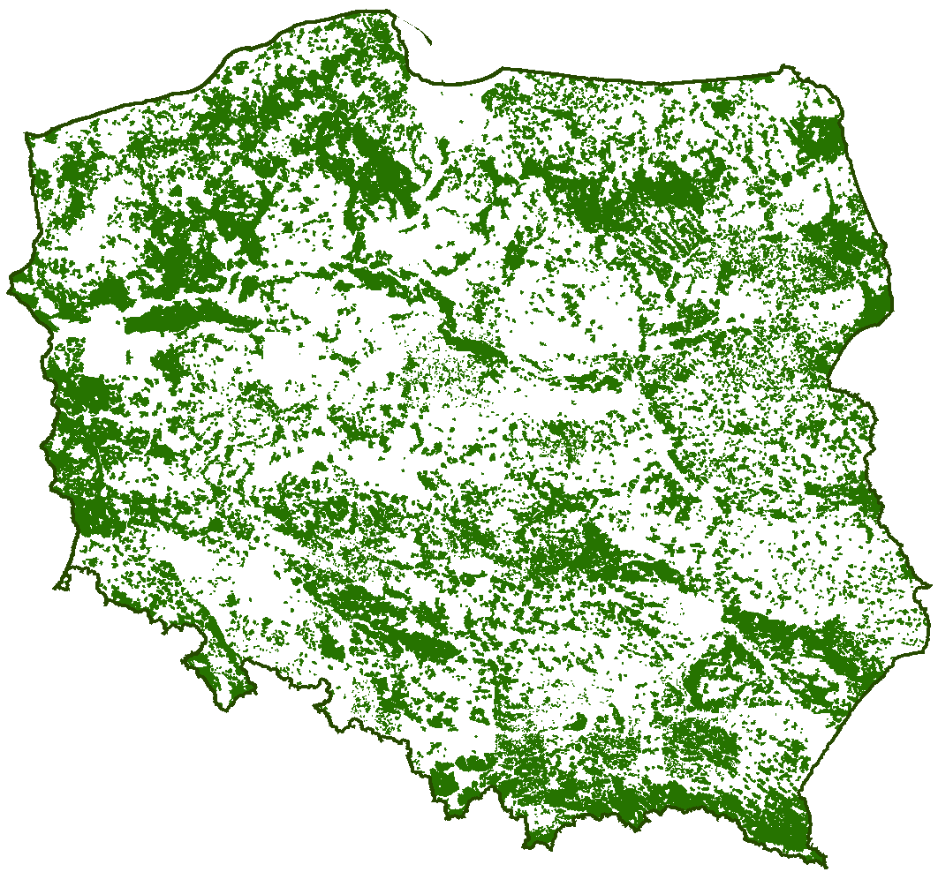
Forests in Poland
Poland is a European leader when it comes to the surface of forests. They take 29.2 percent. territory of the country. Forests are growing in the area of 9.1 million hectares.

Slide 3
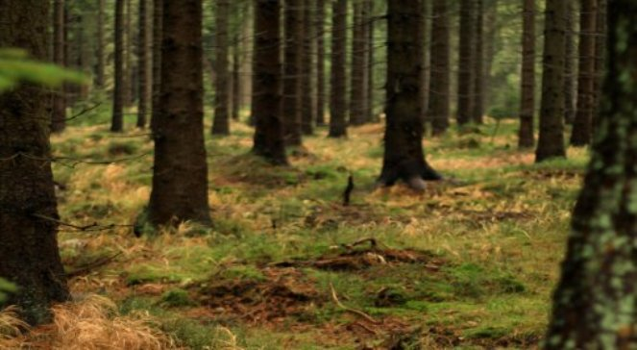
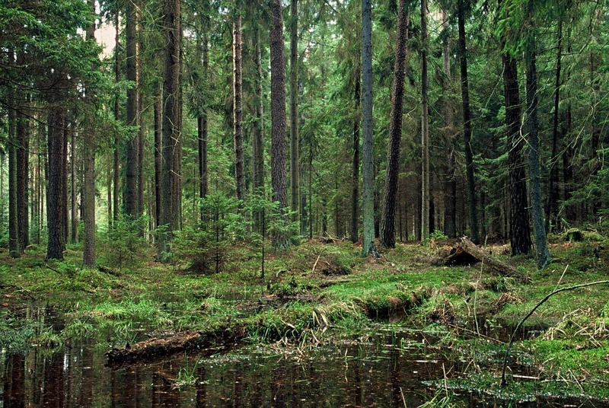
Forests in Poland
Forests grow in our country on the weakest soils, because of the development of agriculture in previous centuries. This affects on the distribution of types of forest habitat in Poland. More than 55 per cent. Forest area occupy woods.

Slide 4
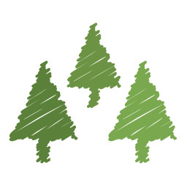
Forests in Poland
In our forests they stand occur most frequently between the ages of 40 and 80 years. The average age of forest is 60 years. An increasing number of trees are large, with more than 80 years.

Slide 5
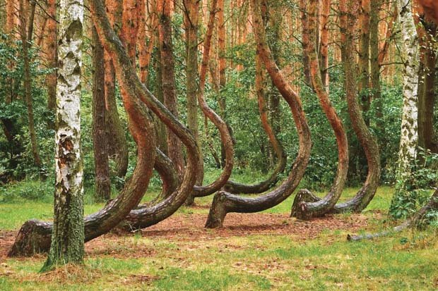
Crazy Forest in Szczecin
It is a natural monument with an area of approx. 1.7 ha. The area was named because of the growing here deformed pine ordinary. The most popular theory is that the trees have been formed as a result of deliberate human activities. They were planted in the 30s of the twentieth century.

Slide 6
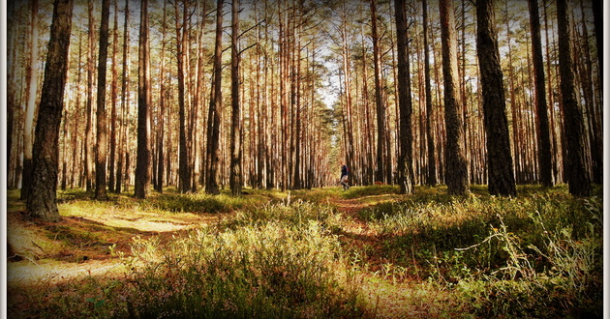
European Forests
Forests cover 44% of Europe. Species richness of forests is conditioned by the geographical location of the country. Most European forest land - about 80% - is located in the Russian Federation.

Slide 7
Natural diversity in Europe
"Biological diversity" is a term that we use to give all the wealth of the natural world. They consist of animals, plants, their habitats and genes. Across Europe biodiversity is in danger. Plants and animals are dying out, mainly because of human activities.

Slide 8
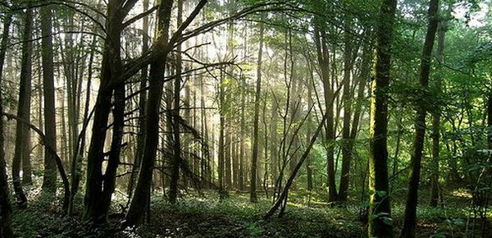
Interesting Facts about European Forests
In nearly half of European countries areas
Forest is a public forest.
The area of forests are under protection over the past five years increased by about 2 million hectares and now accounts for almost 5% of all forests in Europe.

Slide 9
The volume of work in the area of forest available for wood

Slide 10
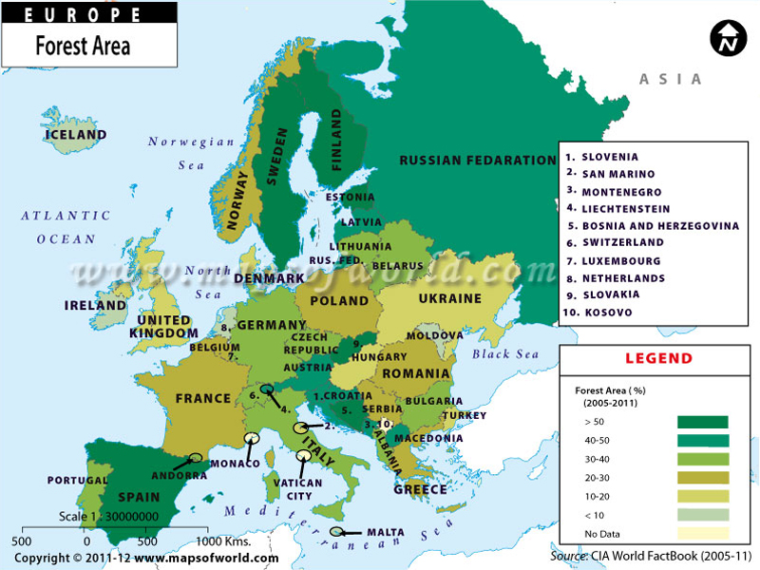
Forest cover

Slide 11
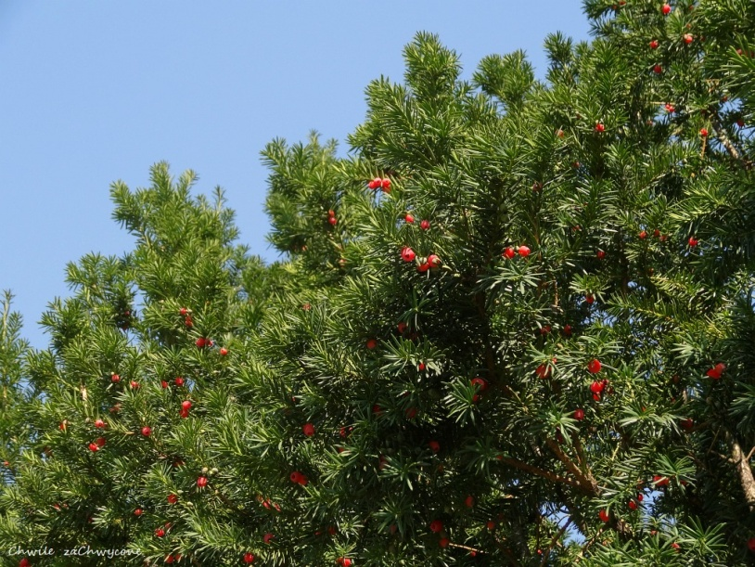
Common yew in the polish woods
Common yew is now a rare species. In natural conditions, they occurs individually almost exclusively in nature reserves. In Poland and Europe in natural conditions, there is only common yew.

Slide 12
Thanks for Watching!
SOURCES https://www.unece.org/fileadmin/DAM/timber/other/reports_key_findings_PL.pdf
http://ppbio.pl/roznorodnosc-biologiczna/

Slide 13
Aneta Król,
Paulina Rybińska,
Konrad Kołodziejczyk
Zespół Szkół Miejskich nr 2
ul. Siennicka 17
05-300 Mińsk Mazowiecki
Gimnazjum, Klasa dwujęzyczna
III a

