Slide 1
TREASURES OF FOREST

Slide 2
POLISH FORESTS
Forest, next to the agricultural landscape,
is the dominant element of
the natural environment in Poland.
Since the dawn of history man used the resources of forests. Forest gave firewood, raw material for building houses and furniture, and food.
It was, and still is, a source of products used in folk
and conventional medicine.

Slide 3
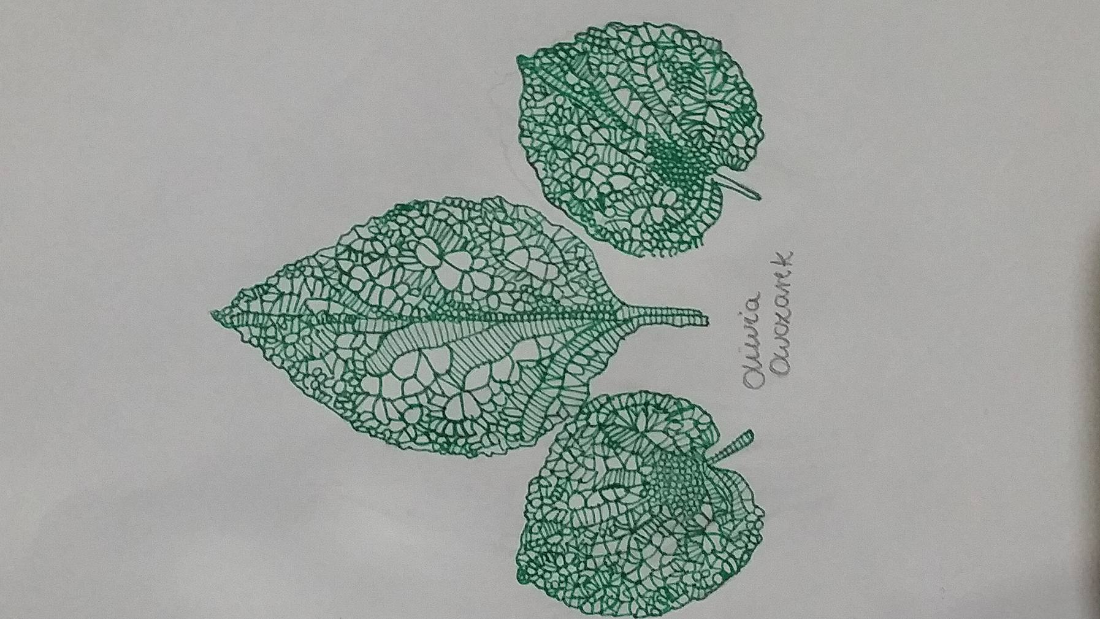
GREEN FARMACY
Some call forest ‘a green pharmacy’ and it's hard to admit that they are wrong.
The list of forest plants serving man as various means of treatment is long. It is worth mentioning at least some of them:
elderberry
common juniper
blueberries
common barberry
buckthorn
birch leaves
oak bark
linden inflorescence
raspberry
sloe
honeydew

Slide 4
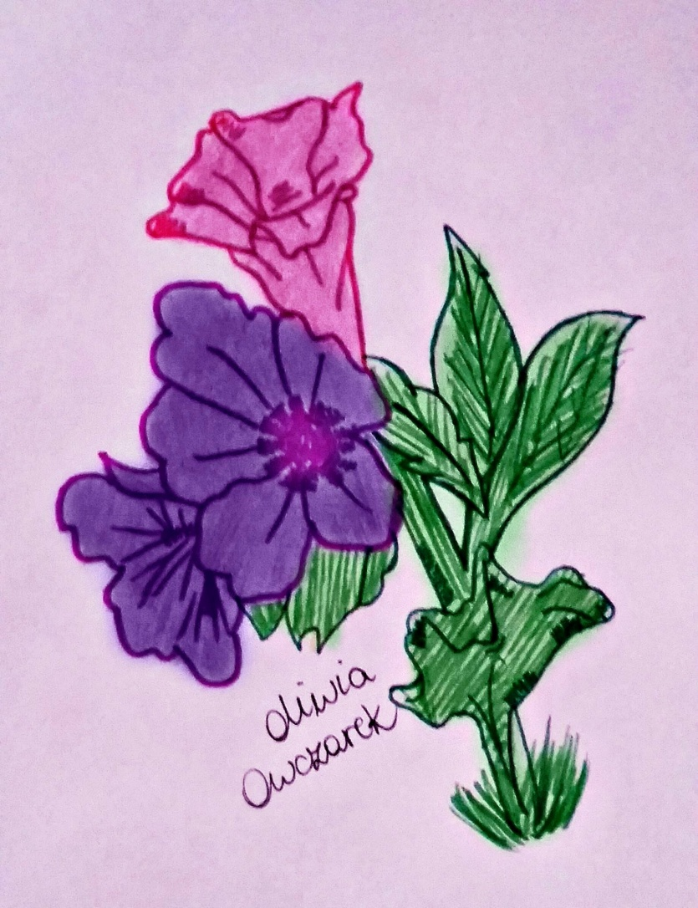
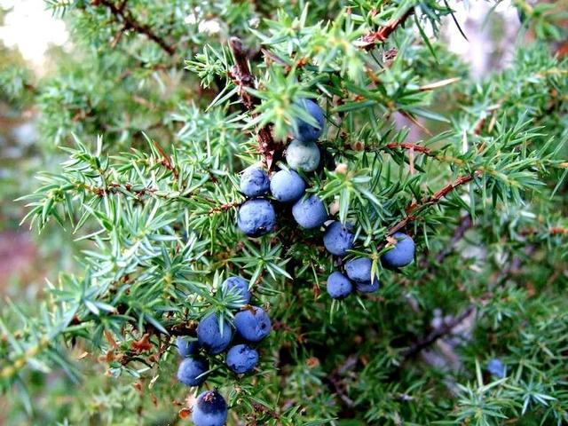
MAGIC PLANTS
COMMON JUNIPER (Juniperus communis):
Fights infections associated with colds, it’s the
anti-cellulite, it helps to clean the body of toxins and helps with digestion, it supports liver and relieves nerve pain.
HONEYDEW (Pulmonaria officinalis):
It is called pulmonary herb . It’s useful in the treatment of respiratory disorders and has a positive effect on lung tissue ,it helps to treat tuberculosis.
Tea with honeydew is rich in soluble silica.

Slide 5
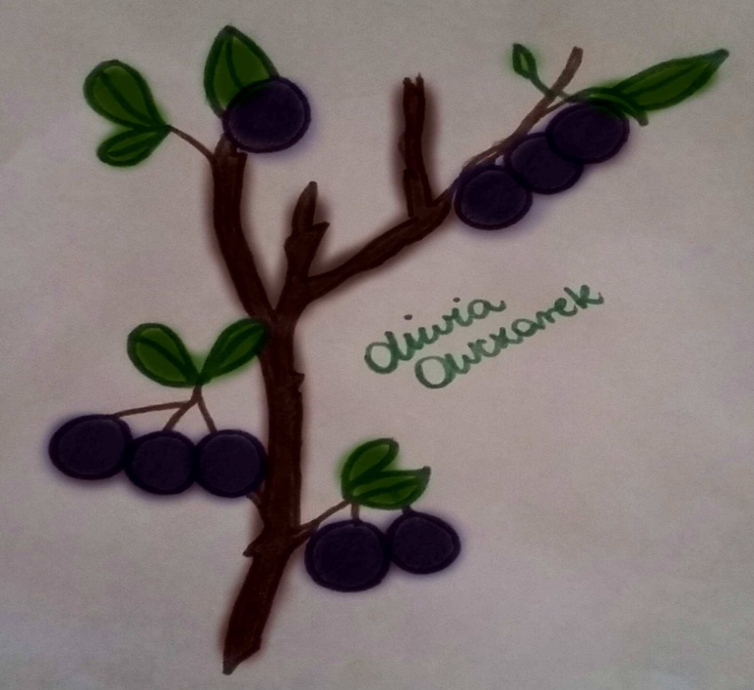
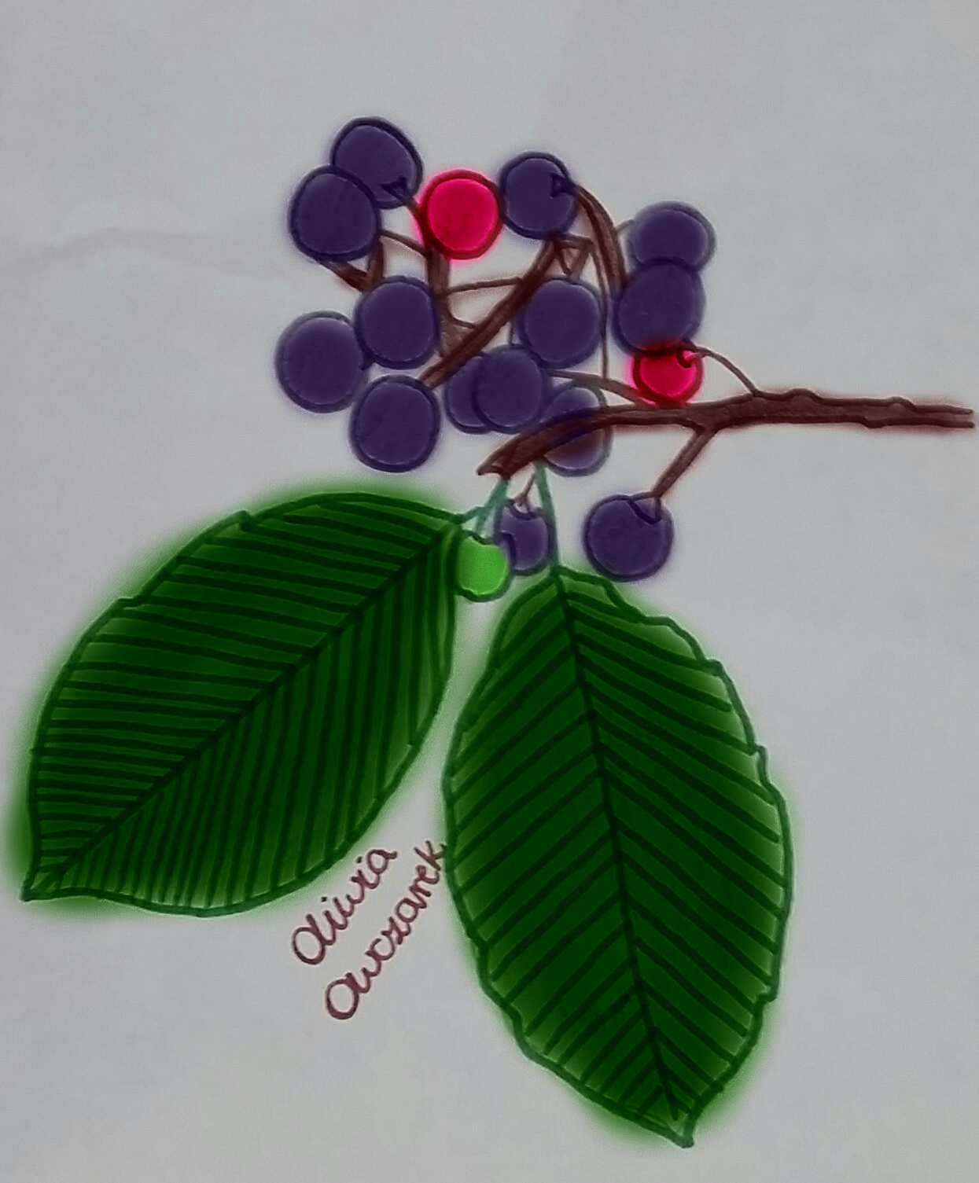
MAGIC PLANTS
GLOSSY BUCKTHORN (Frangula alnus Mill.):
The bark of young trunks and branches collected in the spring, before the leaves appear, is used as a laxative medicine.
BLACKTHORN/SLOE (Prunus spinosa):
Sloes have anti -inflammatory and antibacterial properties , they prevent the formation of atherosclerosis and consequently - the development of heart disease. Flowers of blackthorn reduce inflammation in the urinary tract while the compounds contained in blackthorn reduce blood pressure and levels of "bad " LDL cholesterol.

Slide 6
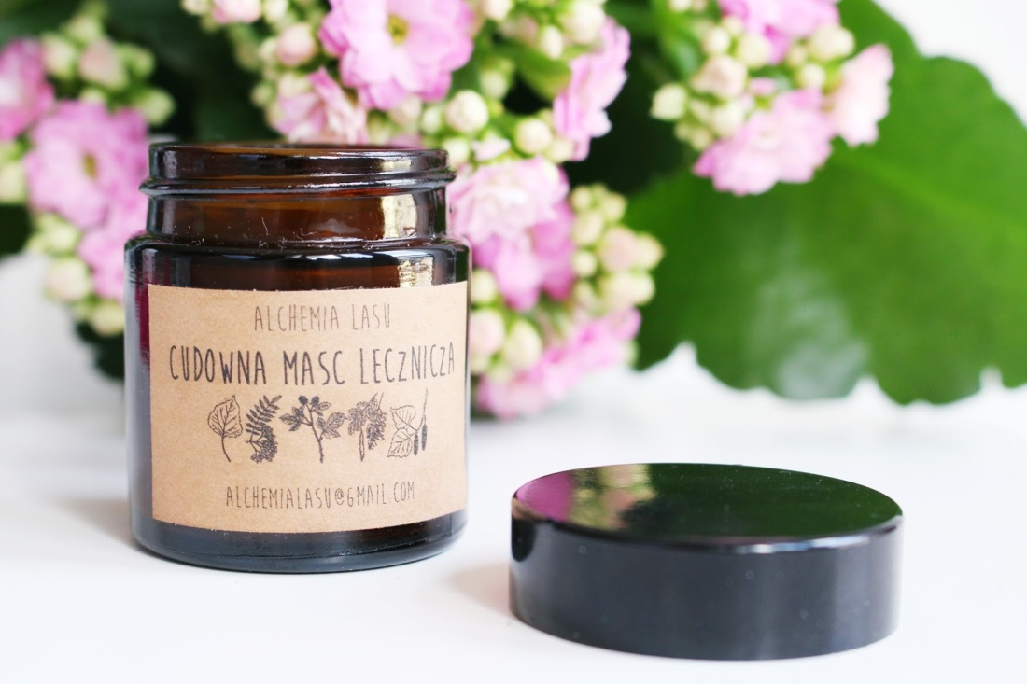
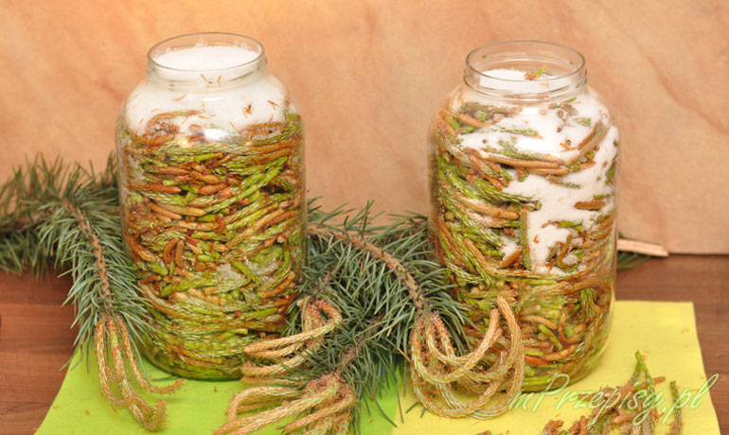
GREEN FARMACY
In medicine, forest plants have always had big importance. Many species of trees and plants provide substances for cosmetics and medicines, for example, cough syrup is extracted from young shoots of pine.
Alchemy Forest is the example of a Polish company producing natural cosmetics
Production of pine shoots syrup

Slide 7
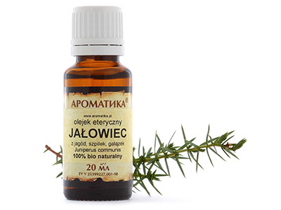
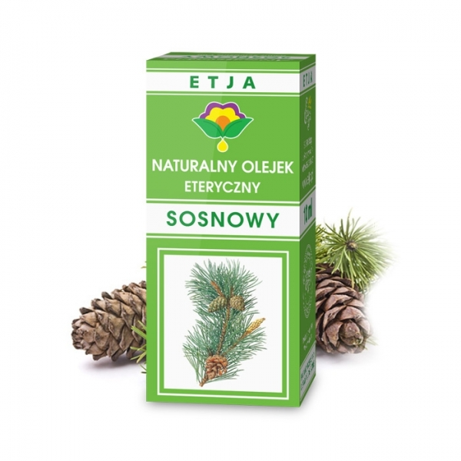
FRAGRANT MEDICINES
In the forest air there are about 70 times less pathogenic germs than in the air of the cities.
This freshness of the air is possible thanks to the presence of, among other things, essential oils secreted by trees, especially coniferous ones. Scientists have discovered that these essentials contain close to 1500 substances acting as germicidal measures, calming or anti-inflammatory.
The most popular oils are pine oil, juniper oil, but also eucalyptus oil, which is produced mostly in Portugal.
The field of medicine curing diseases with the use of essential oils coming from forest trees is called aromatherapy.

Slide 8
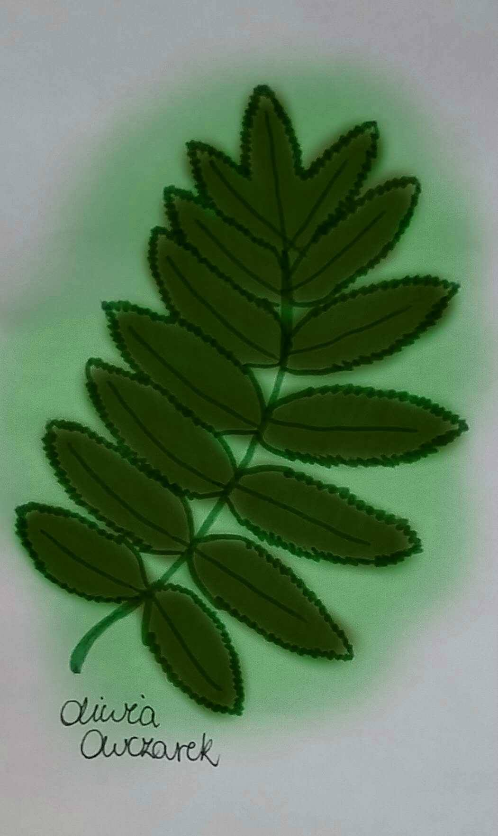
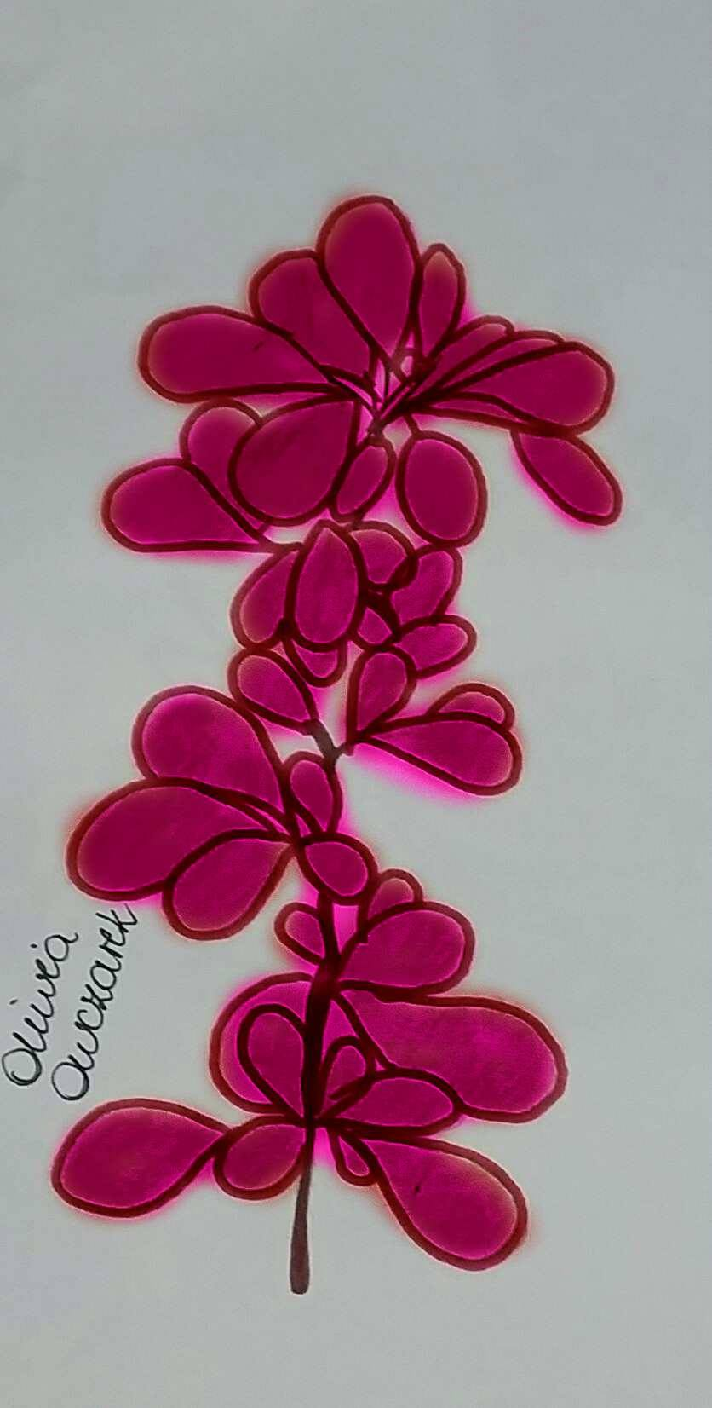
TREES ARE MAGIC TOO
BERBERIS (Berberis):
It was used to strengthen the working of spells, but also to free people from the bad influence or spells cast on us by those hostile to us.
„WITCHES SPRUCE” (Sorbus aucuparia):
One of the most commonly visited natural monuments in Lithuania. Formerly the Lithuanians belived that rowan protected them against witches and devils , so it was often planted next to their homes.

Slide 9
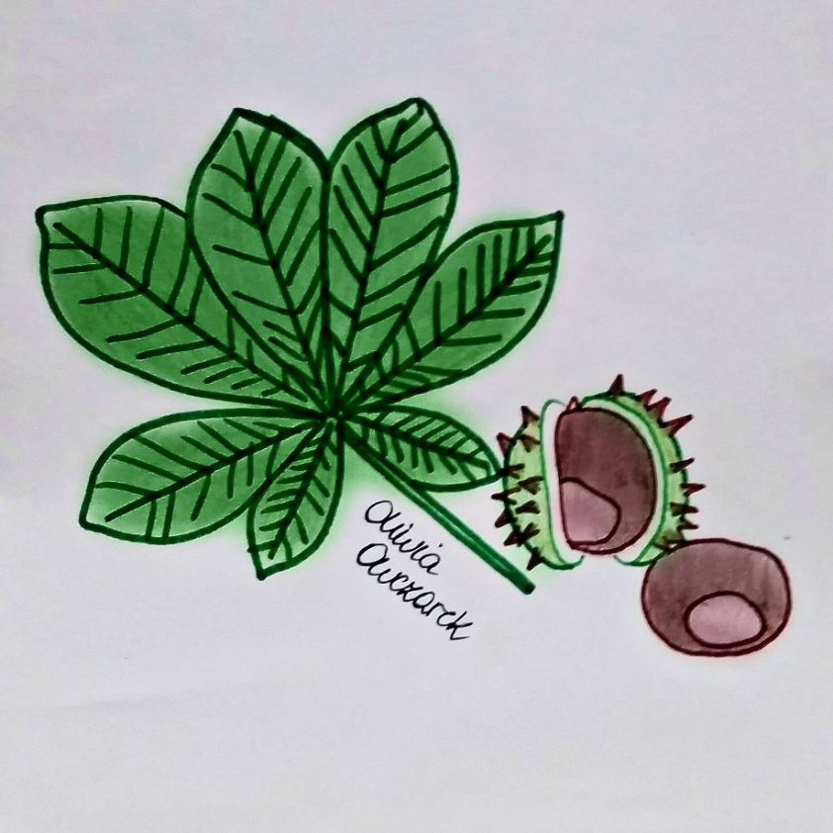
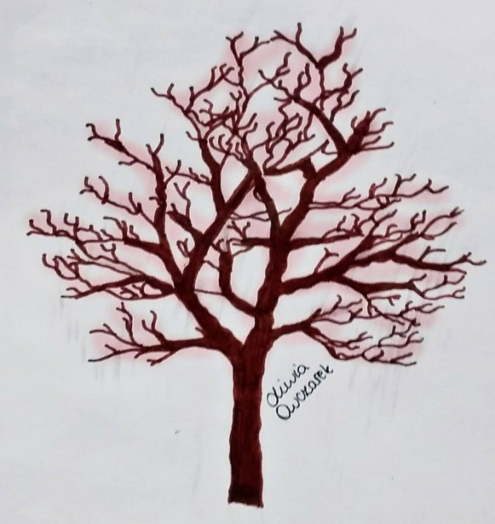
FOREST IN THE KITCHEN
CHESTNUTS (Castanea sativa Mill):
Chestnuts are the main dry fruit produced in Portugal. Chestnuts contain escin, which brings relief to people suffering from varicose veins.
XYLITOL:
Xylitol is a high-quality natural sweetener extracted from birch bark. Xylitol is recommended to people who care about their weight, because it contains 40% fewer calories than refined sugar.
BEECH (Fagus):
It is used to prepare coffee beech or salads made from young leaves. It is also known for edible beechnuts containing, among other things, oils, sugars, starch, malic acid and citric acid.

Slide 10
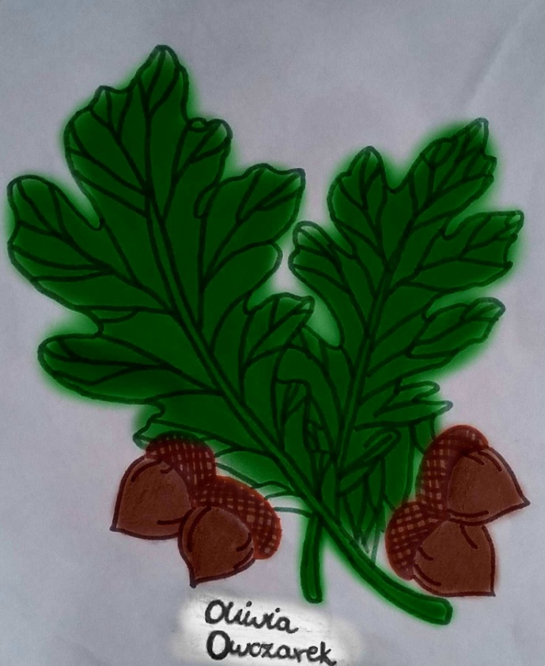
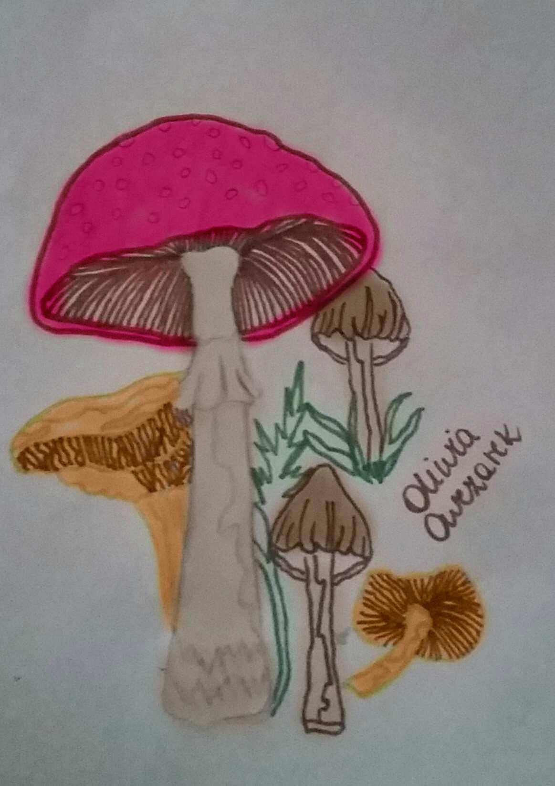
FOREST IN THE KITCHEN
MUSHROOMS:
Mushrooming has been Polish passion for centuries.
Edible boletus, parasol mushroom, leccinum grandmother, chanterelle and boletes are only the most popular wild mushrooms found in Polish forests.
ACORN:
Acorns used for the production of acorn coffee or acorn pancakes.
JUNIPER: (Juniperus communis):
Juniper fruit is an excellent seasoning for dishes or cold meat, spirits and liqueurs production

Slide 11
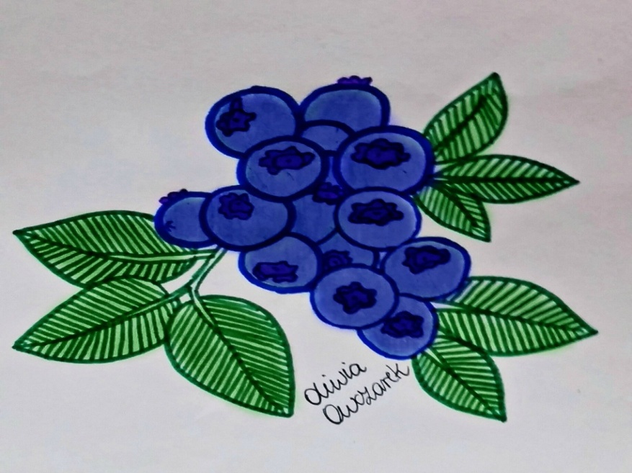
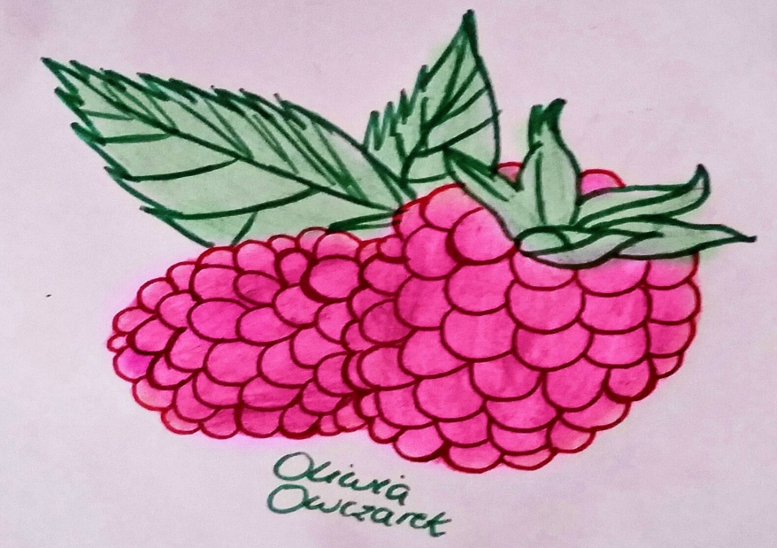
„SWEET” MEDICINES
BILBERRY (Vaccinium myrtillus):
improves microcirculation of blood in the eyes, fresh fruit act as a laxative and dried inhibit diarrhea. Most blueberry products come from Poland and Sweden. In Poland, the Group of Fruit Producers‚ Polish Berries is the supplier of the highest quality berries.
FOREST RASPBERRIES (Rubus idaeus):
They are the source of wit. C, sugars and minerals. They act like aspirin. Raspberry juice and tea work diaphoretically - they are used against cold and flu and they cleanse the body of toxins.

Slide 12
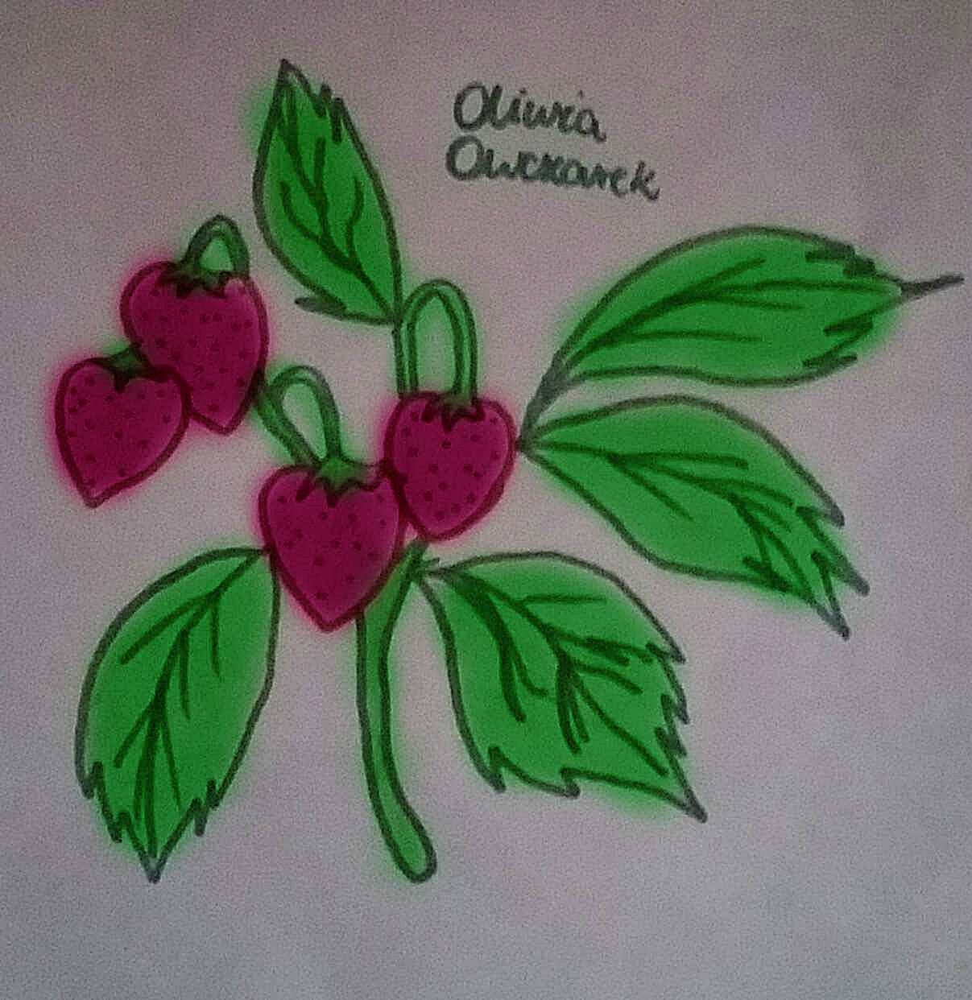
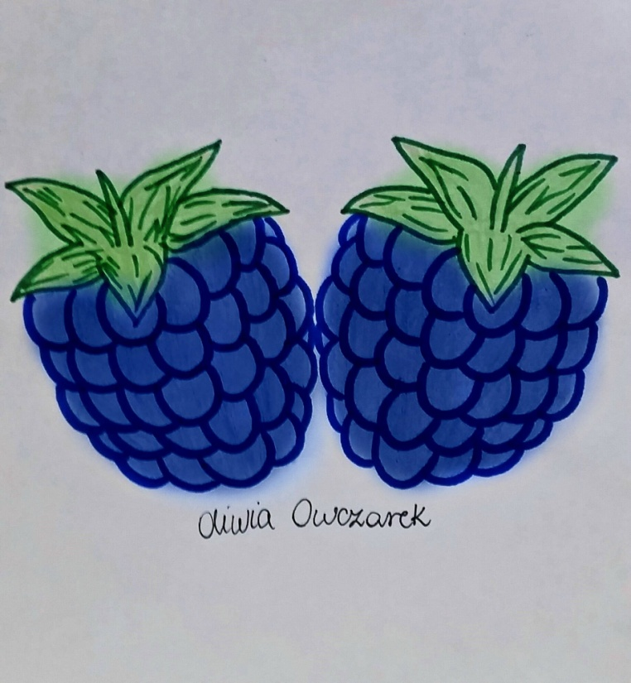
„SWEET” MEDICINES
WILD STRAWBERRIES (Fragaria):
They are the source of wit. C and minerals,they soothe colic and cough, and are helpful in weight loss because they improve metabolism.
LINGONBERRY (Vaccinium vitis-idaea):
fruits are the source of wit. C, flavonoids and organic acids, they help with stomach problems and lack of appetite, they also disinfect the urinary tract.
BLACKBERRIES (Rubus):
They contain vitamins A, C and E. They are the source of magnesium, potassium, calcium, iron and simple sugars, they enhance blood vessels as well as improve skin condition and muscle functioning.

Slide 13
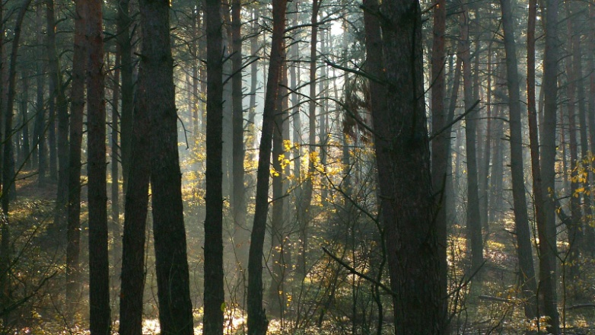
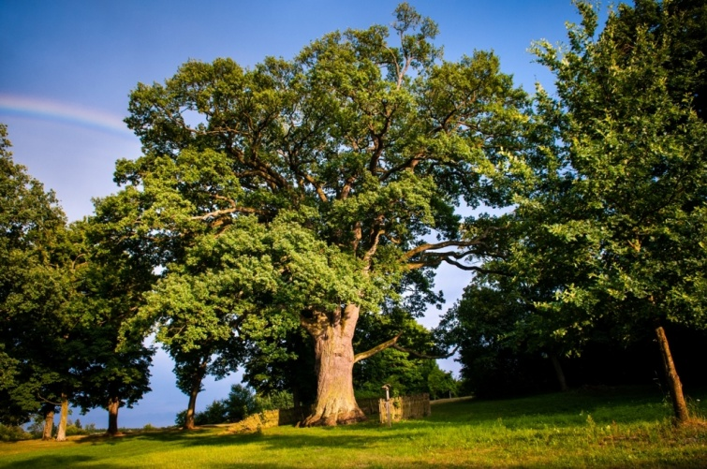
OUR SURROUNDINGS
The origins of the existence of the Puławy Forestry dates back to the year 1794. It is an area of 16. 000 ha and it is located within the province of Lublin Voivodeship. Puławy Woods are split by the Vistula and the Wieprz Rivers. These areas are diverse in terms of landform and vegetation.
Pine dominates in tree stand.
Ranked in ‘The European Tree Of The Year’oak Bolko held 4th position. Bolko is an about 650-year-old pedunculate oak protected since 1959, growing in Lublin Voivodeship.

Slide 14
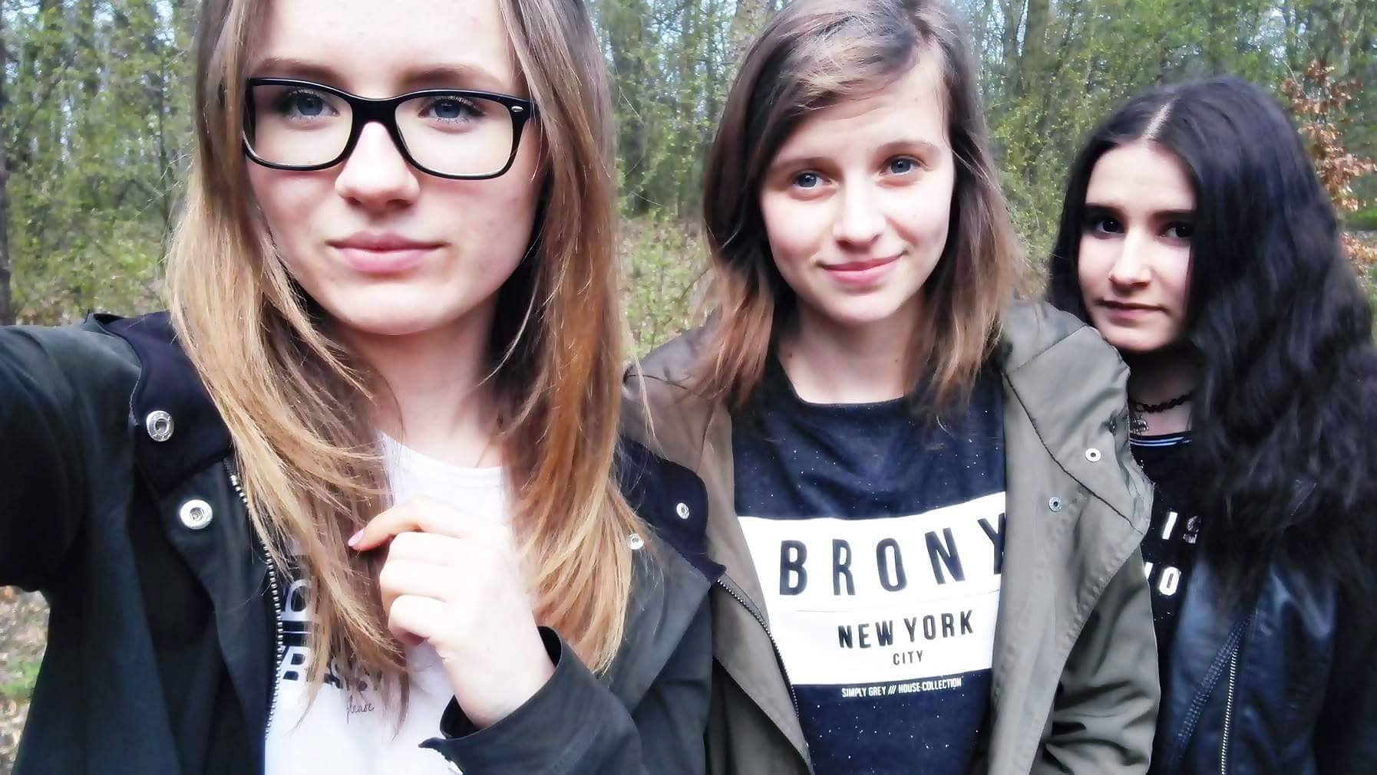
OUR TEAM
We are girls from Puławy. We’re studying in ZSO nr 2 im. F.D. Kniaźnina. We are in the first class of high school.
Iza Rzeszot
Karina Jaśkowska
Oliwia Owczarek

Slide 15
THANK YOU FOR YOUR ATTENTION
MADE BY:
IZABELA RZESZOT (IE LO)
KARINA JAŚKOWSKA (IB LO)
OLIWIA OWCZAREK (IE LO)
Zespół Szkół Ogólnokształcących nr 2 im. F.D. Kniaźnina w Puławach

Slide 16
SOURCE MATERIALS
http://www.tapeta-las-drzewa-pnie-trawa.na-pulpit.com/
http://www.mprzepisy.pl/zdrowie/syrop-z-sosny.html
http://www.makelifeperfect.pl/2016/01/alchemia-lasu-cudowna-masalecznicza.html
http://www.zdrowarodzina.eu/produkt/etja-olejek-sosnowy-10ml/3105/
http://lawendowysklep.pl/pl/p/JALOWIEC-olejek-jalowcowy-20ml/196
http://www.pulawy.lublin.lasy.gov.pl/lasy-nadlesnictwahttp://www.bolko.ruda-huta.pl/
http://dobrytarot.pl/download/file.php?id=5712
Other photos and drawings are by our authorship.

