Slide 1
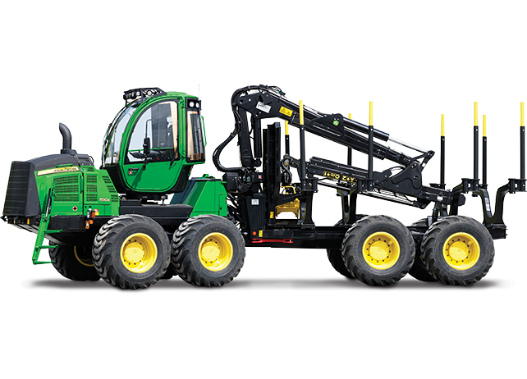
The forestery vehicles in Poland

Slide 2
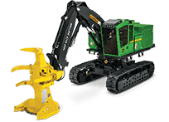
In Polish forestery, we use some vehicles just like harvesters or forwarders. Thanks to them people can cut down trees much faster and better according to the traditional ways-by chain saws. The problem is that the forestery vehicles cost a lot of money… Up to 100 000 Euro! The next problem is the lack of people with professional qualification to work on the machines. In fact, the Polish forestery is going onwards all the time, the equipments are getting better.

Slide 3
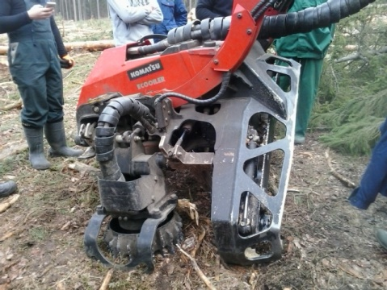
The harvester
It’s a heavy forestery machine which cuts down trees using a chain saw to cut the tree at its base and also cut it to length; two or more curved delimbing knives which reach around the trunk to remove branches; two feed rollers to grasp the tree; a measuring wheel which measures the length of the stem as it is fed through the head. A forest harvester is typically employed together with a forwarder that hauls the logs to a roadside landing.

Slide 4
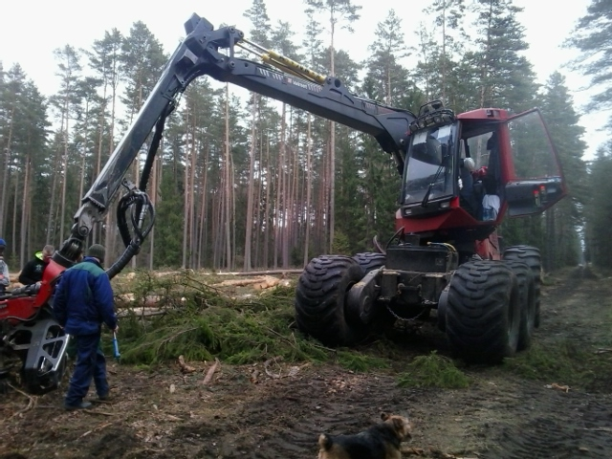
The harvester

Slide 5
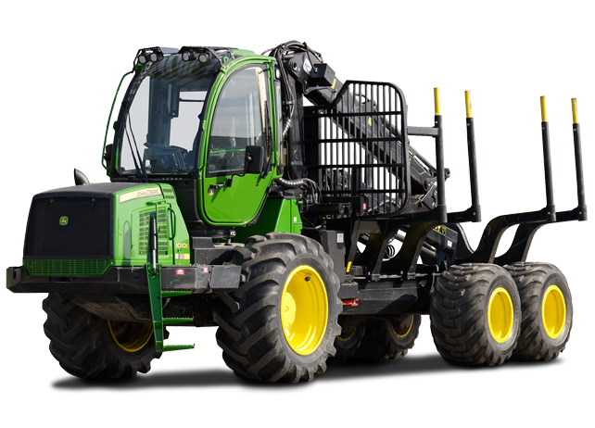
The forwarder
Another heavy forestry vehicle that carries the felled logs from the place that they were cut to a roadside landing. It grabs the trees with the help of a cultch. The small forwarders can carry around 250 kg to 500 kg of logs, but the largest ones can handle up to 20 tonnes. Forwarders also carry them at least 2 feet above the ground.

Slide 6
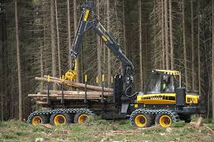
The forwarder

Slide 7
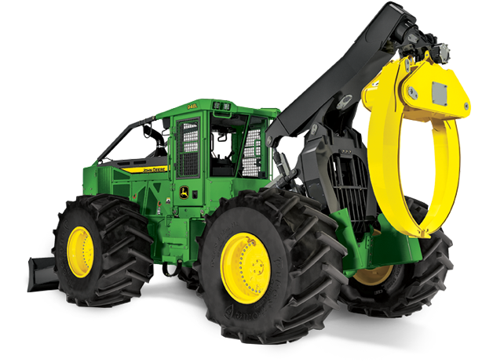
The skidder
It’s used for pulling cut trees out of a forest in a process called “skidding”, in which the logs are transported from the cutting site to a landing. They pull them with a cable/winch just like clambunks. The skidder can also be used for pulling tree stumps, pushing over small trees and logging a path known as a “skid road”. A positive thing about the skidder is that while wood is being yarded (pulled), tree particles and seeds are cultivated into the soil.

Slide 8
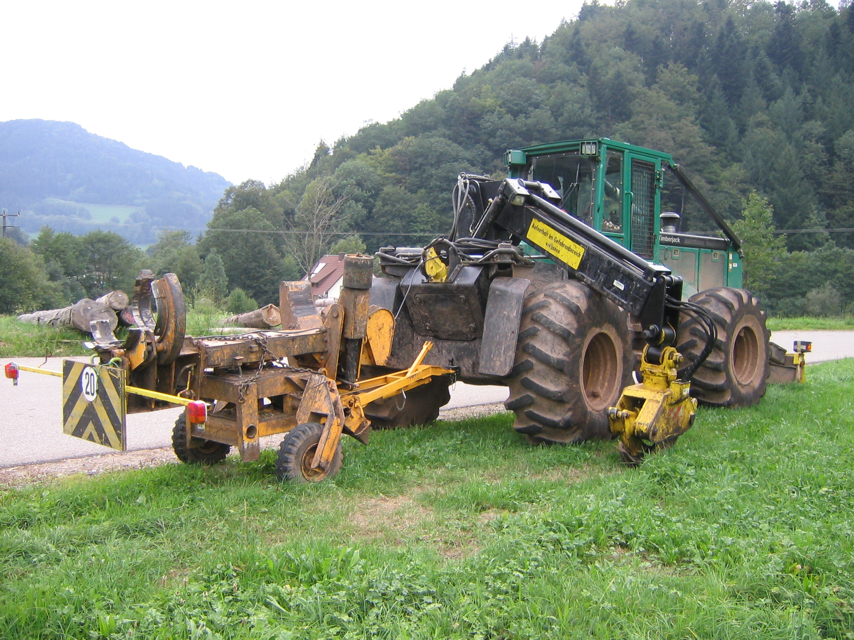
The skidder

Slide 9
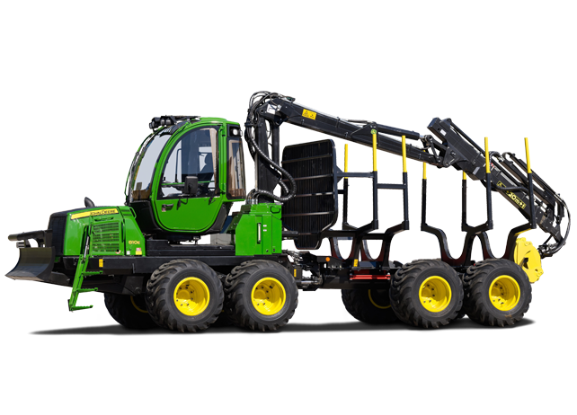
Commonly people think that cutting down trees using a saw is a difficult, dangerous and inefficient way to do it. For this reason, in Poland you can notice a quick development of mechanization in forests. There is a lot pluses but there are also minuses. These heavy and large machines can ruin the whole ecosystem and cause a lot of damage but they can also help much. The work that people do with chain saws in a time of 2 weeks, the harvester does in 2 days. It gives big saves.

Slide 10
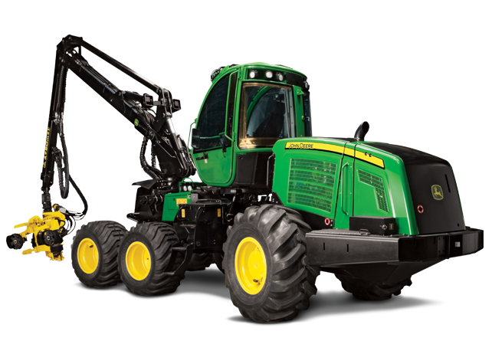
Bibliography
https://en.wikipedia.org/wiki/Harvester_(forestry)
https://en.wikipedia.org/wiki/Forwarder
https://en.wikipedia.org/wiki/Skidder
https://deere.com
HTTPS://naszlas.pl

Slide 11
Authors
Monika Stepanik kl. I TLB
Klaudia Burzyńska kl. III TLB
Wiktor Magdaleński kl. III TLA
Zespół Szkół Leśnych im. Unii Europejskiej w
Rucianem-Nidzie

