Slide 1
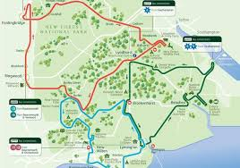
Get on up-close look at the forest

Slide 2
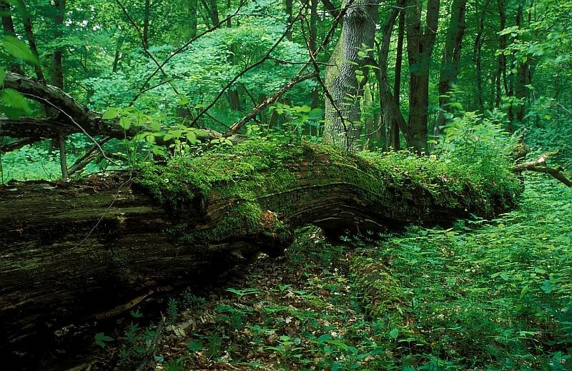
Niepołomice Forest: Puszcza Niepołomicka is a large forest complex in western part of Sandomierz Basin, about 20 km east of Kraków.

Slide 3
Today Niepołomice Forest occupies 110 square kilometres of protected habitat for rare species of owl, fox, boar, spotted eagles and black storks which can still be seen by visitors.

Slide 4
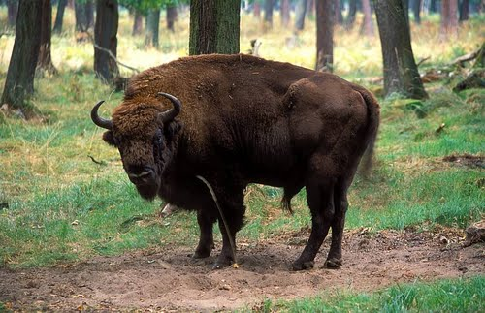
At the very heart of the forest is also a special conservation and breeding ground for Polish bison (żubr) where approximately 30 of the endangered animals currently live.

Slide 5
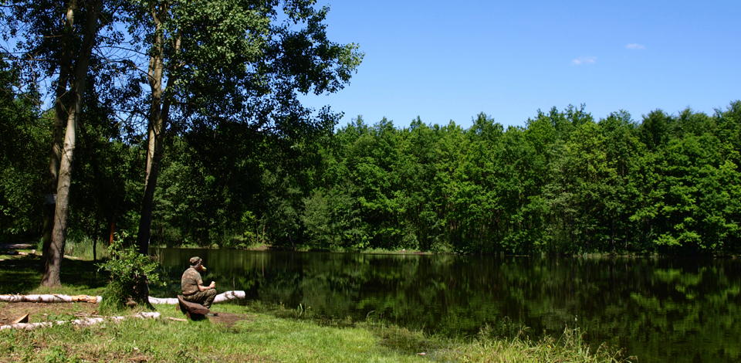
Unfortunately for those hoping to get an up-close look at the largest surviving land mammal in Europe, the 70 hectare habitat is strictly off-limits to the public without permission

Slide 6
It is possible to hike up the perimeter of the reserve by taking the 8km red trail.

Slide 7
Visitors can cycle in the forest, through a newly opened 4km educational trail lined with placards describing the local flora and fauna.

Slide 8
The reserve called Lipówka (25.73 ha) features 200-year-old nature monuments mainly lime trees, oaks and hornbeams.

Slide 9
The New Forest is an area of southern England which includes one of the largest remaining tracts of unenclosed pasture land, heathland and forest in the heavily populated south east of England.

Slide 10
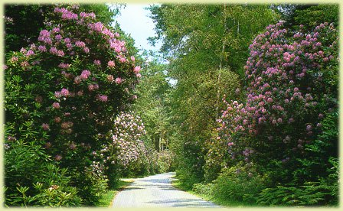
The rare blend of open heathlands and ancient woodlands makes the New Forest - affectionately called the Forest by locals – a unique and very special place.

Slide 11
The New Forest local government district is a subdivision of Hampshire which covers most of the Forest and some nearby areas, although it is no longer the planning authority for the National Park itself. There are many villages dotted around the area, and several small towns in the Forest and around its edges.

Slide 12
New Forest wildlife is by no means unique, but it's long been recognised that the area is of very special interest due to the rare mix of habitats that support the area's animal and plant life.

Slide 13
The New Forest pony represents a major part of the Forest's heritage.

Slide 14
When the New Forest was created in 1079, it immediately fell under very strict Norman Forest Laws, put into place to protect the natural wildlife of the area.

Slide 15
Commoner-owned New Forest wildlife doesn't just stop at the ponies; pigs and cattle of various breeds can also be seen roaming freely.

Slide 16
http://www.inyourpocket.com/krakow/Niepolomice-Forest_66154v
https://en.wikipedia.org/wiki/Niepo%C5%82omice_Forest
http://www.new-forest-national-park.com/
A year in the life of the new forest – Beata Moore

Slide 17
Prepared by:
Bartosz Stelmach – klasa 3 gimnazjum
Konrad Onak – klasa 3 gimnazjum
Kamil Budzik – klasa 3 gimnazjum
Junior High School in Skrzyszów –
Zespół Szkoły Podstawowej Nr 1 im. Jana Pawła II i Gimnazjum w Skrzyszowie

