Slide 1
Wielkopolski National Park
Aleksandra Szenrok, Gabriela Filip & Jakub Szydłowski

Slide 2
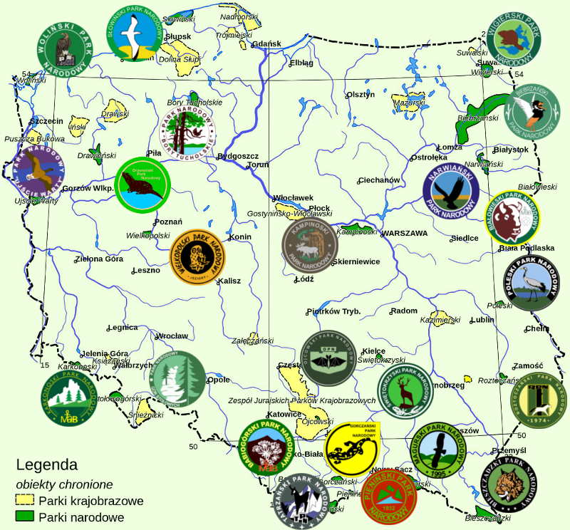
Poland
There are 23 National Parks in Poland located in all parts of our country. We are going to talk about Wielkopolski National Park.

Slide 3
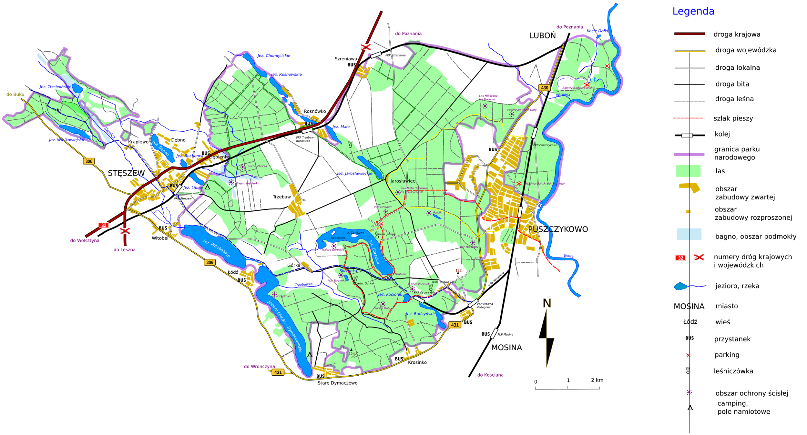
Location
It is located in the North-West of Poland between Poznań, Mosina, Puszczykowo and Komorniki. It is about 7,5 thousand hectares. 70% of the area is hornbeam-oak forest. The park is divided into 6 parts: Jeziory, Górka, Wypalanki, Wiry, Puszczykowo and Osowa Góra.

Slide 4
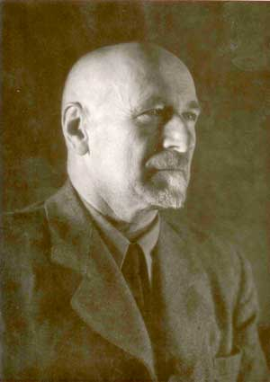
History
After the Second World War, the Germans exploited the area and planted pine. The park was established in 1957 by Adam Wodziczko. In 1996 the borders were changed and managment plan was put in place with green belt in the surrounding area added.
“It is a live museum of glacial forms.” said Adam Wodziczko when he came to the National Park for the first time.

Slide 5
Biocontainment
We can single out two kinds of biocontainment :
active
passive
The active one includes cutting down sick trees, planting new ones in the place where the old trees were before, removing non - native secie and tree not suited to the area e.g. Black locust & Northern red oak.
Passive biocontainment includes taking care of 18 areas in the park, which are the most valuable regions, saving the biodiversity of them and not permitting people to tamper with their biological processes.

Slide 6
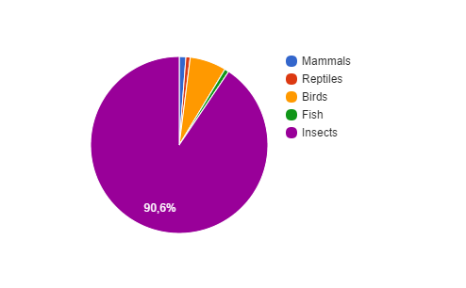
Animals
There are:
3000 sorts of insects,
26 sorts of fishes,
5 sorts of reptails,
220 sorts of breeding birds and 70 sorts of passing birds,
40 sorts of mammals, mainly herd animals such as roe-deer, boar, foxes and badgers

Slide 7
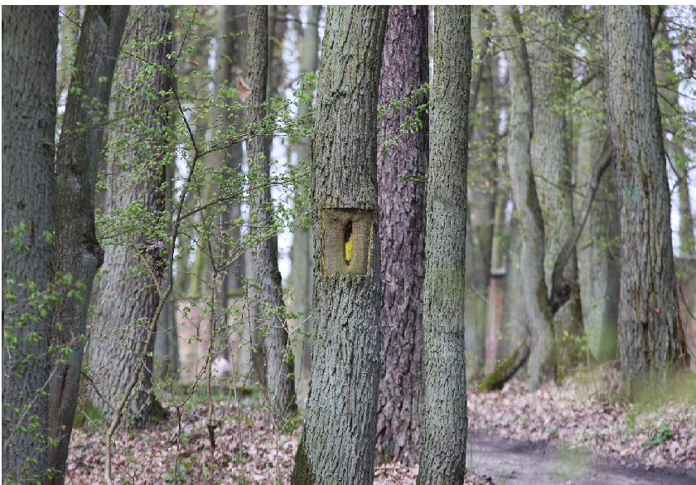
Trees
In this National Park we can see 6 types of forests:
Leucobryo - Pinetum (main types of trees are birch and pine)
Querco roboris - Pinetum (pine and oak)
Calamagrostio - Quarcetum peetraese (oak)
Galio sylvatici - Carpinetum (oak and hornbeam)
Ficario - Ulmetum campestris (oak, ash and elm)
Ribo nigri - Alnetum (alder)

Slide 8
Problems
roads - sometimes new roads are built on animals routes, to avoid their death environmentalists created crossings
fires - a common problem in this park, now people know how to fight them and it is not such a problem
gales and hurricanes - about 26 years ago was the last huricane, it caused much damage to the Park, rangers had to clean the park and plant many species again
insects - there were 2 plags in the Park, all of them have ended and now the park is safe
changes of climate - the climate is drier and trees have started to die

Slide 9
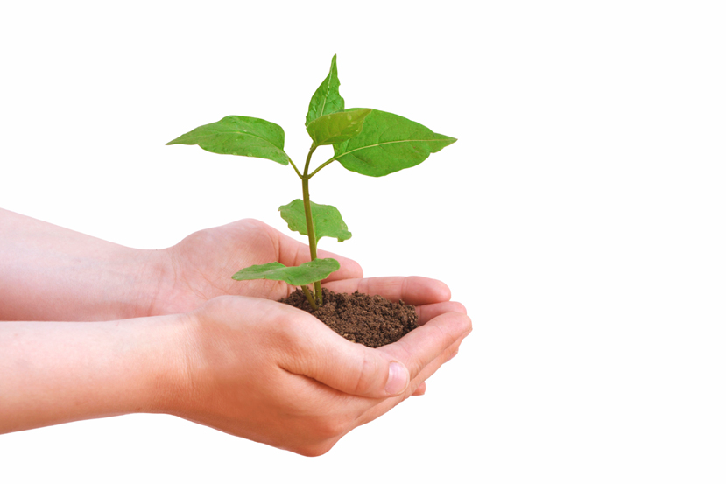
Importance
protect glacial forms
keep good condition of the air
save natural monuments
create habitats for many species
give possibility of making environmental research in the park

Slide 10
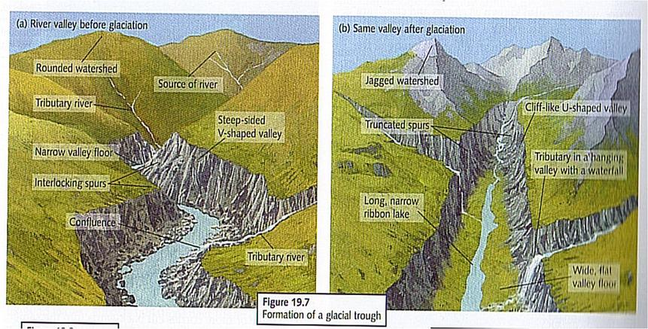
Glacial forms
The park is full of after glacial forms. Especially long, narrow lakes which arose from glaciation of rivers. The deepest lake is the Góreckie lake which is about 17 meters in the deepest place.

Slide 11
Rules of the park
Each park has its own list of rules. We want to mention some of rules of Wielkopolski National Park :
use only designated trails
don’t hunt, angle, kill the wildlife
don’t destroy soil
don’t make a bonfire
don’t pick plants
don’t let dogs off the leash

Slide 12
Cooperation
Wielkopolski National Park cooperates with another parks in Poland. Now it easier because we have got computers and phones. Parks make common projects, e.g. : Nature Guard. It is an action which teach children how to help our planet. So park cooperates with schools too.
Sometimes undergrads or scientists want to do some research and at first they have to ask for permission, and after research they should show efects of their work.
In park work 6 forest ranger. Each of them have got one part of the park. They have to take care about it and react when something is wrong.

Slide 13
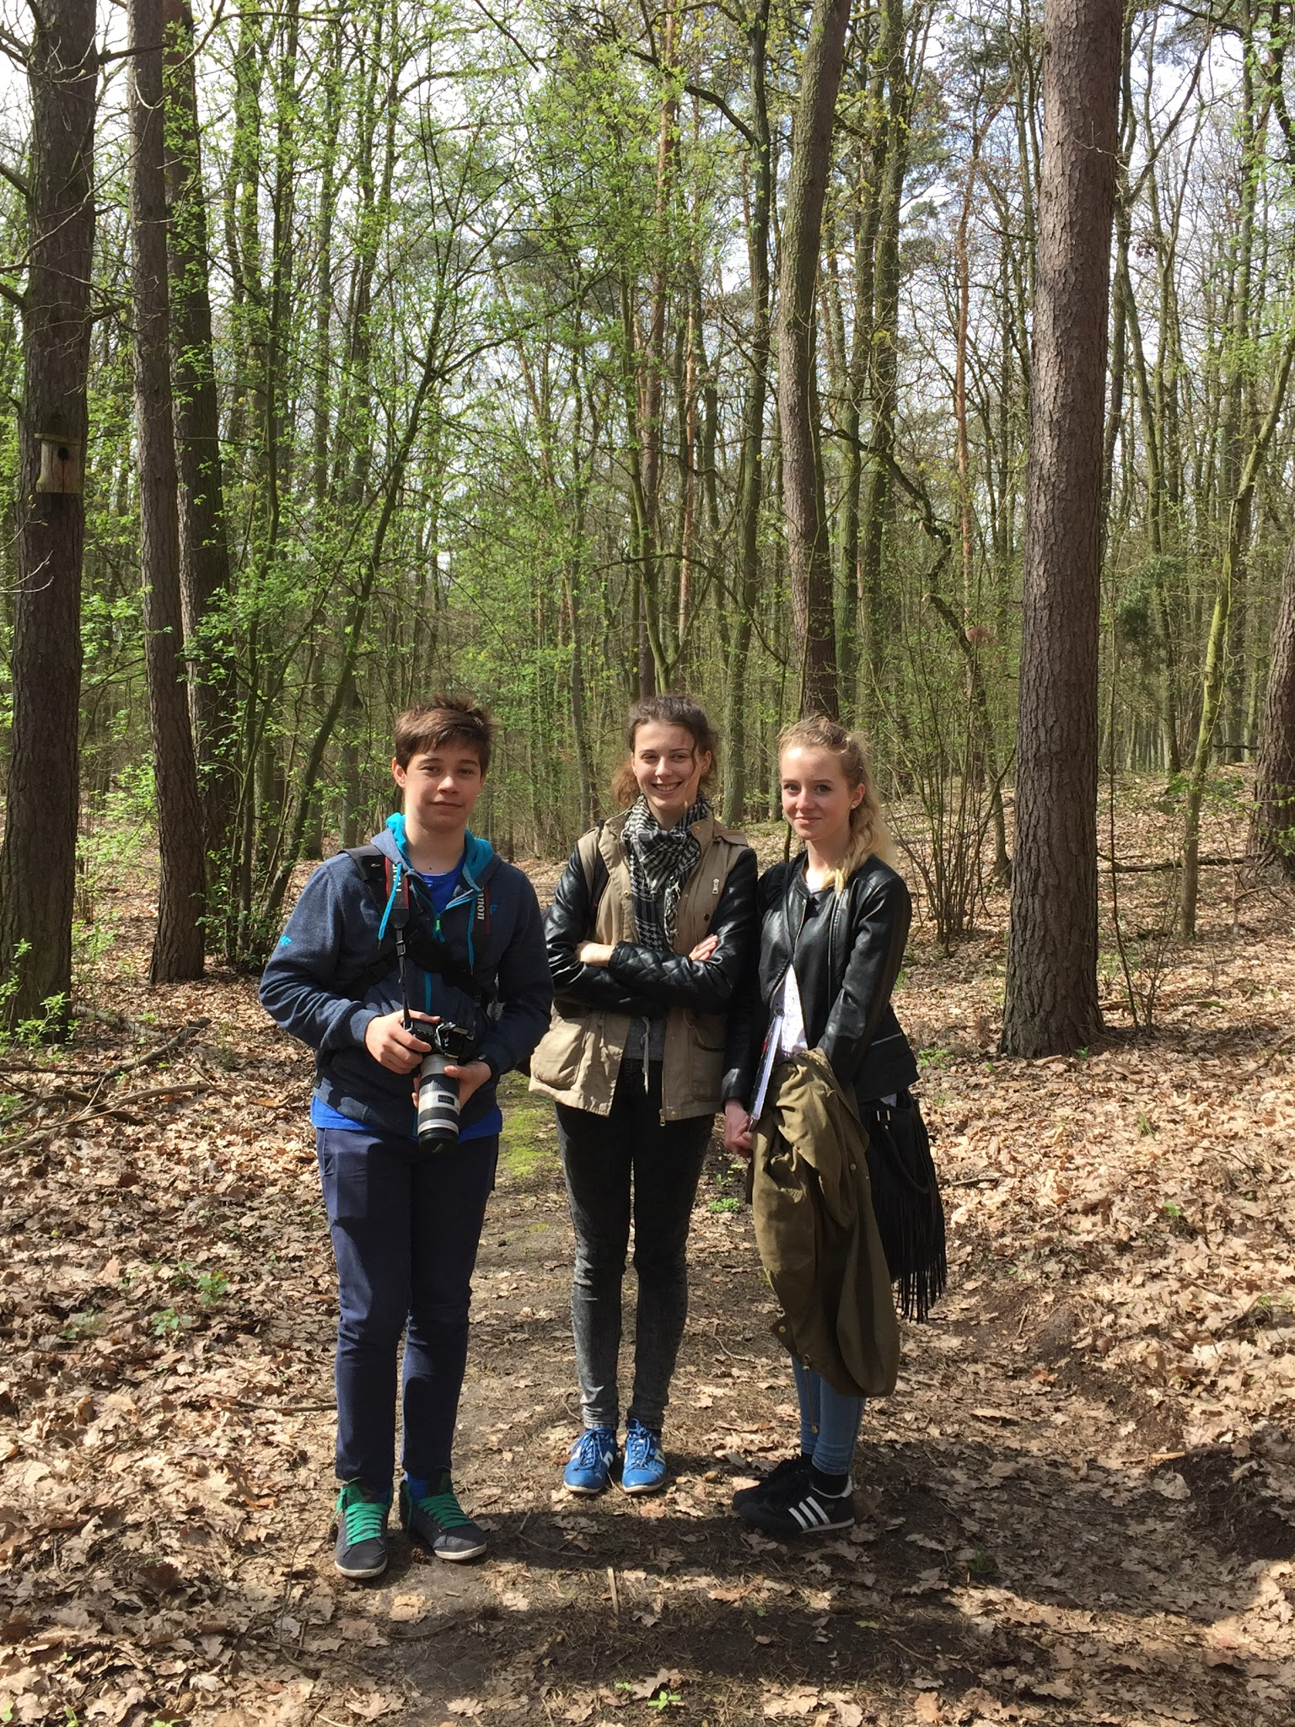
Thanks for your attention!

Slide 14
Bibliography
http://nowymost.pl/rykowisko/
https://greenprinter.wordpress.com/
http://www.acegeography.com/landforms-of-glacial-erosion.html
http://pracownia.org.pl/dzikie-zycie-numery-archiwalne,2303,article,5317
http://www.wielkopolskipn.pl/index.php/park/kategoria/pl/regulamin/20

Slide 15
Autorzy
Aleksandra Szenrok IIb, Gabriela Filip IIb, Jakub Szydłowski IIa
Gimnazjum nr 1 w Swarzedzu
Szkoła Społeczna Fundacji Edukacji Społecznej EKOS

