Slide 1
Species protected by law in Poland
Andrzej Szoplik
Jacek kasiński
Marek paszkowski

Slide 2
There is a wide variety of wild species that can be found in Poland, many of them protected by law.
In this presentation we focus on those which we think are the most recognizable; they are as follows:
the European bison (Bison bonasus), also known as the wisent or the European wood bison,
the white stork (Ciconia ciconia),
the Eurasian beaver (Castor fiber), also known as the European beaver,
the great egret (Ardea alba), also known as the common egret, large egret or (in Europe) the great white heron,
the mute swan (Cygnus olor),
the lynx (lynx),
the European wildcat (Felis silvestris).

Slide 3
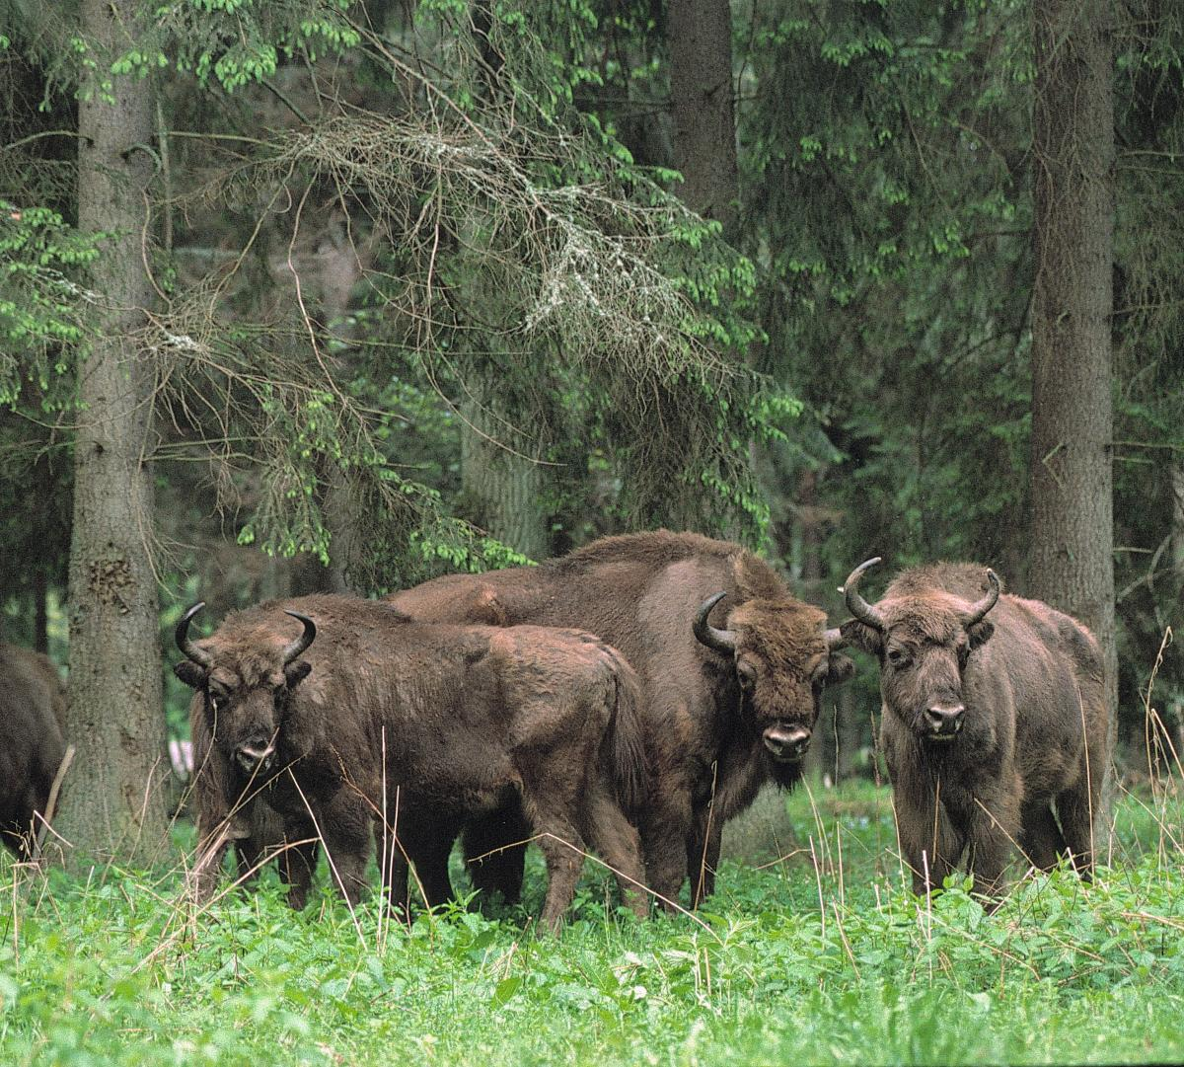
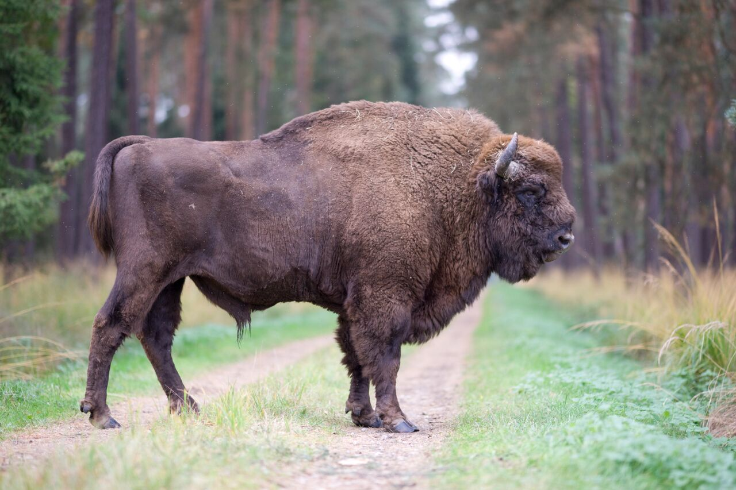
European bison (Bison bonasus)
The European wood bison is the most popular animal associated by Polish people with the issue of “endangered species”. In Poland its main habitat is the Białowieża Forest. The bison became endangered because of human activity: people used to hunt and poach it for centuries. In 2013 the population of the European bison was estimated at a little over 5,000.

Slide 4
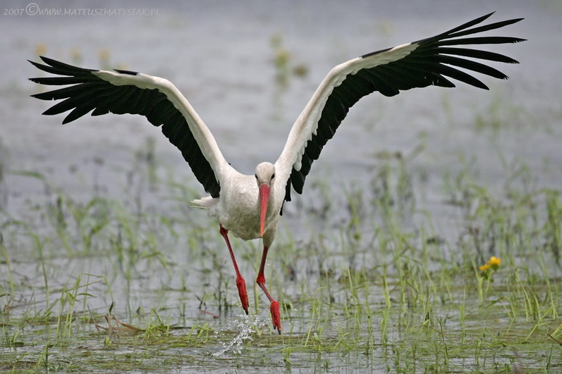
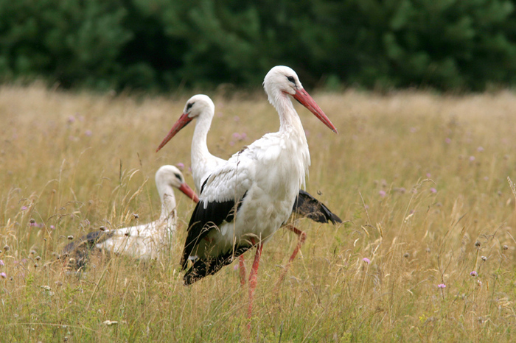
White stork (Ciconia ciconia)
For Poles the white stork symbolizes the oncoming spring. Storks spend about half a year in Poland, migrating to warmer countries for the winter. Folk tradition makes them responsible for “bringing children” to families. Storks rarely return to the nest they left the previous year. They either weave a new one or inhabit one previously used by another pair of storks.

Slide 5
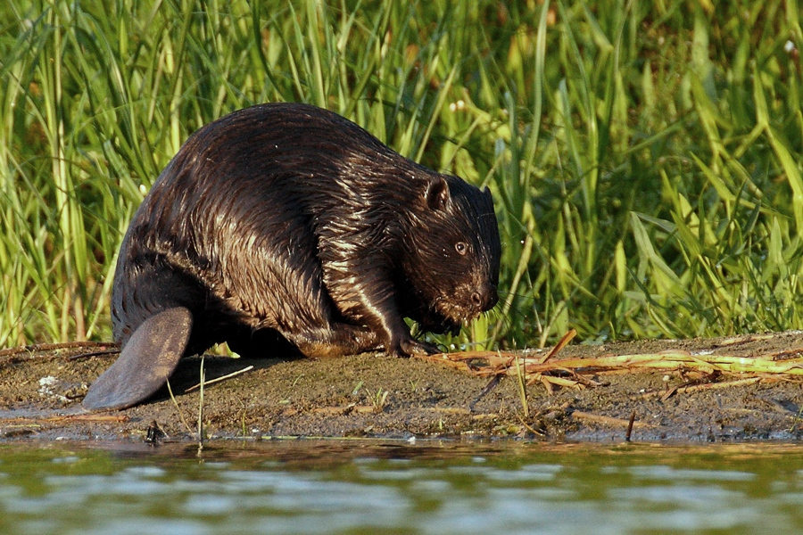
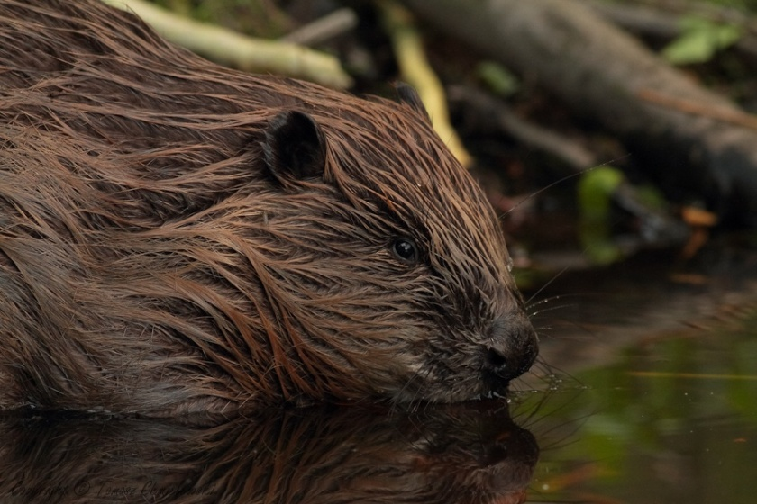
Eurasian beaver (Castor fiber)
The European beaver is generally considered to be the biggest rodent native to Eurasia. Its activity is the cause of many damages: beavers create wetlands while building their dams and block transport infrastructure by falling down trees. The population of beavers in Poland and Europe was close to extinction; after World War II their number was estimated at a little over 100. The situation led to the introduction of the legal protection of the species, which in turn has resulted in the slow but steady growth of the population. Beavers can be observed in the Pułtusk Forestry Management in a special water hole.

Slide 6
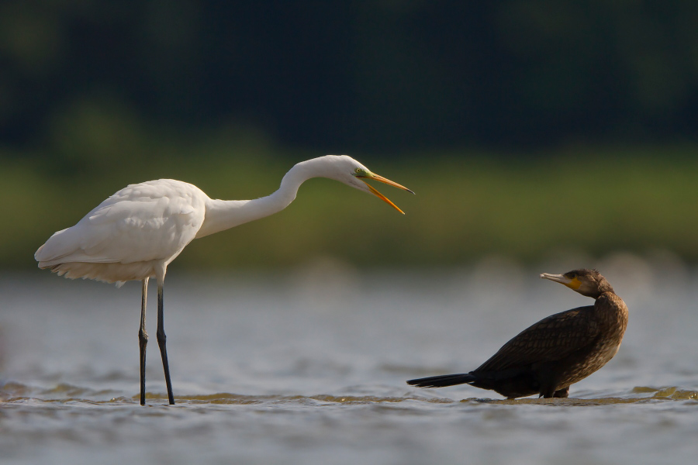
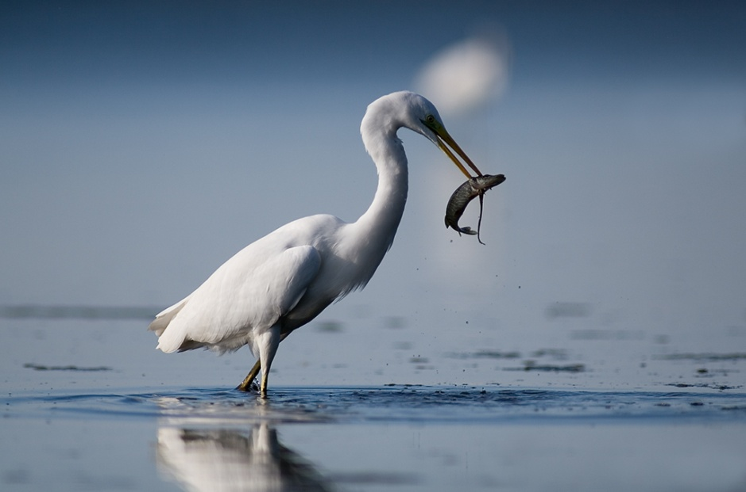
Great egret (Ardea alba)
The great egret, a bird common to all continents, was first noticed in Poland in 1997. The heron usually breeds in wetlands, weaving its nests in bushes or reed beds.

Slide 7
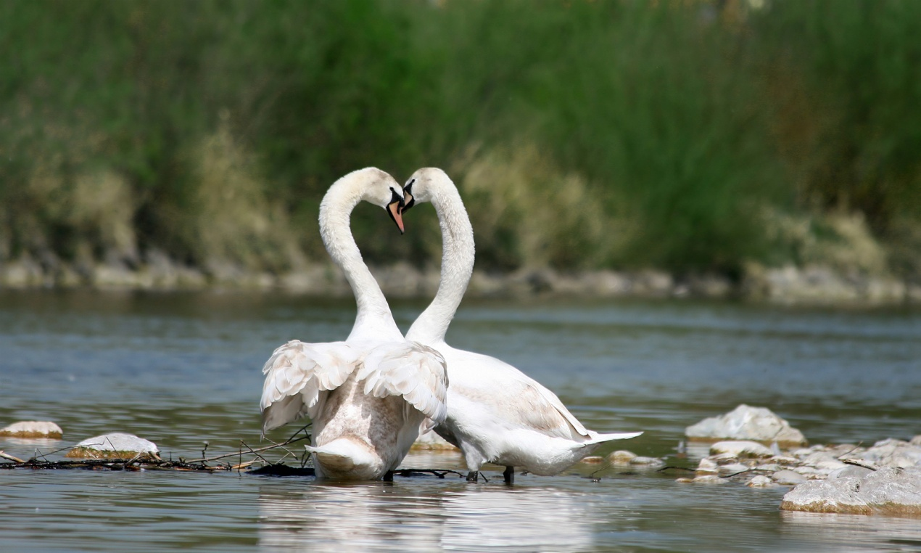
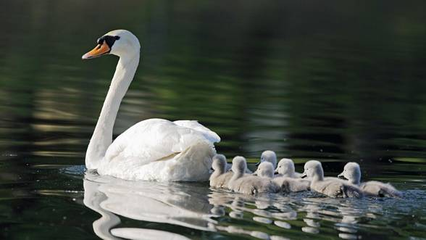
Mute swan (Cygnus olor)
The swan, one of the heaviest flying birds, inhabits vast Polish plains mainly in summer. Mute swans nest near shallow waters: on the shores of lakes, in water holes, in backwaters. The birds often use the same nest each year, restoring or rebuilding it when necessary. The number of swans in Poland is estimated at around 5,000 pairs.

Slide 8
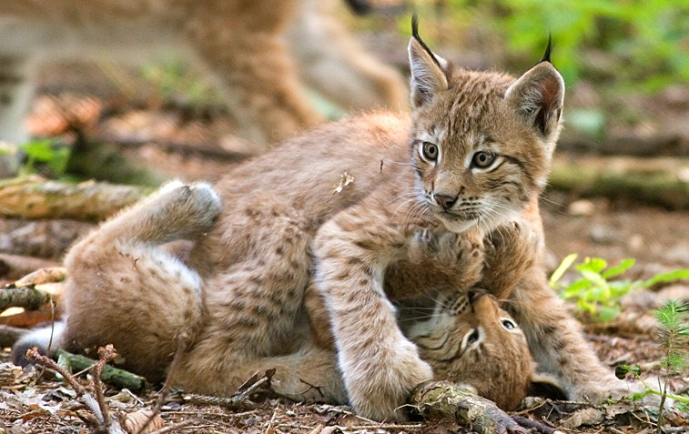
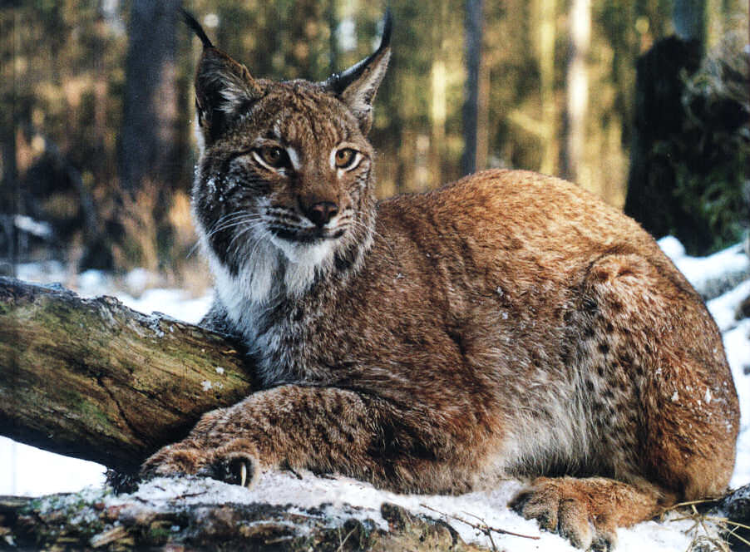
Lynx (Felis lynx)
The lynx belongs to the family of wild cats. It’s rare in Poland, with only a few habitats in the Tatra National Park. The most characteristic features of the lynx are the beautiful tufts of black hair on the tips of its ears and a short tail. Since 2007 the WWF has been very active in their efforts to bring the lynx from the brink of extinction; the species became endangered due to the human interference in their natural habitats.

Slide 9
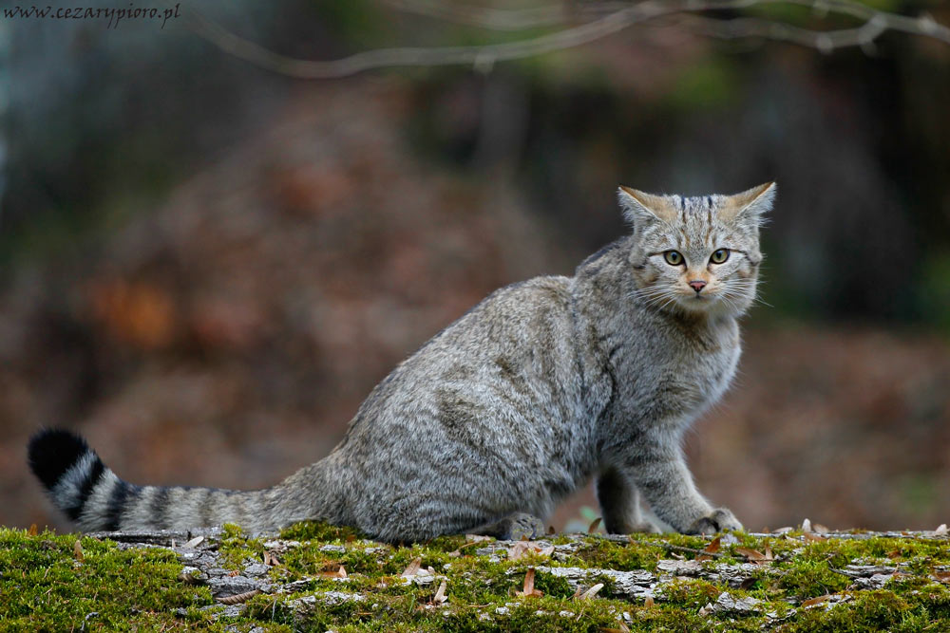
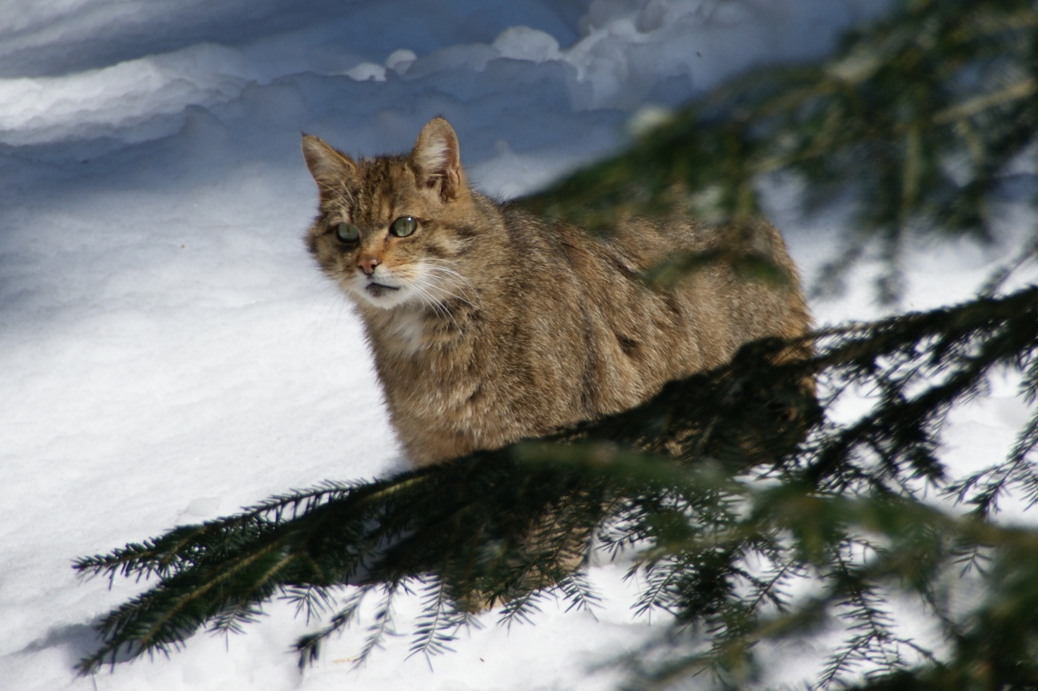
European wildcat (Felis silvestris)
The European wildcat is another mammal belonging to the family of wild cats. It is misleadingly similar to a domestic cat, only bigger and stouter in build. The population of wildcat in Poland is very small and hasn’t grown despite the strict protection of the species introduced in 1952. The wildcat hunts at night, hiding in trees during the day.

Slide 10
Our presentation ends with the wildcat. It would be impossible with only a few slides to present all the endangered and protected species of our country so we have focused on the ones that we consider to be the most recognizable.
We hope that you have learned a few interesting facts about them and that you have enjoyed what we have prepared for you.
Thank you☺

Slide 11
Sources:
https://pl.wikipedia.org/
http://www.bocianopedia.pl/
http://ptaki.info/
http://www.zubry.com/
http://natura.wm.pl/
http://www.wwf.pl/
http://mateuszmatysiak.pl/

Slide 12
Liceum Ogólnokształcące im. Piotra Skargi w Pułtusku
Klasa Ia
Andrzej Szoplik
Marek Paszkowski
Jacek Kasiński

