Slide 1
Birds of prey hospital in Warcino

Slide 2
HISTORY
Traditions of falconry in our forest school reach year 1975 when group of students with Leszek Stryj established falconry. Their acitivity has character pure falconry that means they got raptors only for hunting. After some time character of their work changed. The school started to receive wounded birds of prey. When they became healthy they got free. Then in 1995 by decision of MOŚZNiL(ministry of environment) falconry transformed into birds of prey hospital. Until today hundred of birds got rehabilitated.
A young falconer with a legendary hawk „Dżawat” from which comes the name of our center. This hawk won the race of hawks in nationwide falconry hunting. It also made our center famous among polish falconers.

Slide 3
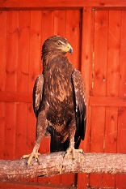
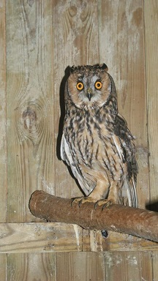
Our patients
Our patients represent the families of owls and crook-taloned birds.
Lesser spotted Eagle (Aquila pomarina)
Long-eared owl (Asio otus)

Slide 4
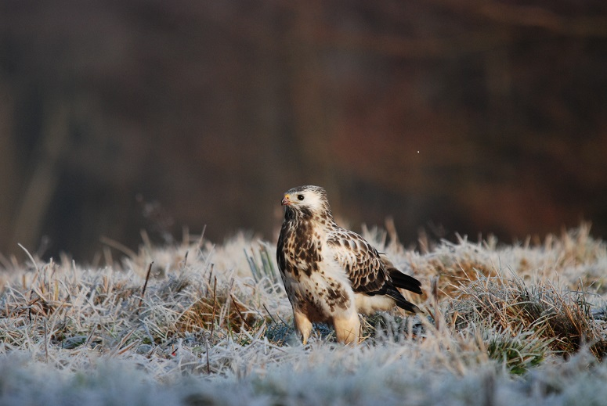
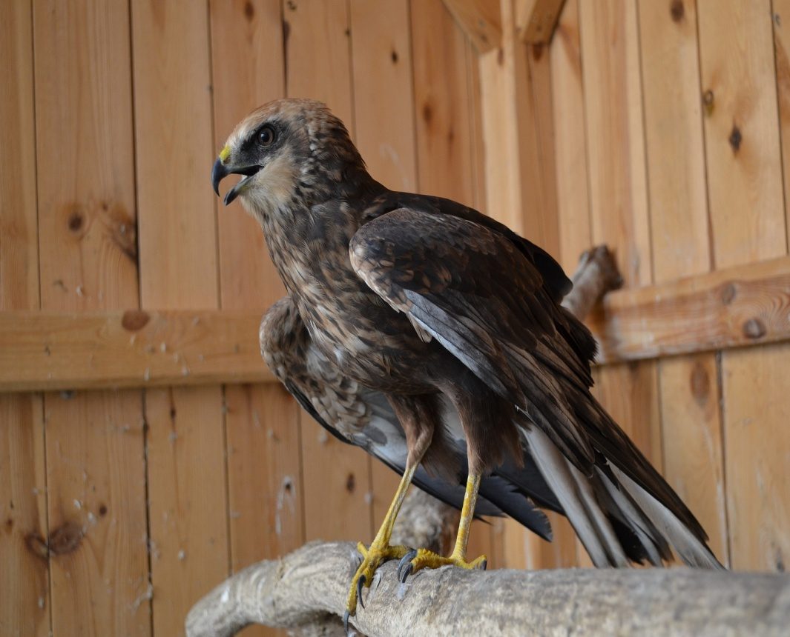
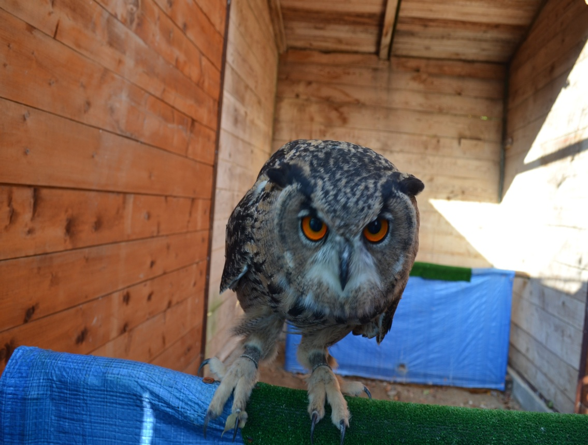
Common Kestrel (Falco Tinunculus)
Common Buzzard (Buteo buteo)
Marsh harrier (Circus aeroginosus)
Eagle Owl (Bubo bubo)

Slide 5
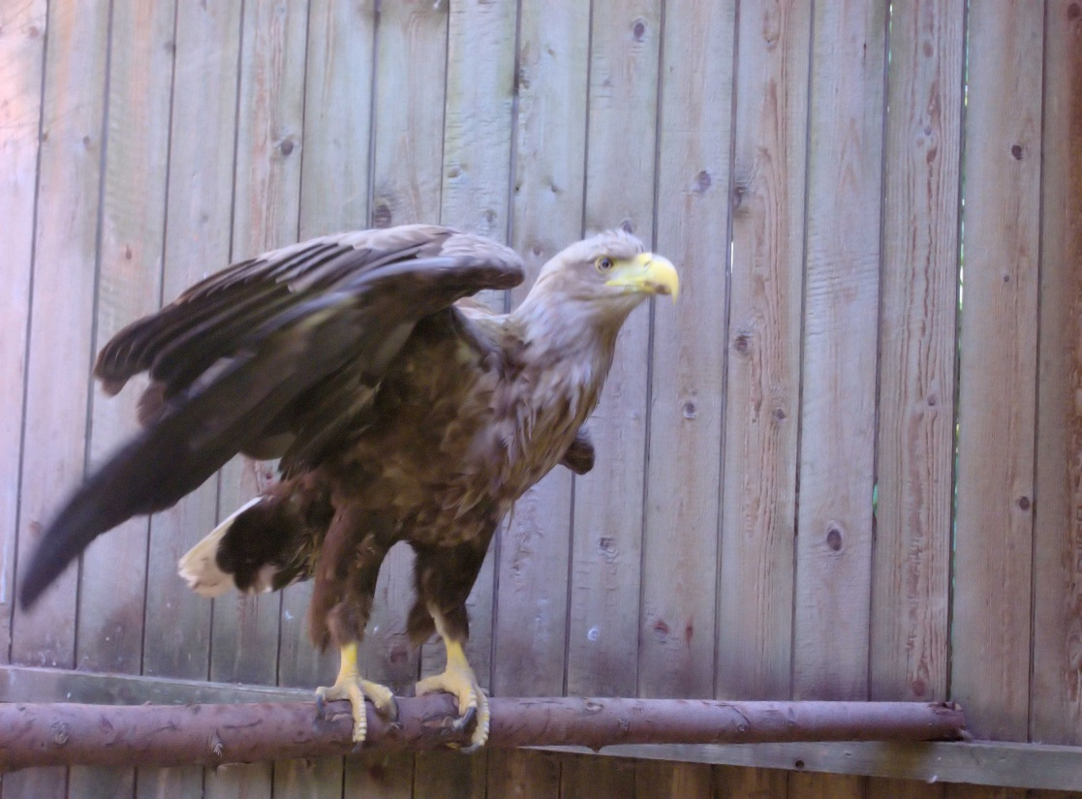
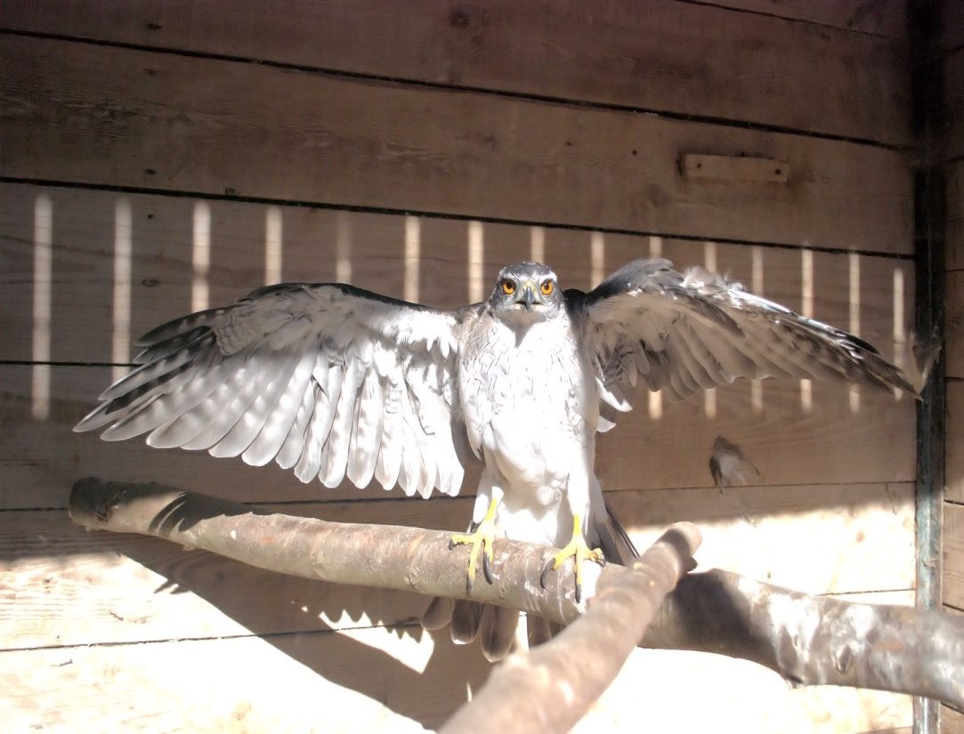
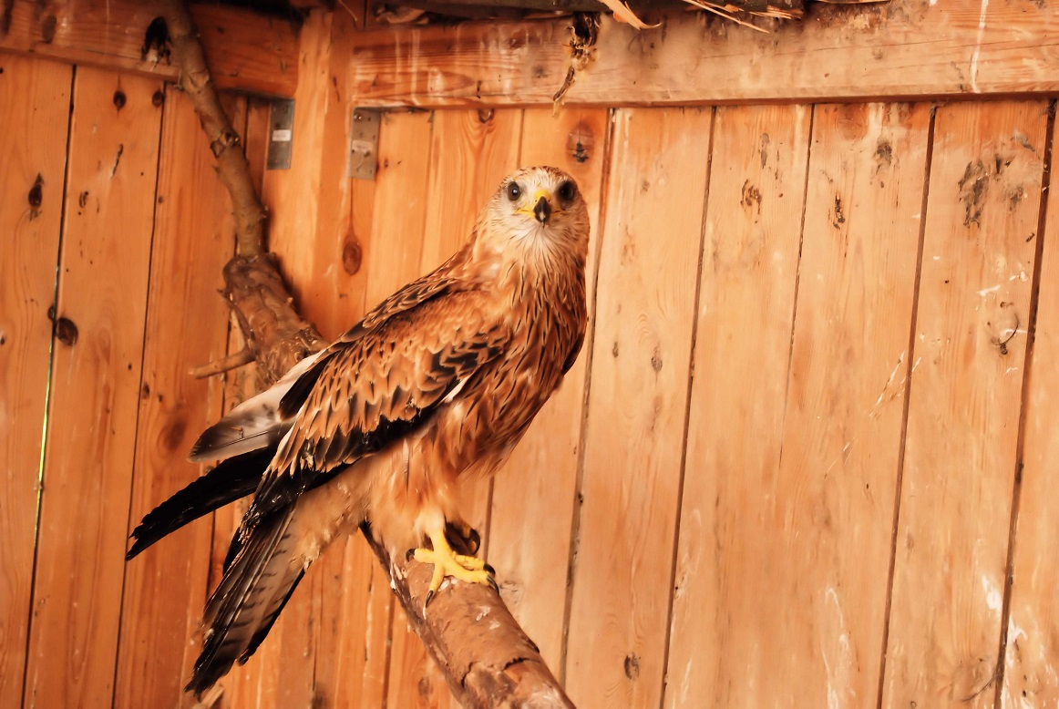
Red-footed falcon (Falco vespertinus)
White-tailed Eagle (Haliaeetus albicilla)
Goashawk (Accipiter gentilis)
Red-kite (Milvus milvus)

Slide 6
The most common cases of a bird appearance in the hospital
Collision with cars and wind power generators
Chicks which fell out from a nest
weak young birds which couldn’t find food

Slide 7
Process of rehabilitation
After we receive a bird we check its health. Then in case of emergency we take the bird to the vet. If the injuries are not serious we cure birds on our own. Then we try to adapt it to its natural habitat using typical falconry methods.

Slide 8
What are ‘Falconry Methods’?
Steps:
Taming – to train a wild bird to obey you and not to attack people
Training birds to eat in the presence of people
Training birds to jump on falconer’s hand
Training birds to jump on falconer’s hand from a longer distance
Trainning for hunting with the use of lure (i.e. the imitation of birds or small mammals). This step has to develop birds’ hunting instincts.

Slide 9
Releasing birds
Thanks to our students we can admire the birds of prey in the sky. The effects of our great job wouldn’t be possible without the engagement of many people who want to help and protect polish birds.

Slide 10
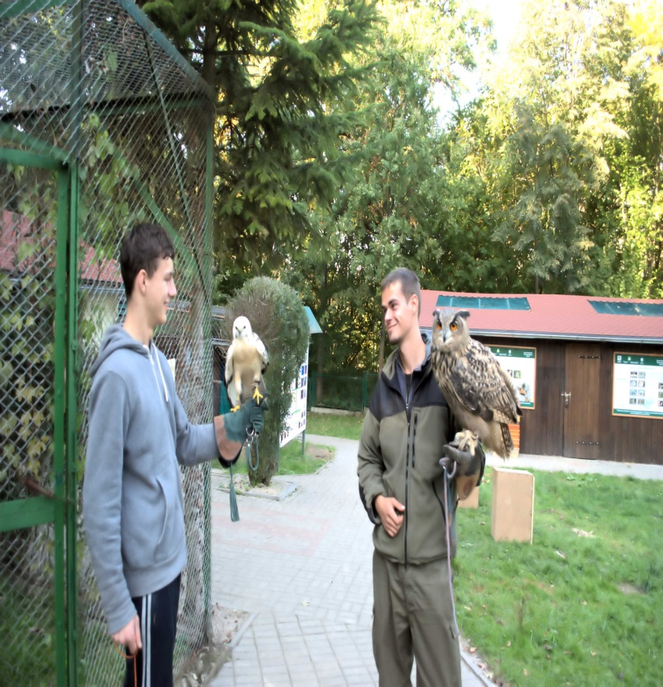
A typical day in our hospital
Every day we clean, feed our birds, get new experience and knowledge.

Slide 11
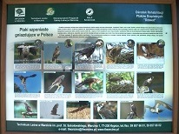
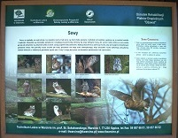
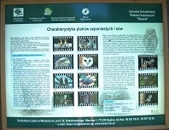
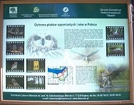
We educate people about important ecological problems. Every year great number of visitors come to our center. However, we feel responsible also for educating young pupils on birds of prey:
Their role in the environment
Their behaviour and biology

Slide 12
Join us and help the birds! Thanks for reading.
Rafał Pastwa, Miłosz Czarnecki, Paweł Talecki

