Slide 1
Who are
the foresters?

Slide 2
Forester:
*manages and protects forests
*takes care about wild animals
*lives in forester’s lodge

Slide 3
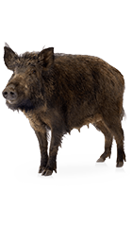
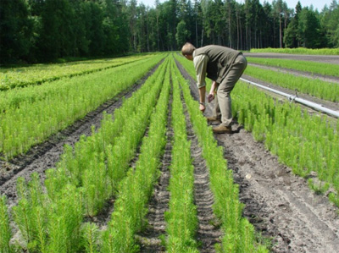
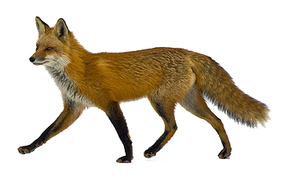
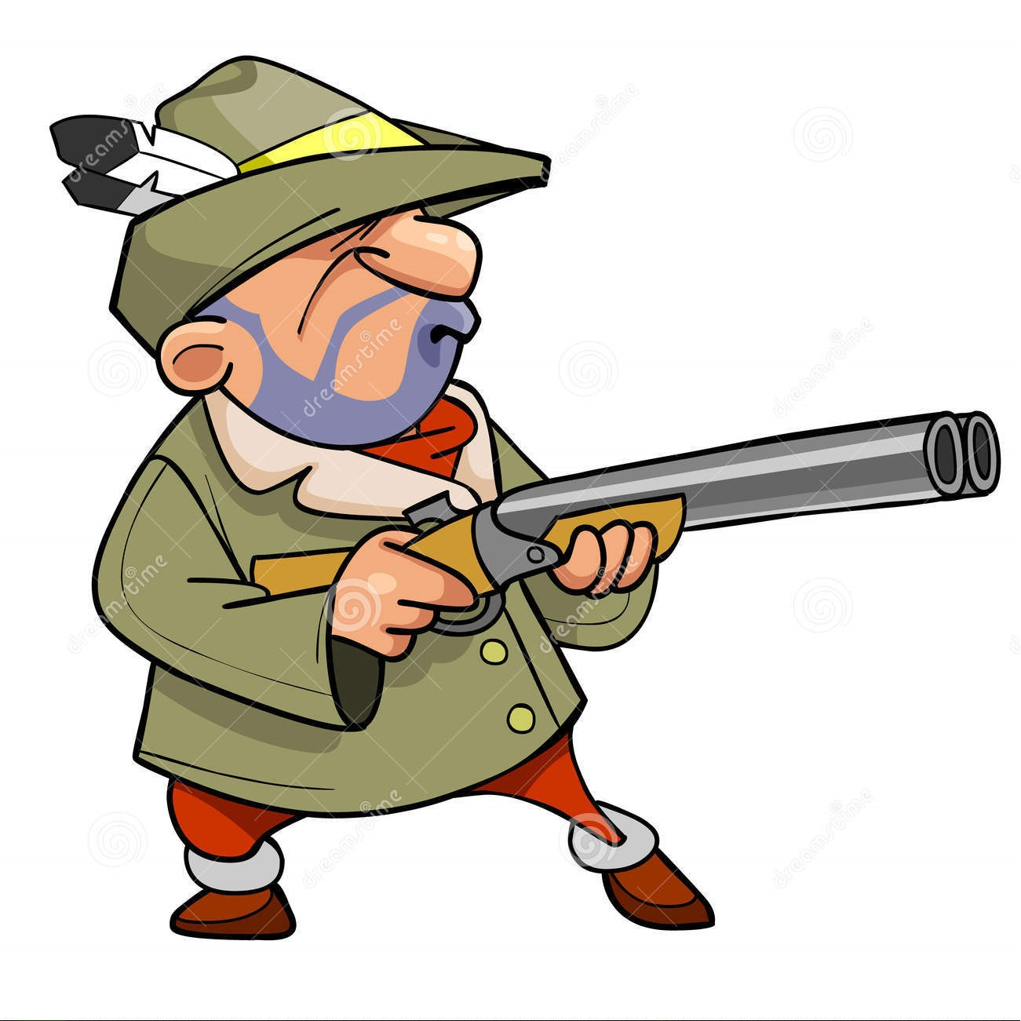
Forester’s duties:
Preparing the forest management plan
Protecting young trees from being cut down
Counting animals
Fighting against poachers

Slide 4
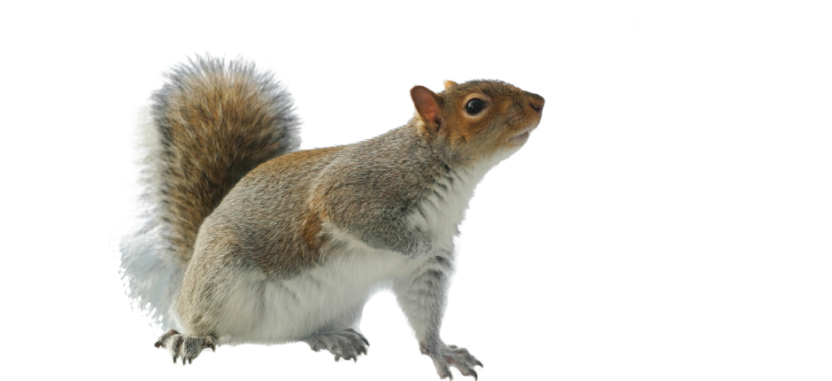
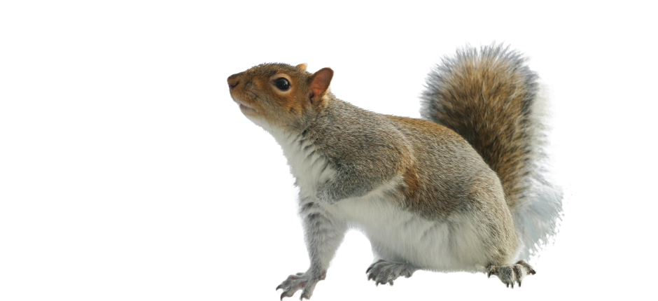
Forester’s duties:
Removing weak trees
Protecting from pests

Slide 5
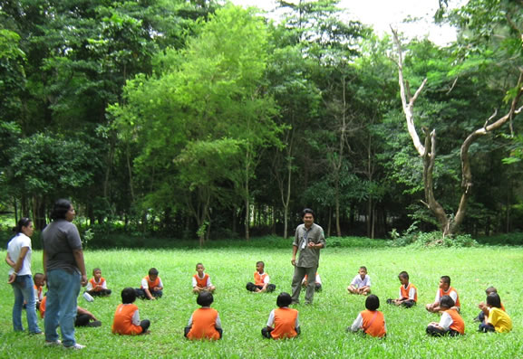
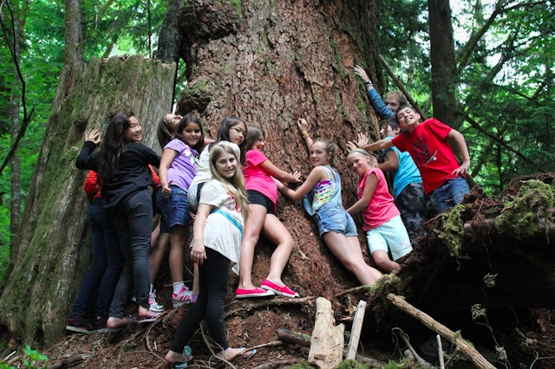
Education
*teaching respect for nature *teaching using forest resources reasonably *teaching our duties towards forest

Slide 6
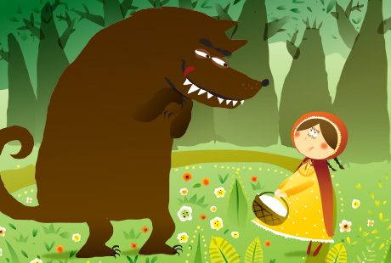
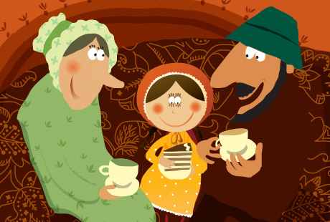
The forester was just passing the house, and thought to himself: 'How the old woman is snoring! I must just see if she wants anything.' So he went into the room, and when he came to the bed, he saw that the wolf was lying in it.

Slide 7
Thank you for watching!
Presentation made by:
Katarzyna Urbańska Radosław Rzadkowolski Angelika Jabłońska
Our teacher is:
mgr Małgorzata Bisaga

Slide 8
Sources we used in our project:
Information are based on: Link 1
Pictures:
www.stoegerindustries.com
www.niemcy.praca123.eu
www.evanslake.com
www.dogforce1.com
www.123rf.com
www.khaoyai.wordpress.com
www.sochocin.pl
www.931jackfm.cbslocal.com
www.speakaboos.com
www.oleszyce.krosno.lasy.gov.pl
www.crocodiledave.com
www.luitenfood.com
www.schmetterling-raupe.de
www.freepngimages.com
www.starkbros.com

