Slide 1
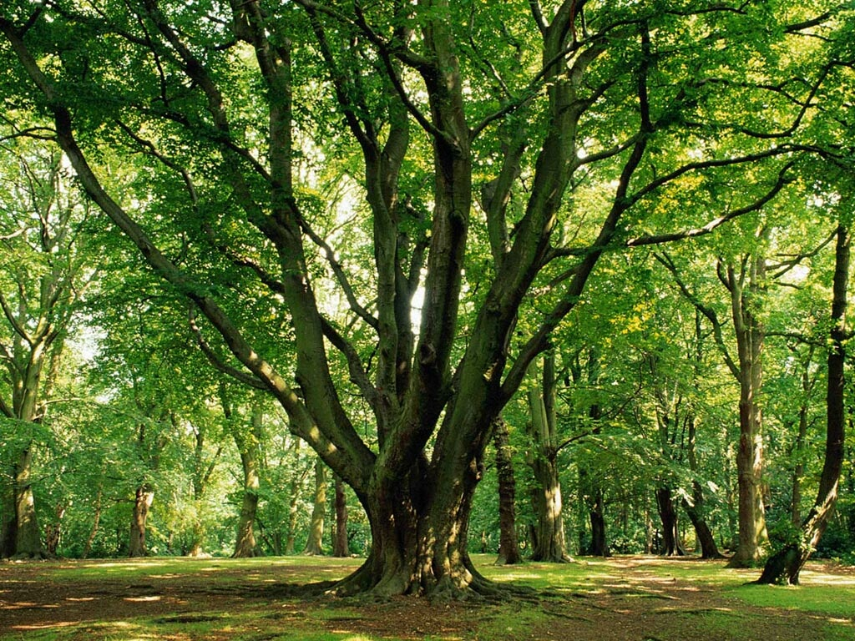
„The forests from Wyszkow and Mazovian province are talking with forests from Greece.”
„Forests in Poland and Europe. Characteristics and management” .

Slide 2
Scotch pine
Cypress

Slide 3
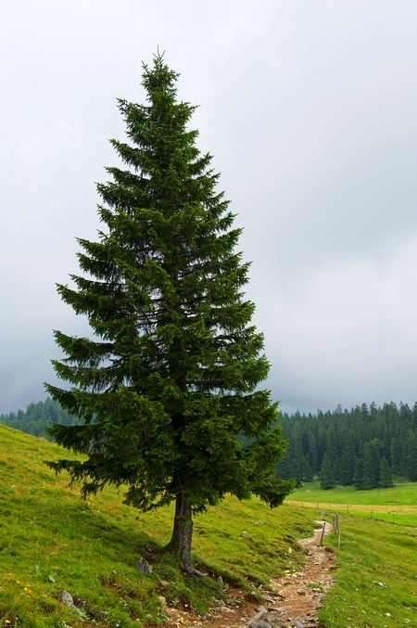
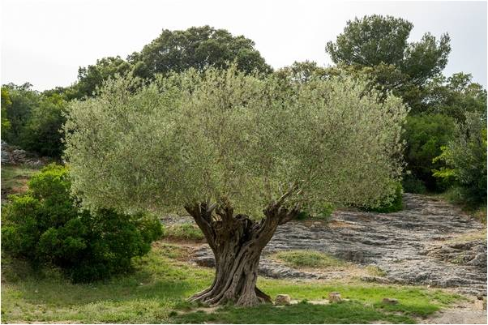
Coat of arms of Greece
Coat of arms of Wyszkow
Olive european
Spruce

Slide 4
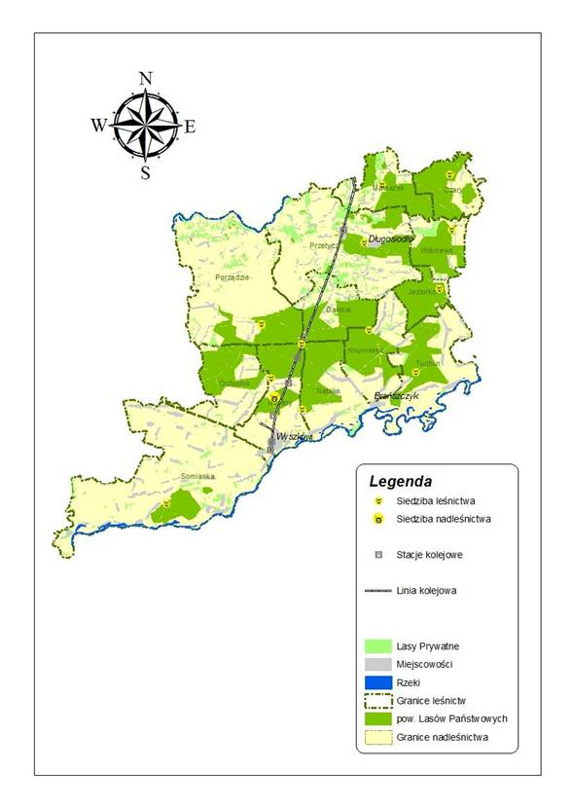
The forests in Wyszkow

Slide 5
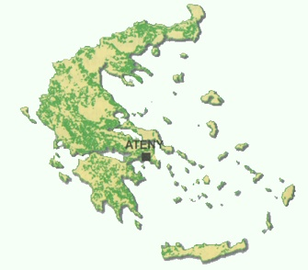
The forests in Greece

Slide 6
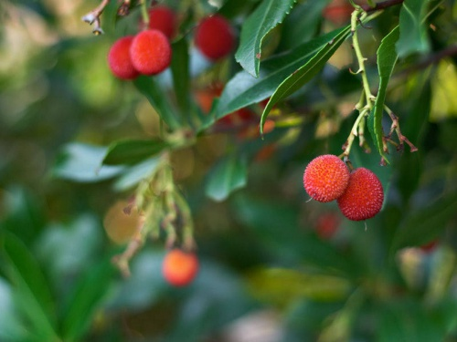
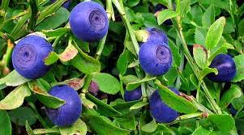
Greece
Wyszkow
Chrusciana strawberry
Strawberry

Slide 7
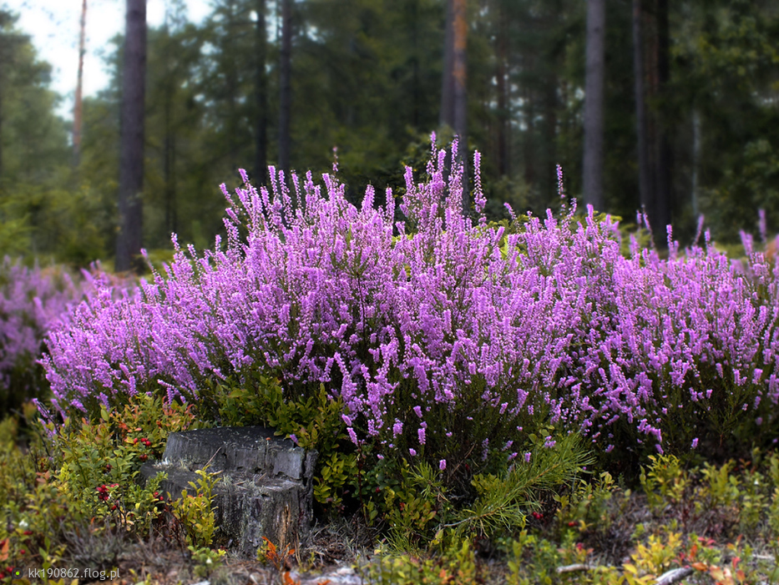
Greece
Wyszkow
Bugseed arboreal | Heather

Slide 8
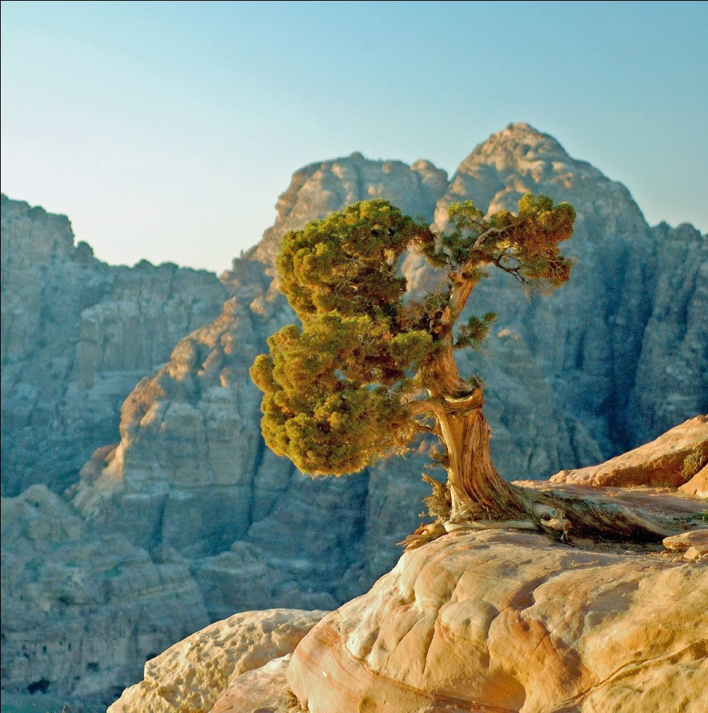
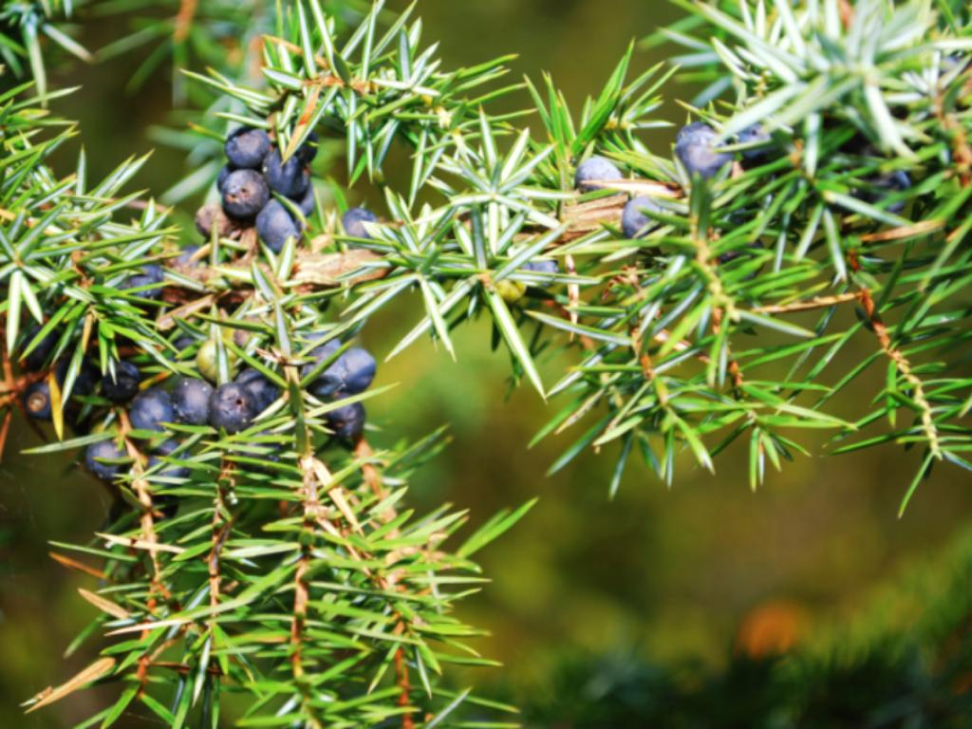
Greece
Wyszkow
Juniper fenicki | Juniper Common

Slide 9
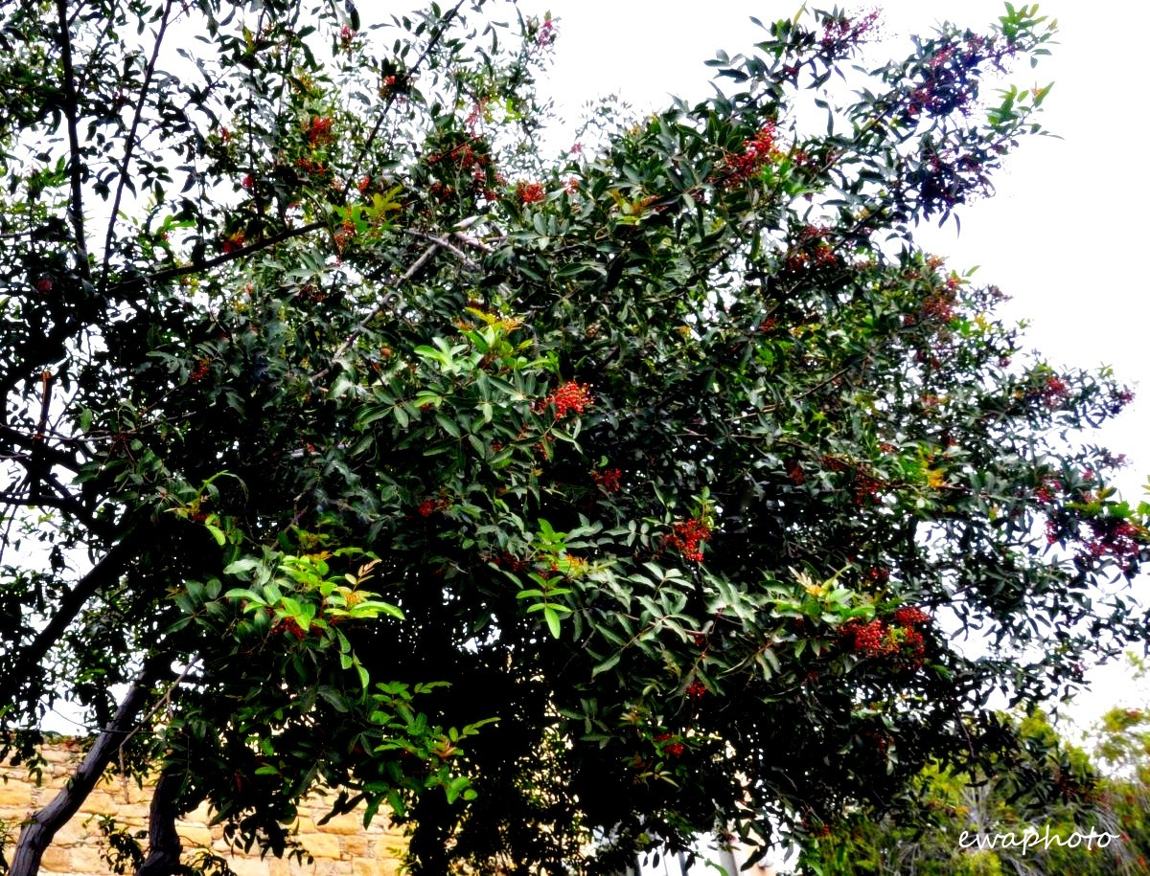
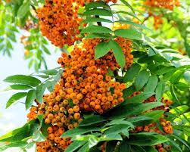
Wyszkow
Greece
Rowan | Terebinth

Slide 10
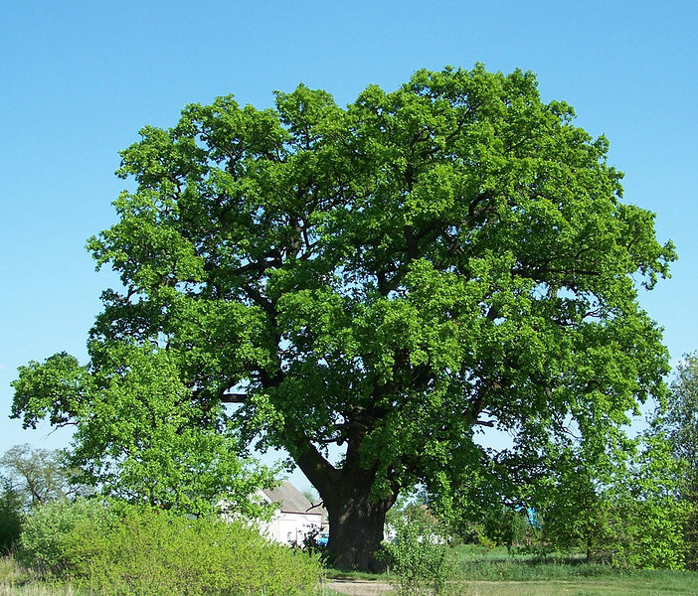
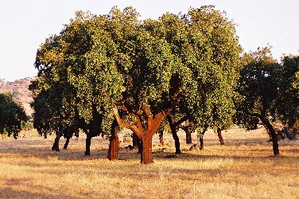
Greece
Wyszkow
Cork oak | Oak

Slide 11
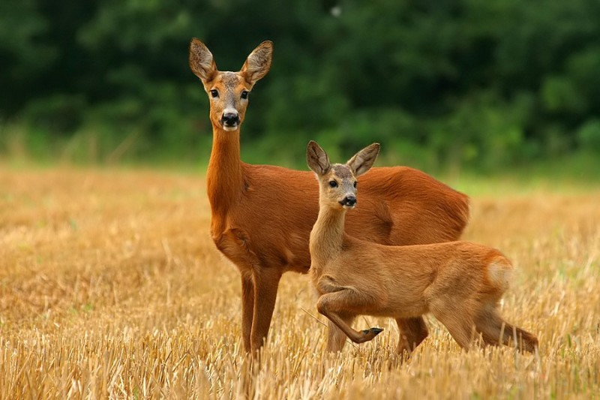
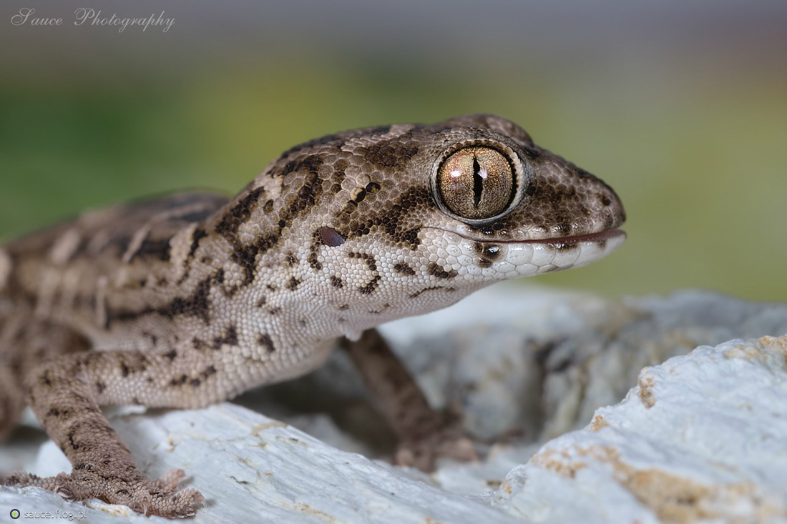
We are from Poland ☺
I am a Gecko from Greece ☺

Slide 12
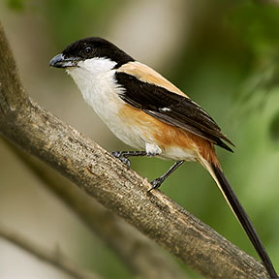
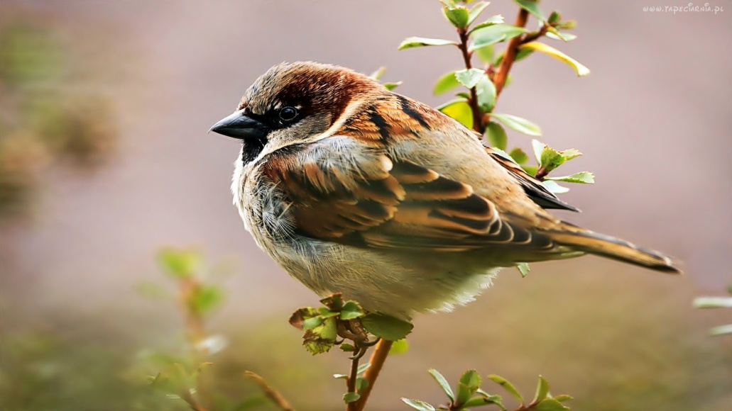
I live in Greece☺ !
I am the most beautiful bird from Wyszkow☺
Sparrow | Shrike

Slide 13
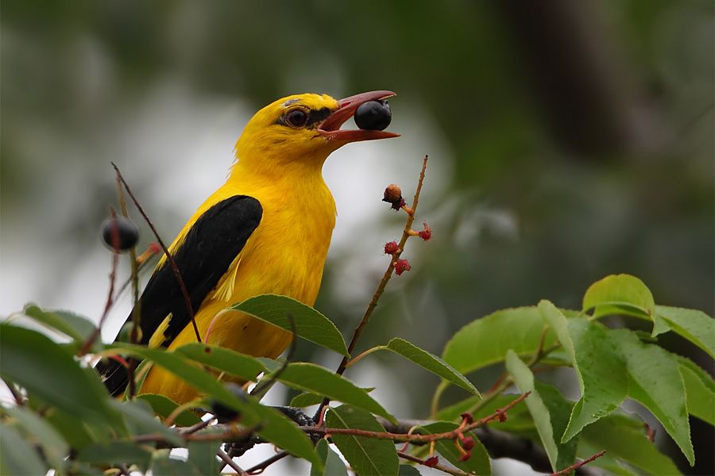
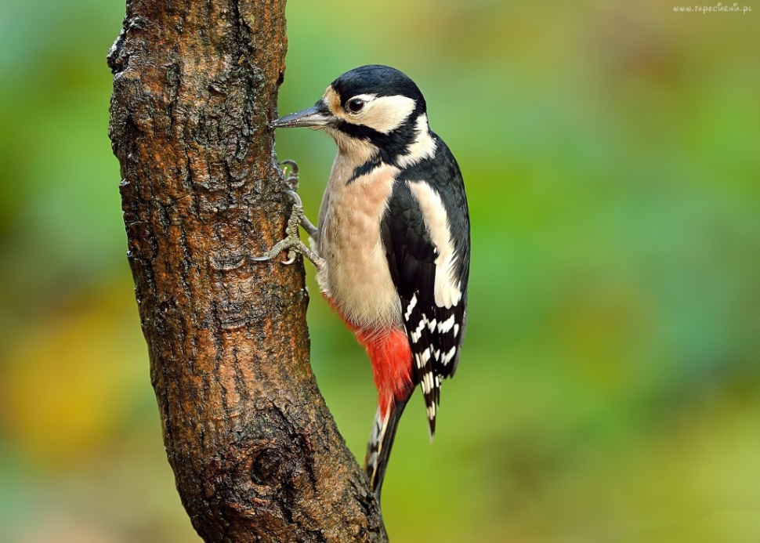
Hello ☺ Where are you from? I am Oriole and I live in Greece ☺
Hello. I am Woodpecker and I found
in Wyszkow forests ☺

Slide 14
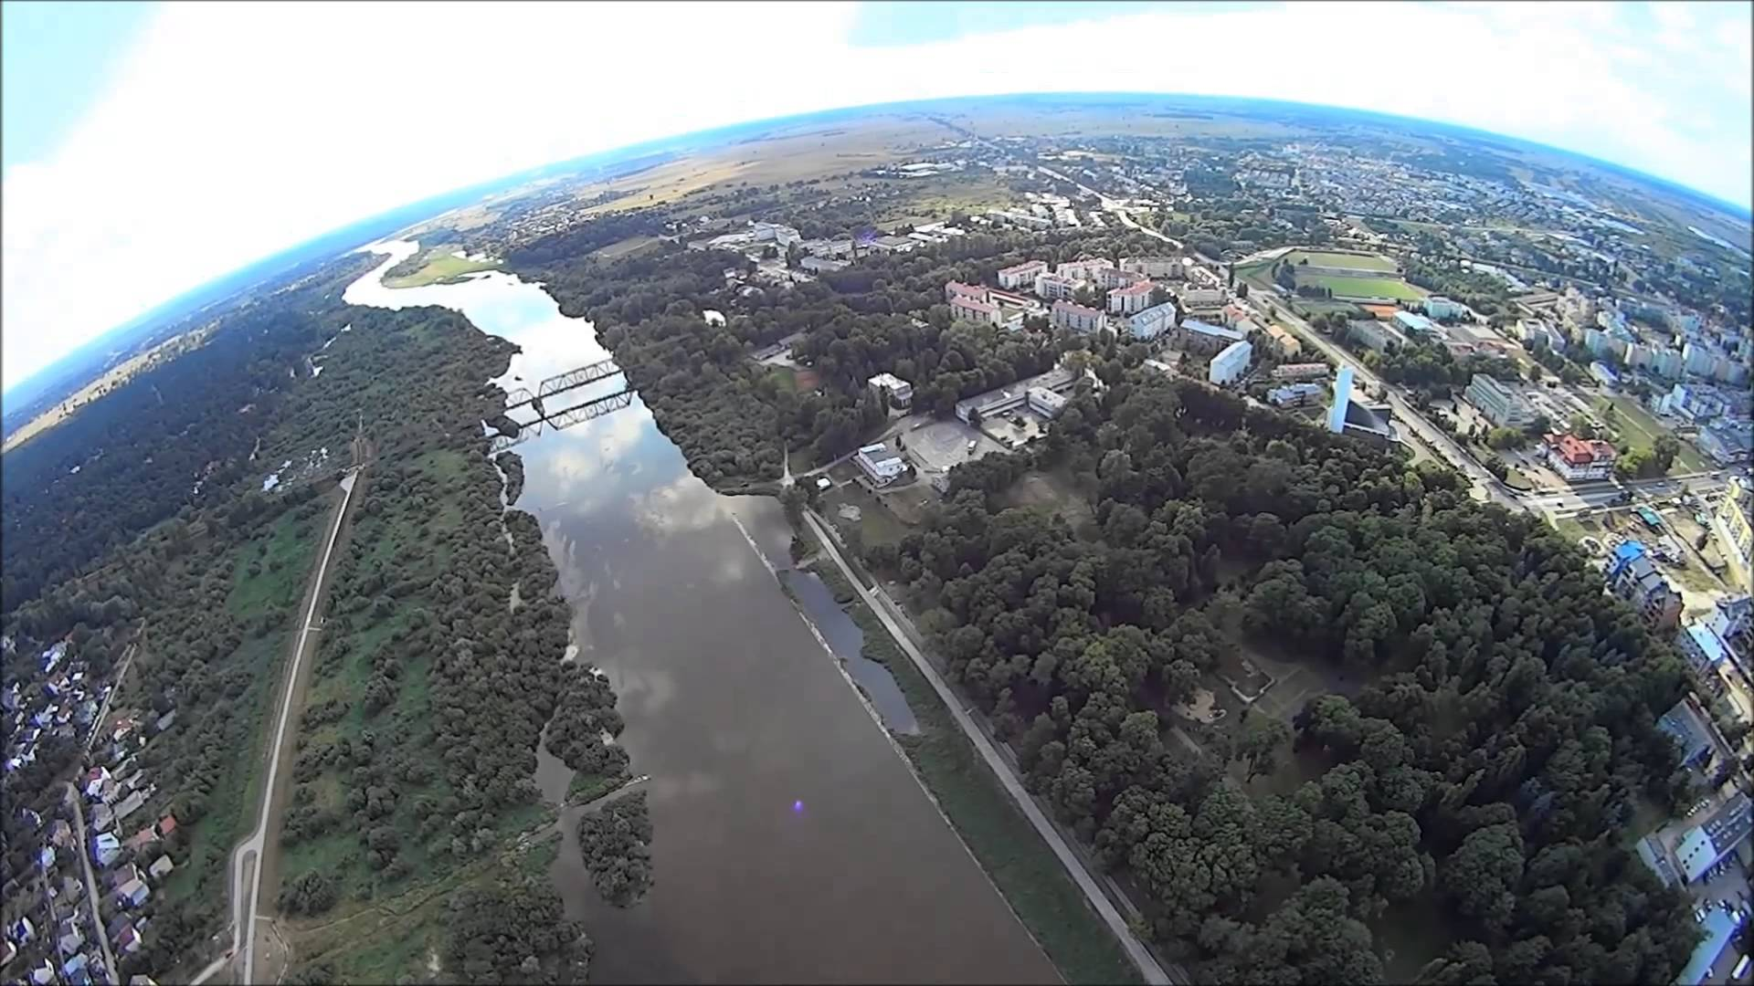
Thanks you for watching
Presentation performed: Angelika Urbanik,
Paulina Pielak, Izabela Wesołowska.
Students II Liceum Ogólnokształcącego
w Zespole Szkół nr 1 im. Marii Skłodowskiej
- Curie w Wyszkowie.

