Slide 1
VI YPEF I LICEUM OGÓLNOKSZTAŁCĄCE IM. TADEUSZA KOŚCIUSZKI UL. NADODRZAŃSKA 4, 98-300 WIELUŃ
Autors:
Julia Wykrota kl. I
Aleksandra Ziomek kl. I
Sandra Wcisło kl. I
What can be interesting about polish landscape and national parks?

Slide 2
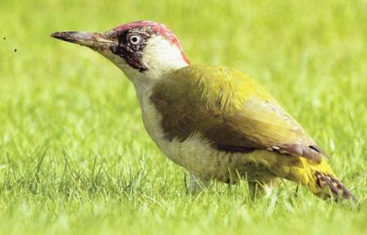
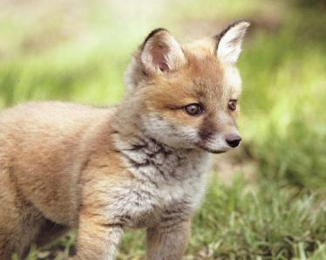
SOME INTERESTING FACTS ABOUTS TREES
A single tree can absorb CO₂ at a rate of 48 lb. per year.
Trees act as natural pollution filters by absorbing pollutants through the stomates in leaf surfaces.
Trees lower temperature by transpiring water and shading surfaces.
Trees reduce heat sinks. Heat sinks are 6-19 degrees F warmer than the surrounding area.
Trees reduce erosion.
‘’The clearest way into the universe is through a forest wilderness.” - John Muir

Slide 3
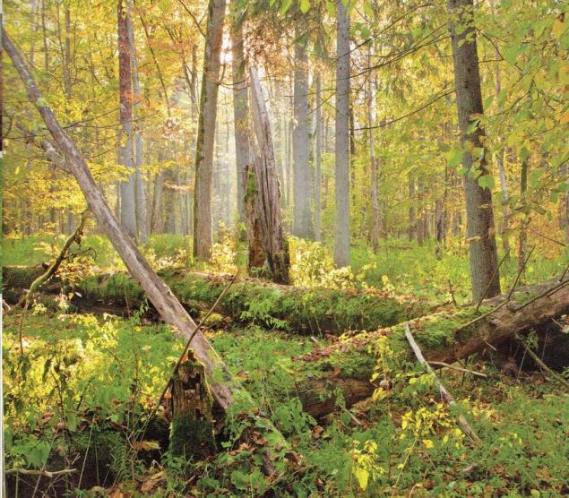
An acre of trees absorbs enough CO₂ over one year to equal the amount produced by driving a car 26,000 miles.
Trees provide food and wildlife habitats.
Planting trees remains one of the cheapest, most effective means of drawing excess CO₂ from the atmosphere.
Trees recharge ground water and sustain stream flow.
One large tree strategically placed in a yard can replace 10 room-size air conditioners operating 20 hours per day.

Slide 4
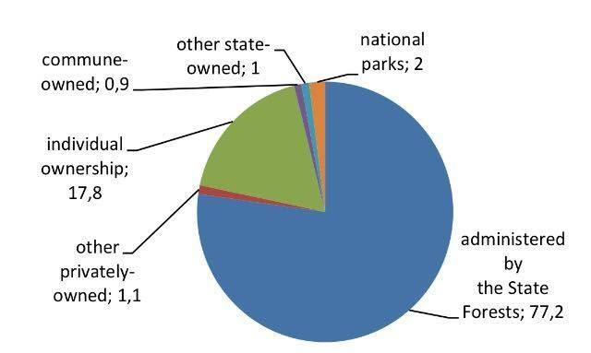
The task of each park is to protect the unique landscape with spectacular fauna and flora. Nowadays forest area in Poland covers ca. 9 million hectares.
Typical and exceptional fauna and flora species in our forests:
Because of its moderate climate (in-between oceanic and continental) Poland is famous for the most diverse and the richest forest biocenose in Central Europe. There are 2.300 vascular plants, 600 mosses, 250 Hepaticopsida, and 1.600 lichens. Among vascular plants we can find species from various geographical regions such as: Eurasia, North-Americn, Arctic, Middle-Europe, West-Europe, Black-Sea; even Mediterranean Sea. Pine trees (Pinus sylvestris) and sporadically larch cover 70% of the forest area.
National Parks are only 2% of the whole structure of forests in Poland but they are unique and exceptional!

Slide 5
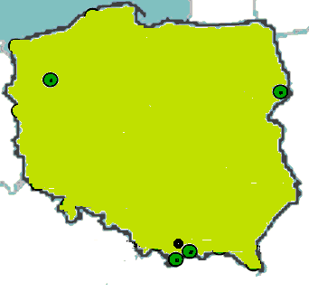
Drawieński National Park
Bialowieża National Park
Popradzki Landscape Park
Tatra National Park
Pieniński National Park

Slide 6
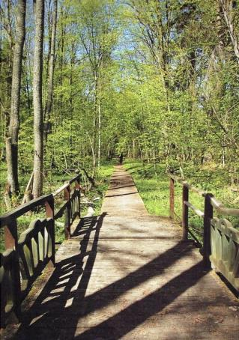
BIALOWIEZA NATIONAL PARK
is the oldest national park in Poland. Its emblem is the bison. It includes very valuable natural lowland forests. 500 years ago hunting and settlement were prohibited with a king’s decree which, although it was issued for other purposes, was beneficial for nature and society. Animals were set free to nature from zoos and animal gardens during interwar times.
Bison bosonus is the King of the forest.
Fauna: lizard, moose, badger, hare, grass snake, deer, viper, tree fog, roe, lynx.
Flora: linden, oak, willow, sallow.
Here we can meet an interesting animal- a cross beetwen a bison and the cow- in polish żubroń .

Slide 7
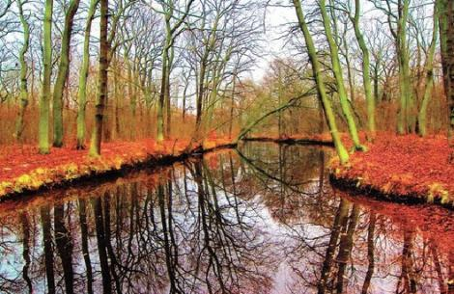
DRAWIENSKI NATIONAL PARK
The area of Drawa National Park and its neighbourhood lies in the a plain called Równina Drawska, which is a fragment of the lake district Pojezierze Południowopomorskie, in the north-western part of Poland. It encompasses for the central part of a forest complex called Drawa Wilderness (Puszcza Drawska). A significant element in the cultural landscape of the Park is the remains of old human settlements, and cemeteries.

Slide 8
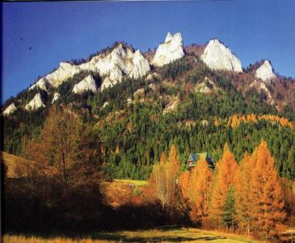
PIENINSKI NATIONAL PARK
Pieniny, a small rocky group of mountains visible well already from Nowy Targ, extends from Czorsztyn village to Szczawnica town. In Pieniny, almost no upland forests exist. One of the most striking features of the Pieniny forest cover is its diversity, which depends on the slopes' exposures. Deeper shaded gorges and gullies of Central Pieniny, with underlying calcareous rock debris, are suitable habitats for the rare forest community – Phyllitido-Aceretum. In Poland, this community is found only in Pieniny, the Sudety Mountains (Kaczawskie Mountains), Krakowsko-Częstochowska Jura and Beskid Niski. But what about fauna? So far about 6,800 species are found here.

Slide 9
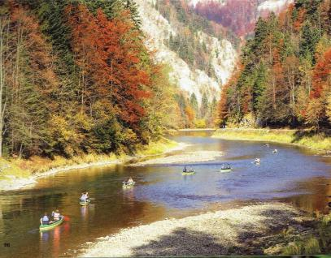
While there have been many studies of park invertebrates, not enough information is known to indicate exactly how many species occur here; it is thought that the total number of invertebrates may be around 13,000 species (about half of the known total from the whole of Poland).
Why is it good to know something about forests in your country? At first, it's really useful knowledge if it comes to planning your holidays. When you know where to take a long walks and rest a little it's much easier to come back to work after a long break. And is anywhere fresher air than in parks or forests? I don't think so.

Slide 10
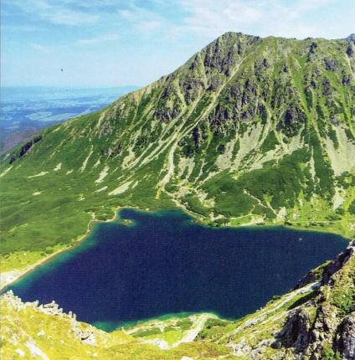
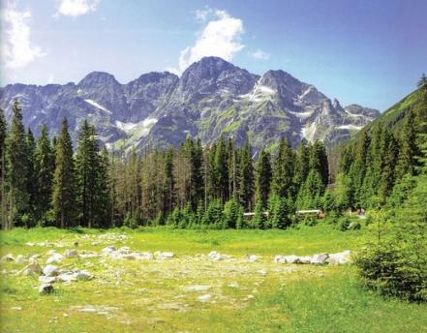
TATRA NATIONAL PARK
Tatra National Park is the only mountain range with alpine characteristics. Ιts emblem is the chamois. It is connected with the Slovak Tatra National Park. In both parks brown bear and alpine marmot can be found.

Slide 11
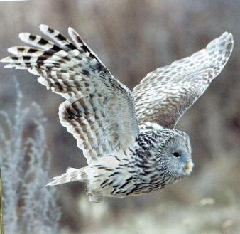
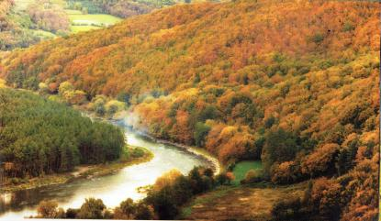
Poprad Landscape Park
Poprad Landscape Park is a protected area in southern Poland, named after the Poprad river running through it. The Park, with the total area of 54,212 ha (133,960 acres), is one of the biggest landscape parks in the country, created in 1987.
It lies within Lesser Poland Voivodeship, in the part of the Beskid mountain range called Western Carpathians south of Nowy Sącz, in the basin of the Poprad river with its picturesque gorge.

Slide 12
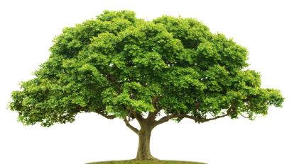
The Forests are our friends
One tree produces 727kg oxygen/ m³
And absorbs 1 tonne carbon dioxide/ m³
The Survey
We asked school children what do they think about Landscapes in Poland?
Here is what our team found out:
- they are beautiful 67%
- they re useful 6%
- I don` t know 15%
- they are unuseful 2%
On the grounds we can ascertain that the forests in Poland are unique and it is worth to see them.

Slide 13
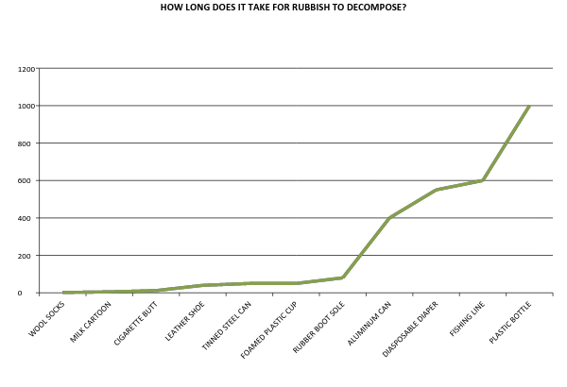
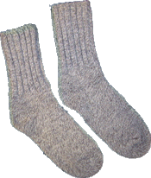
n
Time it takes for garbage to decompose in the environment: Glass Bottle.......................... 1 million years Monofilament Fishing Line… 600 years Plastic Beverage Bottles…… 450 years Disposable Diapers………… 450 years Aluminum Can..................... 80-200 years Foamed Plastic Cups……… 50 years Rubber-Boot Sole............... 50-80 years Tin Cans……………………. 50 years Leather................................. 50 years Nylon Fabric........................ 30-40 years Plastic Bag.......................... 10-20 years Cigarette Butt...................... 1-5 years Wool Sock............................ 1-5 years Apple Core…………………. 2 months Newspaper………………….. 6 weeks Orange or Banana Peel...... 2-5 weeks Paper Towel……………….. 2-4 weeks
HOW LONG DOES A GLASS BOTTLE BIODEGRADE? The Glass Bottle needs 1 million years to disappear. Luckily it can be reused, so we should segregate rubbish so as to use it again and never throw it in the forest.
AND WHAT ABOUT CHEWING GUM? We heard different opinions about the time in which bubble gums decompose. Some people say that it is not biodegradable. We also used to believe in this theory because one can find chewing gum in almost every place, they are in the forests too. The gum is made from synthetic latex rubber and it degrades. Of course the speed of all biodegradation depends on conditions – oxygen, temperature, water and pH but in three months’ time the chewing gum should disappear. Anyway it is not good to throw away garbage and bubble gums in the forests and we would like to advise all the teenagers not to do it and rather put it in a bin. While the gum is decomposing it releases CO2 into the atmosphere and trees have to absorb it. Let’s try to protect our environment an do not harm it!

Slide 15
SOURCES:
,,Parki Narodowe i Krajobrazowe w Polsce” Kamil Nadrowski –FENIX
Wikipedia
You Tube
http://ypef.eu/ypef_eu/files/YPEF_Educational_material_2016.pdf
http://des.nh.gov/organization/divisions/water/wmb/coastal/trash/documents/marine_debris.pdf
http://www.savatree.com/tree-facts.html
THANK YOU FOR WATCHING!

