Slide 1
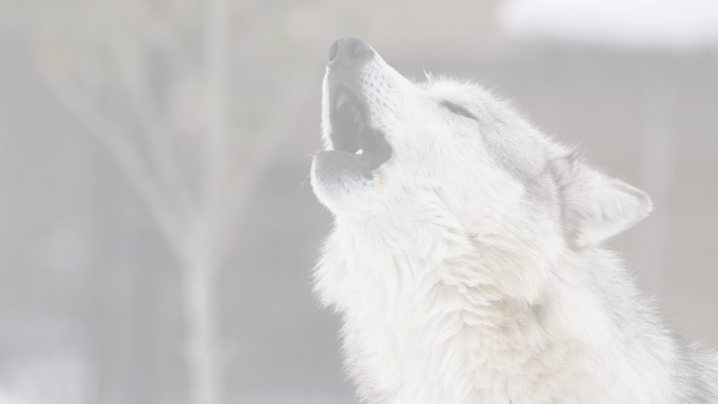
THE MYSTERY OF POLISH WOLVES
Have you ever considered how mysterious the life in Polish forests is? We - the habitants of the north of Poland, will try to convince you about the irrefutable beauty and variety of our closest enviroment.

Slide 2
Forests in Poland
In Poland forests cover about 9,1 mln ha, this is about 29% of our country and they are dominated by scots pine. Only 7,6 mln ha of forests is managed by the State Forests National Forest Holding. One of the most important sector of the polish economy is forestry sector. Interesting fact is that it offers direct employment to 300 000 in the forest and wood industry. (Polish wood industry is one of the biggest in the whole world).
We have 23 national parks. The total area of them in 316 748, 45 ha. It is only 1% of the country area.

Slide 3
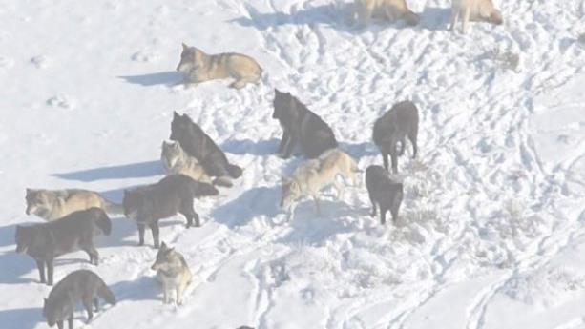
At the beginning…
The wolf has been protected throughout Poland since 1998.
Now, according to official data, there are about 1200 wolves in whole Poland and the number is increasing.

Slide 4
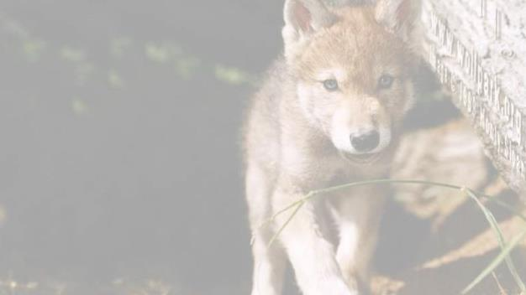
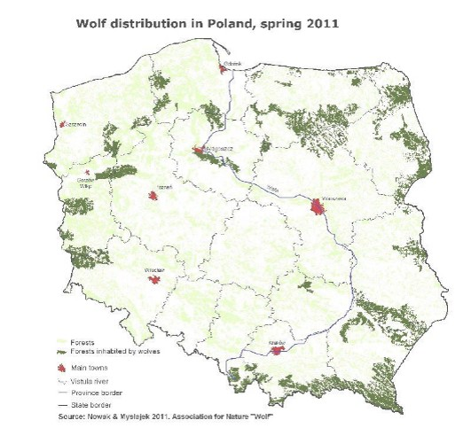
Expansion of wolves…
Between 2001 and 2005 the increase in both the number and range of the wolf population was recorded only in areas of the Vistula river and in the Carpathians.
The wolves distribution was limited to northeastern, eastern, and southern part of the country. In central and western Poland only few individuals were recorded. Since 2005 wolves have begun to resettle Western Poland.

Slide 5
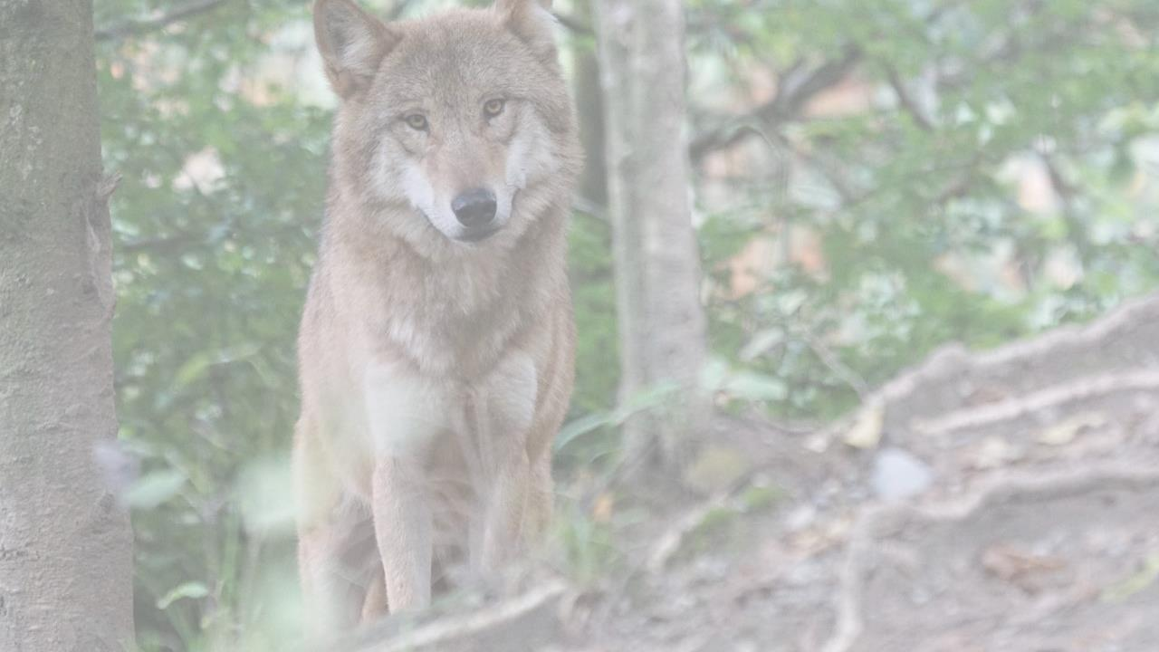
Where can we find the wolves…
Except from Poland, we can come across wolves in Europe:
Italy
France
Spain
Sweden
This countries have more isolated populations, limited in number and genetic diversly and very sensitive to enviromental changes.

Slide 6
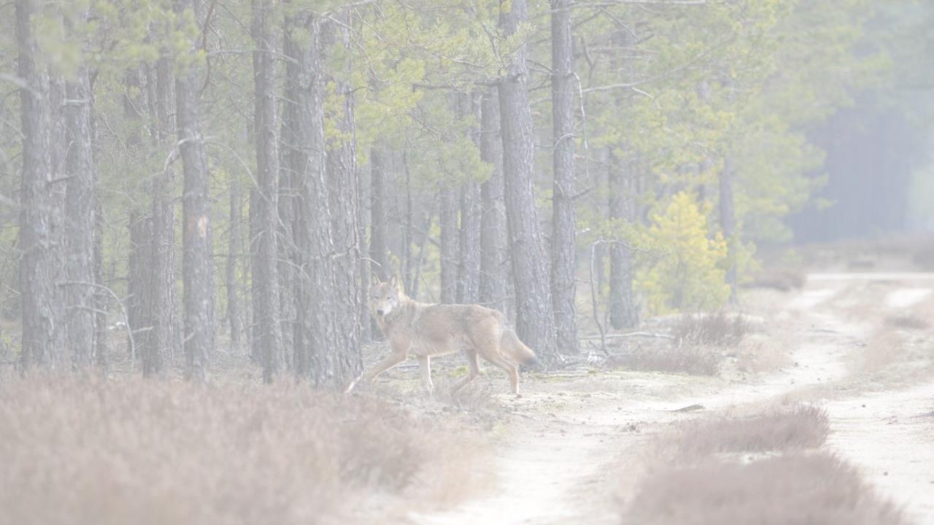
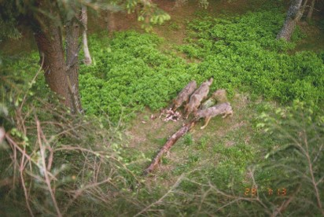
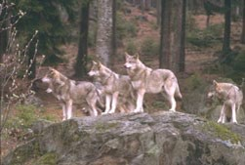
Where do the wolves live?
Studies conducted in Poland reported that wolves requite large areas to function.
The majority of wolf territories include forests.
The climate of the forest is of the cool continental temperature type with some influences of the Atlantic climate. According to long term data the mean annual temperataure is 6,8. The lowest recorded temperature is -38,7, and the highest +34,5.

Slide 7
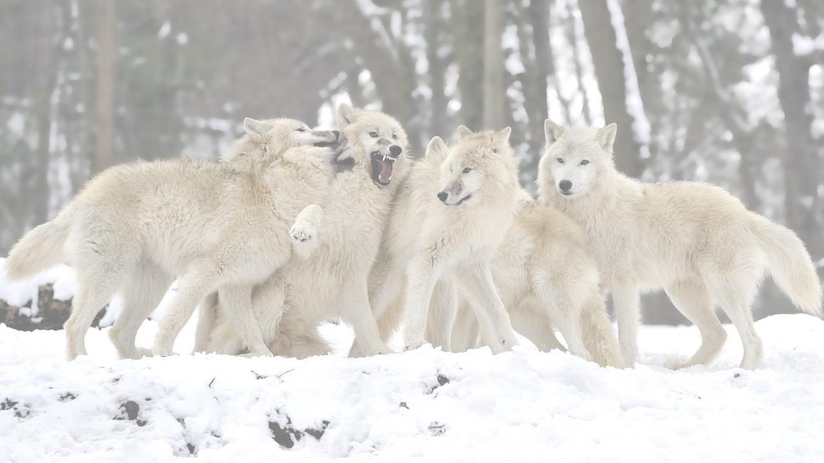
Wolves history in Poland
Poland’s communists regime organised a vast wolf cull in the 60s in respond to their perceived danger paying residents for every animal shot dead. The park’s lost wolf was killed in 1964.

Slide 8
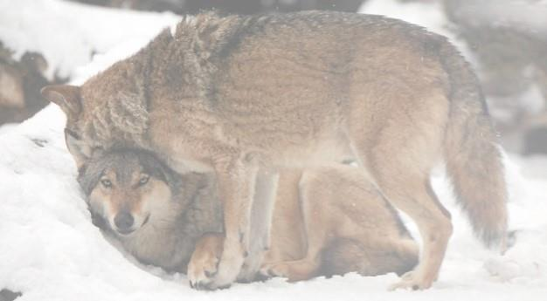
Wolves’ turf
According to recent studies the overaged number of wolves in a pack varies from to 3-5 individuals. The wolf pack territory covers about 200 – 300 km ² lowland and about 100 km² in the mountains.

Slide 9
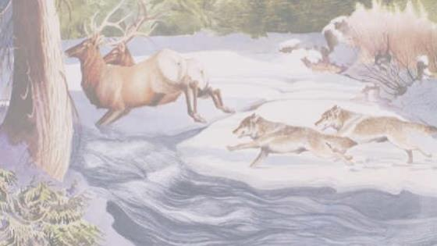
Wolves hunting.
Wolves in Poland mostly prey on wild ungulates. They mainly hunt for red deer, roe deer and wild bear. Wolves are opportunists. They test their prey, sensing any weakness or vulnerability through visual cues and even through hearing and scent. Contrary to ambush predators that rely on the element of surprise and a short and intense burst of energy to secure their prey, wolves are endurance or coursing predators. They chase their prey, often over longer distances, sometimes even a few miles, in order to find the right animal or opportunity. On the hunt, wolves work together with certain individuals typically carrying out their specific role in the hunt, often based on age, gender and social standing.

Slide 10
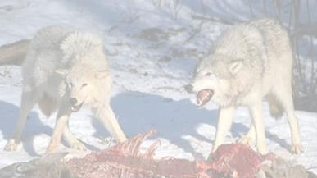
What do the wolves eat?
The average daily consumption is 4-7kilos per wolf, kills are eaten very fast, one medium pack can consume an adult female red deer in 1 ^{½} days. Wolves eat their food very quickly, probably to protect it from being stolen, and to decrease the chance of attack from other predators. They eat the best parts first, and come back later for the remainder, as they can't afford to be wasteful. They will hide food in the snow, or icy soil, which helps to preserve it, and protect it from scavengers.

Slide 11
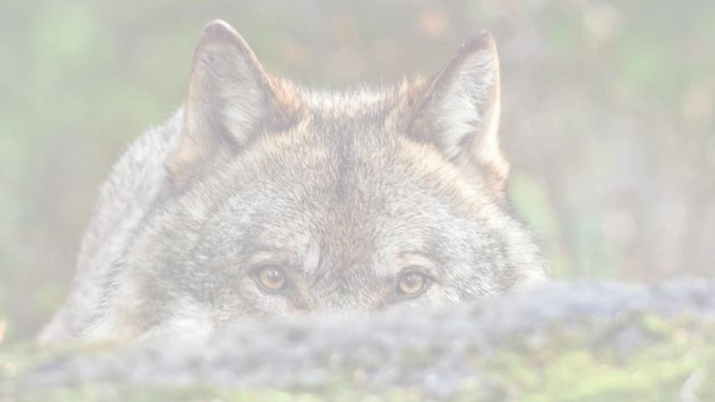
Population
The number of wolves has doubled in 15 years. Before 2001, data on wolf occurrence and numbers in the country were provided by hunting inventories, which frequently overestimated numbers by as much as 100%. Since 2001, a regular large-scale census of wolf and lynx populations, co-ordinated the Mammal Research Institute PAS in Białowieża and the Association for Nature "Wolf", has been conducted for the whole of Poland, in close co-operation with foresters from all forest divisions. Between 2001 and 2005, the increase in both the number and range of the wolf population was recorded only in areas east of the Vistula river and in the Carpathians. Thus wolves’ distribution was mostly limited to the northeastern, eastern, and southern parts of the country. In central and western Poland only few individuals were recorded. However since 2005 wolves have begun to resettle Western Poland. Currently these big predators gradually re-colonise forests where they were extirpated by people dozens years ago.

Slide 12
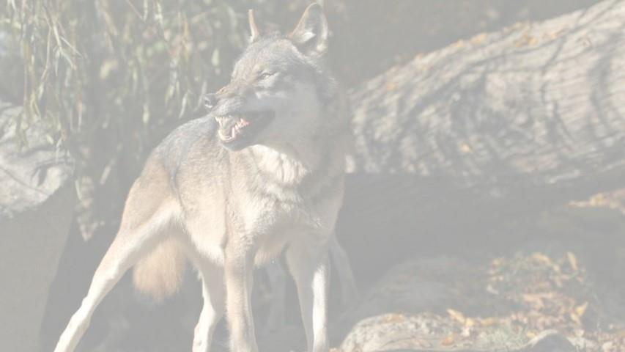
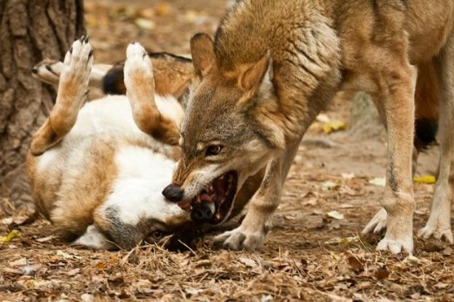
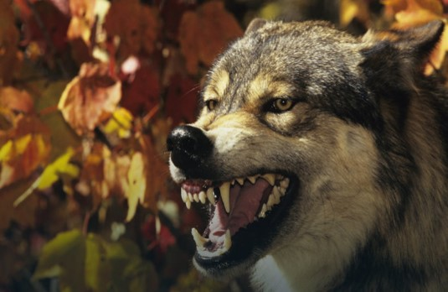
Damage caused by wolves…
The Polish goverment pays compensation for livestocks killed by wolves.

Slide 13
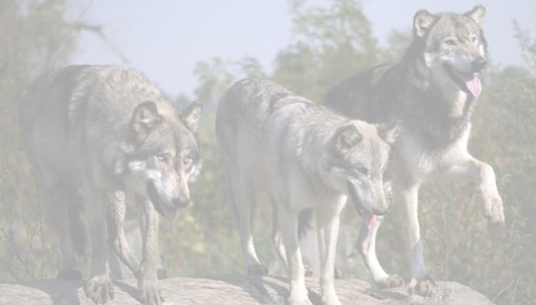
Wolves’ safety
Poland has one of the highest securities in the world of overlead crossings and under parses for wild animals. A number of studies have been conducted to determine the effectiveness of wildlife corridors at providing habitat connectivity (by providing viable migration corridors) and reducing wildlife-vehicle collisions. The effectiveness of these structures appears to be highly site-specific but crossings have been beneficial to a number of species such as wolves.

Slide 14
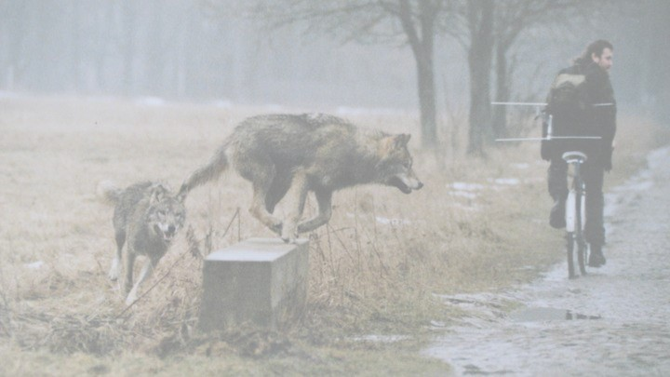
Fear of wolves:
There were reported attacks of wolves on humans in Europe, although there are few verified reports of attacks past the beggining of the 20th century. Today there is conrideredto be very little risk to humans from wolves in Europe, yet public attitude remains negative. Research shows that wolf attacks are perceived to be more common than they actually are.

Slide 15
Authors :
Natalia (Natalie) Kempa
Zofia (Sophie) Ziemba
Karol (Charles) Krupiniewicz
School:
II Liceum Ogólnokształcące z Oddziałami Dwujęzycznymi im. Adama Mickiewicza w Słupsku
Class: I b
Teachers: mgr Iwona Andrzejewska & mgr Shankar Dasgupta

Slide 16
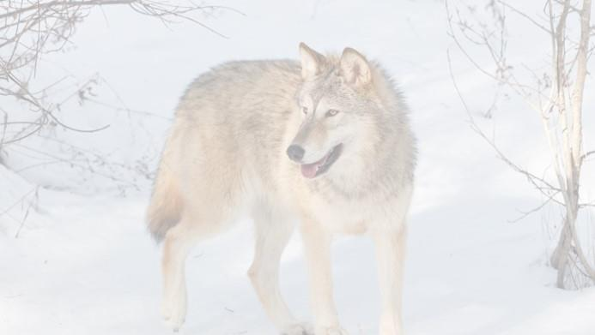
Bibliography:
Group work, Biosphere Reserves in Poland, Agencja Reklamowo – Wydawnicza A. Grzegorczyk, 1997r., Warsaw
Beautifu Baltic Sea, Baltic Landscapes of the Pomorze, Gdańska Fundacja Wody, Gdańsk
Andrzej Grzywacz, Las twoim bogactwem, Agencja Reklamowo – Wydawnicza A. Grzegorczyk, 2000r., Warszawa
Adam Wajrak, Wilki, Agora, 2015r., Warszawa
http://www.polishwolf.org.pl/wolf
http://www.theguardian.com/environment/2015/nov/25/wolves-return-poland-after-being-wiped-out
http://www.wolvesandhumans.org/pdf-documents/Wolves%20in%20Poland.pdf
http://www.lasy.gov.pl/informacje/publikacje/in-english/forests-in-poland/forests-in-poland-2014/view
http://www.fao.org/forestry/43155-0df7c31227721bf2798efd6252dc2f42b.pdf
Google grafika
Wikipedia.org

